Slide 1
Department of
Finance & Administration
Capital Outlay Bureau
DFA Approach to Capital
Wesley Billingsley
Local Government Division Director
Infrastructure Planning & Development Director
Capital Outlay Bureau Chief

Slide 2
Today’s Topics
Capital Outlay Bureau
    What we do & What is capital outlay
2024 Legislative Session
    2024 Capital Appropriations, Reauthorizations & Other Signed Legislation
Administrative Tools
    Infrastructure Capital Improvement Plan (ICIP), Capital Projects Monitoring System (CPMS), Tableau Dashboards & Capital Outlay Request Forms
Capital Outlay Implementation
    EO 2013-006, Anti-Donation, Grant Agreement & Reporting
Upcoming 2025 Legislative Session
    Obstacles, Capital Outlay Timeline
Contact Information
    State Agency Contacts and DFA Contacts

Slide 3
What we do?
The Infrastructure Planning & Development Division (IPDD), formerly the Capital Outlay Bureau (COB) is responsible for:
  Coordinate the funding and administration of capital projects.
  Work closely with executive agencies, the Governor’s office (GOV), State Budget Division (SBD) and the Legislative Finance Committee (LFC) to prepare the Executive Capital Budget.
  Oversee the capital budgeting process:
    Assists with the STB questionnaire process; (SBOF)
    General Fund (GF) Questionnaire process; (COB)
    Identifying local entities; (Executive Agencies)
    EO Compliance; and (Executive Agencies, including OSA)
    Budgeting capital projects. (SBD)
  Maintain the State Capital Project Monitoring System (CPMS).
  Utilize CPMS and SHARE accounting data to create reports on all capital appropriations. These reports are used to update dashboards and assist the LFC with their quarterly reports.
  Monitor the expiration dates of all capital appropriations to ensure timely reversions of expired appropriation balances.
  Provide training, assistance and oversight to state and local agencies on the planning, project management and administration of capital project appropriations, including the Infrastructure Capital Improvement Plan (ICIP) for State Agencies.

Slide 4
What is Capital Outlay?
Definitions
Capital outlay includes but is not limited to:
  Equipment that is properly chargeable to a capital account and has a useful life of ten years or more;
  Major renovations or repairs;
  Acquisitions of existing assets;
  Plan and design;
  New building construction;
  Non-structural improvements to land (grading, leveling, drainage and landscaping)
  Construction of roadways, fences, ditches, and sanitary sewers.

Slide 5
Capital Outlay and 2024 Legislative Session
2024 Legislative Session – SB275
New Mexico was appropriated about $1.5 billion for 1,433 state and local capital outlay projects. (SB275) (5 Vetoes and 11 Partial Vetoes)
1,234 projects totaling over $904 million allocated for local capital outlay projects. (Tribal: 136 projects totaling $89,825,000)
105 projects totaling over $470 million allocated for statewide capital outlay projects. (Tribal: 9 projects totaling $6,816,500)
99 projects totaling about $139 million allocated for higher education capital outlay projects. (Tribal: 1 project totaling $950,000)
General Fund (GF) appropriations will be budgeted through an automated upload by DFA in July.
Higher Education Institutions and other state agencies that do not use SHARE will be receiving an allotment form to sign and return.
GF appropriations must have 5% encumbered within 6 months of execution of grant agreements or receiving funds and expend 85% within the first 3 years for construction projects per language in SB275.
  * Over $6.1 billion total capital outlay appropriated since 2019.

Slide 6
Capital Outlay and 2024 Legislative Session
2024 Legislative Session – SB275 By Category

Slide 7
Capital Outlay and 2024 Legislative Session
Capital Outlay – SB275
General Fund Questionnaire
  Statements made on Questionnaires are legal certifications and they must be true and complete.
  Failure to complete the project timely and as certified may result in the SBOF sweeping proceeds for projects that are ready to proceed or not funding future projects.
  If the project is not ready, return the questionnaire indicating no proceeds are requested at this time. Another questionnaire will be sent out later this calendar year for those projects not included in the July 2024 budget upload.
  The entity must notify the COB if the project changes or faces delays.
Funds will not be issued for a project if:
  the project recipient does not return a questionnaire to the COB
  the project recipient cannot encumber 5% of the funds within 6 months or expend 85% of the funds within 3 years of the execution of the grant agreement
  the funding is not sufficient to complete the project or a well-defined phase of the project
  the public body receiving the appropriation will not own the site or the asset to be funded
  the project recipient is not compliant with the State Audit Act and Executive Order 2013-006
  the project has unresolved anti-donation issues resulting from a private operator/manager/user not paying fair market value for the capital asset

Slide 8
Capital Outlay and 2024 Legislative Session
2024 Legislative Session – HB308
New Mexico was appropriated about $289 million for 136 state and local capital outlay projects. (HB308) (2 Partial Vetoes)
33 projects totaling almost $230 million allocated for Higher Education Institutions.
98 projects totaling over $30 million allocated for Senior center projects.
4 projects totaling over $19 million allocated for library projects.
1 project totaling $10 million allocated for public safety radio communications.
General Obligation Bond (GOB) appropriations will be voted on in November, Bond Sold in Spring 2025 and budgeted through an automated upload by DFA in July 2025.

Slide 9
Capital Outlay and 2024 Legislative Session
2024 Legislative Session – SB246
The capital outlay reauthorization bill reauthorized 225 projects:
  Time extension – Budgets are reduced and re-established immediately following the Governor signing the bill.
  Change of Purpose and/or Agency – Budgets are reduced immediately following the Governor signing the bill.
    For general fund projects – Budgets can be re-established at the same time they are reduced with a new class code and budref in SHARE, if allocated to the same agency. Otherwise, if there is a change in agency, operating transfers must take place prior to the new budgets being established.
    For STB projects – Budgets cannot be re-established until the State Board of Finance has reviewed the new purpose during a future board meeting. Typically occurs prior to the new fiscal year.
35 reauthorizations were vetoed and 2 were partially vetoed for technical corrections.

Slide 10
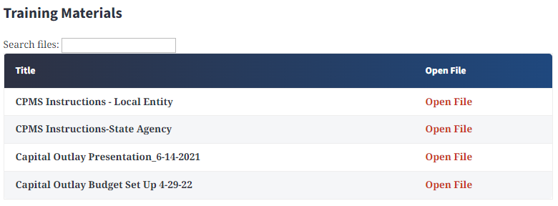
Capital Outlay and 2024 Legislative Session
Capital Outlay Budget Process
The budget process is different for each bill signed during the legislative session. For more detailed instructions please visit the Capital Outlay Bureau website at https://www.nmdfa.state.nm.us/budget-division/capital-outlay-bureau/.

Slide 11
Capital Outlay and 2024 Legislative Session
2024 Legislative Session – HB232
HB 232 creates the Infrastructure Planning and Development Division (IPDD) within the Department of Finance and Administration (DFA) and moves certain infrastructure and capital related functions of the Local Government Division (LGD) to IPDD.
The rural equity ombudsman and local government infrastructure capital improvement plan functions of LGD would move to the new division along with other short- or long-term programs and funds of other divisions of DFA as determined by the Secretary.
Additionally, the bill assigns IPDD the duties of aiding local governments, councils of governments, and tribal governments in identifying and accessing funding for infrastructure development from available sources and administering funding to complete capital projects and of providing guidance on project plans and development.
The new division will start July 1, 2024.
https://www.nmlegis.gov/Legislation/BillFinder/Capital_Outlay

Slide 12
Capital Outlay Implementation
Infrastructure Capital Improvement Plan (ICIP)

Slide 13

Capital Outlay Implementation
Infrastructure Capital Improvement Plan (ICIP)
Infrastructure capital improvement plan (ICIP) establishes planning priorities for anticipated capital projects.
ICIP helps to plan for future capital improvements.
ICIPs must be submitted annually by the deadlines set forth by statute for state agencies or deadlines set by LGD for local entities.
  Covers 5-year period and is developed each year (2026-2030);
  Policy direction, project timelines, estimated costs, justifications, and the details projects proposed, by year, over the five-year period.
    May include:
      Repair/replacement of existing infrastructure
      Development of new infrastructure
  Implementation plan and includes an estimate of operating/maintenance expenses to ensure long-term viability each planned project’s viability and sustainability; and
  Entities should update their ICIP based on what was previously funded and programmatic changes that impact their capital needs.

Slide 14
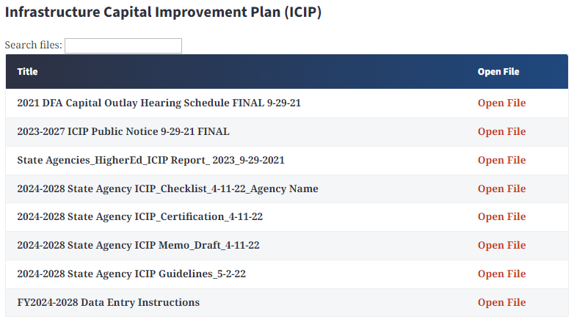

Capital Outlay Implementation
Infrastructure Capital Improvement Plan (ICIP)
ICIP instructions can be found on our website at https://www.nmdfa.state.nm.us/budget-division/capital-outlay-bureau/.
Statutory deadline for state agencies is July 1, 2024.

Slide 15
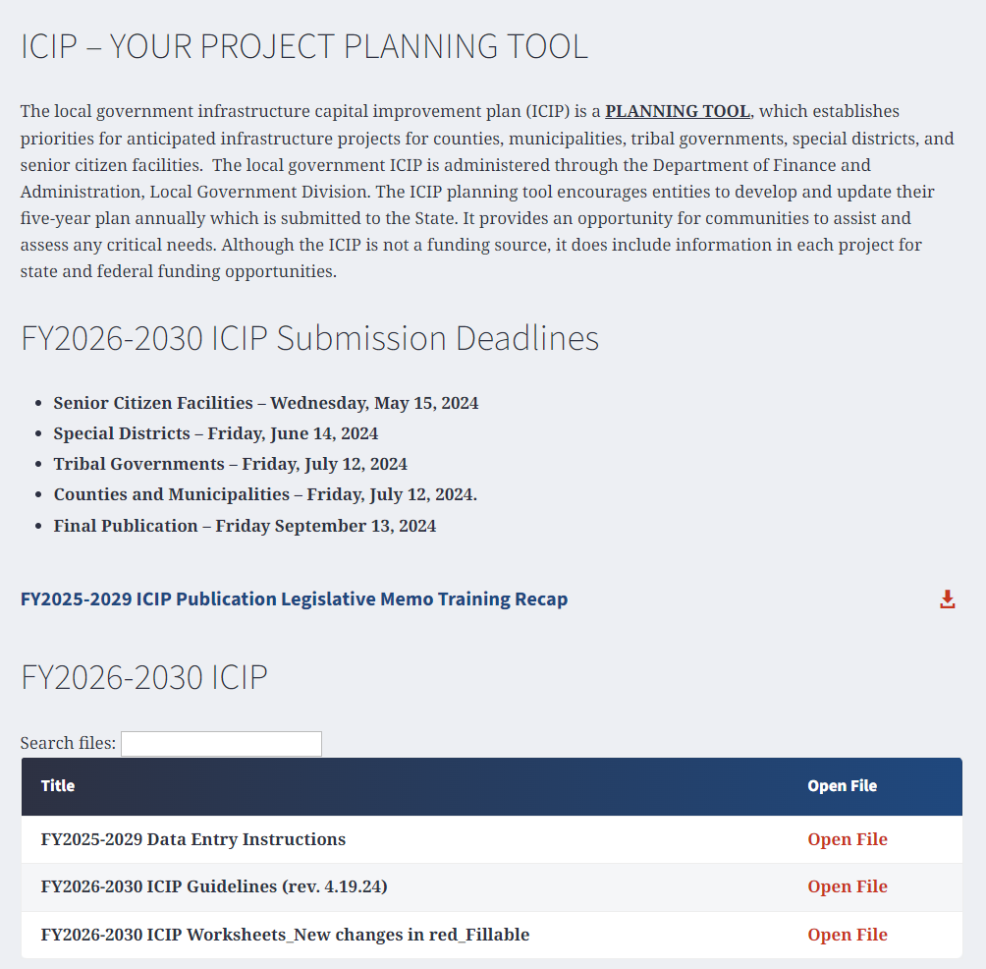
Capital Outlay Implementation
Infrastructure Capital Improvement Plan (ICIP)
ICIP instructions for local entities can be found on the LGD website at https://www.nmdfa.state.nm.us/local-government/icip/.

Slide 16
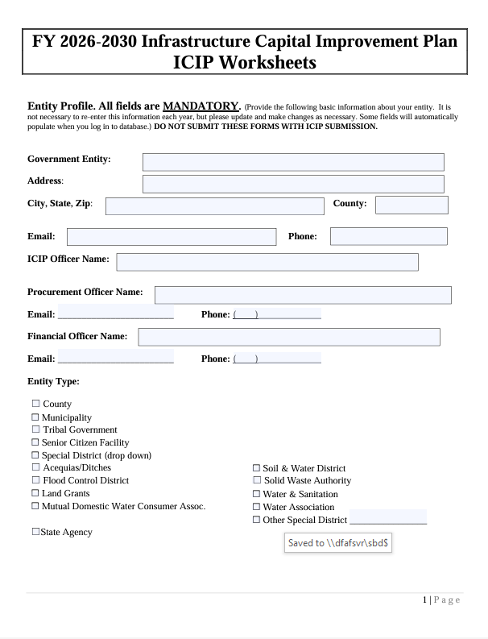
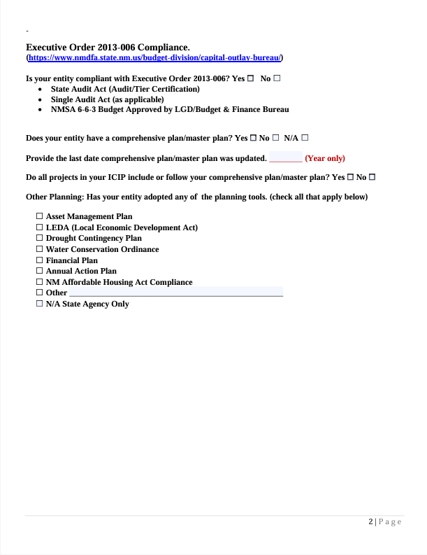
Capital Outlay Implementation

Slide 17
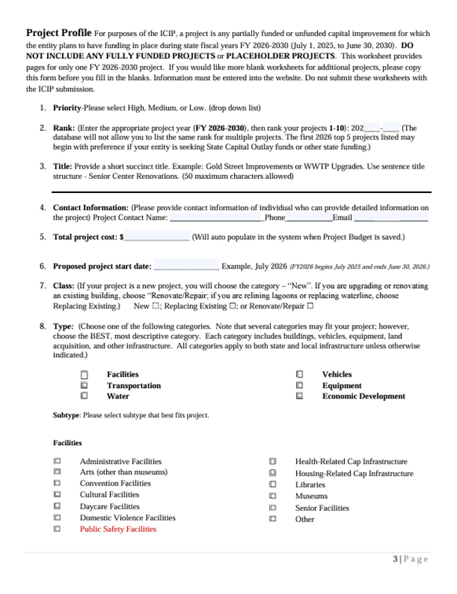
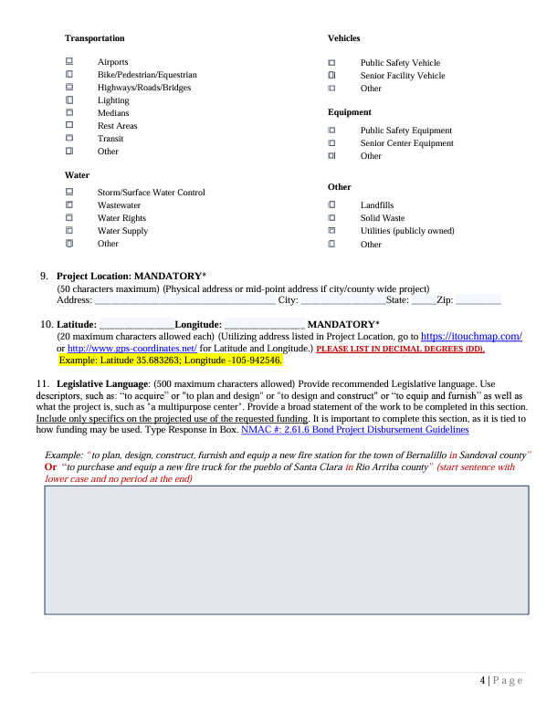
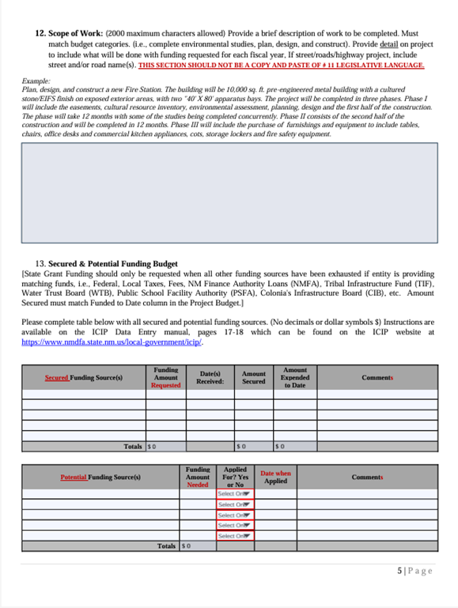
Capital Outlay Implementation

Slide 18
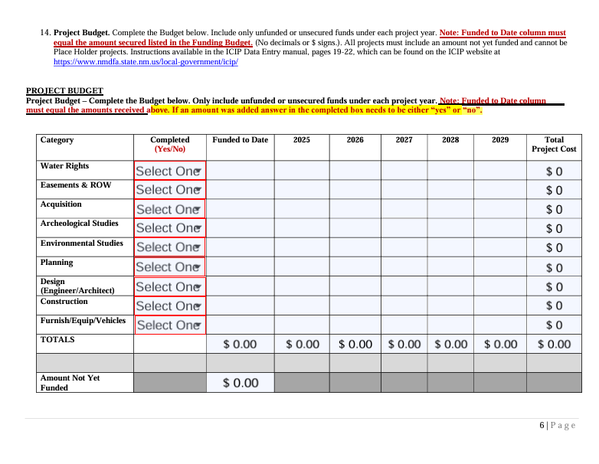
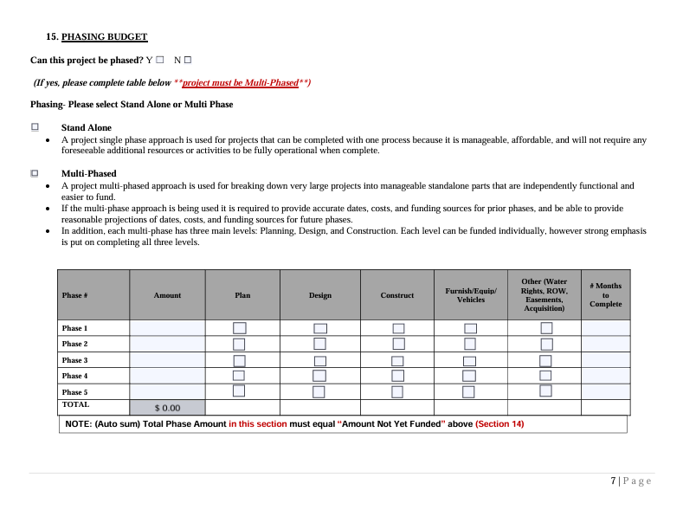
Capital Outlay Implementation

Slide 19
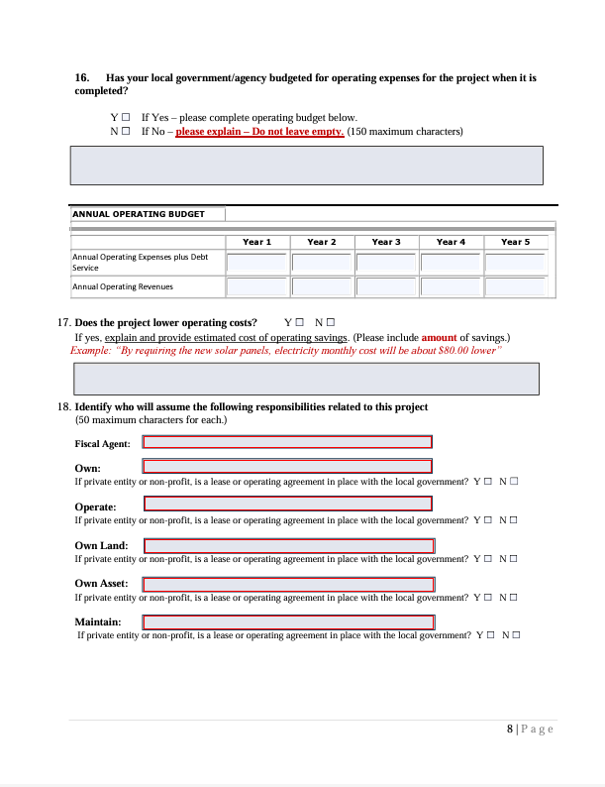
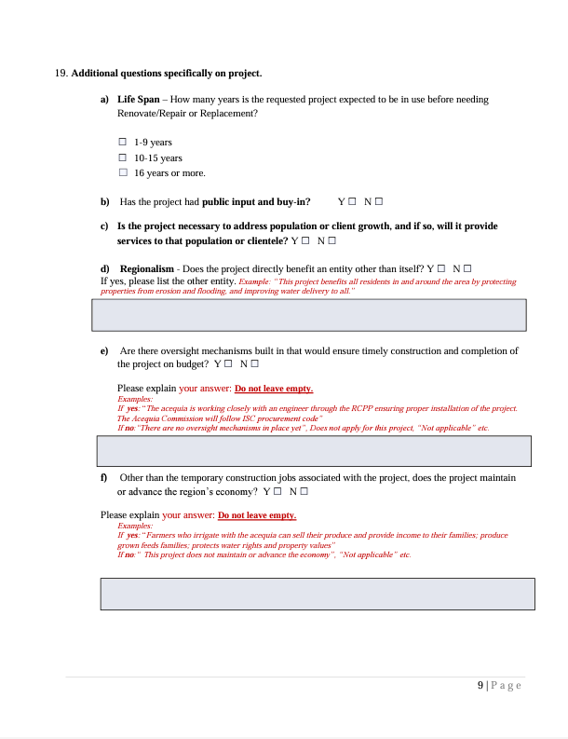
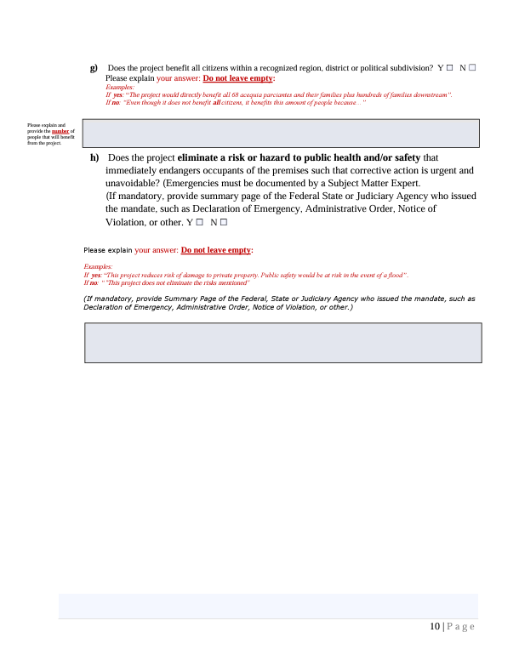
Capital Outlay Implementation

Slide 20
Capital Outlay Implementation
Capital Projects Management System (CPMS)

Slide 21
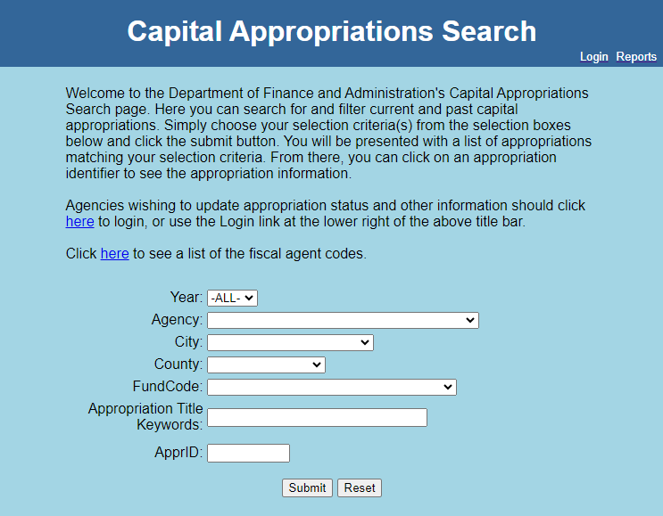
Capital Outlay Implementation
Capital Projects Management System (CPMS)
Capital Projects management System (CPMS) assists with the reporting of capital outlay appropriations.
CPMS provides one location for all capital appropriation reporting.
CPMS records and archives all reporting data for open and closed appropriations.
Reports must be submitted quarterly.
  March 31
  June 30
  September 30
  December 31
  https://cpms.dfa.state.nm.us/

Slide 22
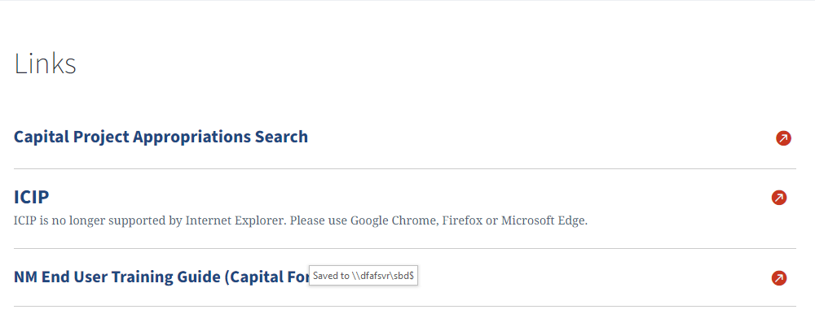
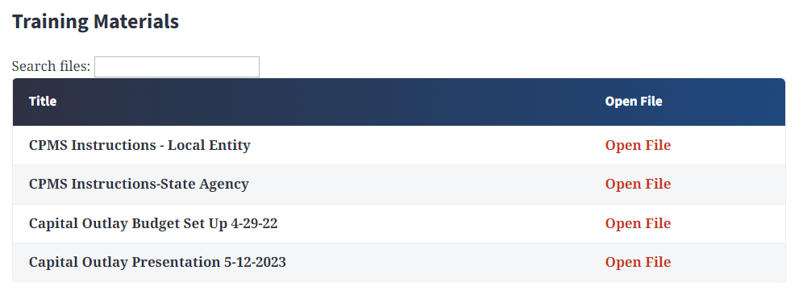
Capital Outlay Implementation
Capital Projects Management System (CPMS)

Slide 23

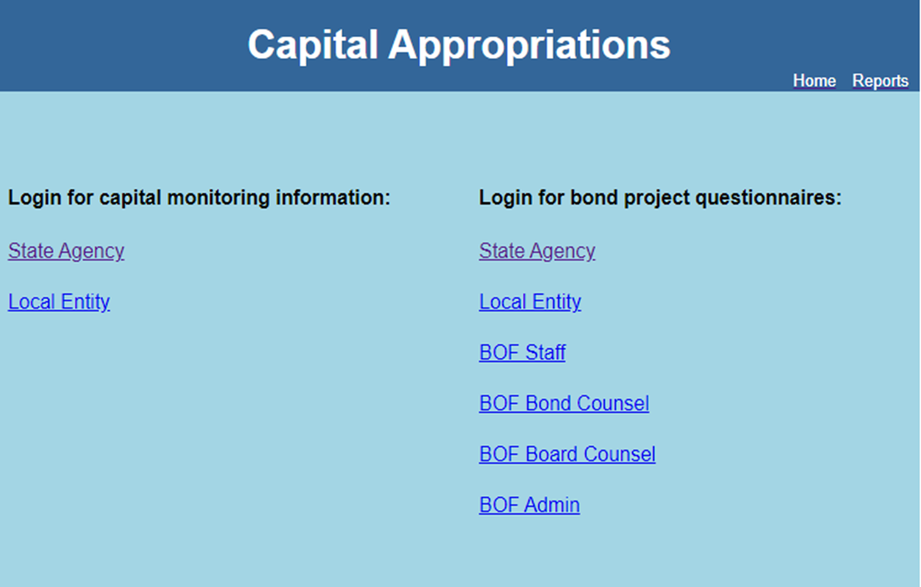
Capital Outlay Implementation
CPMS - Search and Login Screens

Slide 24
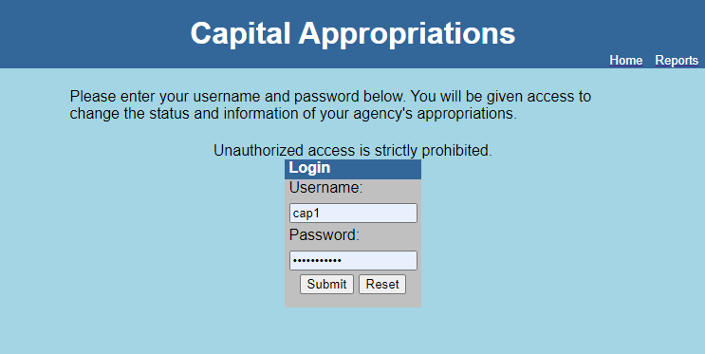
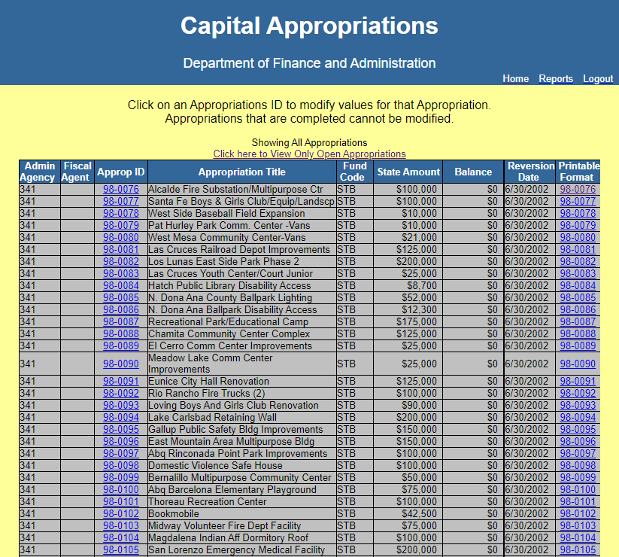
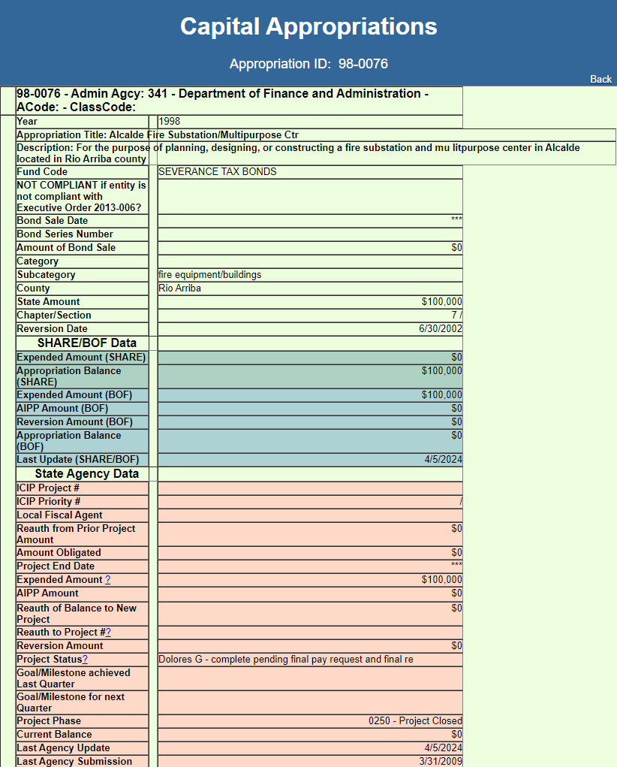
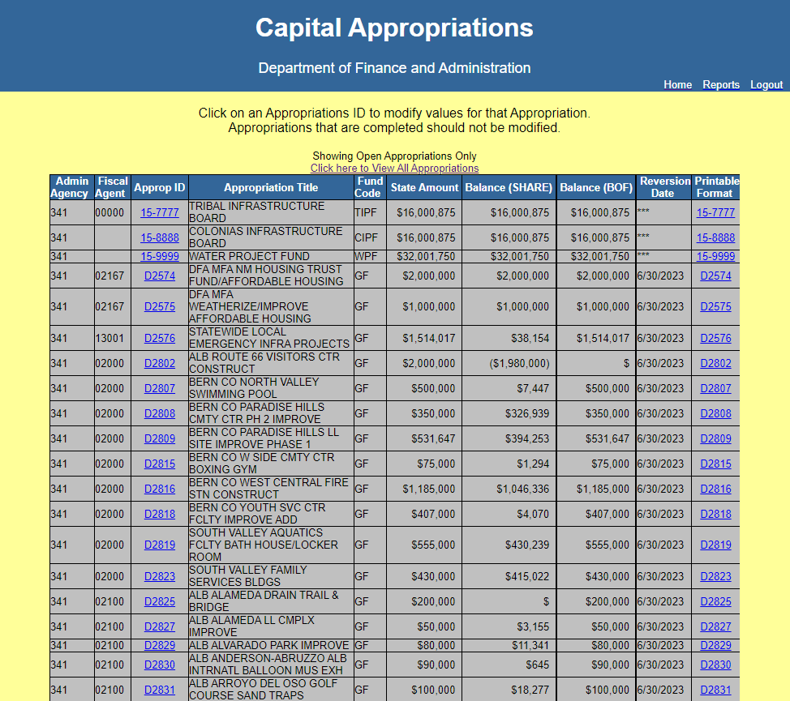
Capital Outlay Implementation
CPMS – Login, Navigation & Print Screens

Slide 25
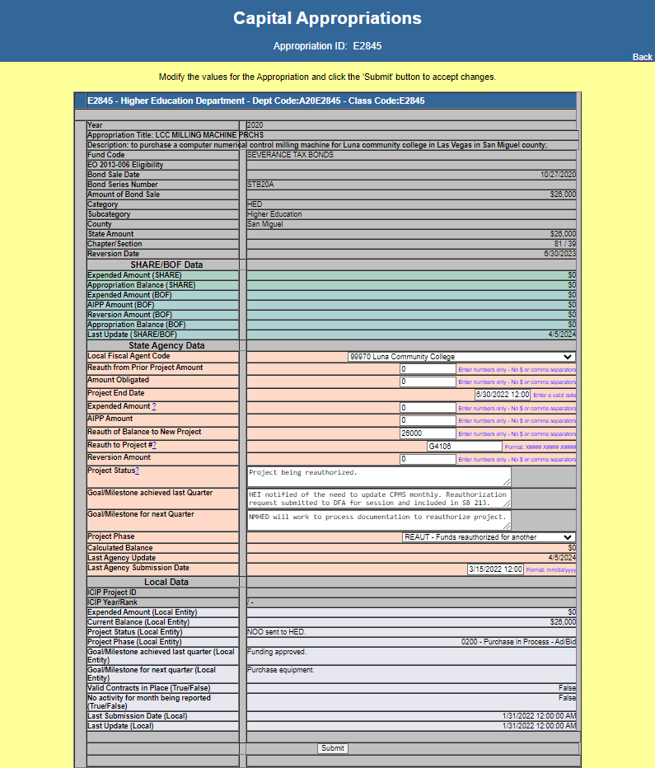
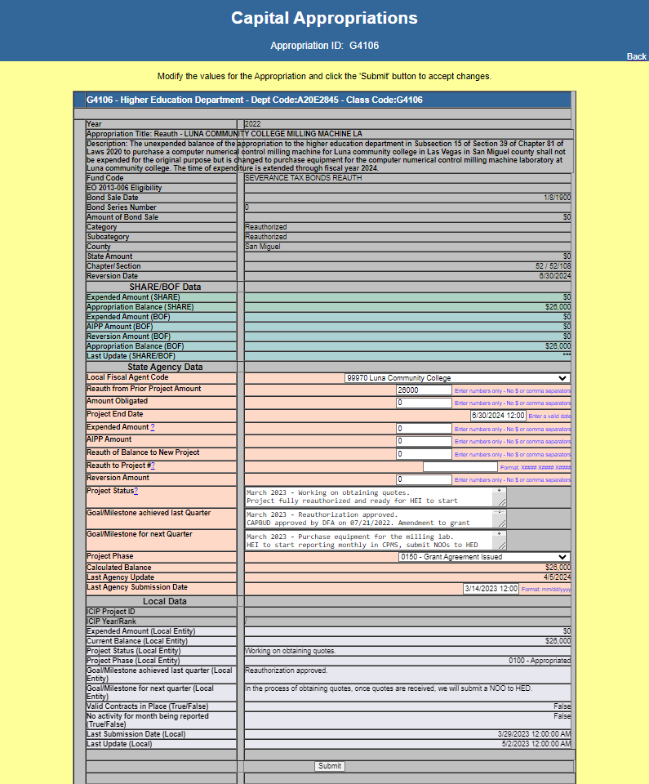
Capital Outlay Implementation
CPMS – Reauthorization Screens

Slide 26
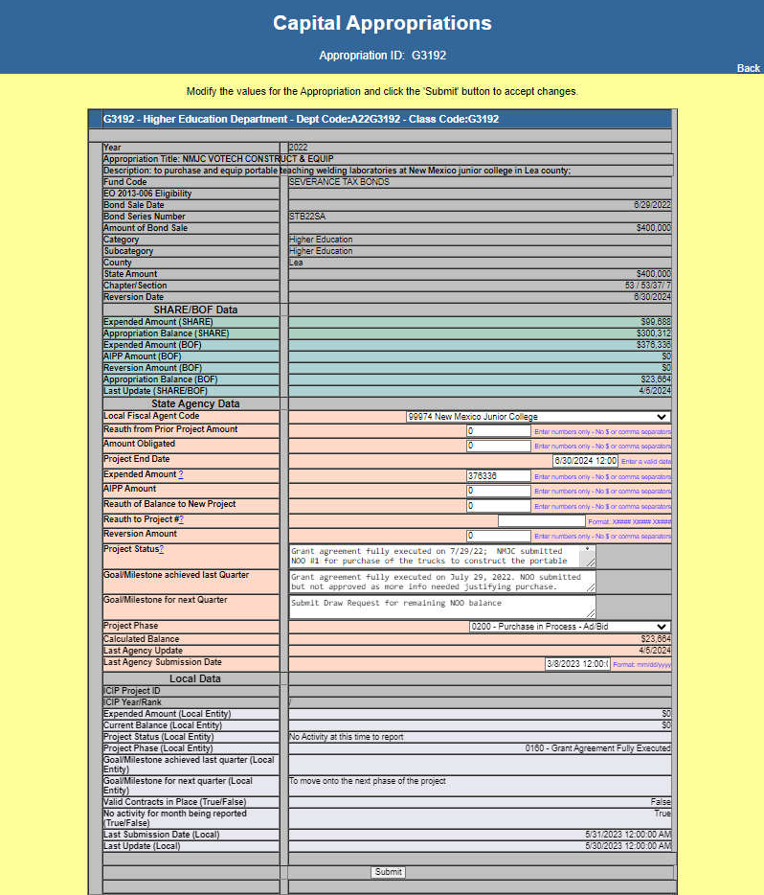
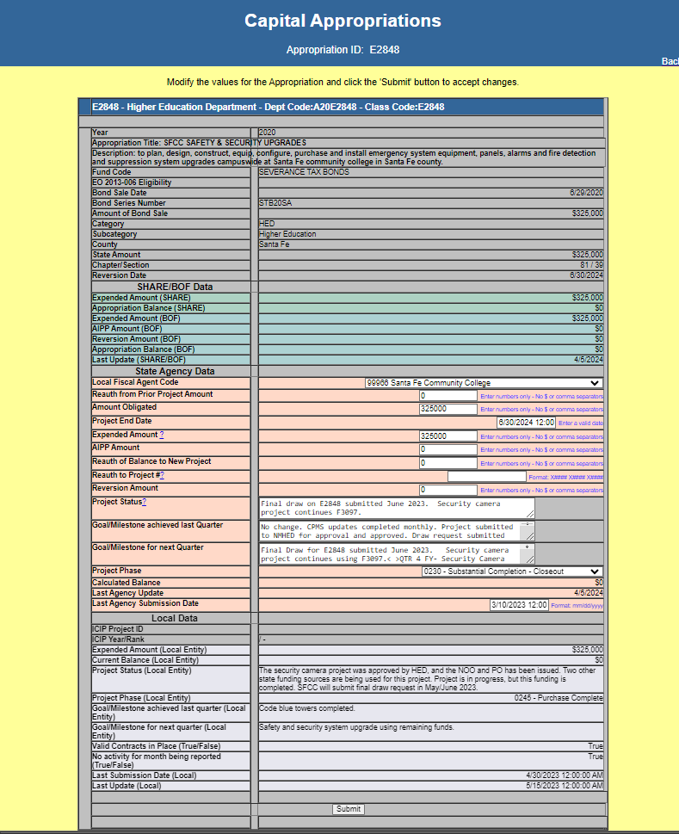
Capital Outlay Implementation
CPMS – Open Project and Closed Project Screens

Slide 27
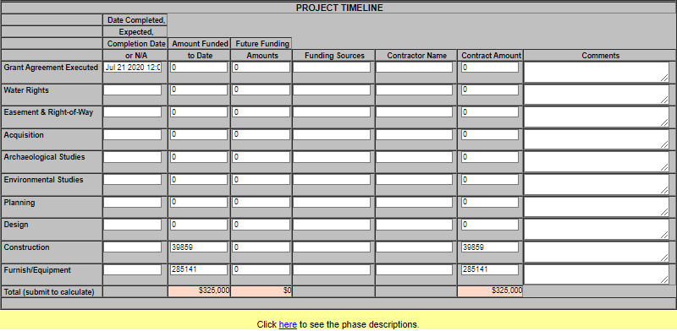
Capital Outlay Implementation
CPMS – Project Timeline Screen

Slide 28
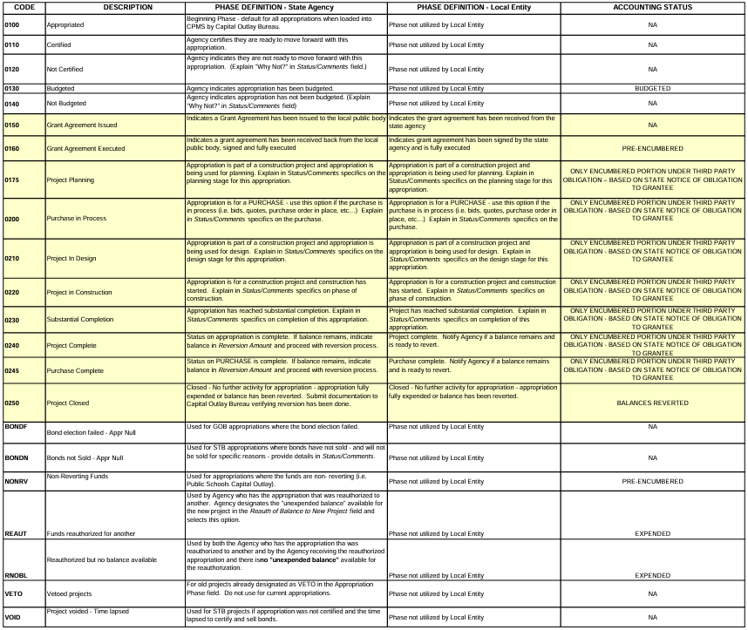
Capital Outlay Implementation
CPMS – Project Phase Description Screen

Slide 29
Administrative Tools
Tableau Dashboard
Online Capital Outlay Dashboard.
  Accessibility of data to easily obtain capital appropriations and balances by year, county, fiscal agent, and project type
  Accessibility of data to highlight spend down progress and potential issues
  Data visualization to drive action by oversight agencies, fiscal agents, and policymakers
  Also used to show Junior Bill expenditures submitted to DFA by each Higher Education Institution and expenditures from SHARE.
  http://www.nmdfa.state.nm.us/dfa-dashboards

Slide 30
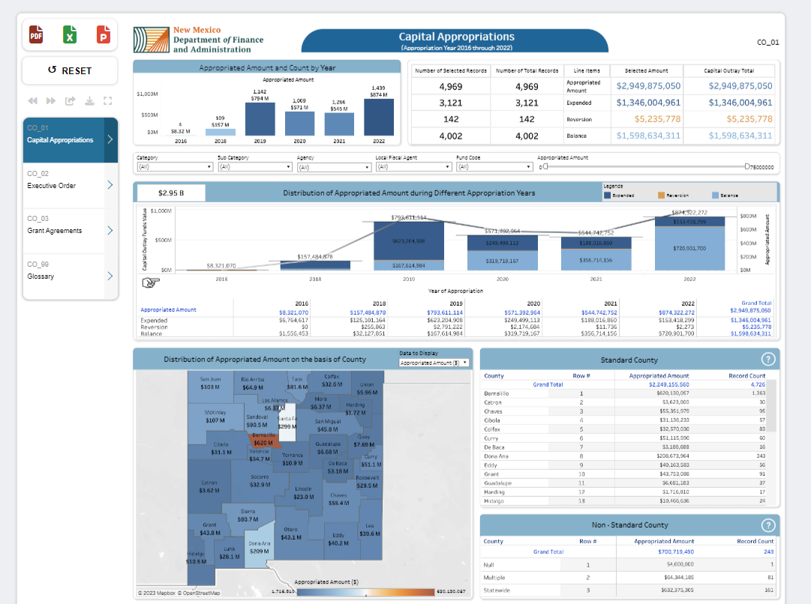

Slide 31
Administrative Tools
Capital Outlay Request Form
Online Capital Outlay Request Form – Department of Finance & Administration (DFA), the Governor’s Office (GOV), Legislative Counsel Service (LCS) and Legislative Finance Committee (LFC) are continuing to work together to make the capital outlay request online.
Goals / Benefits include:
  More accessibility and ease of use
  Data from ICIP can be pulled in, if governmental entity has submitted ICIP
  Better data collected overall, as some fields are required
  Ability to cross compare and analyze requests for policy priorities, project readiness, legal issues
  Forms and/or links are typically found on the LCS, GOV and DFA websites
  https://www.nmlegis.gov/CapitalOutlayWeb/Default

Slide 32
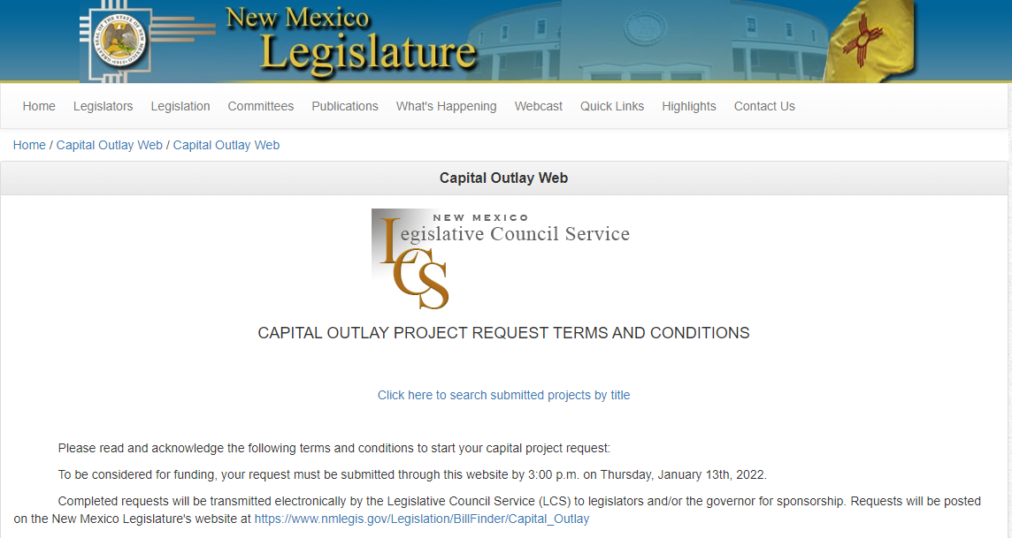

Slide 33
Capital Outlay Implementation
EO-2013-006
Established on May 2, 2013 to address the following:
Lack of audits or findings raise concerns about a grantee’s ability to be a good steward of capital outlay funds thereby increasing the risk of fraud, waste and abuse.
  Independent audits provide the best assessment of grantees’ accounting methods.
  Oversight of grantees’ accounting methods is needed to safeguard appropriations and assets.
FIN 9.2 Grants Management—Funding Criteria and Oversight Requirements
Established by the Financial Control Division of the Department of Finance and Administration (revised September 30, 2013) to create a policy and criteria for implementation of Executive Order 2013-006

Slide 34
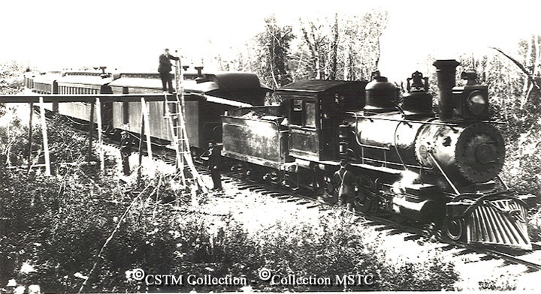
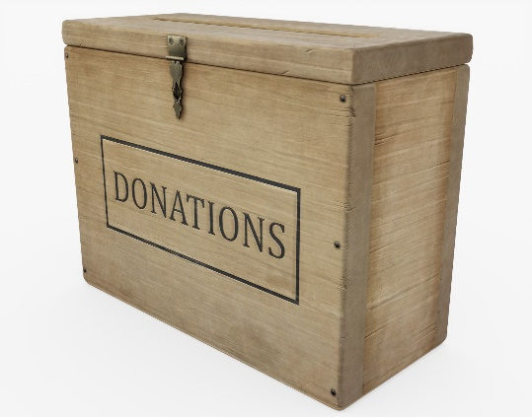
Capital Outlay Implementation
Anti-Donation Clause
Article IX, Section 14 of NM Constitution
Started with the Rail Road companies
The NM Constitution prohibits public entities from donating to private entities
Private entity can’t own a publicly-financed capital asset, but they can operate them if certain conditions are met
When there is a private operator, the market rental value of the public asset must be appraised to determine the fair market value of the asset
Private operators can pay fair market rent in cash or in services
If payment is made in services, the tenant has to be selected in compliance with the Procurement Code and the lease term has to be limited to the Procurement Code contract term limit
The lease/operating agreement must have a “menu” of services to be provided and the value that each service will count towards rent. The value of each service must be demonstrated to be at fair market value
Potential anti-donation is identified and cleared based on funding source
  Bonds => State Board of Finance
  General Fund => State Agency
For general fund appropriations, contact State agency ASAP

Slide 35
Capital Outlay Implementation
Inter-governmental Grant Agreement (IGA)
Before the agency issues a grant agreement, compliance with Executive Order 2013-006 is verified, Anti-Donation Issues are resolved, and the appropriation has been budgeted.
Scope of Work - use appropriation law language as a guide when determining scope of work and ensure all appropriation activity is within the limits of authorizing language.
Notice of Obligation (NOO) Exhibit 2 - agency reviews third party agreement and verifies it falls within authorizing language.
Request for Reimbursement (RFR) Exhibit 1 – submit for payment of expenditures.
Special Conditions (Optional Attachment A) – may be required if the entity is not in compliant with EO2013-006 or if the state agency is required to impose other special conditions.
Reporting requirements (CPMS quarterly updates)
http://nmdfa.state.nm.us/Capital_Outlay_Bureau.aspx

Slide 36
Upcoming Legislative Session
Obstacles facing Local Governments & State Agencies
Piecemealed funding;
Procurement processes;
Contractor availability;
Rising material/contractor costs;
Supply chain causing delays;
Turnover at the state and local levels;
DFA administrative process.

Slide 37
Upcoming Legislative Session
Capital Outlay Administrative Process and Timeline
Complete process for capital appropriations (FY 2025 – 4 Year appropriations):
  Planning process to identify projects that are ready; (Yearly)
  Enter planned projects into ICIP; (May 2024 through November 2025)
  Start preparing for annual audit to ensure EO compliance; (July 2024 through May 2025)
  Projects funded through capital bill; (December 2024 through February 2025)
  Capital bill drafted and signed into law; (February 2025 through April 2025)
  Projects budgeted at DFA; (April 2025 through July 2025)
  Grant Agreements issued and executed; (July 2025 through December 2025)
  Procurement Process; (January 2026 through March 2026)
  Construction; (March 2026 through March 2028) (Depends on project size and scope)
  Reimbursement Process; (March 2028 through June 2028)
  Project Closeout; (March 2028 through January 2029)(11-month warranty period)
  Project Closed. (January 2029 through June 2029)(Remaining balance reverted)

Slide 38
Upcoming Legislative Session
Suggested Administrative Reforms and Collaboration
State Agencies standardize forms and databases to share information. (Grant Agreements & Audit Compliance – UFC forms)
DFA is continuing to work with the Legislative Council Service on the paperless capital project request system to reduce redundancy. (Hope to refine process little by little each year)
Set a minimum project size and funding amount (exception for critical health and safety needs) to streamline administration, oversight, and return on taxpayer investment. (Fully Functional Phase)
Legislators continue to collaborate to fund larger, regional projects vs piecemealing smaller projects.
Require local project matching funds (with exceptions for very small entities and critical health and safety projects). Leverage multiple funding sources, such as local bonds and federal funds.

Slide 39
State Agency - Capital Outlay Bureau
State Agency Contacts | Agency | Title | Phone | Email
Carmen Morin | DFA, Local Government Division (LGD) | Community Development Bureau Chief | 505-470-8979 | carmenb.morin@dfa.nm.gov
Sarah Jacobs | Aging & Long-Term Services Dept. (ALTSD) | Deputy Cabinet Secretary/Capital Outlay Coordinator |  | sarah.Jacobs@altsd.nm.gov
Clarissa Martinez | Department of Transportation (DOT) | Management Analyst | 505-699-9946 | clarissa.martinez@dot.nm.gov
Rhonda Holderman | Environment Department (DOE) | Financial Manager, Loans and Grants | 505-363-9396 | rhonda.holderman@env.nm.gov
Gerald Hoehne | Higher Education Department (HED) | Capital Projects Coordinator | 505-476-8434 | gerald.hoehne@hed.nm.gov
Lawrence John | Indian Affairs Department (IAD) | Tribal Infrastructure Fund/Capital Outlay Manager | 505-690-2997 | lawrence.john@iad.nm.gov
Amanda Lupardus | Public Education Department (PED) | Financial Coordinator | 505-827-6613 | amanda.lupardus@ped.nm.gov
Emily Breen | Office of the State Engineer (OSE) | Program Manager | 505-827-6310 | emily.breen@ose.nm.gov

Slide 40
DFA - Capital Outlay Bureau
Contacts
Wayne Propst (DFA Secretary) – 505-827-4966
wayne.propst@dfa.nm.gov
Wesley Billingsley (Capital Outlay Bureau Chief) – 505-819-1915
wesley.billingsley@dfa.nm.gov
Tonantzin Roybal (Executive Principal Analyst) – 505-470-4673
tonantzin.roybal@dfa.nm.gov
Sarah de la Rosa (Executive Capital Analyst) – 505-570-7769
Sarah.delarosa@dfa.nm.gov
https://www.nmdfa.state.nm.us/budget-division/capital-outlay-bureau/

