Slide 1
Department of
Finance & Administration
Capital Outlay Summary
DFA Approach to Capital
Wesley Billingsley
Local Government Division Director
Infrastructure Planning & Development Director
Capital Outlay Bureau Chief

Slide 2
What we do?
The Infrastructure Planning & Development Division (IPDD), formerly the Capital Outlay Bureau (COB) is responsible for:
  Coordinate the funding and administration of capital projects.
  Work closely with executive agencies, the Governor’s office (GOV), State Budget Division (SBD) and the Legislative Finance Committee (LFC) to prepare the Executive Capital Budget.
  Oversee the capital budgeting process:
    Assists with the STB questionnaire process; (SBOF)
    General Fund (GF) Questionnaire process; (COB)
    Identifying local entities; (Executive Agencies)
    EO Compliance; and (Executive Agencies, including OSA)
    Budgeting capital projects. (SBD)
  Maintain the State Capital Project Monitoring System (CPMS).
  Utilize CPMS and SHARE accounting data to create reports on all capital appropriations. These reports are used to update dashboards and assist the LFC with their quarterly reports.
  Monitor the expiration dates of all capital appropriations to ensure timely reversions of expired appropriation balances.
  Provide training, assistance and oversight to state and local agencies on the planning, project management and administration of capital project appropriations, including the Infrastructure Capital Improvement Plan (ICIP) for State Agencies.

Slide 3
What is Capital Outlay?
Definitions
Capital outlay includes but is not limited to:
  Equipment that is properly chargeable to a capital account and has a useful life of ten years or more;
  Major renovations or repairs;
  Acquisitions of existing assets;
  Plan and design;
  New building construction;
  Non-structural improvements to land (grading, leveling, drainage and landscaping)
  Construction of roadways, fences, ditches, and sanitary sewers.

Slide 4
Capital Outlay Summary

Slide 5

Capital Outlay Planning
Infrastructure Capital Improvement Plan (ICIP)
Infrastructure capital improvement plan (ICIP) establishes planning priorities for anticipated capital projects.
ICIP helps to plan for future capital improvements.
ICIPs must be submitted annually by the deadlines set forth by statute for state agencies (July 1) or deadlines set by LGD for local entities.
  Covers 5-year period and is developed each year (2026-2030);
  Policy direction, project timelines, estimated costs, justifications, and the detailed projects proposed, by year, over the five-year period.
    May include:
      Repair/replacement of existing infrastructure
      Development of new infrastructure
  Implementation plan and includes an estimate of operating/maintenance expenses to ensure long-term viability each planned project’s viability and sustainability; and
  Entities and Agencies should update their ICIP based on what was previously funded and programmatic changes that impact their capital needs.

Slide 6
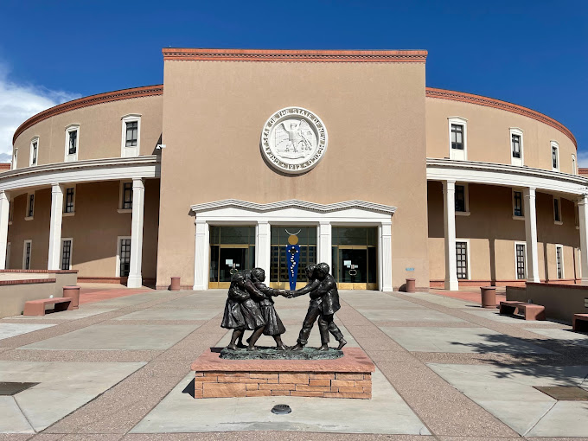
Capital Outlay Hearings
State Agency Capital Outlay Hearings
Capital Outlay Hearing presentations are due to the Infrastructure Planning and Development Division (IPDD) by mid September.
The IPDD will consolidate all ICIPs and presentations and create a published document by the end of September for the October Hearings.
The October Hearings take place the second week in October and are held at the Roundhouse.
Each Agency that has an ICIP will be asked to present their top 3 or 5 projects for consideration by the committee.
The committee consists of representatives from DFA, GSD, HED and the LFC.
The projects are then scored, and recommendations are made by both the Executive and LFC prior to session.

Slide 7
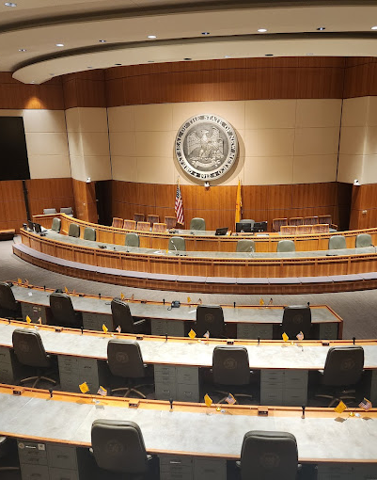
Legislative Session
Legislative Session
The recommendations are heard in front of the Budget Committee prior to the start of session.
Both DFA and LFC work together to come to a consensus on the capital budget recommendation.
The LFC recommendation is typically the framework for the capital bill and the bill is dropped into a committee. The beginning chamber alternates each year.
The local projects are then added to the capital bill as an amendment or committee substitute.
The final version is usually not seen until the final days of session when its quickly passed through committees and the floors.
The reauthorization and GOB bills have similar cycles through the session.

Slide 8
Legislative Session
Continued
Legislative Session
Once the bills make their way through both chambers, the Governor has 20 days to sign. Bill Signing period.
During this period, a capital outlay group is created at DFA to create the spreadsheets and begin the page and line process.
This process consists of continuously reading each bill, line by line, and comparing the bill to the spreadsheet for accuracy.
After the bills are read multiple times, there should be no discrepancies between the bills and spreadsheets.
After this process is complete (sometimes during this process), DFA asks agencies for veto recommendations and compiles the list for the Governor’s office.
The bills are mocked up with recommended vetoes, the actual bills are then lined, and the Governor initials and signs the bill, usually the last day of the bill signing period.

Slide 9
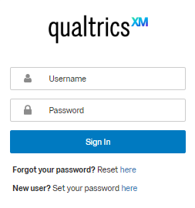
Capital Outlay Questionnaires
Capital Outlay Questionnaires
The public spreadsheets are created and uploaded onto the DFA website.
The appropriations are uploaded into the questionnaire system to gather information about each appropriation.
If questionnaires are not completed, access to the funding may be delayed.
Anti-donation concerns are addressed during the questionnaire process.
Some agencies are asked to review local entity audits for EO 2013-006 Compliance.

Slide 10
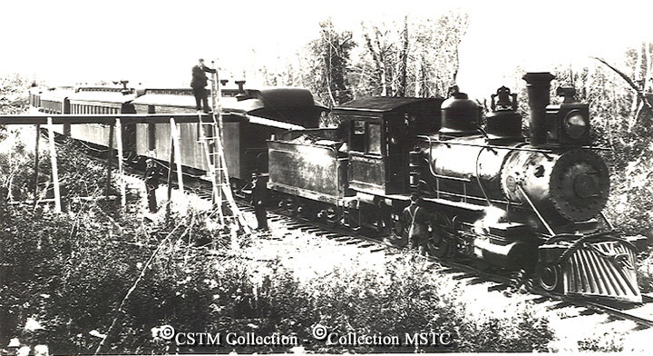
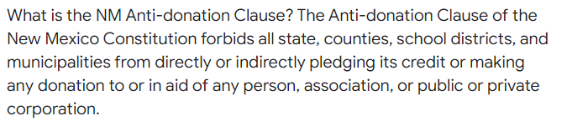
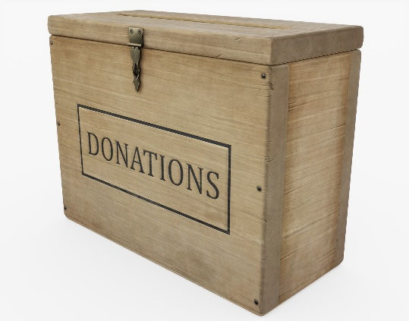
Capital Outlay Anti-Donation Clause
Anti-Donation Clause
Article IX, Section 14 of NM Constitution
Started with the Railroad companies
The NM Constitution prohibits public entities from donating to private entities
Private entity can’t own a publicly-financed capital asset, but they can operate them if certain conditions are met
When there is a private operator, the market rental value of the public asset must be appraised to determine the fair market value of the asset
Private operators can pay fair market rent in cash or in services
If payment is made in services, the tenant has to be selected in compliance with the Procurement Code and the lease term has to be limited to the Procurement Code contract term limit
The lease/operating agreement must have a “menu” of services to be provided and the value that each service will count towards rent. The value of each service must be demonstrated to be at fair market value
Potential anti-donation is identified and cleared based on funding source
  Bonds => State Board of Finance
  General Fund => State Agency
For general fund appropriations, contact State agency ASAP

Slide 11
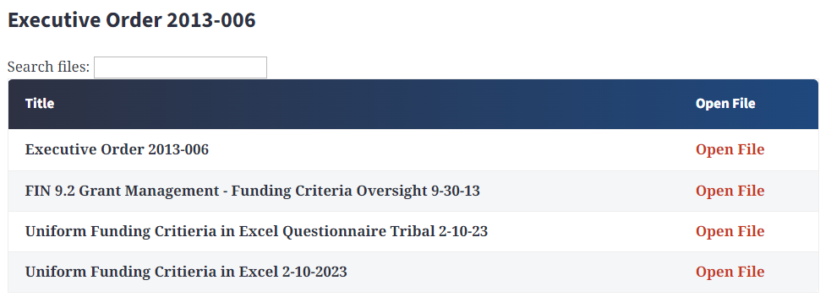
Capital Outlay Executive Order 2013-006 (Audits)
EO-2013-006
Established on May 2, 2013, to address the following:
Lack of audits or having significant findings raise concerns about a grantee’s ability to be a good steward of capital outlay funds thereby increasing the risk of fraud, waste and abuse.
  Independent audits provide the best assessment of grantees’ accounting methods.
  Oversight of grantees’ accounting methods is needed to safeguard appropriations and assets.
FIN 9.2 Grants Management—Funding Criteria and Oversight Requirements
Established by the Financial Control Division of the Department of Finance and Administration to create a policy and criteria for implementation of Executive Order 2013-006

Slide 12

Capital Outlay Budget Process
Capital Outlay Budget Process
After the questionnaire process is complete, the bonds are sold, and the budgets are established.
The budget analysts will upload the project list into the Budget Formulation & Management System (BFM).
The agencies will enter the category information for each appropriation into the system.
The SHARE upload file will be created and loaded into SHARE for budget review.
The budget analysts review each journal for accuracy and approves the budget journals.
Appropriations not included in the budget upload will need to wait until the next questionnaire cycle or for emergency situations, a CAPBUD may be allowed.
The budget analysts will also send an allotment form for all appropriations in the budget upload to each agency.

Slide 13

Capital Outlay Budget Process
Capital Outlay Budget Process (Continued)
Outside of the budget upload periods (typically twice a year), other capital budget journals and documents are submitted for approval.
CAPBUDS are submitted for capital appropriation budgets outside of the budget upload process. (Reauthorizations)
CBARS are submitted for other capital funding that is not appropriated in a capita bill. (Example: Federal grants and/or private donations)
CBRFs are submitted to change the account category. (moving funding from 300s to 400s)
The budget analysts review each journal for accuracy and approves the budget journals.

Slide 14
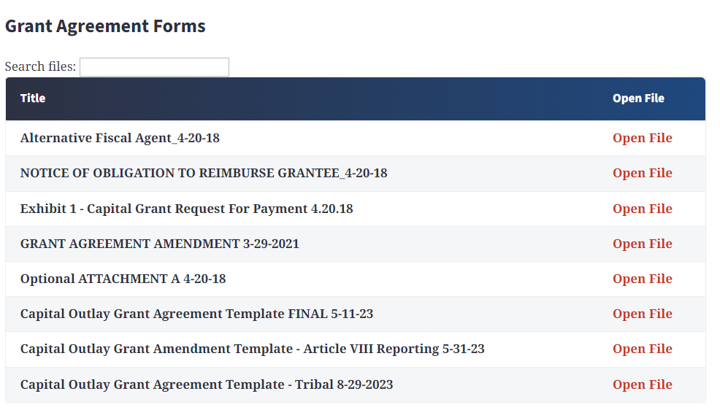
Capital Outlay Implementation
Inter-governmental Grant Agreement (IGA)
Before the agency issues a grant agreement, compliance with Executive Order 2013-006 is verified, Anti-Donation Issues are resolved, and the appropriation has been budgeted.
Scope of Work - use appropriation law language as a guide when determining scope of work and ensure all appropriation activity is within the limits of authorizing language.
Notice of Obligation (NOO) Exhibit 2 - agency reviews third party agreement and verifies it falls within authorizing language.
Request for Reimbursement (RFR) Exhibit 1 – submit for payment of expenditures.
Special Conditions (Optional Attachment A) – may be required if the entity is not in compliant with EO 2013-006 or if the state agency is required to impose other special conditions.
Reporting requirements (CPMS quarterly updates)
http://nmdfa.state.nm.us/Capital_Outlay_Bureau.aspx

Slide 15
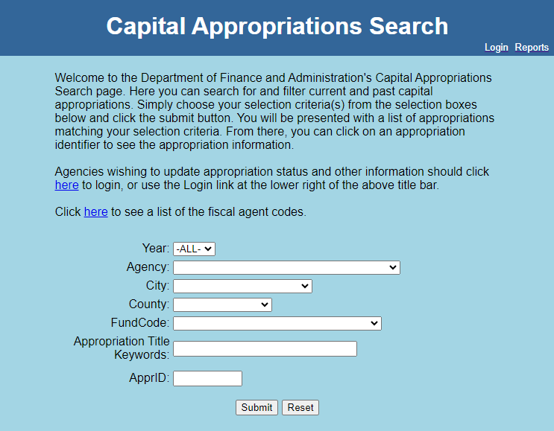
Capital Outlay Implementation
Capital Projects Management System (CPMS)
Capital Projects management System (CPMS) assists with the reporting of capital outlay appropriations.
CPMS provides one location for all capital appropriation reporting.
CPMS records and archives all reporting data for open and closed appropriations.
All appropriations must be closed and reverted. If a reversion is necessary, please reach out to our office for instructions.
CPMS reports must be submitted quarterly.
  March 31
  June 30
  September 30
  December 31
  https://cpms.dfa.state.nm.us/

Slide 16
State Agency - Capital Outlay Contacts
Local Government Appropriations
State Agency Contacts | Agency | Title | Phone | Email
Carmen Morin | DFA, Local Government Division (LGD) | Community Development Bureau Chief | 505-470-8979 | carmenb.morin@dfa.nm.gov
Sarah Jacobs | Aging & Long-Term Services Dept. (ALTSD) | Deputy Cabinet Secretary/Capital Outlay Coordinator |  | sarah.Jacobs@altsd.nm.gov
Clarissa Martinez | Department of Transportation (DOT) | Management Analyst | 505-699-9946 | clarissa.martinez@dot.nm.gov
Rhonda Holderman | Environment Department (DOE) | Financial Manager, Loans and Grants | 505-363-9396 | rhonda.holderman@env.nm.gov
Gerald Hoehne | Higher Education Department (HED) | Capital Projects Coordinator | 505-476-8434 | gerald.hoehne@hed.nm.gov
Lawrence John | Indian Affairs Department (IAD) | Tribal Infrastructure Fund/Capital Outlay Manager | 505-690-2997 | lawrence.john@iad.nm.gov
Amanda Lupardus | Public Education Department (PED) | Financial Coordinator | 505-827-6613 | amanda.lupardus@ped.nm.gov
Emily Breen | Office of the State Engineer (OSE) | Program Manager | 505-827-6310 | emily.breen@ose.nm.gov

Slide 17
DFA - Capital Outlay Bureau
Contacts
Wayne Propst (DFA Secretary) – 505-827-4966
wayne.propst@dfa.nm.gov
Wesley Billingsley (Capital Outlay Bureau Chief) – 505-819-1915
wesley.billingsley@dfa.nm.gov
Tonantzin Roybal (Executive Principal Analyst) – 505-470-4673
tonantzin.roybal@dfa.nm.gov
Sarah de la Rosa (Executive Capital Analyst) – 505-570-7769
Sarah.delarosa@dfa.nm.gov
https://www.nmdfa.state.nm.us/budget-division/capital-outlay-bureau/

