Slide 1


Performance Measure Training
July 1 & 2, 2025
State Budget Division

Slide 2
Accountability in Government Act (AGA)
Passed into law in 1999, New Mexico’s Accountability in Government Act exchanged multiple specific categorical appropriations in the GAA for few categories but increased performance-based budgeting oversight.

Slide 3
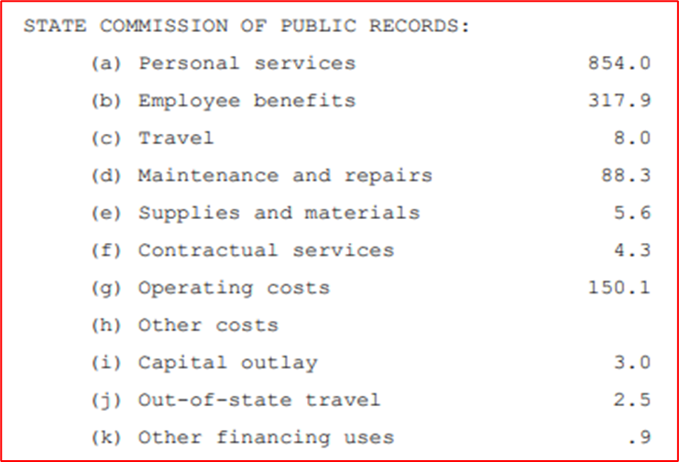
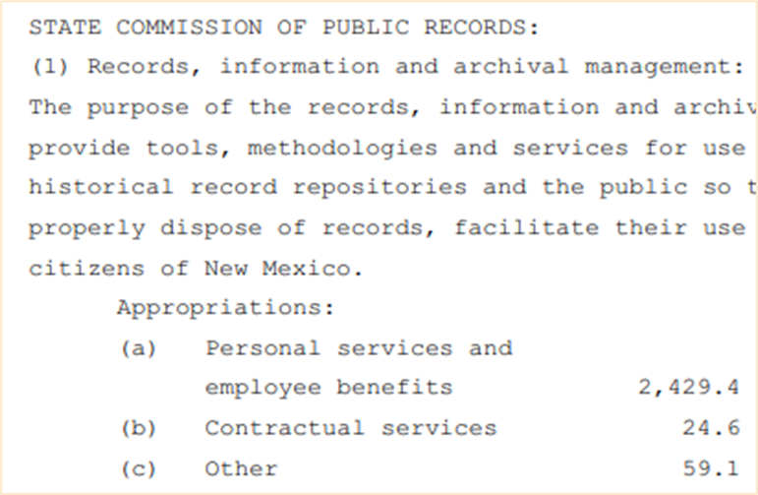

HB2 Categories Before & After AGA Implementation
General Appropriations Act of 1996 General Appropriations Act of 2019

Slide 4


AGA Statute: Section 6-3A-2 NMSA 1978
Accountability in Government Act
Purpose:
To provide for more cost-effective and responsive government services by using the state budget process and defined outputs, outcomes and performance measures to annually evaluate the performance of state government programs.
The AGA establishes the framework for performance-based budgeting:
Accountability
Evaluating performance and assessing progress
Informing the public of benefits derived from the delivery of government services

Slide 5

AGA Statute: Section 6-3A-2 NMSA 1978
Findings and Purpose
The legislature finds that agencies should:
Be granted sufficient statutory authority and flexibility to use their resources in the best possible way to better serve the citizens of New Mexico through the efficient delivery of services and products and the effective administration of governmental programs;
Be held accountable for the services and products they deliver in accordance with clearly defined missions, goals and objectives;
Develop performance measures for evaluating performance and assessing progress in achieving goals and objectives, and those measures should be integrated into the planning and budgeting process and maintained on an ongoing basis;
Have incentives to deliver services and products in the most efficient and effective manner and, if appropriate, recommend the restructuring of ineffective programs or the elimination of unnecessary programs;
Have their performance in achieving desired outputs and outcomes and in efficiently operating programs measured and evaluated in an effort to improve program coordination, eliminate duplicate programs or activities and provide better information to the governor, legislature and the public; and
Strive to keep the citizens of this state informed of the public benefits derived from the delivery of agency services and products and of the progress agencies are making with regard to improving performance.

Slide 6

AGA Cycle
Dates & Processes
REMEMBER: the AGA cycle over the summer is when agencies work with SBD and LFC to retain or adjust wording, change measure types, or add/inactivate measures. Targets for measures are not entered into BFM until the Appropriation Request due September 2
June 15:
DFA notifies agencies of their current approved performance measures
July 15:
Agencies propose changes to program structure and performance measures for FY27 (done within BFM)
Key agencies propose changes to key measures for FY26 (done outside of BFM)
August 15:
After collaboration with LFC and the agency, DFA finalizes approval of new, changed or inactivated measures – Annual for FY27 and quarterly for FY26 – and approves changes to program structure
September 2:
All agencies submit performance-based appropriation requests with requested targets for FY27 along with the agency’s updated strategic plan for FY26
NOTE: Explanatory measures do NOT have targets

Slide 7
Quarterly Reporting
6-3A-9. Quarterly reporting.
The division, in consultation with the committee, shall select agencies and specify performance measures for those agencies that shall be reported on a quarterly basis.
Quarterly reports shall compare actual performance for the report period with targeted performance and shall be filed with the division and committee within thirty days of the end of a reporting period.
History: Laws 2004, Ch. 39, § 9

Slide 8
Quarterly Reporting/Key Agencies
Quarterly Reporting Agencies:
200-280 – Judiciary (Including AOC and PDD)
333 – Taxation and Revenue Department
350 – General Services Department
419 – Economic Development Department
521 – Energy, Minerals and Natural Resources Department
550 – Office of the State Engineer
624 – Aging and Long-Term Services Department
630 – Health Care Authority
631 – Workforce Solutions Department
Quarterly Reporting Agencies:
665 – Department of Health
667 – Environment Department
690 – Children, Youth and Families Department
770 – Corrections Department
790 – Department of Public Safety
805 – Department of Transportation
924 – Public Education Department
952-977 – Higher Education Institutions

Slide 9
Semi-Annual Reporting Agencies
341 – Department of Finance and Administration
378 – State Personnel Office
950 – Higher Education Department
978-980 – Special Schools
993 – Public Schools

Slide 10
Performance Measure Structure
Performance measures are simply subsets of other groups of measures.
AGENCY INTERNAL MEASURES (all agency measures)
AGA APPROVED ANNUAL MEASURES (first subset)
KEY/QUARTERLY MEASURES (second subset)
HB2 MEASURES (third subset)

Slide 11
Types of Performance Measures
Output = amount of work done (least emphasis on these)
Outcome = program results
Efficiency = unit costs to produce or services
Quality = quality of service level
Explanatory = where agency cannot be held accountable, but the data is of high interest to the public

Slide 12





Examples of Performance Measures
(Courtesy of NMDOT)
Output:
Number of statewide lanes preserved
Outcome:
Percent of non-interstate lane miles rated fair or better
Efficiency:
Percent of invoices paid within thirty days
Explanatory:
Annual number of riders on the rail runner
Quality:
Percent of cost-over-bid amount, less gross receipts tax, on highway construction projects

Slide 13
Government Results and Opportunity (GRO)
GRO Appropriations are 3-year appropriations from the GRO expendable trust with the purpose of piloting new programs to determine effectiveness before including funding for new programs in agency base operating budgets
Measuring Success in GRO
A solid logic model with specific deliverable due dates
Defining program’s intended impact and goals, sequence of intended effects, and where to focus outcomes and evaluations
Tracking quality OUTCOMES – not output, explanatory, efficiency, or quality metrics
Expenditure of annual funding to the maximum ability of the agency

Slide 14
Government Results and Opportunity (GRO)
GRO Performance Measures
Agencies with GRO appropriations will need to track their GRO performance measures outside of BFM
These measures are not being entered in BFM due to being project-based as opposed to P-code-based

Slide 15

LFC Performance Measures and Reports
Helen Gaussoin, LFC Analyst
Maggie Klug, LFC Evaluator

Slide 16
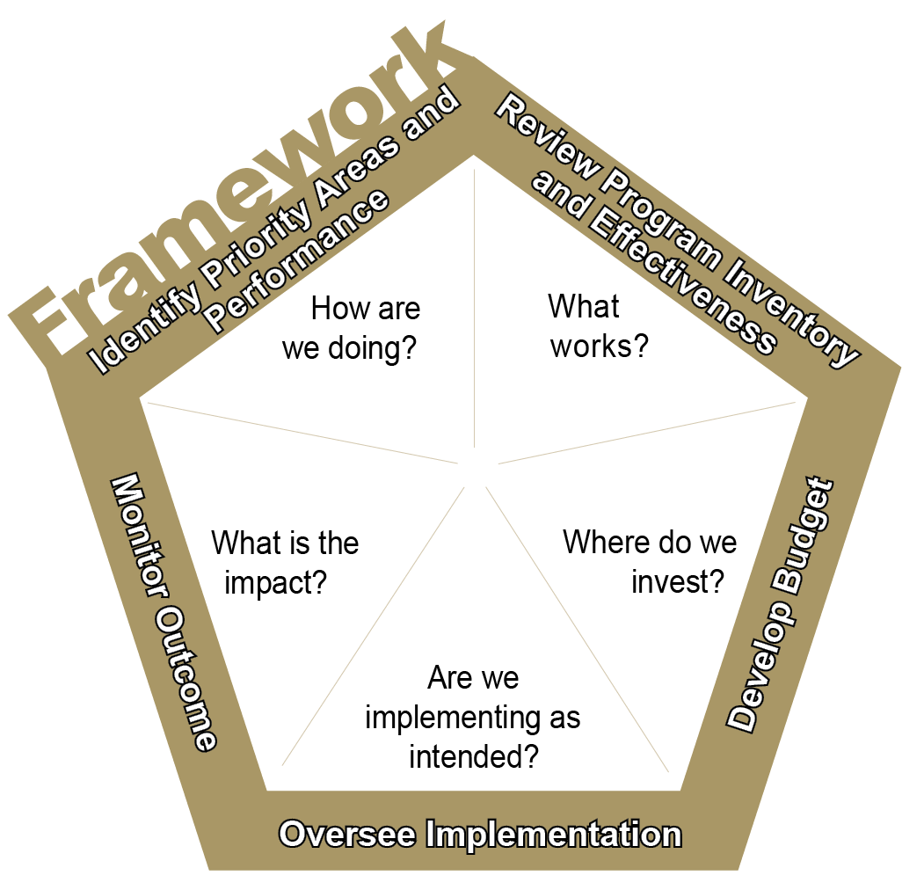

Performance measures and report cards are components of the Legislating for Results framework.
Identify priority areas and performance. Performance data helps highlight the need for additional attention through the budget process.
Review program inventory and effectiveness. A systematic review of the evidence, either through research or performance data, on the effectiveness of these activities can identify whether agencies are spending money on what works.
Develop Budget. Evidence of program effectiveness is incorporated into the budget process with the intent to move money toward programs likely to work.
Implementation Oversight. Performance reports (report cards) and other tools are used to ensure programs are effectively implemented to ensure the taxpayers’ investment is protected.
Outcome Monitoring. A combination of performance reports and program evaluations assess whether programs are achieving desired results.
Notes:
Performance measures are a foundational step. They tell us how we are doing. They show us what’s working and what isn’t. They don’t tell us why it’s not working. Is it underfunded, a bad practice, a good practice poorly implemented? The Legislating for Results framework attempts to answer all those questions but it must start with how are we doing.

Slide 17
Performance data can help improve policy development and budgeting.
According to the National Conference of State Legislatures, performance data
• Enable legislators to ask state agencies the right questions—about both past performance and expected future results.
• Improve oversight of state programs and policies to encourage program management to focus on results.
• Provide useful information about state programs that can be communicated easily and clearly to constituents.
• Provide objective evidence on outcomes of agency, which can help enable legislators to ask meaningful questions about politically sensitive programs.
• Help identify areas for potential budget reductions, increases, or reallocations, including identifying the estimated consequences of such changes.
• Enhance state strategic planning efforts by encouraging a long-term focus on results.
Notes:
Generally, performance measures means legislators are better informed, can ask better questions, can be more objective, and can make better budget decisions based on results.

Slide 18
A good performance measure provides a meaningful assessment of the effectiveness of a program.
Ideal performance measures should be
Results-Oriented: Focus on outcomes
Relevant: Assess the core function of the program or significant budget expenditures
Useful: Provide valuable and meaningful information to the agency and policymakers
Clear: Communicate in a plain and simple manner to all stakeholders (employees, policymakers, and the general public)
Responsive: Reflect changes in performance levels
Valid: Capture the intended data and information
Reliable: Provide reasonably accurate and consistent
Comparable: Allow direct comparison of performance at different points in time
Economical: Collect and maintain data in a cost-effective manner
Accessible: Provide regular results information to all stakeholders
Benchmarked: Use best practice standards
Notes:
The bottom line on measures is that they should provide for the meaningful assessment of the effectiveness of a program. A measure of the number of miles of highway in good condition is more meaningful than a measure of the number of hours road crews spent on repairs. It’s also important to get the best possible measure from the start. Evolving conditions can necessitate the need to change, add, or abandon a measure but constantly changing measures make it impossible to gauge progress over time.

Slide 19
Common Performance Measure Concerns
Measure Not Focused on Performance
Some measures offer surface-level information, providing no insight into the effectiveness of an agency or information that could help with policy decisions.
Example 1: Board of Veterinary Medicine: “Number of veterinarian licenses issued annually.”
Discussion: This measure fails to address important questions that could easily be answered. Is the agency reviewing all license applications that it receives in a timely manner? How effective is the agency at informing licensees of the requirements they must meet to get a license renewed? How does the licensed veterinarian-to-pet ratio differ from New Mexico to other states?
Example 2: Public School Insurance Authority: “Number of loss control prevention seminars.”
Discussion: The measure simply demonstrated that seminars are occurring. It does not provide information on the impact of Public School Insurance Authority-led seminars on schools.
Takeaway: Agencies should institute measures that provide a fuller picture of agency performance.
Notes:
These examples are very old and were developed when all of us – agencies, LFC and DFA – were just starting to get the hang of performance measures. I’ve included them as examples here because the problems can still crop up even if infrequently.

Slide 20
Common Performance Measure Concerns
Unclear or Confusing Language
Measures with unclear language are less effective than well-written measures because legislators, the governor, the public, and even analysts may have difficulty interpreting targets and results.
Example 1: Department of Health-Facilities Management: “Percent of collectable third-party revenues at all agency facilities.”
Discussion: This measure is actually trying to gauge the percent of third-party revenues collected by DOH out of the total amount that can be reimbursed to DOH from third-parties, like Medicaid.
Example 2: School for the Blind and Visually Impaired: “NMSBVI will foster an atmosphere of creativity that results in innovative practices and programs.”
Discussion: This measure is vague and more of a goal than a performance measure. When this measure was in place, the school routinely reported 100 percent.
Takeaway: Performance measures should provide information to the public and anyone outside the agency on agency effectiveness. They must be easy to understand and free of jargon.
Notes:
The first example also illustrates an example of a missing denominator. Is it the percent of all revenue?

Slide 21
Common Performance Measure Concerns
No Target or a Target that is Easily Achievable
Measures that have no target because they are explanatory or have a target that is easily achievable are less effective because they lack an incentive to improve performance.
Example 1: Energy, Minerals and Natural Resources Department: “Number of visitors to state parks”
Discussion: The number is readily available and easy to compare with past numbers or numbers from other states. Without a target, it is unclear what number should be the goal.
Example 1: Economic Development Department: “Film and media worker days”
Discussion: The agency easily met the target in FY22 and is on track to exceed the target in FY23. Targets that are set too low are little different than nonexistent targets.
Takeaway: While explanatory measures have no target by design and can provide important context to agency performance, their use should be limited. Targets provide the public and policymakers with the information needed to assess performance.

Slide 22
Tips on Number Use in Measures
Be clear on the denominator
When crafting measures, keep in mind the difference between a number, a percentage, a rate, and a ratio.
Number: A raw data point that is not relative to any other number
Example: Number of stolen livestock reported: 500 head
Percentage: A data point divided by the total possible, expressed as a percentage of the total
Example: Percent of total livestock reported as stolen: 5% (500/10,000 = 0.5 = 5%)
Rate: A certain quantity of one thing considered in relation to a unit of another thing, often expressed with “per”
Example: Number of livestock reported stolen per 1,000 head: 50
Ratio: A relationship between two numbers indicating how many times the first number contains the second. The total is not included but is derived by adding the two numbers together.
Example: Ratio of stolen livestock to non-stolen livestock: 50:950 (=50/1,000 = 5%) Note: Ratios are seldom appropriate for measures. Craft carefully and accurately.

Slide 23
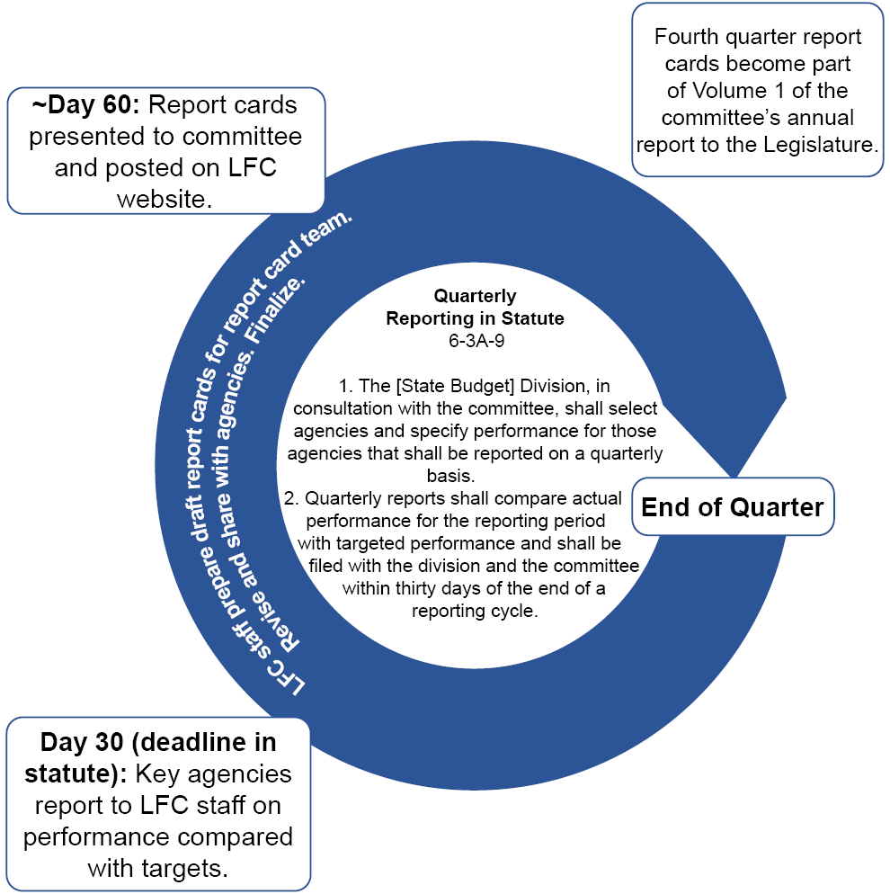
The report card cycle starts with the agency.
Notes:
Quarterly performance reports are required by statute. Report cards are the way LFC communicates performance information to the committee and the public. They are not intended to “judge” the agency but to assess effectiveness. The Accountability in Government Act traded micromanagement of agency budgets for information. In exchange for greater flexibility in how they spend their funding, agencies must identify their core services (programs) and ways to measure program effectiveness and report on whether programs are demonstrating that effectiveness.

Slide 24
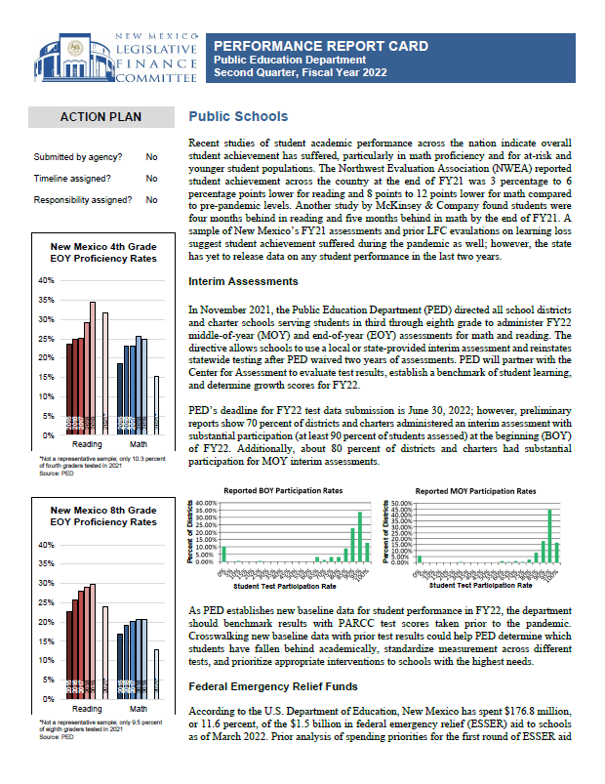
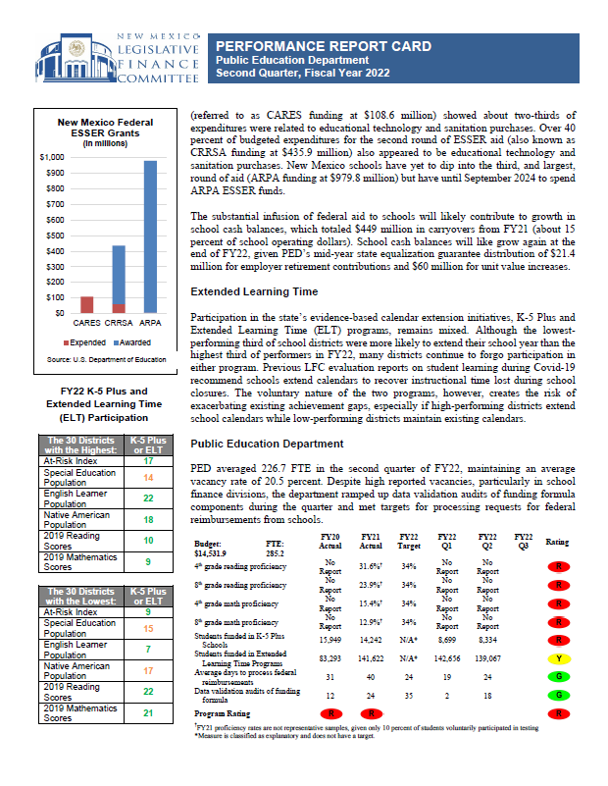
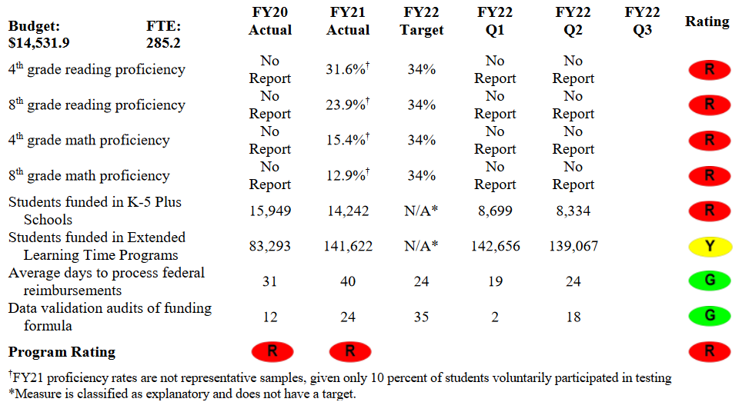
Example Report Card
Notes:
<zooms into the table>Report cards include some discussion and tables with ratings from green to red. The red does not mean failure and this report card is a good example of that. In this case, from a report from more than a year ago, the red is reflection of the lack of data.

Slide 25
Green is not always good; red is not always bad.
Green
Agency has met the quarterly target or is on track to meet the annual target.
Yellow
Agency slightly missed the target or is off track for meeting the annual target.
Red
Agency missed the target or is off track for meeting the annual target.
Fine Tuning
Did the agency provide the data? How reliable is the data? Is the collection method transparent?
Does the measure gauge a core function of the agency? Is the measure a good gauge of effectiveness?
Does the agency use the information internally? Does the agency have a plan to maintain or improve performance.
Notes:
Green is not always good and red is not always bad. Sometimes a consistent green means the target has been set too low. Raising that target can result in better information on the effectiveness of the program. A red isn’t failure but a red flag that something is off. It could be missing data or bad data. And again, ratings show us what’s working and what isn’t but they don’t tell us why it’s not working.

Slide 26
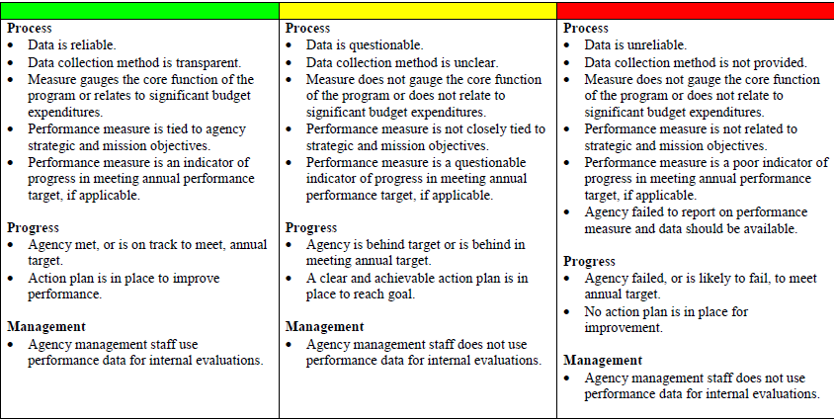
How are report cards scored?

Slide 27
PERFORMANCE MEASURE DATA ENTRY IN BFM

Slide 28
Performance Measures in BFM
In BFM, you can:
Request to add or inactive a measure
Request to change wording or measure type
Add justifications and contextual information
REMEMBER: Justification is KEY! Be sure to fill out ALL fields
Enter targets for the upcoming fiscal year (this is done for the September 1st Appropriation Request deadline in the 4000 Performance Measures Form)
Explanatory measures do NOT have targets

Slide 29
Before Making Changes in BFM
Make sure your agency has reviewed all measures and information
Internal approval is needed before you start to enter data into BFM to ensure reduced duplicative entries

Slide 30
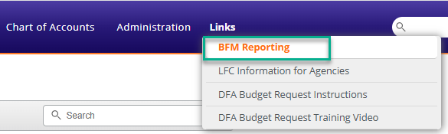
4400 Form: Performance Measure Change Request
The 4400 form is used for requests for new measures, changes, or inactivation for FY27 ONLY.
Changes to key measures are done on a form outside BFM that agencies will return to SBD and LFC. SBD analysts will handle FY26 key measure changes in BFM.
If you are not requesting any sort of change, you do not need to fill out and submit the 4400 form.

Slide 31
Changing Existing Measures in BFM
Changing Existing Measures in BFM
Existing measures will pre-populate
To change an existing measure, click on the Header link for the measure in question
Update the “Proposed Measure” and “Explanation of Change” data fields on the left
Inactive Year: select next FY (FY27 in this case) if requesting to inactivate a current measure
Measure Type: Outcome, Output, Quality, Efficiency, Explanatory
Measure Format: How should the measure data be displayed (integer, date, percent, etc.)
Good Direction: “Over” if the target is met if the result is higher, “Under” if the target is met if the result is lower
Can update methodology, reliability, validity, etc. on the Narrative Changes tab
Some fields are for SBD analyst use – do not complete these fields

Slide 32
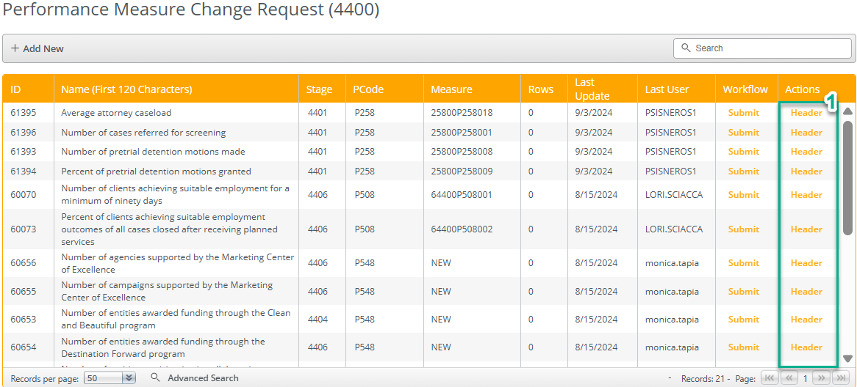


Slide 33
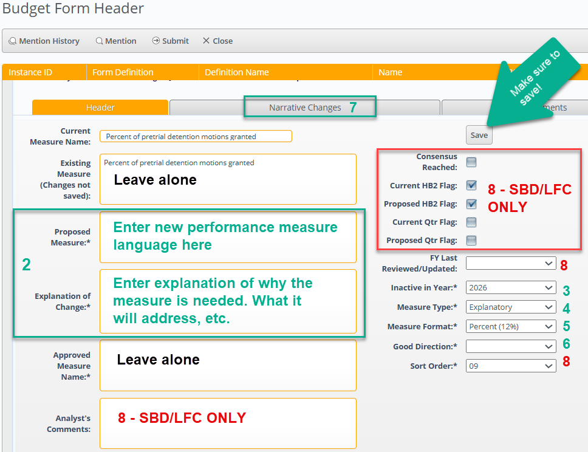

Slide 34
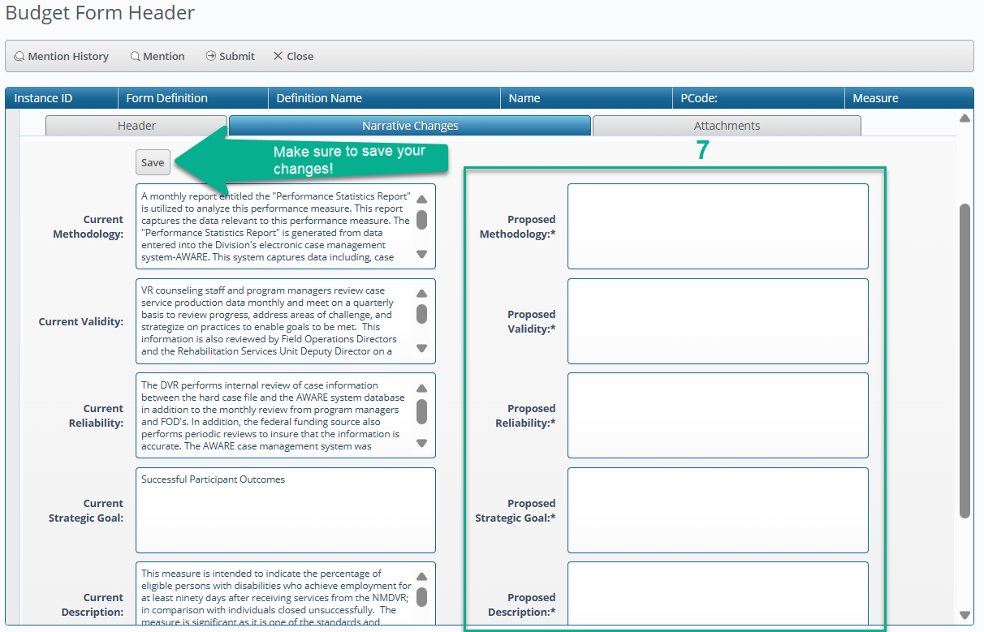

Slide 35
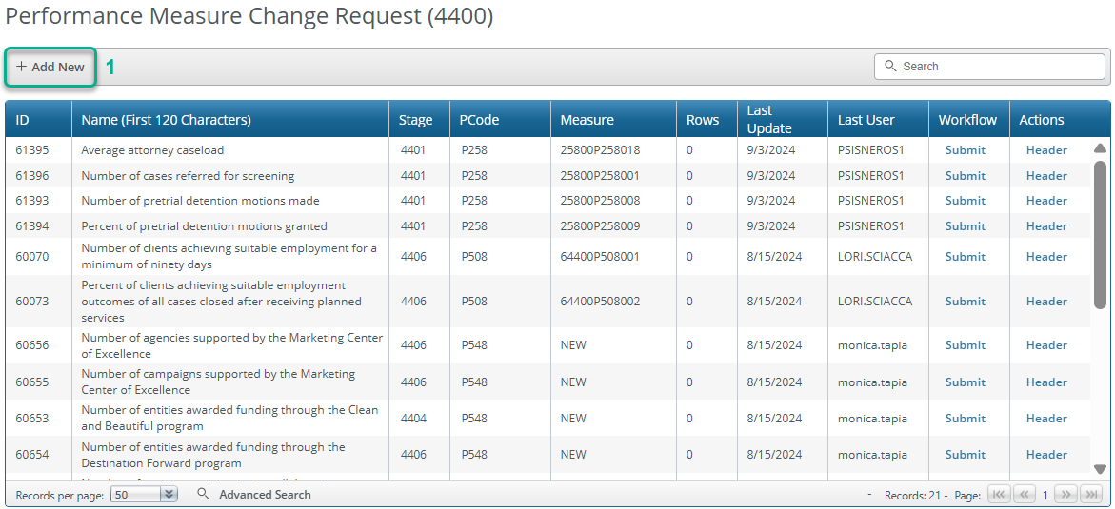
Creating New Measures in BFM
Creating New Measures in BFM
Click “Add New” in the main 4400 form screen, where current measures are listed

Slide 36
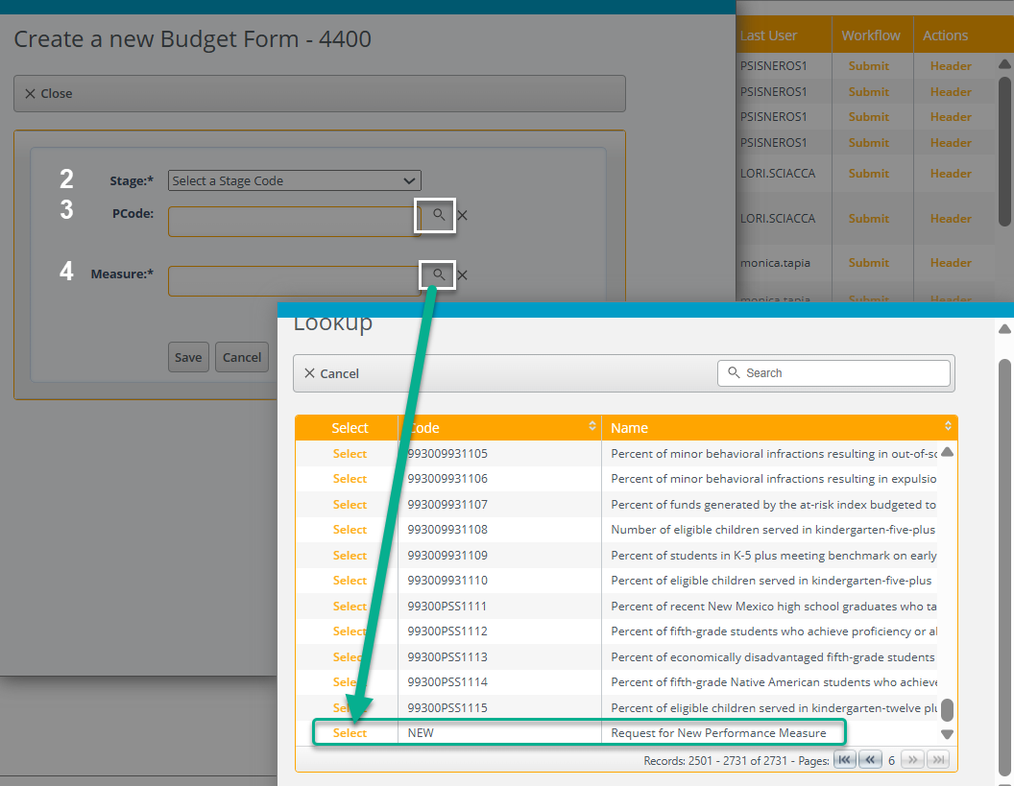
Creating New Measures in BFM
Select stage 4401 – Initial Entry
Use the magnifying glass to select the P-code the measure will be associated with
Use the magnifying glass to bring up a list of existing measures
Scroll to the end of the list and select “NEW”

Slide 37
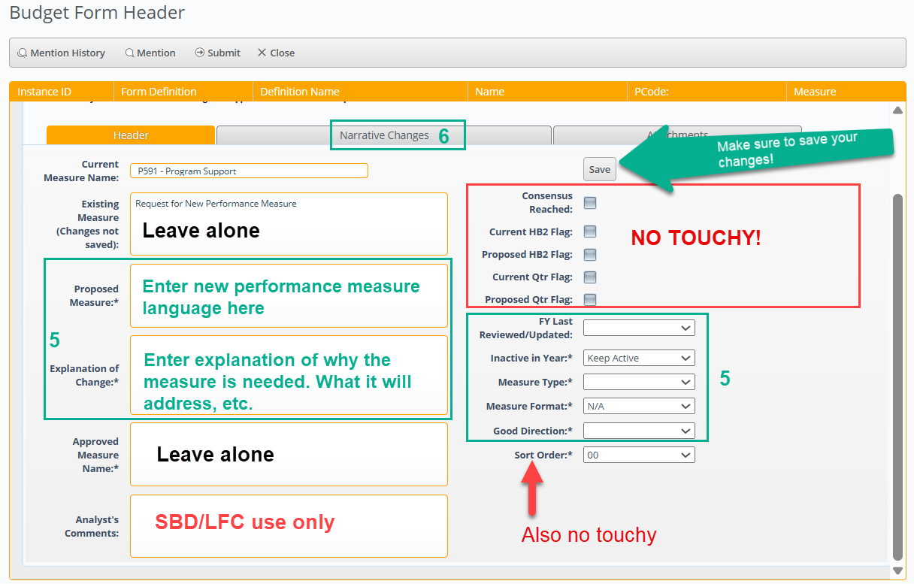
Creating New Measures in BFM
The process is now like changing an existing measure:
Complete the data fields on the left side that have an asterisk (*)
“Inactive in Year” should say “Keep Active”
Select the Measure Type, Measure Format, and Good Direction
Do NOT check any boxes under the Save button and do NOT touch the Sort Order
Click on the Narrative Changes tab and complete all asterisked (*) data fields

Slide 38
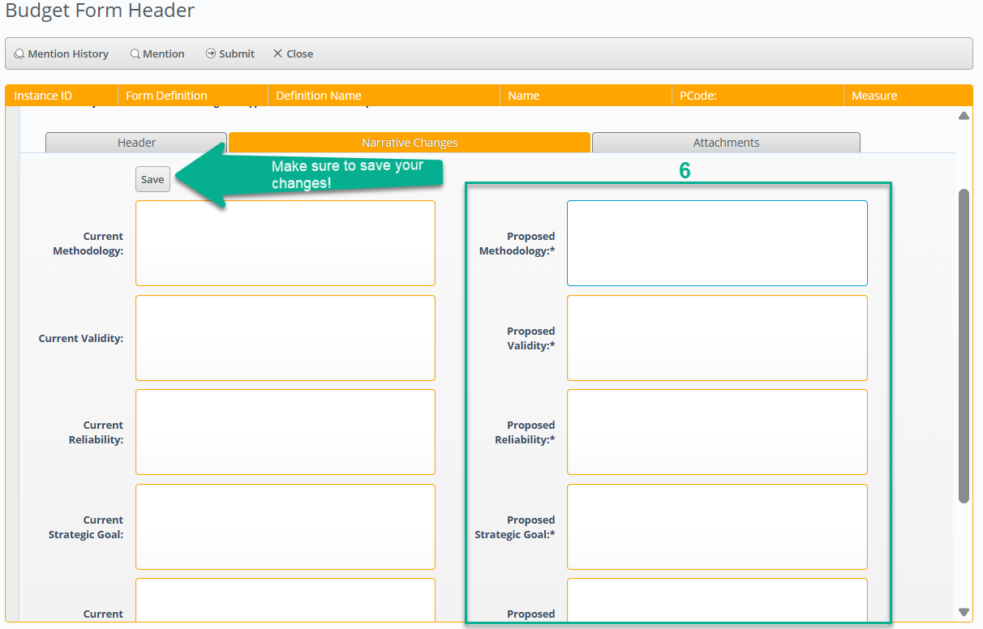
Creating New Measures in BFM
Click on the Narrative Changes tab and complete all asterisked (*) data fields

Slide 39
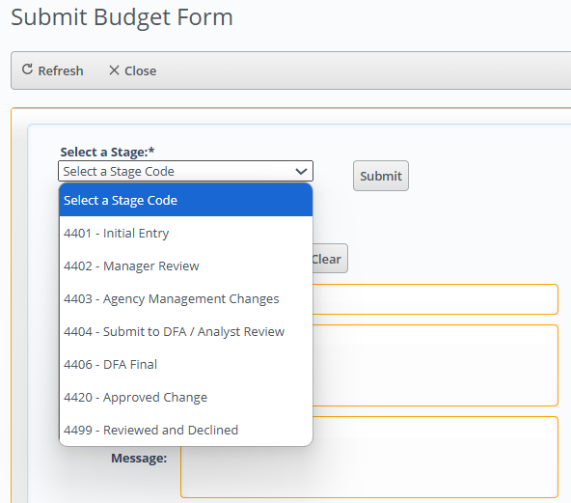
Submitting Changes in BFM
Once your edits are complete, use the submit button to submit them to the next level within your agency for management review.
Once they are ready for submission to DFA, the Level 3 reviewer will need to submit them to Stage 4404 – Submit to DFA/Analyst Review

Slide 40
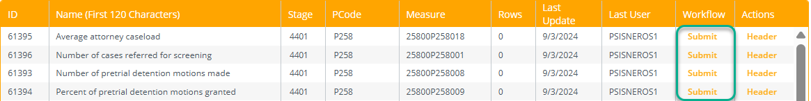
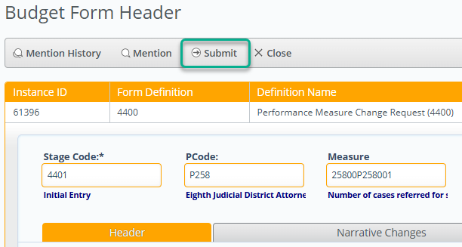
Submitting Changes in BFM
The Submit button is available in two locations:
On the main page of the 4400 form
Within the specific measure itself

Slide 41
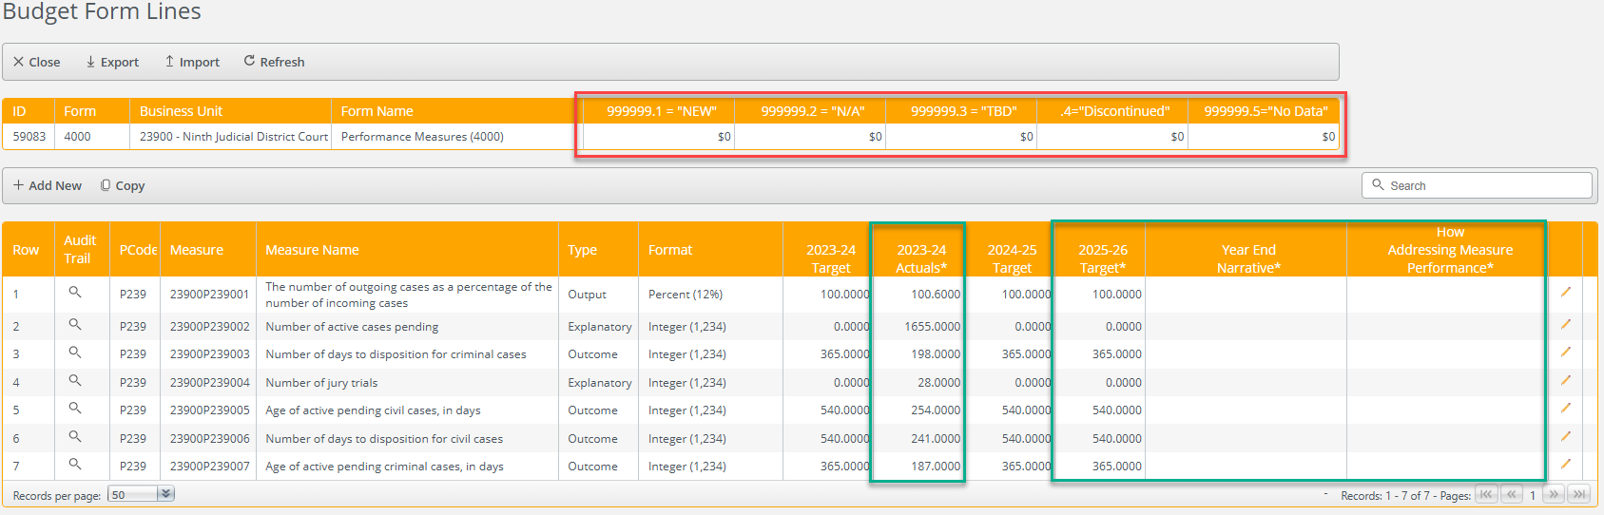
4000 Performance Measure Form – September 1 (2nd in 2025)
This form is used for the Appropriation Request Submission due in September
Once in the 4400 form, you’ll have several fields to complete
Actuals
Target
Year-End Narrative
How Addressing Measure Performance
It is important to complete the Year-End Narrative and How Addressing Measure Performance fields
If the measure is new for FY27 type in 999999.1 in the Actuals column
If the measure is deactivated for FY27 enter 999999.4 in the Target column
If the measure is an explanatory measure enter 999999.2

Slide 42
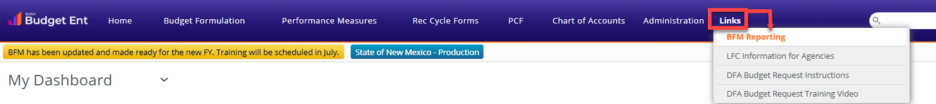
BFM Performance Measure Reports
Annual Performance Report
Full Program and Measure Report
Performance Measure Table 2 Summary
Performance Monitoring Plan
PB-1 Summary of Requested PM Changes (former Word document, also incorporates PB-2 for quarterly reporting agencies

Slide 43
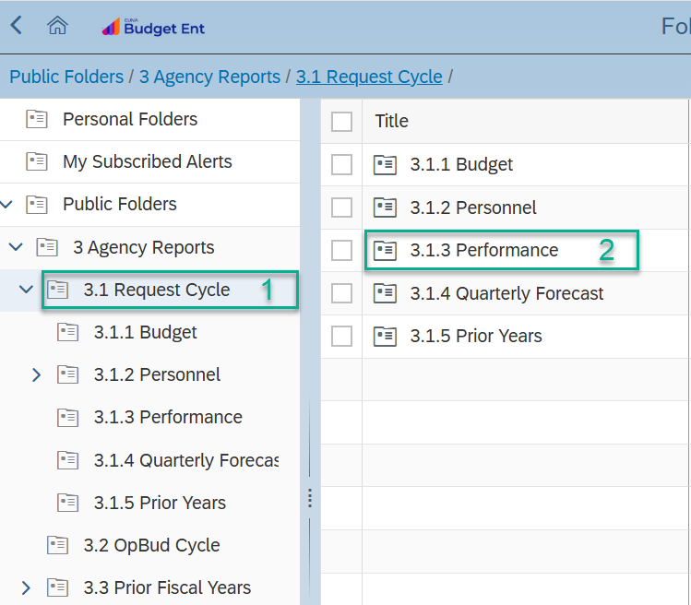
Generating Performance Measure Reports
After you’ve clicked on the folder titled “3 Agency Reports”:
Double click on the folder titled “3.1 Request Cycle”
Look to the frame on the right (or in the expanded list of folders below where you clicked on the left) and double click on “3.1.3 Performance”

Slide 44
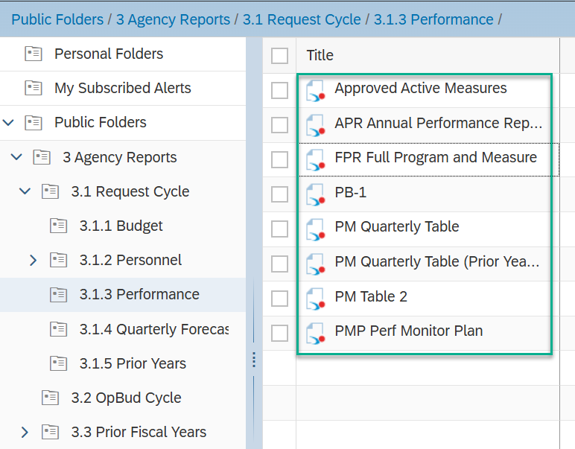
Generating Performance Measure Reports
A new frame will appear on the right, providing a list of available reports for you to generate.

Slide 45
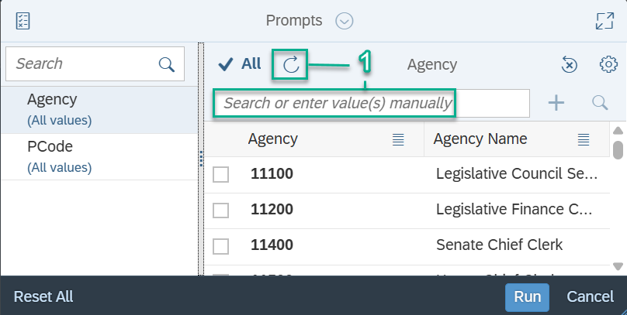
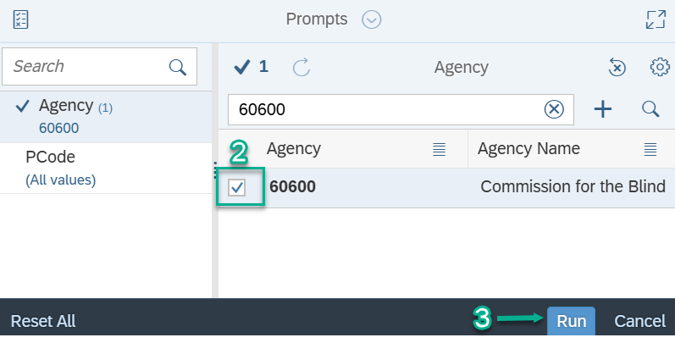
Generating Performance Measure Reports
Once you’ve selected the report to generate:
Type in your agency BU (5-digits) in the data field named “Search or enter value(s) manually” and then hit enter. Alternatively, you can click the refresh circle above that data field to see a list of all available BUs and check the box next to yours.
If you manually typed in your agency BU, click on the check box once your agency appears below.
Click “Run” to generate your report.

Slide 46

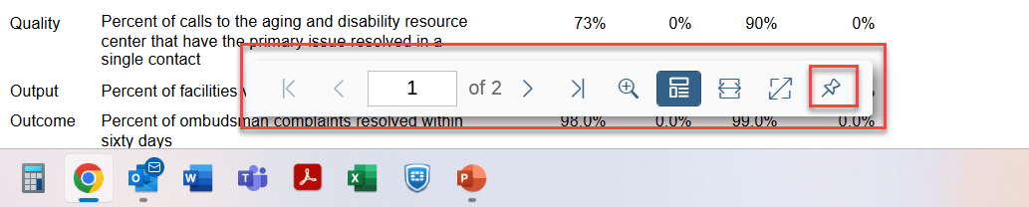
Generating Performance Measure Reports
When the report opens, you will have the ability to:
Export the report to PDF or Excel and save to your computer
Navigate between pages with the navigation bar at the bottom of the report that can be pinned to stay shown or can only appear when hovering in its general area (vanishing toolbar)

Slide 47
Government Results and Opportunity Fund Pilot Projects
Ability to pilot programs before including in recurring budget
Opportunity to demonstrate a program’s effectiveness
How it works:
Section 9 divided into A, B, C → specifies the funding for one fiscal year, any balance at the end of the fiscal year reverts to the GRO Expendable Trust Fund unless otherwise specified in the appropriation language
Ex. In the 2025 GAA, Section 9A specifies the funding for FY26, 9B for FY27, and 9C for FY28
Key to determining a program’s effectiveness:
A clearly defined logic model
Clearly defined output and outcome performance measures
A counterfactual to compare the program to

Slide 48
What is a logic model and why is it important?
A graphic illustration of the relationship between a program’s resources, activities, and its intended effects
Creates a roadmap of how the program will work and achieve the desired results → helps to identify causal pathways and data needs
Inputs
Activities
Outputs
Outcomes
The resources supporting the program
What the program does with the resources to achieve the desired results
The direct results of the program activities
The changes or benefits seen in the population served – what difference does the program make?
Tip: “If/then” statements can help guide you!

Slide 49
What’s an example of a logic model?
Scenario: Baking cookies for your coworkers!
Inputs
Activities
Outputs
Outcomes
Recipe
Cookie sheet
Oven
Chocolate Chips
Butter
Sugar
Eggs
Flour
Vanilla
Look up recipe
Go to grocery store
Preheat oven
Combine ingredients
Bake dough
A dozen cookies
New recipe
Lessons learned
Dirty kitchen
Coworkers eat the cookies and enjoy them
Satiated coworkers
Improved moral, good work relationships

Slide 50
Outputs vs. Outcomes
Outputs
The direct results of the program activities
Outcomes
The changes or benefits seen in the population served – what difference does the program make?
Number of children tutored
80% of tutored students score higher on end-of-year exam compared to start-of-year exam
Amount of Narcan distributed
Reduced overdose deaths

Slide 51
A brief introduction: Counterfactuals
Definition: what would have happened without the program or intervention
Key to understanding causal impact
Basis of comparison and control groups
Confounding variables: affects both independent and dependent variable, makes it difficult to determine if observed effects are solely due to independent variable
Confounding Variable: Smoking
Independent Variable:
Alcohol Use
Dependent Variable:
Lung Cancer

Slide 52
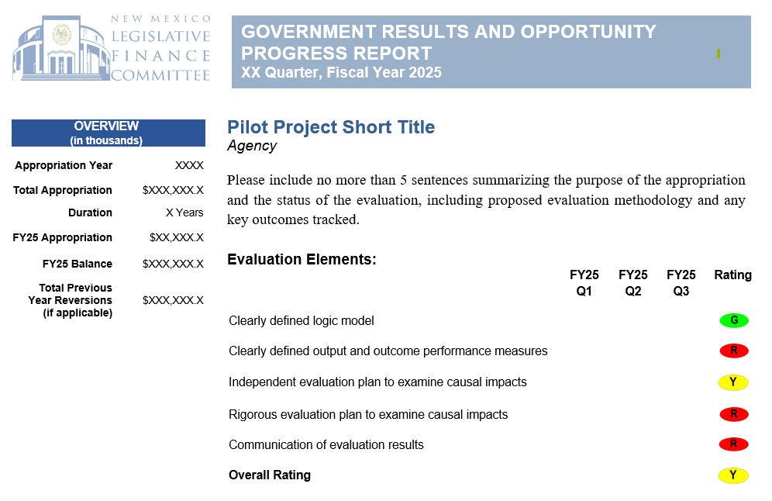
LFC Quarterly Performance Tracking

Slide 53
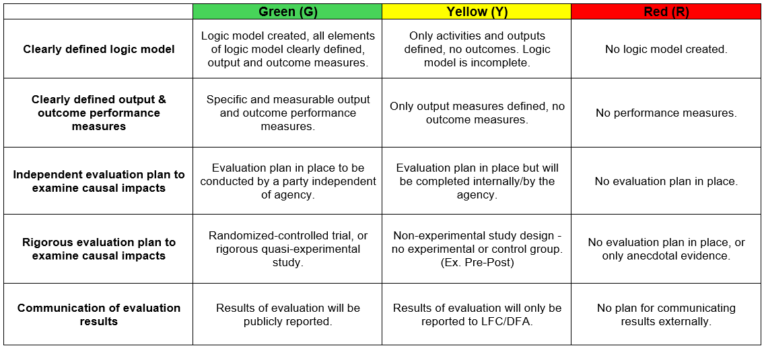
How is progress rated?

Slide 54



