Slide 1


State Bonding Programs
New Mexico State Board of Finance
NMHED 2021 Capital Outlay Training Series
Administration of Capital Outlay
April 6, 2023

Slide 2



Agenda
Municipal Bonds & Program Overview
Municipal bonds and how they work
New Mexico’s General Obligation and Severance Tax bonding programs
Bonds as a Source of Capital Funding
Factors and timing of bonding capacity
Bonding capacity and capital appropriations
Selling Bonds/Notes
Capital project review & questionnaires
The bond sale
Bond Proceed Disbursement & Reversions
The bond proceed draw request process
HEI draw requirements
Reversions

Slide 3
Municipal Bonds & Program Overview
Municipal bonds and how they work
New Mexico’s General Obligation and Severance Tax bonding programs

Slide 4

What is a Municipal Bond?
A Municipal Bond is…
Why borrow?
Allows the state to fund capital projects regardless of the money available from the General Fund (note that General Fund dollars are not pledged to paying the debt)
Often advantageous if the interest rate on the debt is very low.
A debt instrument issued by a governmental entity.
A security.
An obligation.
New Mexico wants to fund capital projects. To do so, it usually “borrows” the money by selling bonds.
New Mexico pledges/guarantees to pay back the money borrowed.
New Mexico is obligated to repay the debt

Slide 5
How do Bonds Work?
An investor buys the bonds, thus loaning money to the governmental entity (issuer).
The governmental entity gets the money for capital projects
The investor gets interest income on loaning that money
Debt instruments typically specify:
An obligation to pay
A stated amount | the principal
At a given time | Known as the “term of the bond” or “maturity” and represents the borrowing period (i.e., how long does the state have to pay off the debt)
With interest | Can be fixed or variable
Bonds can be taxable or tax-exempt
Relates to whether the investor must pay taxes on income earned.

Slide 6
Tax-Exempt & Taxable Bonds
Tax-Exempt Bonds
Governmental entities may issue tax-exempt bonds.
In essence, a subsidy of the federal government because it allows interest earned on the bonds to be exempt from the bondholder’s taxable income.
Generally limited to projects that are capital assets (i.e., brick and mortar), not used by a private entity (i.e., not leased to a non-profit), and benefit the public at large.
Why would an issuer sell a tax-exempt bond? Because it results in a lower cost of capital/borrowing because less is paid in interest.
Why would an investor buy a tax-exempt bond? The income they receive is not taxable, the bonds serve a public purpose, and municipal bonds typically have a very low rate of default.
Taxable Bonds
Includes all corporate bonds and some governmental bonds (issued when there’s private use)

Slide 7
Overview of Bonding Programs
The State Board of Finance (SBOF) manages the General Obligation Bond and Severance Tax Bond programs.
General Obligation Bonds
Issued as tax-exempt bonds every two years (usually in the spring)
Issued with a 10-year maturity
Secured by the full faith and credit of the State
Paid by property tax revenues generated from the mill levy and ad valorem tax revenues on oil, gas, and minerals production and equipment
Funds higher education, aging & long-term (senior), and library capital projects (and occasionally public education and public safety projects)
Subject to voter approval

Slide 8
Overview of Bonding Programs
Severance Tax Bonds & Notes
Long-term Senior and Supplemental Severance Tax Bonds and short-term Senior and Supplemental Severance Tax Notes are issued by the BOF.
Senior Severance Tax Bonds and Notes fund capital projects appropriated by the legislature, including earmarks for tribal, colonias, and water projects.
Supplemental Severance Tax Bonds and Notes are issued to fund public school capital projects, as certified and managed by PSCOC.

Slide 9
Bonds as a Source of Capital Funding
Factors and timing of bonding capacity
Bonding capacity and capital appropriations

Slide 10
Determining the Size of Bonds/Notes: Key Factors in Capacity
Bonding capacity is an estimate of the amount of debt the State
can incur, taking into account several key factors, including:
Statutory Limits on Debt
GOB: 1 percent of the total assessed value of property in the State
        STB: Senior annual debt service cannot exceed 47.6 percent of the lesser of the prior year’s actual severance tax revenues and the current year’s estimated revenues.
        Senior and Supplemental annual debt service cannot exceed 87.8 percent of the lesser of the prior year’s actual revenues and current year’s estimated revenues.
        Projected Future Severance Tax Revenues (primarily oil and gas)
        The BOF uses 10-year severance and property tax revenue projections produced by the DFA Chief Economist and the Consensus Revenue Estimating Group (CREG).
        Outstanding and future projected long-term debt service
        Long-term debt service (both STBs and GOBs) is spread across a 10-year period,
        because the State issues its long-term bonds with a maturity of 10 years.

Slide 11
Determining the Size of Bonds/Notes: Capacity Timing
Bonding capacity estimates are used to guide the legislature when it makes capital project appropriations during the Legislative session.
SBOF staff, with the State’s financial adviser, prepare preliminary capacity estimates each August, upon release of new tax revenue projections from the Consensus Revenue Estimating Group (CREG) and the DFA chief economist.
The SBOF updates capacity estimates in December for release to the legislature prior to session start in January.
If major changes occur that will impact revenue projections during the year, SBOF staff will update the capacity estimates to reflect the most recent revenue outlook.

Slide 12
How Capacity is Used in Determining Capital Appropriations
The Legislature:
Uses capacity estimates to appropriate funding to capital outlay projects that will be funded with bond proceeds.
Makes GOB appropriations in even years for sale in the following odd-year spring.
Makes STB appropriations every year (typically).
The Senior Severance Tax bonding capacity available for new appropriations equals the total capacity net:
  Any past capital project appropriations not yet funded (known as “Authorized but Unissued” projects)
  Earmark projects, including water, colonias, and tribal set asides.
  Water project funding is managed by the Water Trust Board, which receives 9 percent of annual senior severance tax bonding capacity.
  Tribal project funding is managed by the Tribal Infrastructure Board, and Colonias project funding is managed by the Colonias Infrastructure Board. Each receive 4.5 percent of annual senior severance tax bonding capacity.

Slide 13
Capacity through Bill Signing/Voter Approval

Slide 14
Selling Bonds/Notes
Capital project review & questionnaires
The bond sale

Slide 15
Questionnaire Process
After the bonds sell:
Bonds available memo is issued (~ 2 weeks)
Conditions memo is issued (~2 to 4 weeks)
Projects are uploaded to Bond Tracking System for use in processing draw requests
Oversight agencies may issue grant agreements
The capital authorized but unissued list is posted (STBs only)

Slide 16
Why Questionnaires are Used and Required
SBOF staff & legal counsel review all projects for compliance with:
State & Federal Tax Law
  Appropriate use — planned expenditures are allowable under appropriation
  Public purpose — must be for a public purpose
  Project readiness — has or will begin within 6 months, full project or well-defined phase will be funded
  Ability to expend funds in reasonable time — 3 years
  Capital use of funds — operational uses (aka “working capital) are not allowable
  Reimbursement of funds already spent — requires specific actions taken ahead of sale (strongly discouraged or not allowed)
  Constitutional anti-donation concerns (when a non-public entity owns or will be managing, operating, using the capital to be funded)
  Executive Order 2013–006
  Requires the entity to have submitted its most recent audit prior to receiving appropriated capital funds

Slide 17
Project Status & EO Compliance
Questionnaire review results in a final project list and an authorized but unissued list.
Final Project list
Projects that are determined to comply with state and federal law are “READY” and will be included in the sale.
Some projects are “READY” immediately upon review.
Projects that require additional information be provided are “FOLLOW UP” and go through Q&A to update and finalize the questionnaire information. The follow-up will result in the project being “READY” or “NOT READY”.
Projects for which remaining issues may be cleared fairly quickly but after the bond sale (primarily third-party agreements) are ‘READY WITH CONDITIONS” and included in the sale but also in the conditions memo.
Authorized but Unissued List
Projects for which the entity (1) rejects funding at that time, (2) the questionnaire is missing, or (3) state/tax law issues cannot be resolved are “NOT READY” and are added to the authorized but unissued list to be considered for a future sale.
!!! Projects have two years to be considered for a bond sale, unless statute specifies otherwise.
Should a project require more time, it can be reauthorized for a time extension.

Slide 18
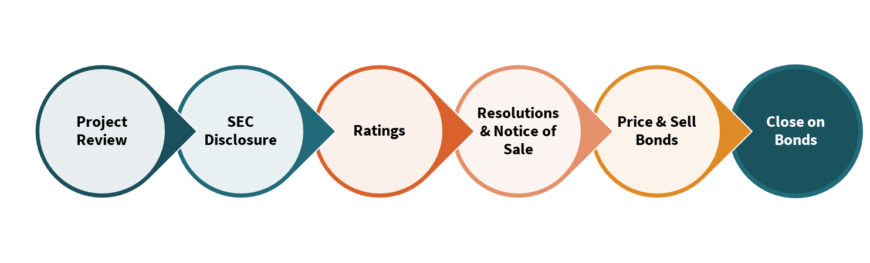
The Bond Sale Process
The bond sale process is very involved and typically takes 3 months in total.
Participants are broad and include several state departments, legal counsel, and the State’s financial advisor, in addition to the State Board of Finance.

Slide 19
Bill/Voter Approval through Bond Sale

Slide 20
Bond Proceed Disbursement
The bond proceed draw request process
HEI draw requirements
Reversions

Slide 21
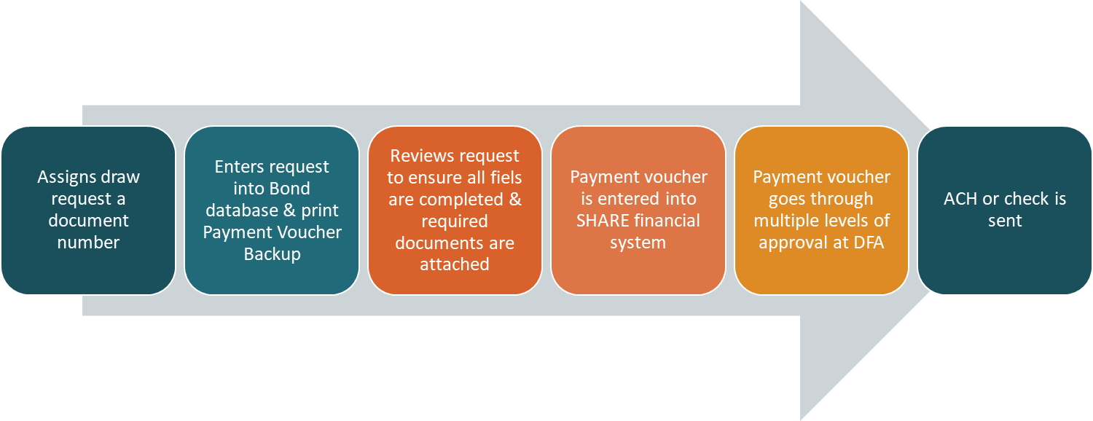
The Bond Proceed Draw Process
All bond proceeds are provided through the draw process on a reimbursement basis.
Draw request are due on the 1st & 15th of each month. Once received, SBOF:

Slide 22
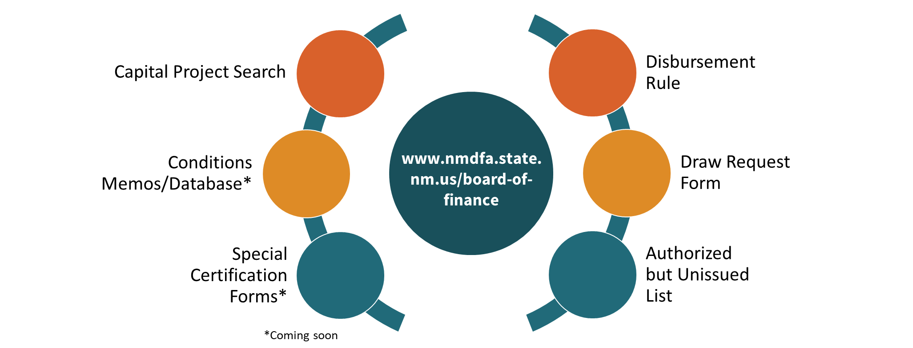
HEI Draw Requirements
When reviewing HEI draw request forms, the SBOF is looking for:
Correct Appropriation stated in the top right corner
Correct Bond Series filled out
Correct Title to Appropriation
Draw request amount stated
Authorizing signature and Notary signature with stamp
HED Review and Approval
State BOF Actions (if applicable)
Necessary back-up documentation has been provided

Slide 23
Draw Request Required Fields & Back-Up Documentation
Draw Request Form Required Fields
Date, Name of HEI & Appropriation Language
SBOF Project Number
General Obligation, Severance Tax Bond, or Supplemental Severance Tax Bond Series
Project Title & Appropriation Language
Law Reference, Reversion Date & Amount of Bonds Sold
Reauthorization Information (if applicable)
Amount of Draw
Accounting Information
Authorized Signature
Notary Public Signature and Seal
Required Back-Up Documents
NMHED review not required
Project Approval Verification
Detailed information on expenditure timing
NMHED Approval & SBOF and Non-SBOF review required
NMHED Approval Letter w/ Secretary Signature
SBOF approval required
SBOF Actions/Approval
Evidence conditions have been satisfied (if applicable)

Slide 24
Reversions
SBOF staff process reversions at the end of each year.
Reversion request is sent to all oversight agencies three years after the oversight agency certifies the need of the proceeds.
NMHED/HEI is required to identify any proceeds that are to be reverted.
NMHED/HEIs must have their draw requests in prior to July 8, 2023. This deadline provides adequate time to review and process requests to comply with 2.61.6 NMAC.
If NMHED/HEI identifies draw requests after 7/8/23, they may process a manual journal entry until June 30.
Bond proceeds revert two years (equipment) and four years (capital) following certification by the oversight agency
If the project has encumbered obligations at the time the reversion request is sent (three years after certification), the HEI has one additional year to expend funds until reversion is required.

Slide 25
Thank You
Ashley Leach, Director
Nicholas Gonzales, Financial Coordinator
New Mexico State Board of Finance

