Slide 1
Capital Outlay Project Request Process
Legislative Council Service (LCS) Presentation
Department of Finance and Administration
Local Government Division Training
November 13, 2025

Slide 2
LCS Capital Outlay Project Request Website: www.nmlegis.gov/CapitalOutlayWeb
Website opens on November 3, 2025
Website closes at 3:00 p.m. on December 12, 2025
Project requests must be submitted by the deadline to be considered for funding.
If you are submitting a capital outlay project request to the governor, you must submit a request form to the LCS first and then use the LCS ID number and the LCS project title on the governor’s request form. Information on the governor’s form can be found at: https://www.governor.state.nm.us/request-capital-outlay/.

Slide 3
Capital Outlay Request Form Guidelines - 1
ICIP # auto-fill - if you have an ICIP number, enter it at the top of the form and it will automatically populate some of the fields. If you do not have an ICIP number, you can just skip over this item.
Contact Information – please use current contact information, preferably someone who is knowledgeable about the project, such as a project director or manager.
Fiscal Agent – only the state or a political subdivision of the state is eligible to receive funding. If an entity is not in the fiscal agent dropdown menu, please contact the LCS Capital Outlay Division, and we will work with the DFA to get an entity number. For Navajo Nation chapters, please select the chapter name as the fiscal agent, instead of the Navajo Nation.
Budget Fields – please provide a complete budget breakdown, including “funded to date” and “not yet funded” to generate a total project cost. Use whole numbers only; do not use decimal points, commas, dollar signs or other punctuation.

Slide 4
Capital Outlay Request Form Guidelines - 2
Project Description – please use the legislative language so that the project description is clear and concise. In preparation for the capital outlay bill, LCS staff will continue to refine and edit the language once it is pulled from the website and entered into the LCS database.
Project Titles (#25) – use the exact name of the facility, road, school, etc. The system will generate the fiscal agent or requesting entity at the beginning of the title, as well as the project type at the end of the title. Make sure that the project title matches the project description.
Avoid Project Duplicates – please make sure to avoid duplicating project requests. If you have inadvertently entered duplicate projects, please contact the LCS Capital Outlay Division for assistance.

Slide 5
Capital Outlay Project Request Summary Sheets
Summary sheets are generated from the project information collected online. An LCS ID number can be found at the top right corner. Summary sheets provide a snapshot of the project request, including the description, the total amount requested and the total project cost.
Once the project request is submitted, changes cannot be made to the summary sheets. Project information collected online will be going out early to legislative leadership offices.
Summary sheets for submitted projects are stored online and can be searched and accessed by the LCS ID number or by a keyword in the project title. Projects can also be searched by municipality or county.

Slide 6
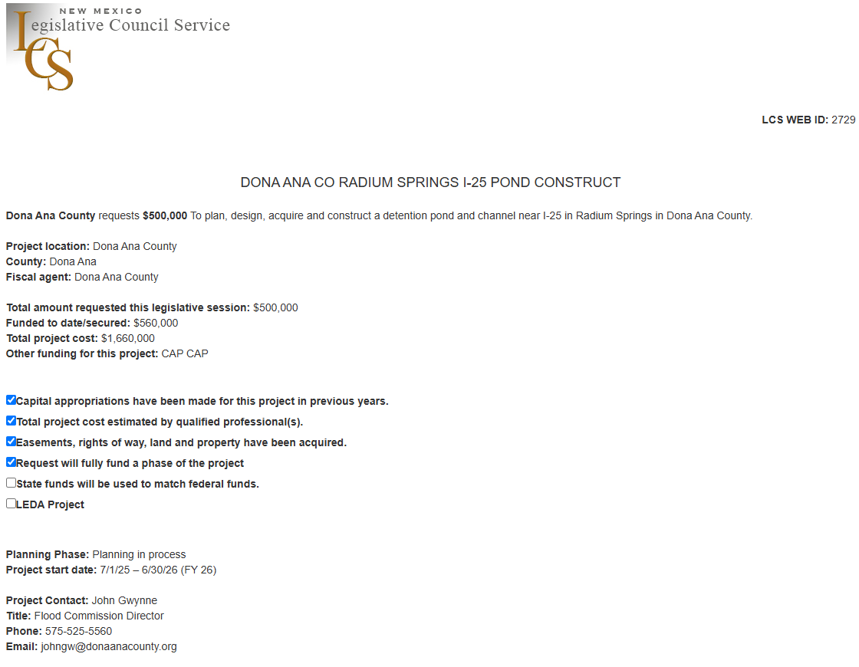
Sample LCS Summary Sheet

Slide 7
Search function: https://www.nmlegis.gov/CapitalOutlayWeb/Default

Slide 8
Capital Outlay website - https://www.nmlegis.gov/Legislation/BillFinder/Capital_Outlay

Slide 9
Search: Capital Outlay Project Requests Submitted for 2025

Slide 10
Reauthorization Request Forms:
https://www.nmlegis.gov/Publications/Capital_Outlay/Reauth%20Request%20Form%202026.pdf
Deadline for legislators to submit reauthorization request forms is:
February 1, 2026 (3:00 p.m.)
Capital outlay project appropriations from previous years can be reauthorized to:
extend the time of expenditure;
change the administering agency; or
change or expand the scope of the project.
Entities seeking to reauthorize an appropriation must complete a reauthorization request form which can be accessed and filled online. The system cannot accept reauthorization forms online. A completed paper reauthorization request form, signed by a sponsoring legislator, is required to process the request. Please submit the paper reauthorization request form to the LCS Capital Outlay Division.

Slide 11
LCS Capital Outlay Process Time Line
November 3, 2025 Capital Outlay Request Form website opens
December 12, 2025 (3:00 p.m.) Capital Outlay Request Form deadline
January 20, 2026 Legislative Session begins
February 1, 2026 (3:00 p.m.) Reauthorization Request Form deadline
February 4, 2026 Capital Outlay Request (COR) introduction deadline
February 19, 2026 (noon) Legislative Session ends

Slide 12
Thank you
Sheila Keleher
Capital Outlay Programs Coordinator
Legislative Council Service
505-986-4682
sheila.keleher@nmlegis.gov

