Slide 1
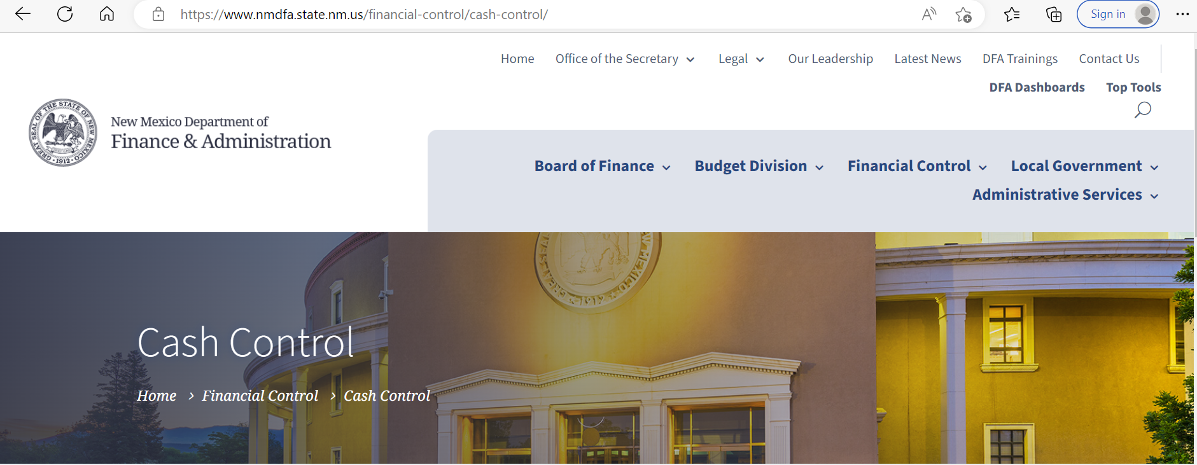
Cash Control 101

Slide 2
Cash Control 101
Department of Finance and Administration
Heather Kent – Cash Control Manager – 505-695-3784 - heather.kent@dfa.nm.gov
Jennifer Peabody - Cash Control Specialist – 505-695-3852 - jennifer.peabody@dfa.nm.gov
Terese Montoya – Cash Control Specialist - 505-695-3861 - terese.montoya@dfa.nm.gov
Assists with Deposits once they’ve been loaded into SHARE
State Treasurer's Office Contact Information
sto-cmd@state.nm.us
Assists with Deposits before the are uploaded into SHARE

Slide 3
Table of Contents
Governing Bodies Page 04
History Page 09
How SHARE works Page 11
What Accounting Should I use Page 16
How to work a Deposit Page 21
How to Manually Enter A Deposit Page 67
How to Identify and fix Deposit under Modify Accounting Entries Page 89
How to Reconcile Bank to the AR Module Page 106

Slide 4
What are Some of the Governing Statutes, Rules or Policies that Most Affect Deposits? (This is not a comprehensive list)

Slide 5
STATUTE: Section 6-10-54 NMSA 1978. Payment of state money into treasury; suspense funds. Commonly known as the “24 Hour Rule” Only the legislature can authorize an exemption to a state Statute.
State Official or Agency
EMNRD St Parks Div./DCA St Monuments Div.
County Treasurers
State Agency – Agreement / Contract
- $$$ not yet earned
Commissioner of Public Lands

Slide 6
STATUTE: Section §8-6-7 NMSA Wrongful drawing or payment of warrant by secretary or treasurer; penalty.

Slide 7
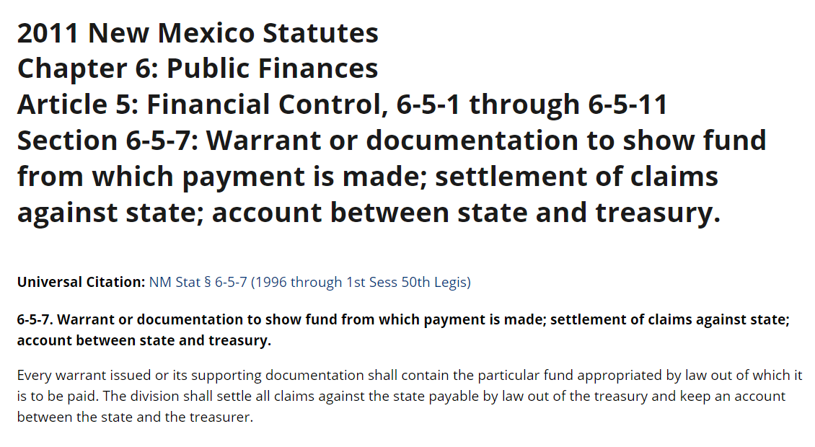

Slide 8
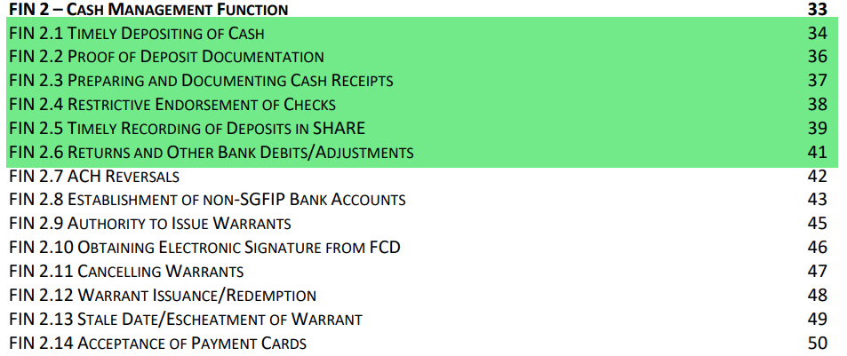
Maps FIN 2 – Cash Management Function and Maps FIN 11 - Receivables
FIN 2.1 – FIN 2.6 and Fin 11.3 relate to the collection, depositing and posting of monies collected by the State throughout the year. These rules are put in place to help ensure the State is in compliance with Statutes Section 6-10-54 and Section §8-6-7 and amongst others.
Fin 11.1 is usually used at the end of the fiscal year when you want recognize revenue in one fiscal year, but the cash is deposited in another fiscal year.

Slide 9
An Overly Simplified History of the Accounts Receivable Module
Prior to May 2006 - The State Fiscal Agent Bank was Wells Fargo Bank (WFB).
All agencies deposited their money into the Master Depository Bank account. The only way to identify which agency was the owner of the monies was for the user to match their receipts to the amount, date and deposit slip number. Agencies were expected to know which ACH transactions belonged to them and subsequently post them. Transactions, that agencies weren’t expecting, would sit unposted for weeks or even years. There was a three-way reconciliation between the Agency’s accounting system, DFA’s accounting system and STO’s accounting system.
May 2006 - The State of New Mexico awarded the state fiscal agent contract to Bank of America.
Each agency was assigned a “Sub Account”. This allowed STO and the Bank to identify which agency “owned” the money that was deposited into the master depository account. All deposits were hand entered by the agencies into SHARE. Deposits were allowed to be entered with a netted amount and if two transactions balanced to zero, they were not entered into SHARE at all. The transfers between the bank accounts were not entered in SHARE either.
July 2006 - The State of New Mexico implemented SHARE as their Statewide Accounting System.
2010 - The State of New Mexico awarded the state fiscal agent contract back to WFB.

Slide 10
An Overly Simplified History of the Accounts Receivable Module – Cont.
2012 - 2013 - Cash Remediation 1 was started and implemented. Phase 1 addressed the Accounts Receivable Module and the transactions moving monies between the various bank accounts to/from the Master Depository account.
Each agency was assigned a new bank account at Well Fargo Bank. The money is swept from the Agency bank account into the Master Depository account. To minimize the impact on agencies, the Sub accounts that were assigned to the agencies were re-directed from the Master Depository account to their new bank accounts. Each Agency’s deposit slips still have the ZBA account numbers printed on them.
Only deposits were uploaded into the Accounts Receivable module. All ACH Returns and/or bank debits needed to be entered manually.
Cash Remediation was designed and implemented with two main purposes.
1) To ensure every bank transaction was posted to a State of New Mexico general ledger and
2) To track the claims on cash balance by agency and fund once it is transferred to the Master Depository account for investment.
The claims on cash and true cash balances are held on Business Unit 39401. To accomplish this, the claims on cash lines (101800) are inferred with the affiliate and fund affiliate on the Agency GL and the BU 39401 State Treasurer’s Office (STO). No entries can be made directly to Account #101800. These actions were implemented so that the State could comply with Statute Chapter 6-5-2.1 J, NMSA 1978 and Chapter 6-5-7, among others.
2015 – 2016 - Cash Remediation 2 was started and implemented. Phase 2 addressed the recording of distributions for the third-party bank accounts and moving money between funds and Agencies through journal entries. During Cash Remediation 2, State Treasurer’s Office (STO) was also able to upload the majority of returned items.
ACH returns on the depository bank accounts that have a BAI/Statement code 469 must be manually entered.

Slide 11
How Do Deposits Work? (Day 1)
Money is collected by the agencies throughout the day. All customers receive a receipt, and the money is logged by the Agency via a system they have developed. (MAPS FIN 2.2 and 2.3)
Cash should be secured, at all times, and should be verified by two people.
When possible, money should be deposited into the Agency Depository Bank account by the close of the business day, but no later than the close of the next business day. (Statute Section 6-10-54 and MAPS FIN 2.1 and FIN 2.4)
Throughout the day, ACH transactions, Credit Card Transactions and Bank adjustments are being posted to the bank accounts.
State Fiscal Agent Bank (WFB) closes their books for the day.
Brick and Mortar Banks close their books typically at 3:00 p.m.
Electronic Deposits (i.e. desktop scanners, ACH or Credit Card transactions) close their books typically at 8:00 p.m.

Slide 12
How Do Deposits Work? (Day 2)
At 5:30am, WFB places the bank statement file into a transfer folder.
The bank statement file has all of the bank activity for the State from the day before.
Between 7:30am and 8:00am, STO starts the upload process. There are two main steps:
The Reconciliation Process - SHARE tries to reconcile all of the system generated transactions (i.e. completed deposits, redeemed warrants, ACH transactions) to the bank transactions. The Bank Account, Payment ID/Check Number, Date and Amounts must match exactly for the system to automatically reconcile the transaction.
The new bank transactions are loaded into the Accounts Receivable module in SHARE.

Slide 13
How does SHARE know “where” and “how” to handle these bank transactions?
The Bank Account Number and the BAI/Statement Codes are the two main driving factors for bank transactions.
BAI/Statement Codes are standard 3-digit codes used to identify bank statement items delivered electronically in a common format widely accepted by the majority of commercial banks. They are assigned by the bank to each transaction.
SHARE Debits/Credits are opposite of the WFB Debits/Credits
We typically describe transactions as coming into/leaving a bank account or deposited/disbursed from a Bank Account.
BAI/Statement Code less than 400 - Money coming/deposited into a Bank Account
BAI/Statement Code more than 400 - Money leaving/disbursed from Bank Account

Slide 14
How does SHARE know “where” and “how” to handle these bank transactions? – Cont.
The BAI/Statement Codes, most commonly used by the State of NM, were entered into SHARE and were assigned which SHARE Module would be used to book the SHARE entry to support the bank transaction. For example:
BAI/Statement Code 169 “Miscellaneous ACH Credit” (bank description) is money coming into a bank account (below 400), so the Accounts Receivable Module is where the SHARE accounting entry should be made.
BAI/Statement Code 475 “Check Paid” (bank description) is money leaving the bank account so the Accounts Payable Module is where the SHARE accounting entry should be made.
Where it gets tricky is when a BAI/Statement Code can be processed by two different SHARE Modules. When this happens, we assign it to the Module that should handle the majority of the transactions. For example:
BAI/Statement code 469 “Miscellaneous ACH Debit” (bank description) is money leaving the bank account. It can be an ACH we disbursed for a payment, or it can be a bank return from a deposit. Since the majority of the 469 transactions we see on our bank accounts are disbursements, we’ve told SHARE that the transaction will be booked through the Accounts Payable module. This is why you have to manually enter the 469 ACH return transactions into the Account Module.

Slide 15
How does SHARE know “where” and “how” to handle these bank transactions? – Cont.
Templates are created using the BAI/Statement codes.
These template tell SHARE which Module is booking the transaction and if the transaction should be a debit or credit to the general ledger.
Each Bank account is entered into SHARE through the Banking Module and assigned a True Cash account.
When the bank accounts are created, the appropriate templates are assigned to that bank account. This tells SHARE which bank accounts are assigned to the AR module and which True cash account should offset the accounting entry made in SHARE.

Slide 16
Determining Which Account Codes to Use

Slide 17
When determining where to post a deposit or returned item, you’ll need to ask yourself some of the following questions.
What type of deposit or returned item is this?
Was this a normal deposit in the course of my Agency's function?
Is there a budget person or manager who I can ask where the transactions should be posted?
Can I find previous deposits for the same type and mirror them?
What time of the year is it? Was a receivable or payable established in a previous year that I should relieve?
Was the money sent to my Agency by mistake or was a service rejected?
How will the money be returned to the customer?
Is this a refund from a supplier my agency paid?
When was the original payment made (current fiscal year or previous fiscal year)?
Was the Fund used to pay the original payment a reverting or a non-reverting fund?
Is the refund under $500.00?
Is the debt still owed?
Is this a returned/bounced Check a customer paid the Agency?
When was the original check deposited (the current fiscal year or previous fiscal year)?
Should I reverse the entry from the original deposit or set up a receivable?
Is this a deposit correction (at the bank or desktop scanner)?
Is the deposit correction from the bank an Agency error or a Bank error?
Will there be another bank entry corresponding this error?

Slide 18
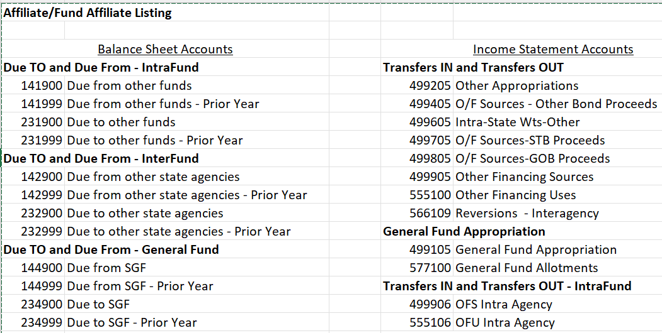
The Account Codes below require an Affiliate and a Fund Affiliate to be entered in the accounting string of the deposit. If you use one of the Account Codes below and you do not include the Affiliate and Fund Affiliate, then your deposit should error at some point.

Slide 19
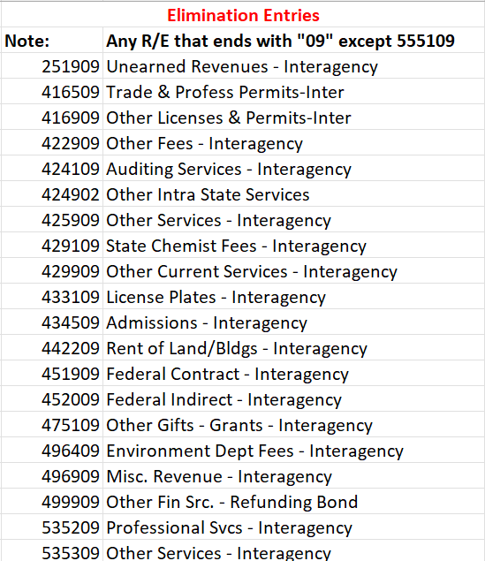
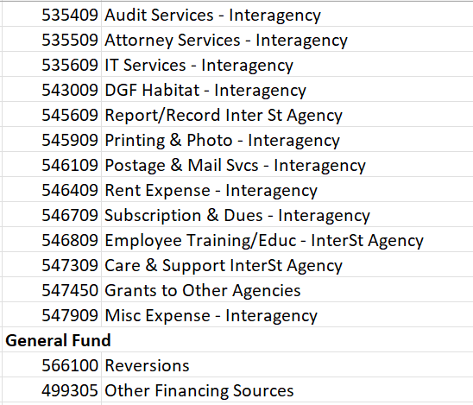
The Account Codes below require an Affiliate and a Fund Affiliate to be entered in the accounting string of the deposit. If you use one of the Account Codes below and you do not include the Affiliate and Fund Affiliate, then your deposit should error at some point. Continued.

Slide 20
An accounting string with a Revenue Code should include, at a minimum, the Fund, the Department Code, Bud Ref and Class Code. PLEASE NOTE: Your Agency could require additional fields. An accounting string with a Balance Sheet Code should have, at a minimum, the Fund. PLEASE NOTE: Your agency could require more fields, but you need to be consistent on how they are established/entered. Balance sheet codes are meant to be zero at the lowest level when all of the transactions have been posted. Make sure you are relieving the balance sheet balance EXACTLY the same way it was established.

Slide 21
How to Work and Enter Transaction in the AR Direct Journal Module through SHARE

Slide 22
There are two ways to work a deposit through the AR Module.
Direct Journal - This is where you enter the accounting string directly into the deposit. All agencies use this method.
Worksheet - This is where an invoice is created, and the deposit is applied against the invoice. Only the agencies listed below use worksheets.
** If you are not one of the agencies listed below, always use the Direct Journal instruction.
The DFA Cash Control Bureau does not have complete access to the worksheets, and we don’t have instructions on how to work deposits using worksheets. Make sure your Agency has desk manuals on how to work and problem solve your worksheets.
CYFD
DFA – Local Government
DoIT
DPS
DWS
ECECD

Slide 23
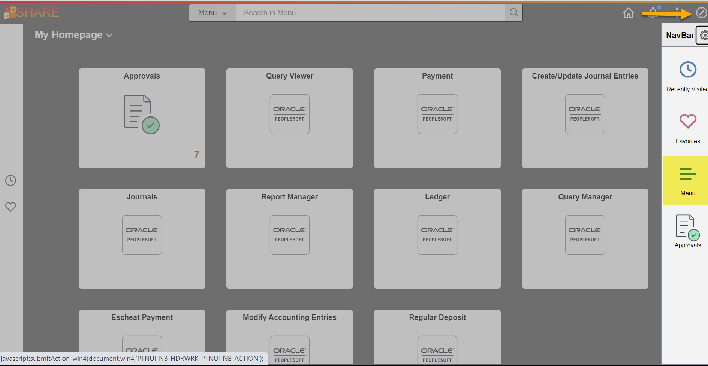
In SHARE, use the NavBar to find Menu and click on it:

Slide 24
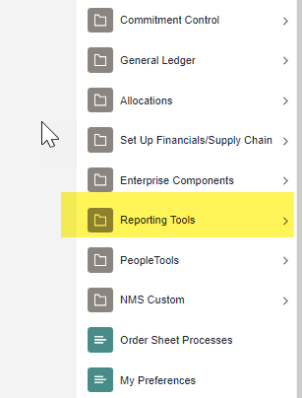
Click on Reporting Tools

Slide 25
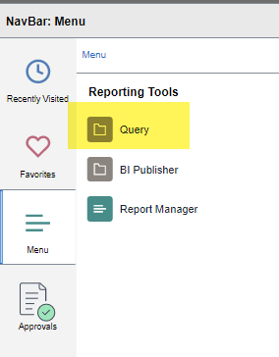
Click on Query

Slide 26
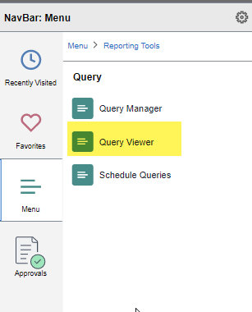
Click on Query Viewer

Slide 27
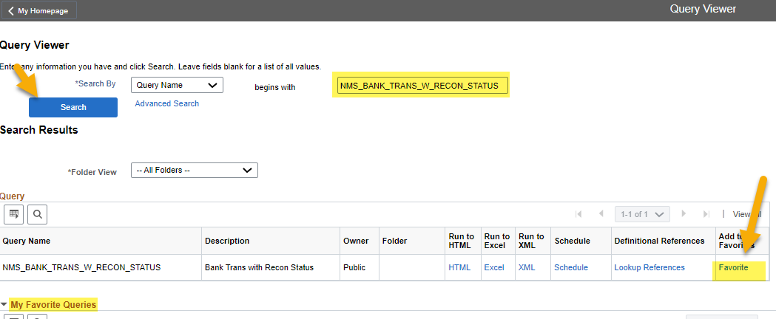
Search for query: NMS_BANK_TRANS_W_RECON_STATUS If this is the first time accessing this query, you will need to type it in the Search By box and then click the SEARCH button. Once the query comes up, then you should click “Favorite”. This will save the query below under “My Favorite Queries” This is an important query and should be ran daily.

Slide 28
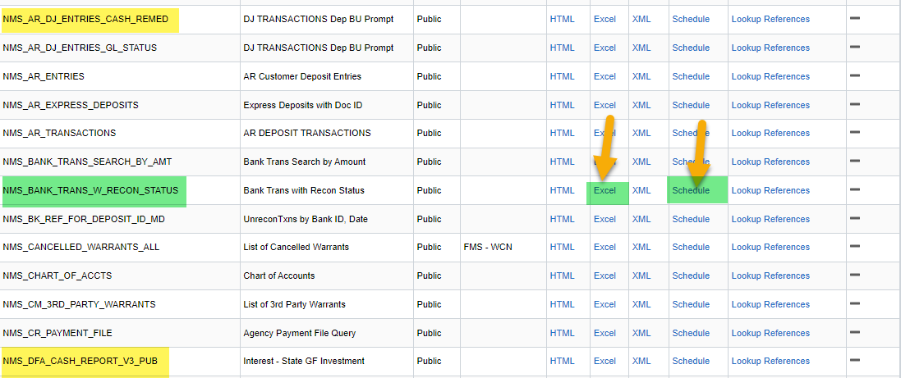
Search for query: NMS_BANK_TRANS_W_RECON_STATUS If you are running this query daily and you do not have a lot deposits, then you can click on the Excel hyperlink. If you are running this query for multiple dates and/or your Agency has a lot deposits, you should schedule the query.

Slide 29
In SHARE, use the NavBar to find Menu and click on it:

Slide 30
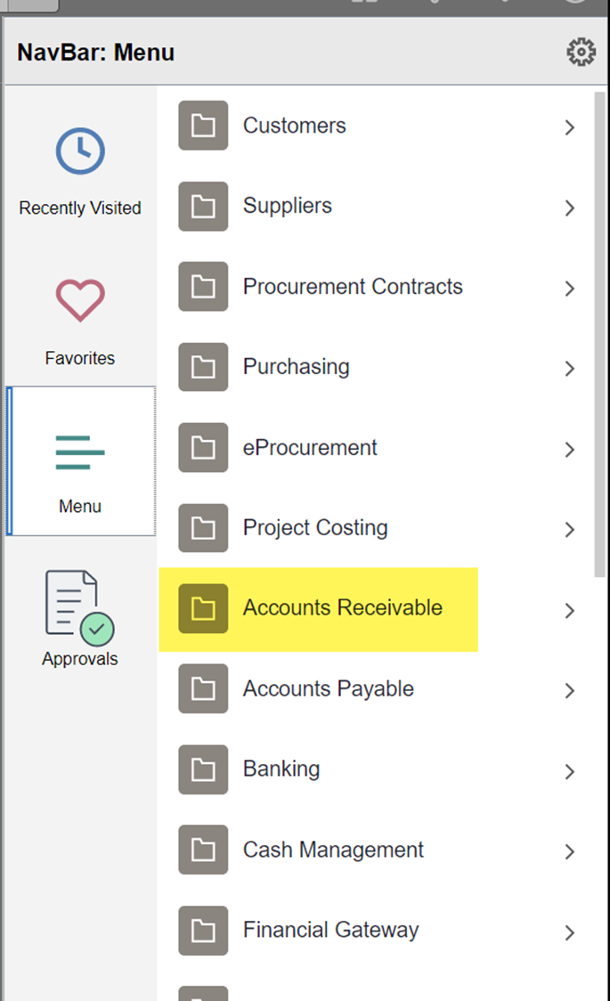
Click on Accounts Receivable

Slide 31
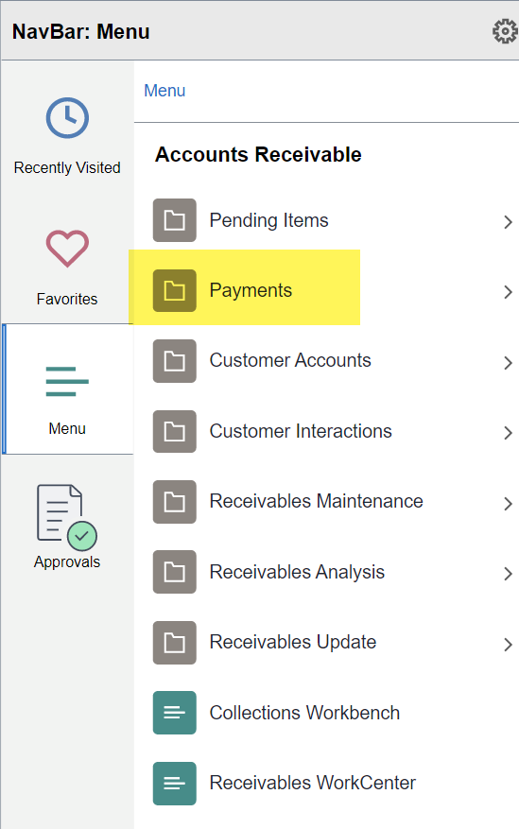
Click on Payments

Slide 32
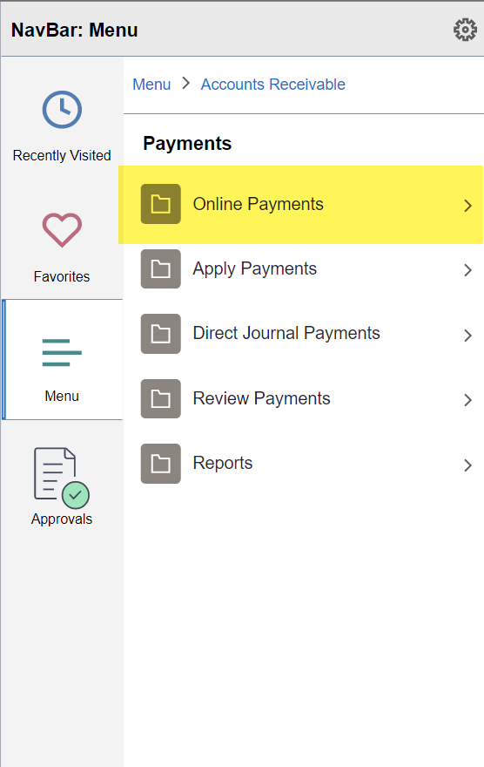
Click on Online Payments

Slide 33
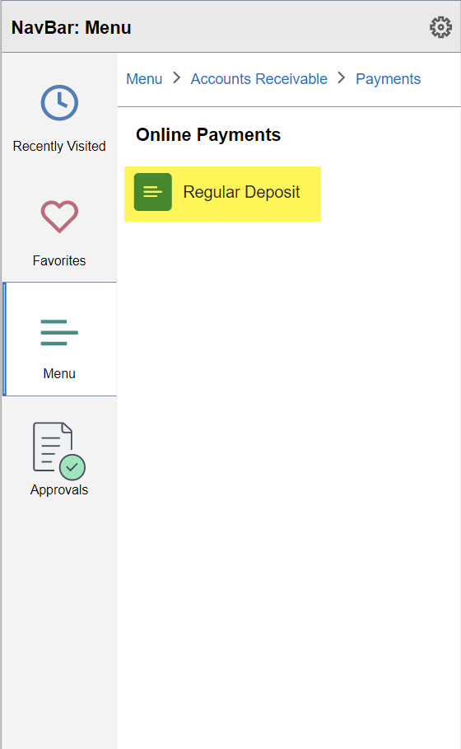
And finally… Click on Regular Deposit

Slide 34
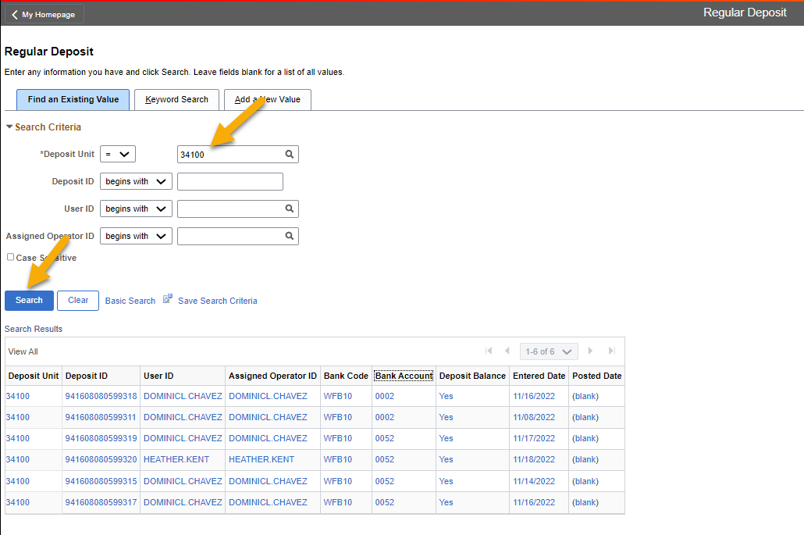
Your Deposit Unit will be your Business Unit and should automatically default. If it doesn’t default, please enter our 5-digit Business Unit. Click the Search button for a list of your outstanding deposits. If there is only one deposit to work, it will automatically open. If there is more than one outstanding deposit to work, a list will appear.

Slide 35
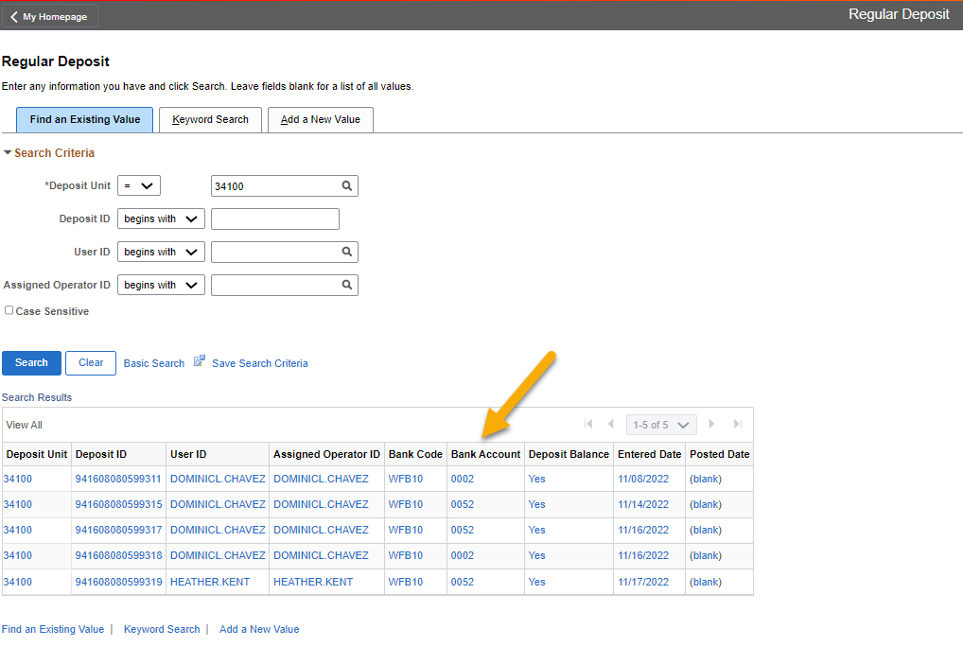
If your Agency has more than one bank account, it is important to know which bank account you are working on and what type of an account it is. PLEASE NOTE: A return on a depository account is opposite than a return on a warrant account. You can sort any of the fields by clicking on the headers.

Slide 36
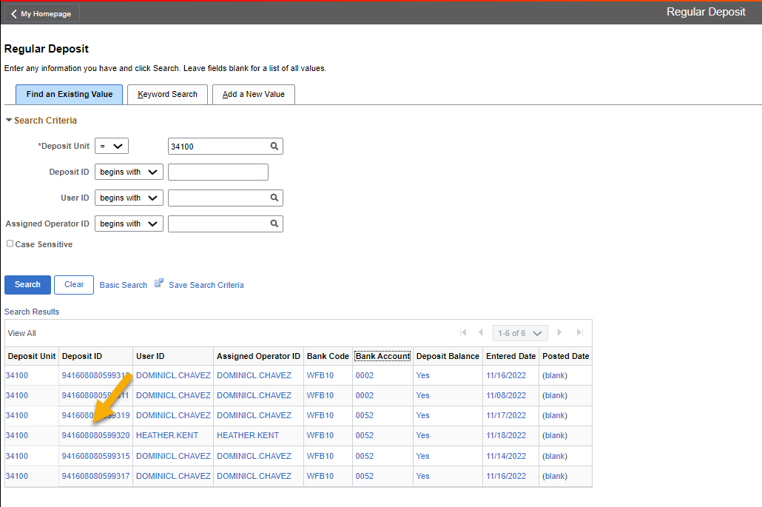
Click on the deposit you would like to work. For the purpose of this training, we will be working on a deposit for a depository bank account.

Slide 37
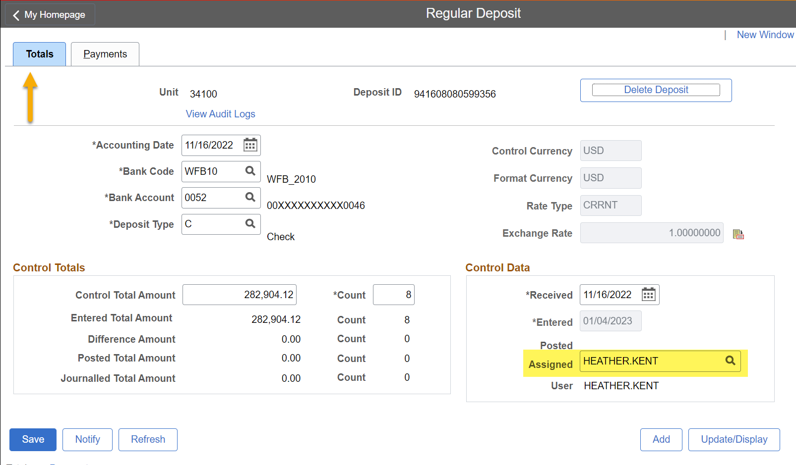
This is the REGULAR DEPOSIT SCREEN: Totals Tab. The only thing you should change on this screen is the name in the Assigned Box. You should enter your SHARE User Id. The field is case sensitive, so you have to enter your SHARE User ID using all CAPS.

Slide 38
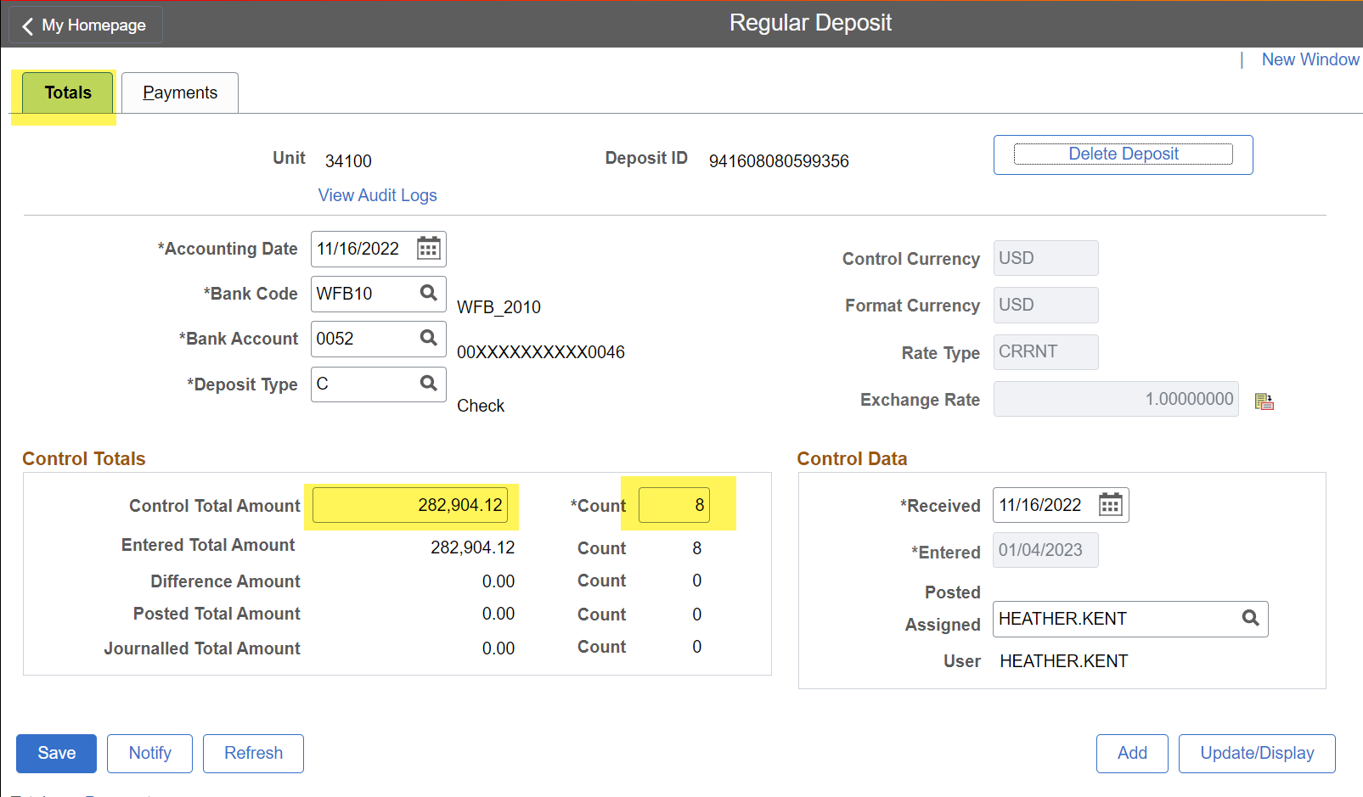
REGULAR DEPOSIT SCREEN: Totals Tab PLEASE NOTE: The Control Total Amount and the Count. You’ll need to work each piece of the deposit. (In this example, there are 8 pieces to this deposit that total $282,904.12)

Slide 39
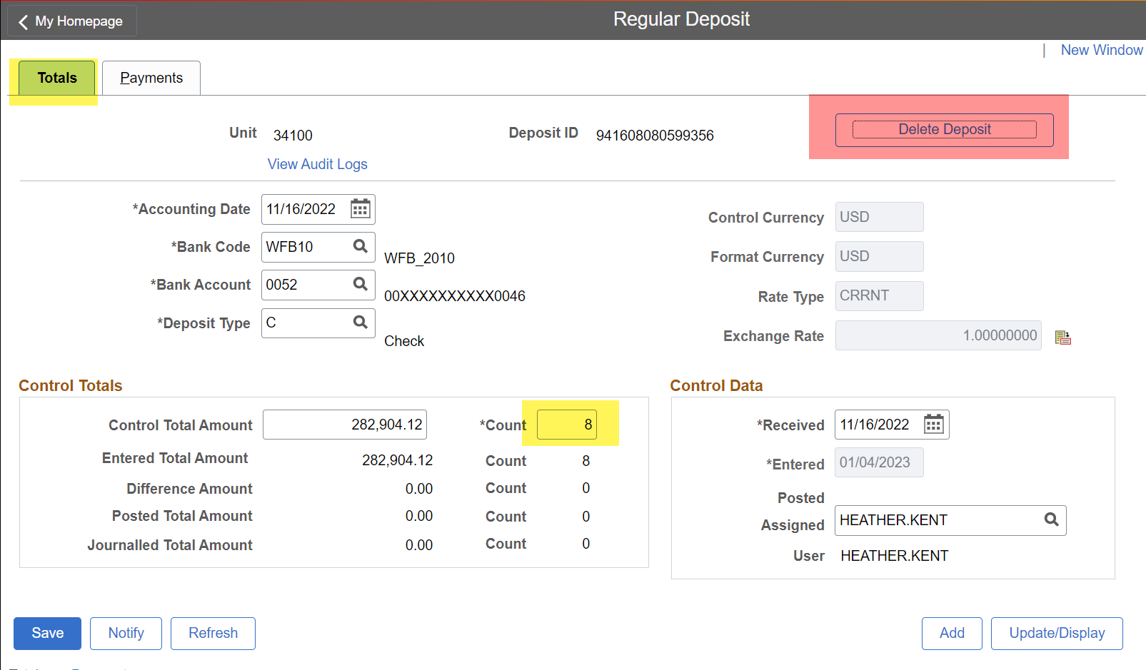
REGULAR DEPOSIT SCREEN: Totals Tab IMPORTANT: Never click the delete deposit button If you do, you will have to enter each transaction manually. There is no reload function. In this example, that means 8 deposits will need to be manually entered

Slide 40
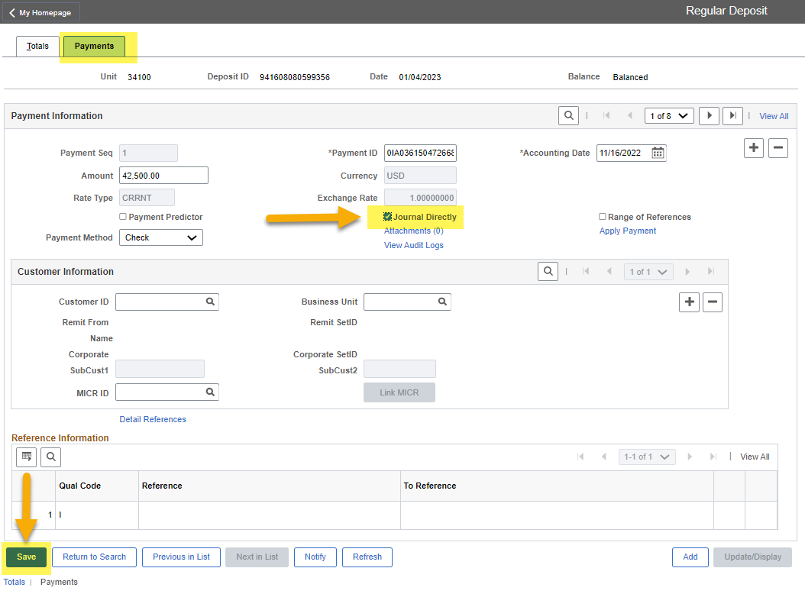
REGULAR DEPOSIT SCREEN: Payments Tab By clicking the Journal Directly box, you are telling the SHARE Accounts Receivable Module that you will be entering the accounting string manually for this deposit. You will need to do this for each Payment ID. In this example there are 8 items/deposits. Click the Save Button

Slide 41
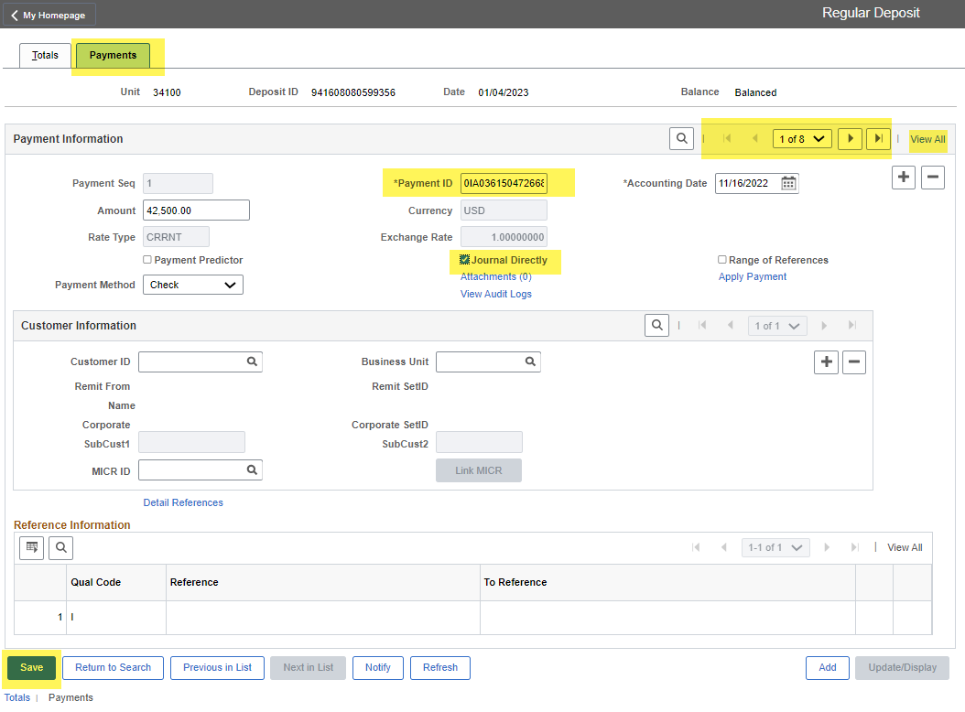
REGULAR DEPOSIT SCREEN: Payments Tab If you are NOT one of the Agencies listed below, then you will always click the Journal Directly box. These agencies use a combination of Worksheets and Direct Journals (DJs): 34100 36100 61100 63100 69000 79000 80500

Slide 42
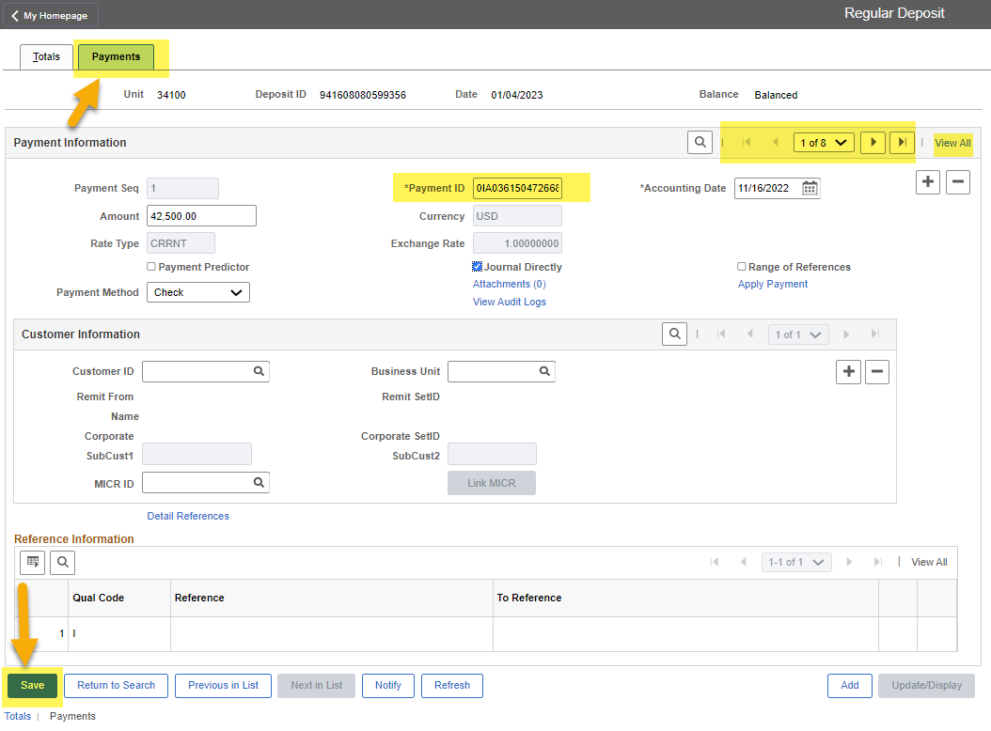
REGULAR DEPOSIT SCREEN: Payments Tab On the Totals tab, there was a count of 8 items for this deposit. You will need to work each sequence, called a Payment ID, on the Payments Tab. Again, in this example, there are 8). Use the View All option, which will list all of the Payment IDs on the screen or use the Next feature to move thru each Payment ID individually.

Slide 43
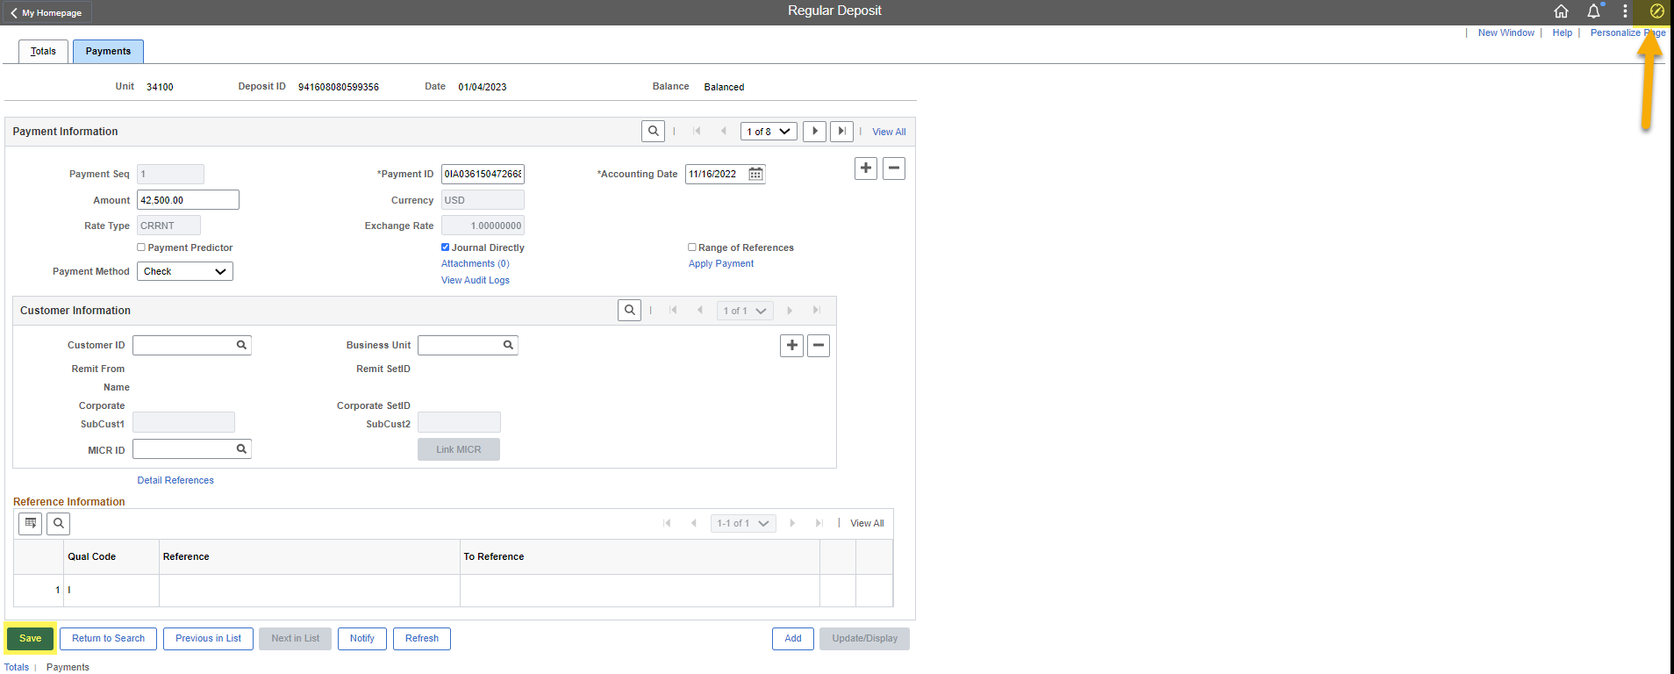
REGULAR DEPOSIT SCREEN: Payments Tab After you have clicked the Save button for the final time, you will need to click on the Navigator Icon again.

Slide 44
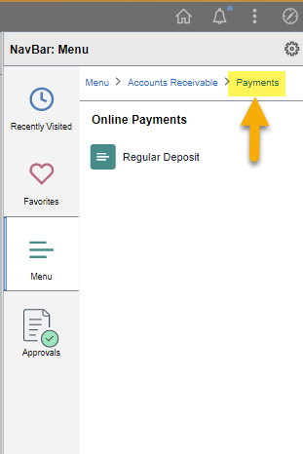
Click on the Payments hyperlink

Slide 45
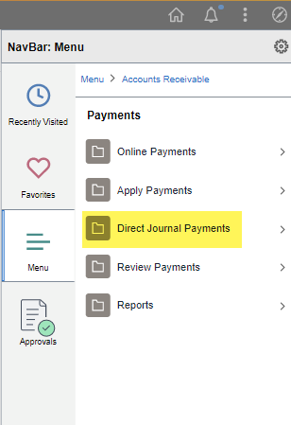
Click on Direct Journal Payments

Slide 46
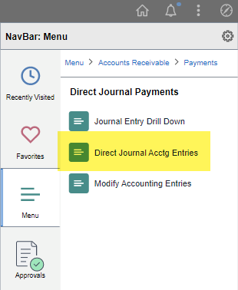
Click on Direct Journal Acctg Entries

Slide 47
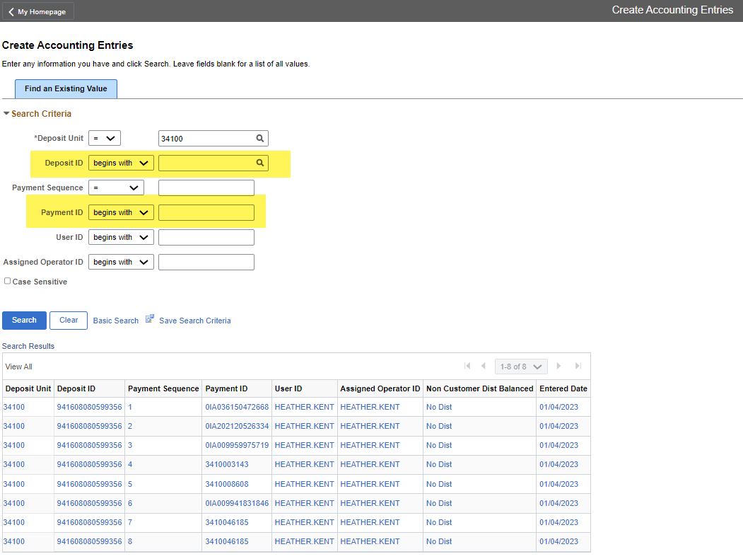
The search screen will open and your Business Unit should default. You can click the Search button to get a list of all the Payment IDs you need to work, or you can enter the Deposit ID or Payment ID to search for a specific one. Click on the Payment ID you want to work on to enter the accounting string for.

Slide 48
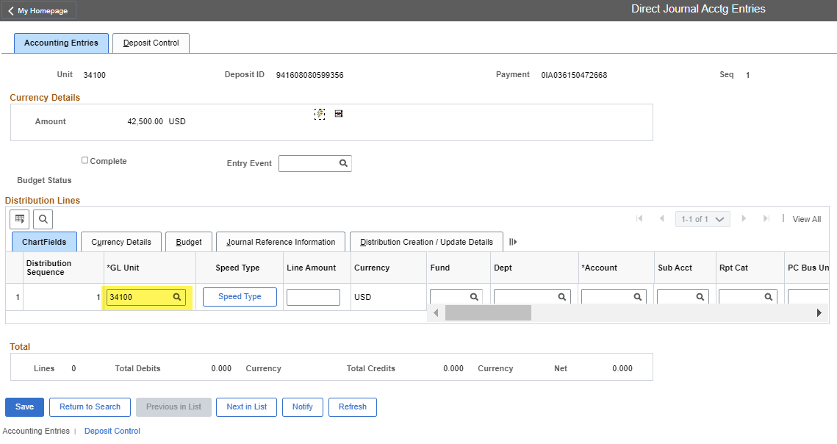
DIRECT JOURNAL ACCTG ENTRIES SCREEN: Accounting Entries Tab This is where you’ll need to enter the accounting string When this screen first opens, the GL Unit box is the only box that will be populated You’ll need to key the appropriate accounting string for your Agency IMPORTANT!! YOU SHOULD NEVER USE ACCOUNT CODE 101800 NOR YOUR TRUE CASH ACCOUNT IN AN ACCOUNTING STRING THEY WILL BE INFERRED LATER

Slide 49
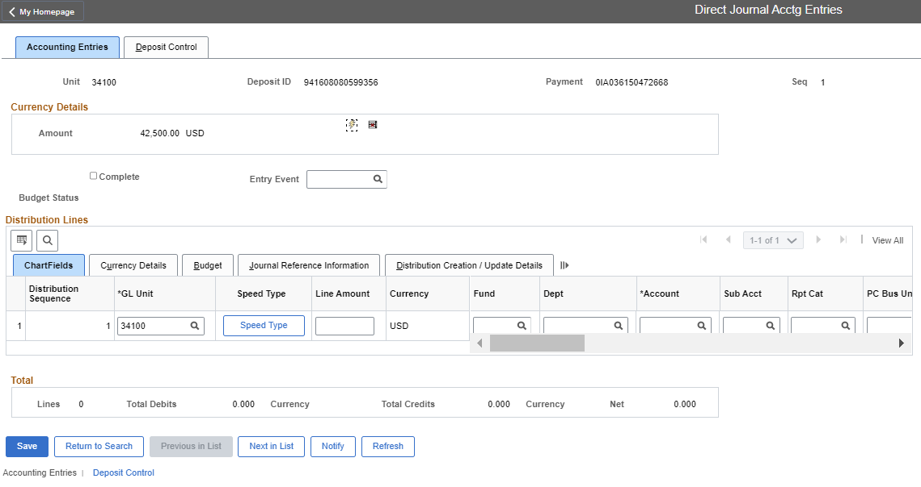
DIRECT JOURNAL ACCTG ENTRIES SCREEN: Accounting Entries Tab Remember that all revenue and expense codes need to have a Fund, Department, Bud Ref and Class code, at a minimum. Your Agency my require more fields. Balance Sheet accounts need a Fund, at the minimum. Your Agency may require more fields. Please be careful when you are crossing fiscal years. Make sure you have the correct Bud Ref and Class code and that a receivable was not set up in the previous year. Some account codes (Revenue, Expense and Balance Sheet accounts) require Affiliates and Fund Affiliates. See the next two pages for list.

Slide 50
DIRECT JOURNAL ACCTG ENTRIES SCREEN: Accounting Entries Tab You can enter the account information as the screen shows or you can click the expand button and see most of the fields.

Slide 51
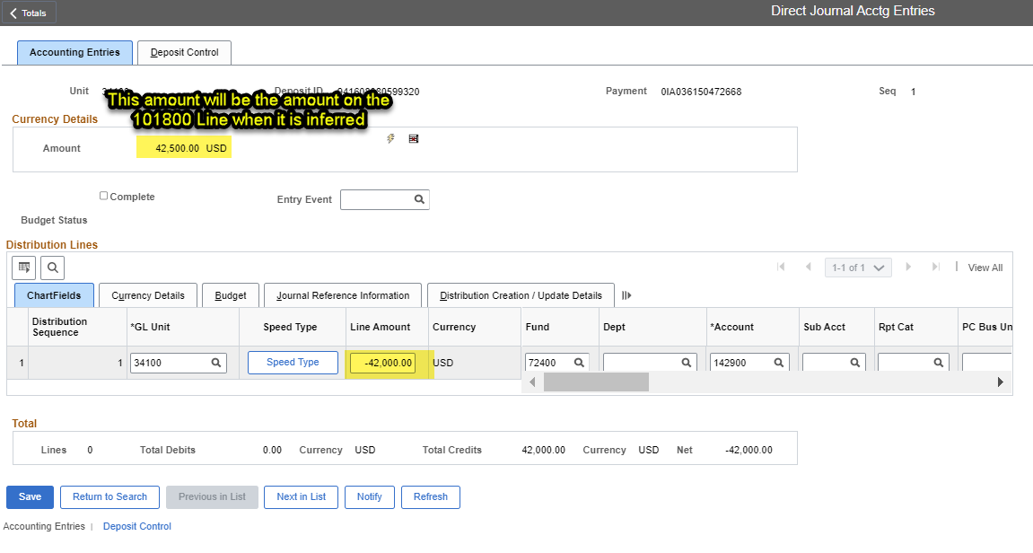
DIRECT JOURNAL ACCTG ENTRIES SCREEN: Accounting Entries Tab The amount in the Line amount column is generally going to be the opposite of the Amount in the upper left part of the screen. Since most transactions are deposits (money coming into the account) the amount is usually a Credit (Negative).

Slide 52
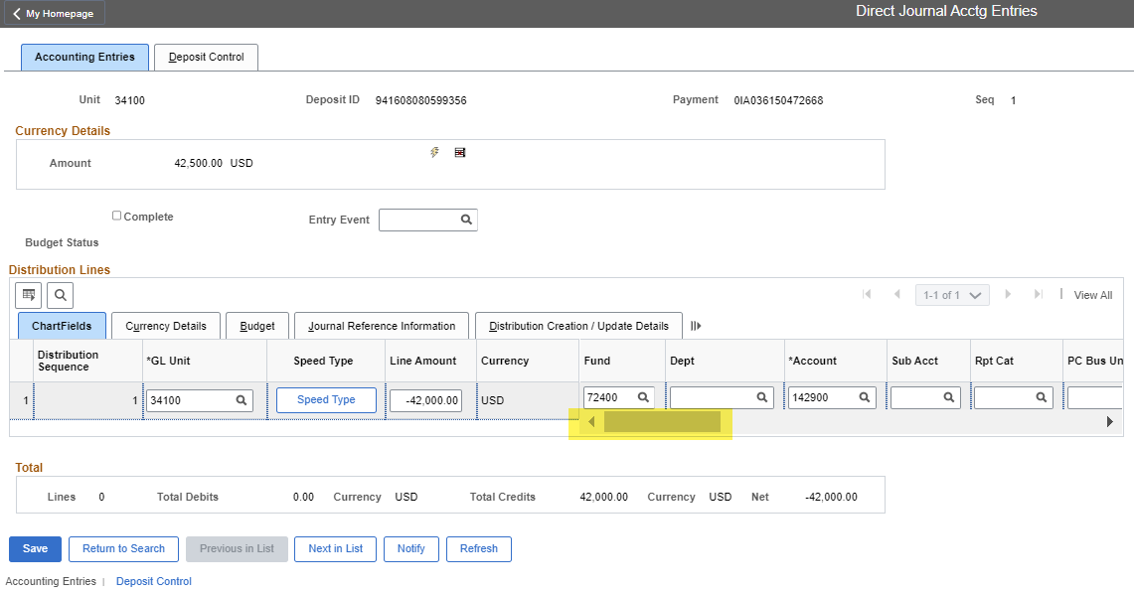
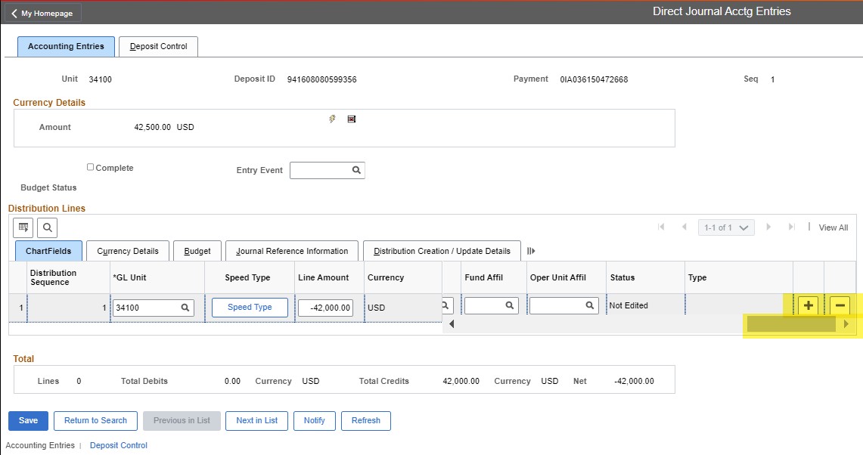
DIRECT JOURNAL ACCTG ENTRIES SCREEN: Accounting Entries Tab To Add or Delete a line to enter another accounting string, use the scroll bar or arrows to scroll all the way to the right. You will find the plus and minus buttons which will add (+) a row or subtract (-) a row.

Slide 53
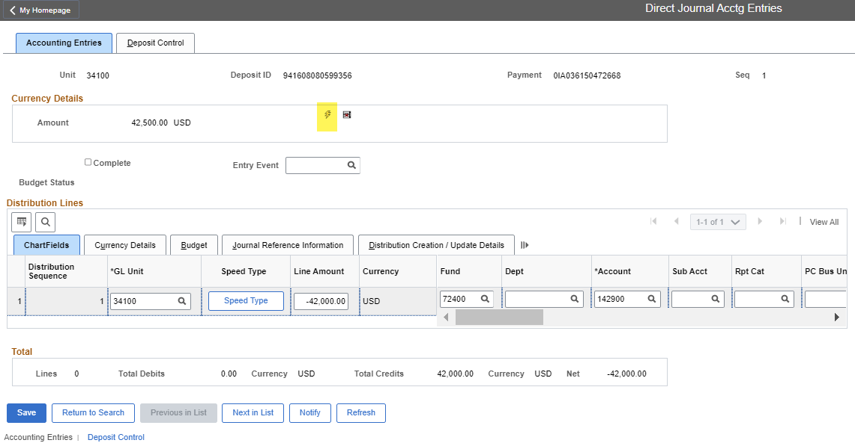
DIRECT JOURNAL ACCTG ENTRIES SCREEN: Accounting Entries Tab Once you have entered the appropriate accounting string, you will want to click on the lightening bolt. This will add the cash lines.

Slide 54
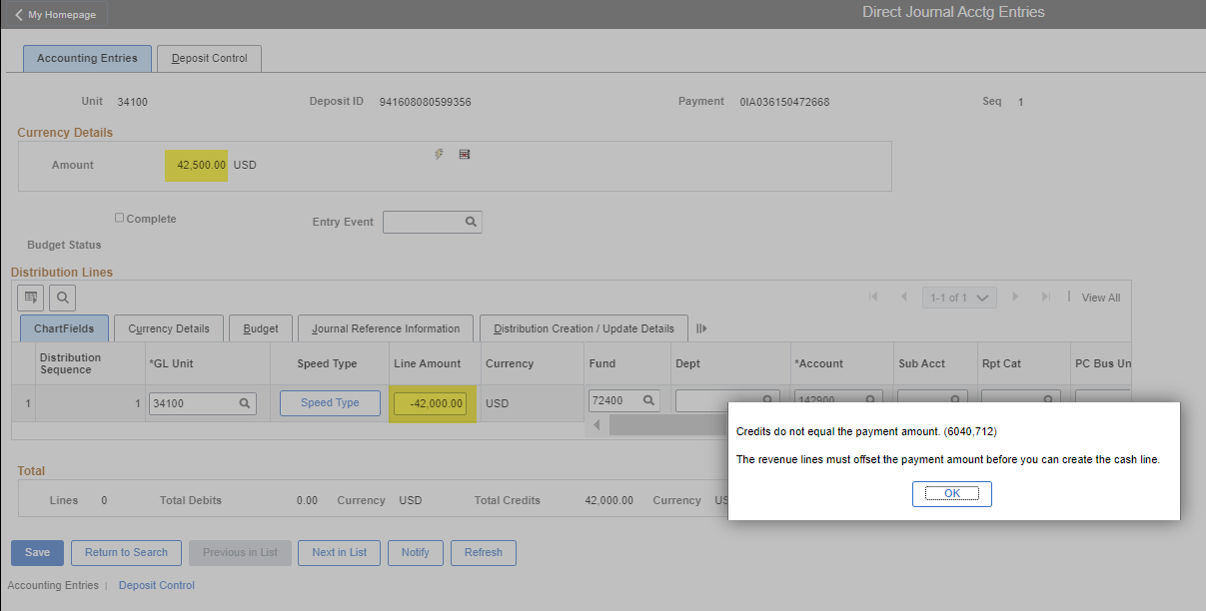
DIRECT JOURNAL ACCTG ENTRIES SCREEN: Accounting Entries Tab If the total amount of all of your accounting lines do not add up to the amount of the Amount of the Payment ID, you will get the error below. If you get this error message, you can click OK and fix the amount.

Slide 55
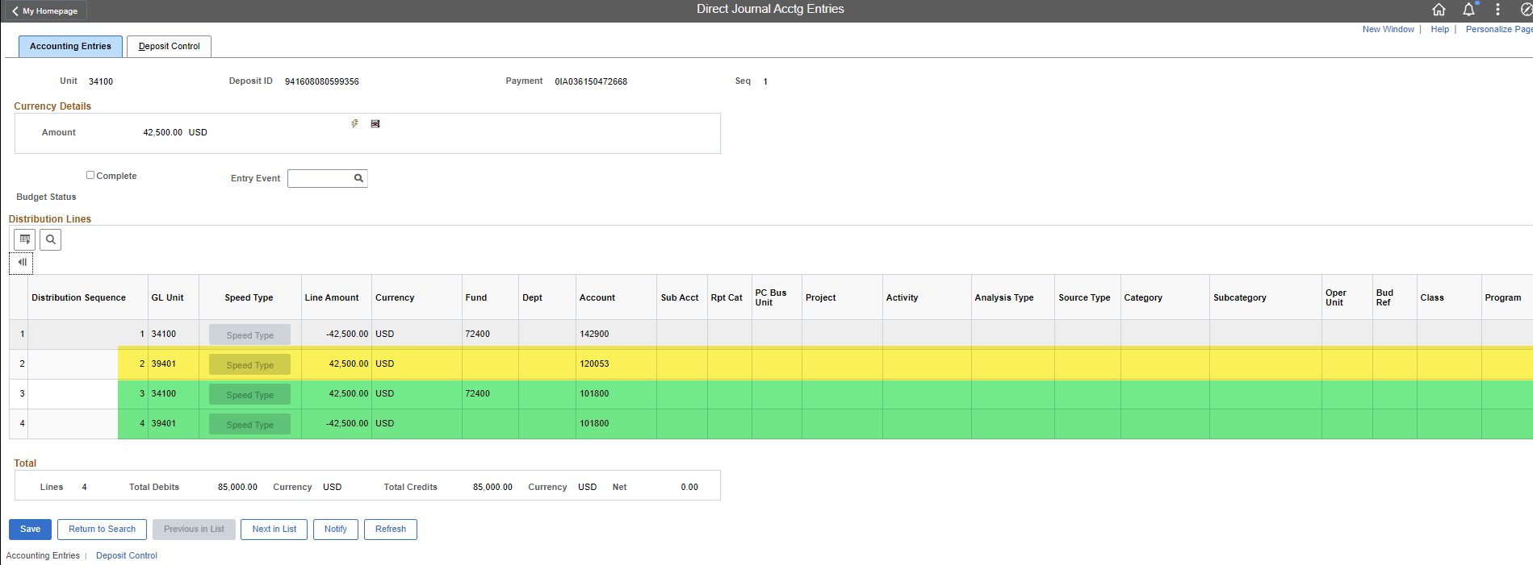
DIRECT JOURNAL ACCTG ENTRIES SCREEN: Accounting Entries Tab As you can see, the accounting line to book the “True” cash line on BU 39401 is generated to offset the revenue that was booked on the Agency’s General Ledger. Since the transaction crosses Business Units, the 101800 “Claims of Cash” lines are inferred using the Fund from the Revenue line. A minimum of three lines will be created in addition to the accounting entry the User entered, but there could be more lines depending on how many funds are used.

Slide 56
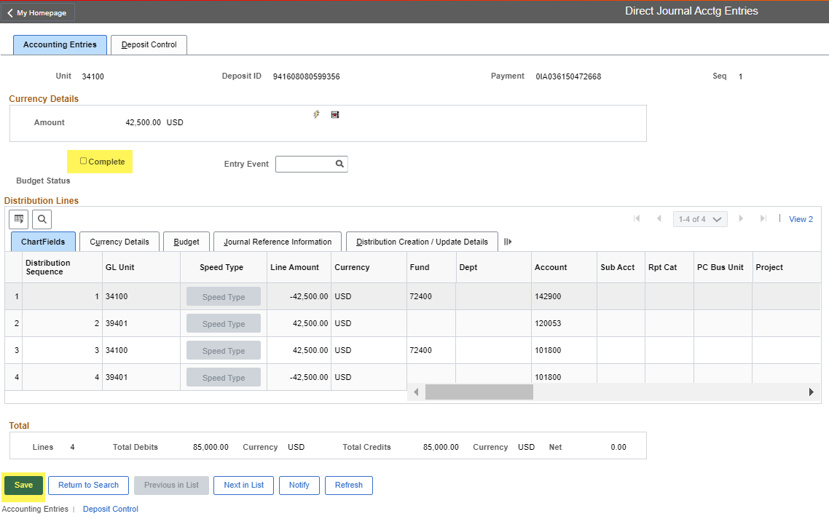
DIRECT JOURNAL ACCTG ENTRIES SCREEN: Accounting Entries Tab At this point the deposit should be reviewed by another person for accuracy. After the second person has completed their review, they should click the Complete box and click Save.

Slide 57
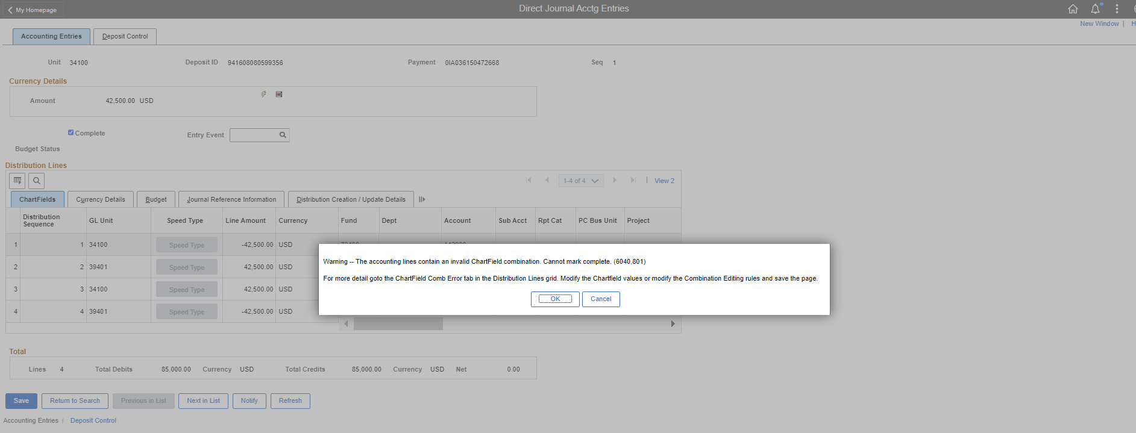
DIRECT JOURNAL ACCTG ENTRIES SCREEN: Accounting Entries Tab If this message below pops up, then there is something wrong with your accounting string. You cannot move forward until it is fixed.

Slide 58
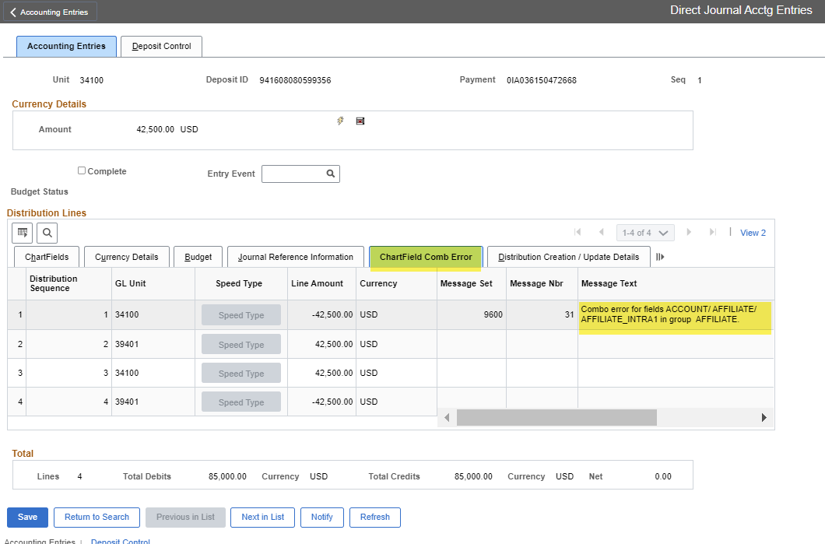
DIRECT JOURNAL ACCTG ENTRIES SCREEN: Accounting Entries Tab If you click on the ChartField Combo Error tab immediately after this error message pops up, you can view under Message Text an explanation of which line is in error and what the error is.

Slide 59
DIRECT JOURNAL ACCTG ENTRIES SCREEN: Accounting Entries Tab This error message in the Message Text box indicates that I need to add an Affiliate and/or Fund Affiliate Code.

Slide 60
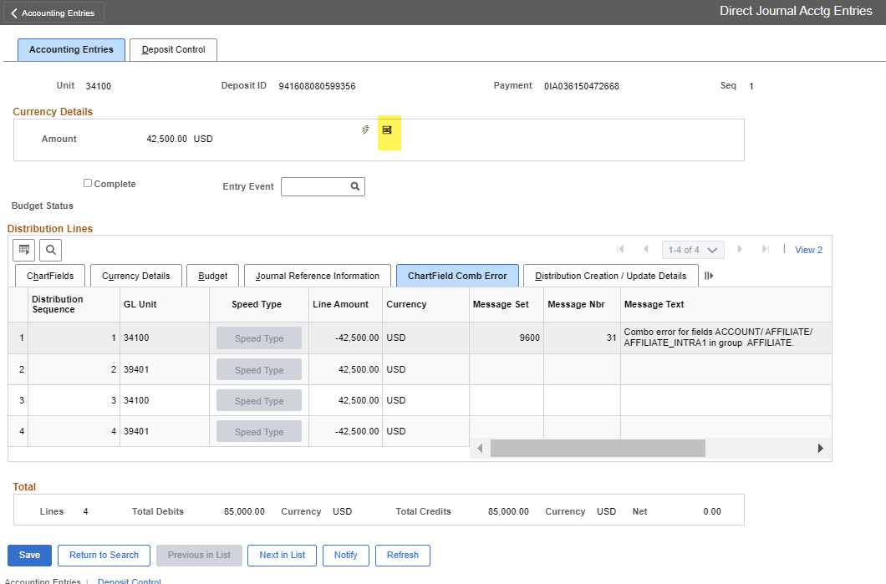
DIRECT JOURNAL ACCTG ENTRIES SCREEN: Accounting Entries Tab In order to make the corrections, you must remove the cash lines by clicking on the icon that looks like a ledger with a little red x in the middle.

Slide 61
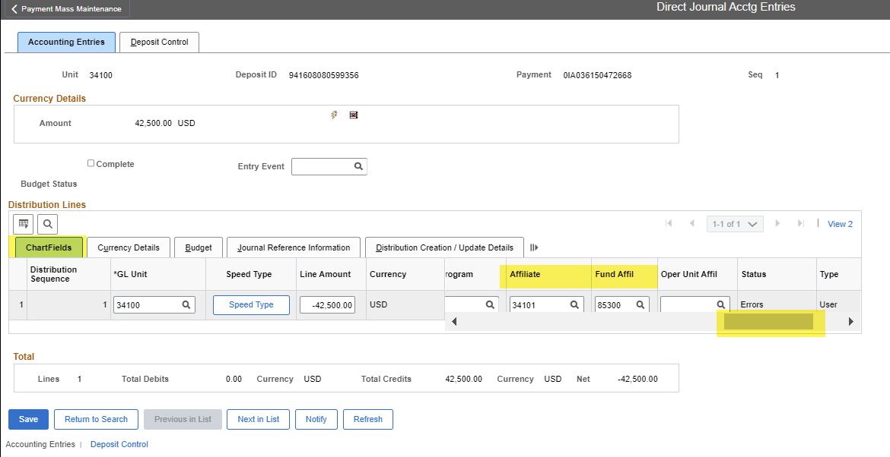
DIRECT JOURNAL ACCTG ENTRIES SCREEN: Accounting Entries Tab You’ll need to go back to the Chartfields fields and then scroll to the fields that needs to be entered. In this example, Account Code 142900 always requires an Affiliate and Fund Affiliate. The Affiliate is the Business Unit that you will be transferring the fund to you and the Fund Affiliate is the fund of the Agency you are transferring it to. You will need to contact that Agency to ensure you have their information correct and that they have your correct BU and Fund. Click Save.

Slide 62
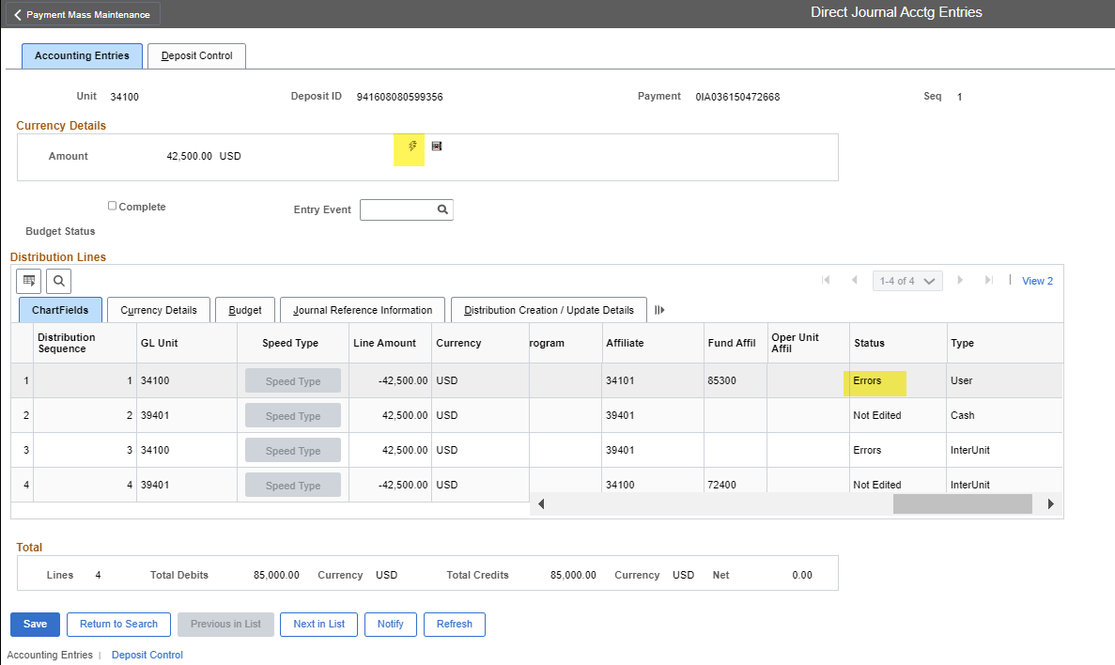
DIRECT JOURNAL ACCTG ENTRIES SCREEN: Accounting Entries Tab Click the lightning bolt to reapply the cash lines. You might see that the Status still says Errors. This will remain there until you click the Complete box and click Save.

Slide 63
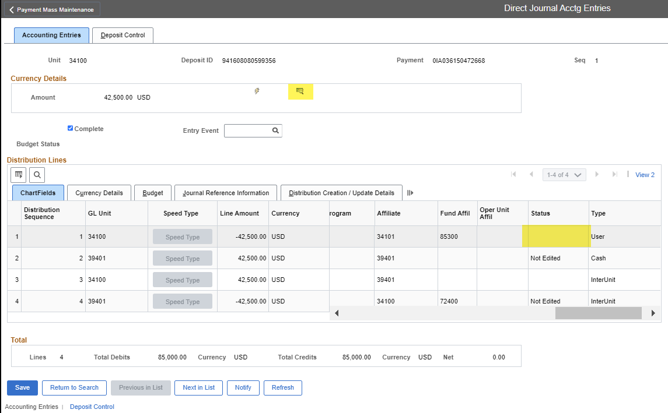
DIRECT JOURNAL ACCTG ENTRIES SCREEN: Accounting Entries Tab The Status is now blank and an icon that looks like a ledger with a magnifying glass appears. This is called the Budget Check Icon.

Slide 64
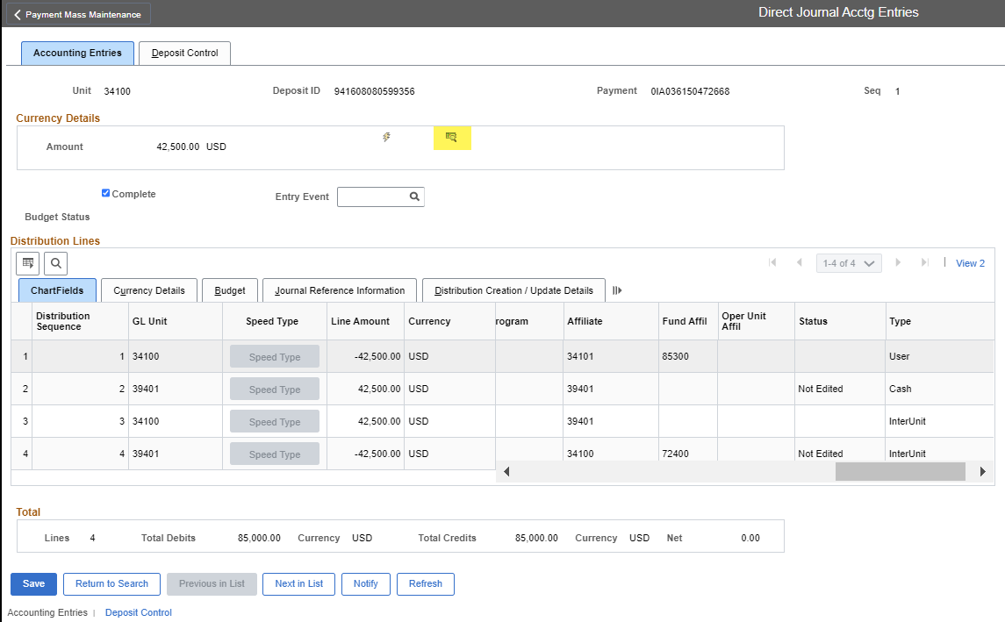
DIRECT JOURNAL ACCTG ENTRIES SCREEN: Accounting Entries Tab Give the deposit one final look. Once you have clicked the Budget Check icon, the Budget Status changes from blank to “Valid”. IMPORTANT: There is no way to go back once this is clicked.

Slide 65
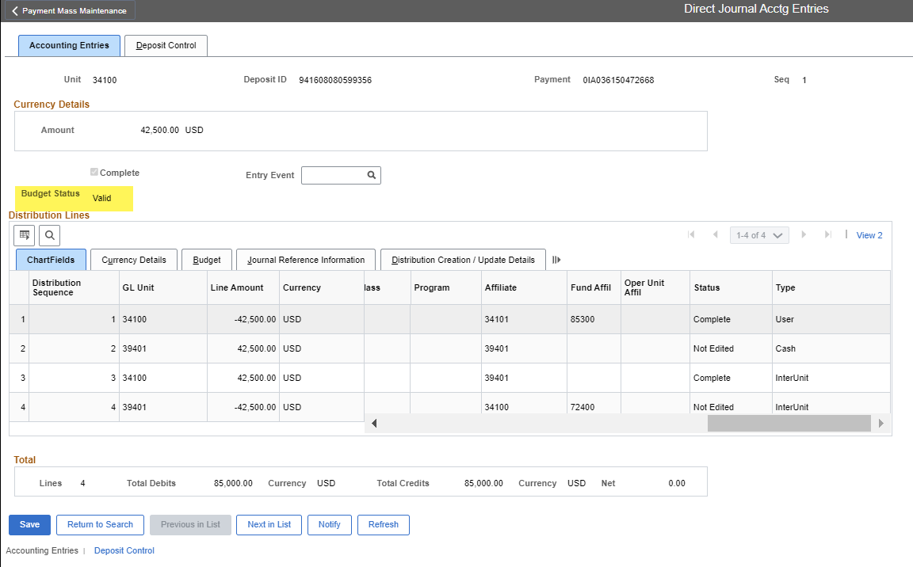
DIRECT JOURNAL ACCTG ENTRIES SCREEN: Accounting Entries Tab When the Budget Status shows Valid, you cannot make any changes to this Deposit. Once Journal Generator runs, which typically takes a day to post, you will see this posted to your GL and the JE number will start with a DJ.

Slide 66
DIRECT JOURNAL ACCTG ENTRIES SCREEN: Accounting Entries Tab If you discover that something on the accounting string is incorrect, you will have to correct the accounting string with a Journal Entry. The only time that we make a correction in the AR module is when we have to correct the True Cash account (someone used the wrong bank account), a deposit was posted in the wrong amount, or a deposit was entered in the wrong Fiscal Year (someone changed or used the wrong date). The reason we don’t make corrections in the AR module is that there is no way to edit an existing deposit once the status is Valid. You have to enter a new deposit to reverse the incorrect one and then enter another deposit to enter it correctly. This creates new entries on the reconciliation tables that won’t reconcile to the bank. STO will have to manually reconcile these transactions.

Slide 67
How to Manually Enter a Deposit into SHARE

Slide 68
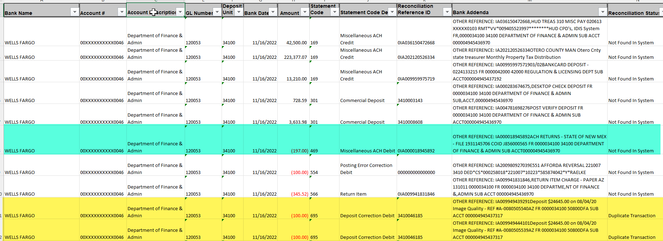
There are times when a deposit was not uploaded into SHARE and it has to be manually entered. 1) This is the case for all bank transactions that have a Bank Statement Code/ BAI Code of 469. 2) There are instances when the Reconciliation Status shows Duplicate Transaction. This means that the automatic reconciliation process is not sure whether two deposits are duplicates. Neither deposit was uploaded and they both have to be manually entered. When entering deposits manually, they should be entered as individual deposits and not entered as one deposit with multiple Payment IDs.

Slide 69
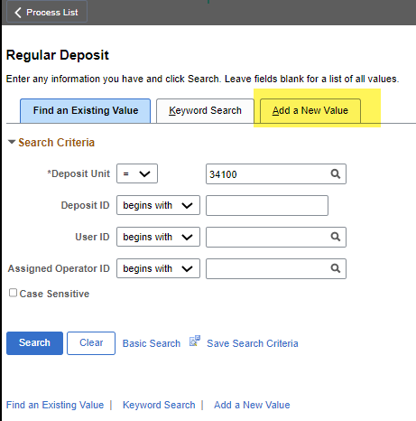
To manually enter a deposit, navigate back to the Regular Deposit screen. Click on the “Add a New Value” Tab.

Slide 70
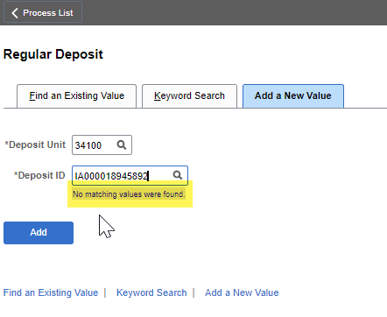
When entering the Deposit ID, you can choose what to name it. The preferred method is to use the IA number from the bank addenda or the Next function.

Slide 71
Click the Add button

Slide 72
When entering the data for the deposit, you want to get it directly from your query

Slide 73
The *Accounting Date on the Deposit MUST MATCH the Bank Date on the NMS_BANK_TRANS_W_RECON_STATUS query. This is important because this is part of the Automatic Reconciliation Criteria.

Slide 74
The *Bank Code is WFB10, which represents Wells Fargo Bank and the year of the WFB contract.

Slide 75
The *Bank Account number is your 4-digit bank account number assigned to your Agency. NOT! the last four digits of you Bank Account number.

Slide 76
If you don’t know your 4-digit Bank Account number, you can click the magnifying glass and then copy the bank account number from the query results and paste it into the Bank Account # field. Then click the “Search” button.

Slide 77
Click on the either of the Bank Account numbers to select your Bank Account. It is important that the correct Bank Account is selected because this is what infers the True Cash Account on BU 39401 line and it is part of the Automatic Reconciliation Criteria.

Slide 78
The *Deposit Type defaults to Check. You can leave it “as is” or “change” it to R for Return.

Slide 79
The Control Total Amount should be the amount of the deposit on the query and the *Count should be 1 since we are working each manual deposit individually.

Slide 80
Click the “Payments” Tab

Slide 81
Copy the number from the Reconciliation Reference ID field on your query and paste it into the *Payment ID field. This is important because this is part of the Automatic Reconciliation Criteria.

Slide 82
Ensure that the *Accounting Date matches the Bank Date from the BANK TRANS_W_RECON_STATUS query. This is the most important date. Usually, this date infers from the Accounting Date on the “Totals” tab, but if you changed the date on the “Totals” tab after you saved the deposit, the date on the “Payments” tab will not update. The *Accounting Date on the Payments tab is the date used when the deposit posted to the GL.

Slide 83
Copy the Amount of the deposit on the query and paste it in the Amount field on the deposit.

Slide 84
Click the Journal Directly box. Click Save.

Slide 85
If the deposit is entered correctly, the Control Total Amount and *Count should match the Entered Total Amount and Count. If they don’t match you cannot move forward.

Slide 86
Navigate to the Direct Journal Acctg Entries using Menu > Accounts Receivable > Payments.

Slide 87
If you came directly from the Regular Entry screen the Deposit ID is inferred. Click the Search button.

Slide 88
From this point forward, the deposit is worked like every other deposit. Since this is a return, the most challenging aspect is determining where to post the deposit.

Slide 89
How to Identify and Fix a Deposit under Modify Accounting Entries

Slide 90
One of the most common requests for help that we receive is when an Agency has worked their deposit, but they cannot see that it has posted to the General Ledger and they can no longer see the deposit in the AR module. This happens when a deposit has been completed, but the user exited the deposit before it had been budget checked.

Slide 91
When this happens, the deposit is no longer visible under Direct Journal Acctg Entries. You have to look for the deposit under Modify Accounting Entries (Menu > Accounts Receivable > Payments).

Slide 92
The problem is you have to know the Deposit ID number or the Payment ID of the missing deposit to find it. Every deposit the Agency has entered is stored under Modify Accounting Entries so you can’t just click search. When you do click search without the Deposit ID or Payment ID criteria, the system will only bring you bank the first 300 deposits.

Slide 93
Most users do not know the Deposit ID or Payment ID that is missing. To find the Deposit ID/Payment ID and to confirm if there is a budget check problem, you need to run the NMS_AR_DJ_ENTRIES_CASH_REMED query. We suggest that you run the query for the month you are working so you can see if there are any other issues. NOTE: Instructions on how to schedule a query are below under the How to Perform Month End Reconciliation.

Slide 94
When you create your pivot table, we suggest you use the set up below. We find this set up is the easiest way to identify issues and have access to the data needed to find it in SHARE. NOTE: Instructions on how to create and format a pivot table are below under the How to Perform Month End Reconciliation.

Slide 95
For simplicity’s sake, we have a pivot table that shows you the different stages a deposit can be in once the Direct Journal box has been checked. There are generally 5 stages.

Slide 96
Stage 1: If the Journal Directly box has been checked but no accounting lines have been entered yet, it will not be on this report. You can still see this deposit under the Direct Journal Acctg Entries.

Slide 97
Stage 2: The accounting entries have been entered and saved. The cash lines can either be applied or not, it WILL appear on the query, but the Journal ID, the Chartfield Combo Edit Status and the Budget Checking Header Status will be (blank) or “Not Edited”. The deposit is under Direct Journal Acctg Entries and needs to be completed and budget checked.

Slide 98
When a deposit is in Stages 1 and 2, you can see the deposit(s) under Create Accounting Entries.

Slide 99
Stage 3: The accounting entries have been entered, the cash lines have been applied and the Complete box has been checked, but the Budget Check icon was not clicked. The Chartfield Combo Edit Status will say “Complete”, but the Journal ID and the Budget Checking Header Status will be (blank).

Slide 100
Stage 3: You will not see the deposit listed under Create Accounting Entries.

Slide 101
Stage 3: You have to navigate to Modify Accounting Entries (Menu > Accounts Receivable > Payments).

Slide 102
Stage 3: Copy and paste the Deposit ID and the Payment ID in the appropriate fields to look up the deposit.

Slide 103
Stage 3: Now you can click the Budget Check Icon. The deposit will not post until this icon is clicked and the deposit is in “Valid” status.

Slide 104
Stage 4: The deposit has a Chartfield Combo Edit Status of “Complete” and the Budget Checking Header Status is “Valid”, but the Journal ID is blank. This means the deposit is sitting on the table waiting for journal generator to run. The process usually runs overnight and posts the next day.

Slide 105
Stage 5: The deposit has a Chartfield Combo Edit Status of “Complete”, the Budget Checking Header Status is “Valid”, and the Journal ID has a Journal ID that starts with DJ populated. This generally means the deposit has been posted to your general ledger.

Slide 106
How to Reconcile the Bank to the Accounts Receivable Module at Month End

Slide 107
Navigate to Query Viewer and search for the query NMS_BANK_TRANS_W_RECON_STATUS Since you are running this query for the entire month, you should schedule the query.

Slide 108
If you’ve never scheduled the NMS_BANK_TRANS_W_RECON_STATUS query, you’ll need to click the “Add a New Value” button. You must name your *Run Control ID. There can be no spaces and then click the “Add” button. I suggest copying the *Query Name from above. This way you’ll never forget which query you are scheduling. If you’ve scheduled this before and you only have one Run Control ID, just click one of the hyperlinks.

Slide 109
If this is your fist time scheduling this query, the fields will be blank. Otherwise, you’ll need to click the Update Parameters hyperlink to update the search criteria.

Slide 110
You want to enter the date range. For this purpose, it will be the first and last day of the month. The *Bank will always be WFB10 and the *Account will be the 4-digit bank account number assigned to your Agency, NOT the last four digits of your Bank Account number. Click the “OK” button

Slide 111
Click the “Apply” button

Slide 112
Click the “OK” button

Slide 113
Click the “Report Manager” hyperlink

Slide 114
“Every once in a while”, click the “Refresh” button until the report is listed. Repeatedly clicking the “Refresh” button will not make the report run faster, even if it makes you feel better. ☺

Slide 115
Click on the hyperlink of the query you just ran.

Slide 116
Click on the hyperlink again of the query you just ran.

Slide 117
Depending on the Browser you use, an Excel/CSV file should prompt you to open it somewhere on your screen. I used Chrome so my prompt appeared on the bottom of the screen.

Slide 118
Navigate back to Query Viewer and search for query NMS_AR_DJ_ENTRIES_CASH_REMED Since you are running this query for the entire month, you should schedule the query. NOTE: If you are one of the agencies listed below, you will have to run the additional queries that are highlighted in blue. BUs 34100, 36100, 61100, 63100, 69000, 79000, and 80500. These agencies use a combination of Worksheets and DJs. The NMS_AR_ENTRIES query are for grants. The NMS_AR_EXPRESS_DEPOSITS query is for express deposits. The Express Deposits query is not accurate, but there is no other accurate query at this time.

Slide 119
If you’ve never scheduled the NMS_AR_DJ_ENTRIES_CASH_REMED query, you’ll need to click the “Add a New Value” button. You must name your *Run Control ID. There can be no spaces and then click the “Add” button. I suggest copying the *Query Name from above. This way you’ll never forget which query you are scheduling. If you’ve scheduled this before and you only have one Run Control ID, just click one of the hyperlinks.

Slide 120
If this is your fist time scheduling this query the fields will be blank. Otherwise, you’ll need to click the Update Parameters hyperlink to update the search criteria.

Slide 121
You want to enter the date range. For this purpose, it will be the first and last day of the month. The *Account # will be the 15-digit masked Bank Account number. You can copy it from the NMS_BANK_TRANS_W_RECON_STATUS query you just ran. Click the “OK” button.

Slide 122
Click the “Apply” button

Slide 123
Click the “Report Manger” hyperlink

Slide 124
“Every once in a while”, click the “Refresh” button until the report is listed. Repeatedly clicking the “Refresh” button will not make the report run faster, even if it makes you feel better. ☺

Slide 125
Click on the hyperlink of the query you just ran.

Slide 126
Click on the hyperlink of the query you just ran.

Slide 127
Depending on the Browser you use, an Excel/CSV file should prompt you to open it somewhere on your screen. I used Chrome so my prompt appeared on the bottom of the screen.

Slide 128
Add a tab to one of the worksheets.

Slide 129
Copy the other query and paste it into the new worksheet. We want the data from both queries in one workbook. Re-name the new worksheet with the name of the query you just pasted there.

Slide 130
You want to create a pivot table for each query. Start by placing your cursor in cell 1 column A. You should see a box around the first cell.

Slide 131
Click on “Insert”

Slide 132
Click on “PivotTable”

Slide 133
A box will appear. If you had your curser in the first cell, Excel assumes that you meant to include the entire worksheet in your pivot table. If you look closely, there is moving box around the data that will be included in your pivot table. It’s important that every column has a Title or you will have issues with your pivot table. You only need to worry about this if you added new columns/data to the existing data.

Slide 134
Click the “OK” button

Slide 135
Click the “OK” button

Slide 136
A new tab will be created so that you can design your pivot table. The Titles of the columns from your query will be the fields you can choose from in the PivotTable Fields.

Slide 137
To create your PivotTable, you want to drag the Title name where you want the data to be presented.

Slide 138
As you drag and place the fields into the boxes, you can see where the data will be presented on the PivotTable on the left.

Slide 139
You can create your PivotTable anyway you want, but the Cash Control Bureau finds this set up works the best for the NMS_BANK_TRANS_W_RECON_STATUS query when we perform our monthly reconciliations.

Slide 140
Additionally, the filters box works best if you are only supposed to have one item for the entire pivot table, but you don’t really need the information as part of your analysis. In this example, there should only be one Bank Account. If there were more then you know you would have a problem.

Slide 141
When the pivot table is created, it defaults to subtotals on every row (highlighted in green) and column (highlighted in yellow). Additionally, the data in the rows is present vertically as opposed to horizontally with the subtotals presented at the top.

Slide 142
To make the rows present horizontally, RIGHT click anywhere in the blue area of the pivot table and a box will appear. Click on PivotTable Options.

Slide 143
Click on the Display tab.

Slide 144
Click the little box that says Classic PivotTable layout (enables dragging of fields in the grid). Click the “OK” button.

Slide 145
Note: This is the only proper way to look at pivot tables. Don’t let anyone tell you otherwise ☺

Slide 146
There are now Subtotals for each of the row values instead of one total at the top. For this reconciliation we do not need all of the subtotals, so they can be removed.

Slide 147
You can remove the subtotals manually by RIGHT clicking on the header of the row or column you want to adjust and removing the green check mark next to the Subtotal “Reconciliation Refe”. This is good if you want some of the rows and/or columns to have subtotals.

Slide 148
Notice that the subtotals for the Bank Ref ID rows are gone, but the subtotals for the Bank Date and Statement Code are still there. This method is good if you want some of the rows and/or columns to have subtotals.

Slide 149
To remove all subtotals on a pivot table at one time, click somewhere in the blue area of the pivot table.

Slide 150
A Design option will appear. Click on it.

Slide 151
Click on Subtotals

Slide 152
Click on Do Not Show Subtotals

Slide 153
All of the subtotals have been removed from the pivot table.

Slide 154
Notice how the row header/value is only be on the first row. If you want the row header/value on every row, then go back to design.

Slide 155
Click on Report Layout

Slide 156
Click on Report Layout

Slide 157
The Row Labels are now on each row

Slide 158
Collapse on the “Bank Date” field. Right Click on “Bank Date” and hover over Expand/Collapse.

Slide 159
Collapse the Bank Date field. Right Click on “Bank Date”

Slide 160
Click on Collapse Entire Field

Slide 161
The pivot table displays the data by the date. If you need to expand it, you can click on a specific date to expand. Click the “+” icon to add a new tab.

Slide 162
Schedule the NMS_AR_DJ_ENTRIES_CASH_REMED query for the month you are reconciling.

Slide 163
Copy the NMS_AR_DJ_CASH_REMED query results and paste them on the new tab in your workbook.

Slide 164
Rename the Sheet and make sure the data is configured so that you can understand it. If you can’t read the raw data, you won’t be able to read the data on the pivot table.

Slide 165
Use the tools you learned earlier to create and format a pivot table for the NMS_BANK_TRANS_W_RECON_STATUS query.

Slide 166
This is how we suggest you set up the pivot table layout, but you can adjust it to your preferences

Slide 167
Copy one pivot table and paste it next to the other. In this example, I copied the NMS_BANK_TRANS_W_RECON_STATUS pivot table and pasted next to the NMS_ AR_DJ_ENTRIES_CASH_REMED pivot table. I also used the filter to select the totals for each pivot table.

Slide 168
Create a formula to compare the total amount posted in the AR module (NMS_ AR_DJ_ENTRIES_CASH_REMED) by day to the amount posted to the bank account (NMS_BANK_TRANS_W_RECON_STATUS).

Slide 169
If there is a difference between what was worked in the AR module and what posted to the bank you will need to research what the issue is. Some issues could be: Deposit was not worked at all. Deposit was completed and not budget checked. View under Modify Accounting Entries. A Return Item was not manually worked. A Return Item was entered with the wrong date or bank account.

Slide 170
You can click on the + next to the date to expand the data in the pivot table.

Slide 171
Once you have identified the transactions, you can take the appropriate steps fix them. Once the missing transactions have been addressed, you can re-run the affected queries to ensure everything balances to Zero. NOTE: If you are an Agency that uses worksheets (see below), you will need to run additional queries to perform your reconciliation. CYFD, DFA – Local Government, DOIT, DPS, DWS, ECECD

