Slide 1

Performance measure training
June 13 & 14, 2023
Meribeth Densmore
Diego Jimenez
State Budget Division

Slide 2
Accountability in government act (AGA)
Passed into law in 1999, New Mexico’s Accountability in Government Act exchanged multiple specific categorical appropriations in the GAA for fewer categories but increased performance-based budgeting oversight.

Slide 3
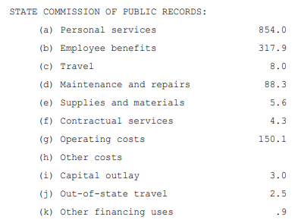
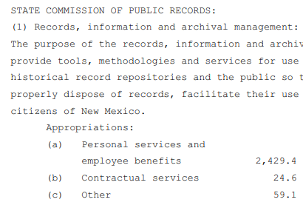
HB2 categories before and after AGA implementation
General Appropriations Act of 1996
General Appropriations Act of 2019

Slide 4
Accountability in government act
AGA Statute: Section 6-3A-2 NMSA 1978
Purpose:
  The purpose of the Accountability in Government Act is to provide for
  more cost-effective and responsive government services by
  using the state budget process and defined outputs, outcomes and
  performance measures to annually evaluate the performance
  of state government programs.
The AGA establishes the framework for performance-based budgeting:
Accountability
Evaluating performance and assessing progress
Informing the public of benefits derived from the
delivery of government services

Slide 5
6-3A-2 NMSA 1978
Findings and purpose
  The legislature finds that agencies should:
  1. be granted sufficient statutory authority and flexibility to use their resources in the best possible way in order to better serve the citizens of New Mexico through the efficient delivery of services and products and the effective administration of governmental programs;
  2. be held accountable for the services and products they deliver in accordance with clearly defined missions, goals and objectives;
  3. develop performance measures for evaluating performance and assessing progress in achieving goals and objectives, and those measures should be integrated into the planning and budgeting process and maintained on an ongoing basis;
  4. have incentives to deliver services and products in the most efficient and effective manner and, if appropriate, recommend the restructuring of ineffective programs or the elimination of unnecessary programs;
  5. have their performance in achieving desired outputs and outcomes and in efficiently operating programs measured and evaluated in an effort to improve program coordination, eliminate duplicate programs or activities and provide better information to the governor, the legislature and the public; and
  6. strive to keep the citizens of this state informed of the public benefits derived from the delivery of agency services and products and of the progress agencies are making with regard to improving performance.

Slide 6
AGA cycle dates & processes
June 15:
  DFA notifies agencies of their current approved performance measures
July 15:
  Agencies propose changes to program structure and performance measures for FY25 (done within BFM)
  Key agencies propose changes to key measures for FY24 (done outside of BFM)
August 15:
  After collaboration with LFC and the agency, DFA finalizes approval of new, changed or inactivated measures – Annual for FY25 and quarterly for FY24
  After collaboration with LFC and the agency, DFA approves changes to program structure
September 1:
  All agencies submit performance-based appropriation requests with requested targets for FY25
  Budget requests must also include the agency’s updated strategic plan for FY25
Remember: the AGA cycle over the summer is when agencies work with SBD and LFC to retain or adjust wording, change measure types, or add or inactivate measures.
Targets for measures are not entered into BFM until the Appropriation Request is due on September 1.

Slide 7
Performance measure structure
Performance measures are simply subsets of other groups of measures.
AGENCY INTERNAL MEASURES
(all agency measures)
AGA APPROVED ANNUAL MEASURES
(first subset)
KEY/QUARTERLY MEASURES
(second subset)
HB2 MEASURES
(third subset)

Slide 8
TYPES OF PERFORMANCE MEASURES
Outcome = program results
Output = amount of work done (least emphasis on these)
Efficiency = unit costs to produce or services
Quality = quality of service level
Explanatory = where agency cannot be held fully accountable, but the data is of high interest to the public.

Slide 9
Examples of performance measures
(courtesy of NMDOT)
Output:
Number of statewide lanes preserved
Outcome:
Percent of non-interstate lane miles rated fair or better
Efficiency:
Percent of invoices paid within thirty days
Explanatory:
Annual number of riders on the rail runner
Quality:
Percent of cost-over-bid amount, less gross receipts tax, on highway construction projects

Slide 10
Measures in bfm

Slide 11
Entering and updating
Measures in bfm
In BFM, you can:
Request to add or inactivate a measure
Request to change wording or measure type
Add justifications and contextual information. Remember, justification is KEY! Be sure to fill out ALL fields.
Enter targets for the upcoming fiscal year (remember this is done for the September 1 Appropriation Request deadline)

Slide 12
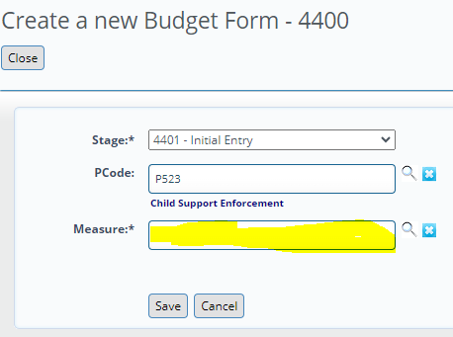
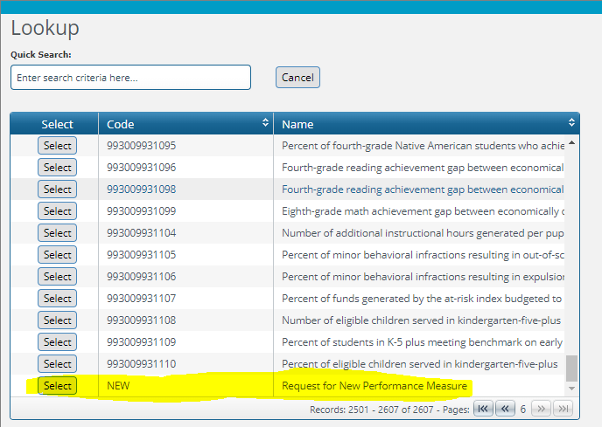
requesting changes:
4400 Form
The 4400 form is used for requests for new measures, for changes, or for inactivation for FY25 ONLY.
Changes to key measures are done on a form outside the system that agencies will return to SBD and LFC. SBD analysts will handle FY24 key measure changes in BFM.
Remember, the 4400 form is used to submit change requests. If you are not requesting any sort of change, you do not need to fill out and submit the form.

Slide 13
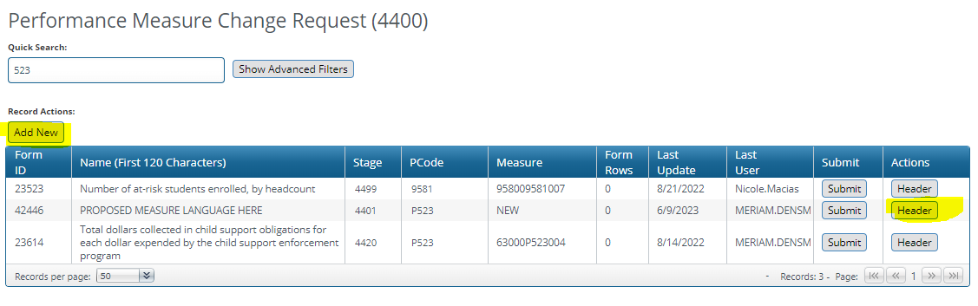

Slide 14
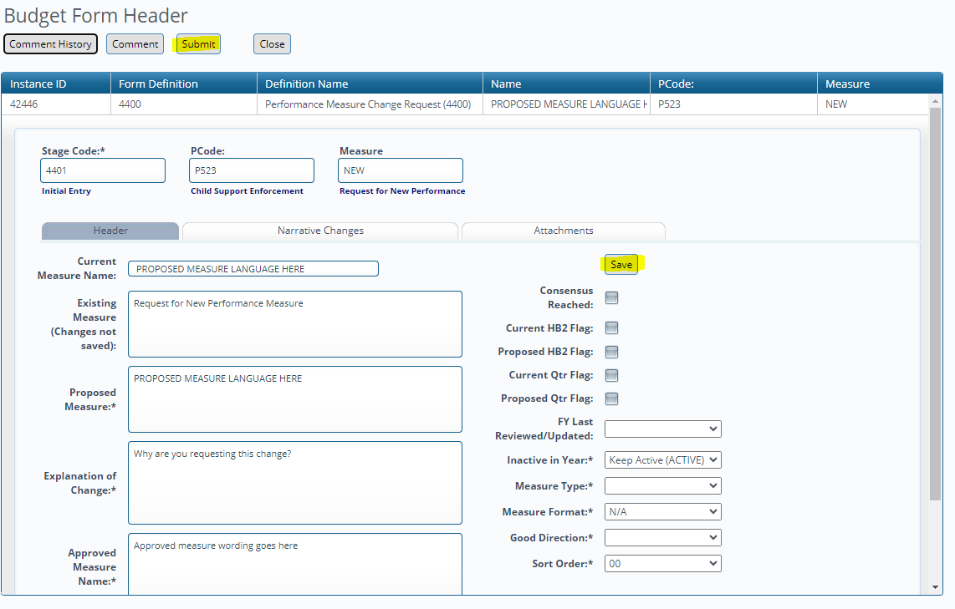

Slide 15
changing measures in bfm
Changing or creating measures
Existing measures will pre-populate.
For a new measure, click Add New to enter proposed change (should be the last option in list of measures)
Inactive Year box: Select next FY if requesting to inactivate a current measure
Measure Format: How should measure data be displayed (integer, date, percent, etc.)
Good Direction: “Over” if the target is met if the result is higher, “Under” if target is met if the result is lower
Some fields are for SBD analyst use, do not need to complete these
Can update methodology, reliability, validity, etc. on Narrative Changes tab

Slide 16
Stages for submission in bfm
4401 Initial Entry
4402 Manager Review
4403 Agency Management Changes
4404 Submit to DFA Analyst Review
If you need to create a new account or recover a password,
please contact your DFA analyst.

Slide 17
Quarterly reporting/ key agencies
6-3A-9. Quarterly reporting.
The division, in consultation with the committee, shall select agencies and specify performance measures for those agencies that shall be reported on a quarterly basis.
Quarterly reports shall compare actual performance for the report period with targeted performance and shall be filed with the division and committee within thirty days of the end of a reporting period.
History: Laws 2004, ch. 39, § 9
As mentioned previously, changes to quarterly measures are done outside BFM.

Slide 18
FY24 Quarterly reporting agencies
Code | Agency
200-280 | Judiciary (Including AOC and PDD)
333 | Taxation and Revenue Department
350 | General Services Department
419 | Economic Development Department
521 | Energy, Minerals and Natural Resources Department
550 | Office of the State Engineer
624 | Aging and Long-Term Services Department
630 | Human Services Department
631 | Workforce Solutions Department
665 | Department of Health
667 | Environment Department
690 | Children, Youth and Families Department
770 | Corrections Department
790 | Department of Public Safety
805 | Department of Transportation
924 | Public Education Department
952-977 | Higher Education Institutions

Slide 19
FY24 Semi-annual reporting agencies
Code | Agency
341 | Department of Finance and Administration
378 | State Personnel Office
950 | Higher Education Department
978-980 | Special Schools
993 | Public Schools

Slide 20

Bfm performance MEASURE reports
  Annual Performance Report
  Full Program and Measure Report
  Performance Measure Table 2 Summary
  Performance Monitoring Plan
  PB-1 Summary of Requested PM Changes (former Word document, also incorporates PB-2 for quarterly reporting agencies)

Slide 21

Questions?
Thank you,
Diego Jimenez
diego.jimenez@dfa.nm.gov
Meribeth Densmore
meribeth.densmore@dfa.nm.gov

