Slide 1

Budget Boot Camp Module 2: Budget Management Documents
Dr. Andrew Miner, DPA
Acting Director, State Budget Division
Andrew.Miner@dfa.nm.gov
(505) 819-1772

Slide 2
Module Overview
Budget Management Documents
Documents that agencies prepare and submit to SBD during the fiscal year to adjust their budget per legislative and statutory authority
  Budget Adjustment Requests (BARs)
    Types and Authority
    How to submit a complete BAR
    Appropriate backup documentation
  Budgeting Nonrecurring Appropriations
    OPBUD-4s and Allotment Forms
  Special Cases
    Reauthorizations and Companions
  Adjusting Nonrecurring Appropriations
    Budget Reallocation Forms (BRFs)
  Creating Budget Projections

Slide 3
Submission process for BARs, OPBUD-4s and BRFs
Create email submission to be sent to DFASBD.Submissions@state.nm.us
01
SBD Office Manager (or backup) will log in and route to analyst
03
Include Excel version of BAR, OPBUD-4, or BRF Form
Include all backup documentation as one PDF
Include appropriate word in email subject line to aid in filtering:
02
BAR – Budget Adjustment Request
BRF – Budget Reallocation Form
OPBUD4 – The form utilized for nonrecurring appropriations

Slide 4
SBD Review Process
Submission
01
Office Manager logs into system, gives control number
BARs – Director does initial review for appropriate use of funds and obvious issues
Initial Review
02
Analyst reviews the documents. If changes are needed, analyst will email the agency to make revisions.
Team Lead Review
03
2nd Review of the submission. If changes are required, sent back to initial review for the agency to revise.
Director Review
04
Non-federal BARs – 10 day wait for LFC passive review. Agency can request waiver.
Posting
05
Team of posters each assigned one day, do not post items that they have reviewed
Final
06
General fund allotment forms (usually sent with OPBUD-4s) are sent to FCD for processing
Final Review of the submission. Once signed by the director the 10 day wait starts.

Slide 5
Budget Adjustment Requests (BARs)
Requests by agency to adjust current-year recurring operating budget (Section 4) according to authority granted by legislature in GAA, either general to all agencies or specific to that agency
Agencies may do “internal” BARs that adjust budgets lower than the P-code level independent of DFA review. Any adjustment to a P-code level budget must be submitted to DFA.
LFC has 10-day passive review of all P-code BARs except those involving federal funds.
Note: Because they have lump-sum budget authority in the GAA (not broken out by expenditure category), Courts submit BRFs where every other agency would submit a BAR.
Types of BARs
  Budget Increase – Request to increase budget according to granted authority (never GF).
  Budget Decrease – Request to decrease budget. Rare but can happen such as to align budget with federal grant amounts.
  Category Transfer – Request to transfer budget authority from one expenditure category to another.
  Program Transfer – Request to transfer budget authority from one P-code to another. Usually limited to specific agencies and/or programs denoted in GAA. Must transfer both expenditure and revenue budget.

Slide 6


Statutory authority for BARs
BAR Statutes: 6-3-23 though 6-3-25 NMSA 1978
Special Revenue Fund Statutes
It is important to refer to language establishing special revenue funds in statutes, as this language will often dictate authority the agency has to increase the budget from this fund outside of the GAA.
“Money in the fund is appropriated to the department” = Agency has broad authority to submit increase BARs from this fund.
“Money in the fund is subject to appropriation by the legislature” = Agency does not have authority to request increases beyond those allowed specifically in the GAA.
Some funds do not have clear language. In such a case please consult your SBD analyst.

Slide 7
GAA Authority for BARs
*Note: Section labels may change slightly from year to year. Consult current authority document on SBD website.
Section 3 (I)
Allows agencies with excess revenue from board of finance loans, other acts of the legislature, gifts, grants, donations, bequests, insurance settlements, refunds or payments into revolving funds to request budget increases
General authority used for federal grant increases
Current FY BAR Authority section (2023 GAA = Section 12)
Denotes specific authority to certain agencies to request budget adjustments for remainder of current FY. In this year’s GAA, this was for the remainder of FY23 so now expired.

Slide 8
GAA Authority for BARs
*Note: Section labels may change slightly from year to year. Consult current authority document on SBD website.
Next FY BAR Authority section (2023 GAA – Laws 2023, Chapter 210, Section 13)
Establishes general authority granted to all agencies to request budget adjustments in next FY as well as specific authority granted to certain agencies
Subsection C: Authority for category transfers among PSEB, Contracts, and Other (not 500 category)
Subsection D: Authority for agencies with appropriations from Other State Funds or Transfers to request increases up to 5% of amount budgeted in Section 4.
Agencies that don’t have broad authority to request increases from special revenue funds must follow this limit
Remember that OSF and Fund Balance are grouped together under OSF in GAA
If you have both OSF and Transfers, 5% authority to limited to each source separately, not combined (cannot use Transfers budget to increase OSF & vice versa)
Subsection E: list of authority granted to certain agencies by fund, program and/or purpose
Note that blanket program transfer authority to all agencies is rare

Slide 9

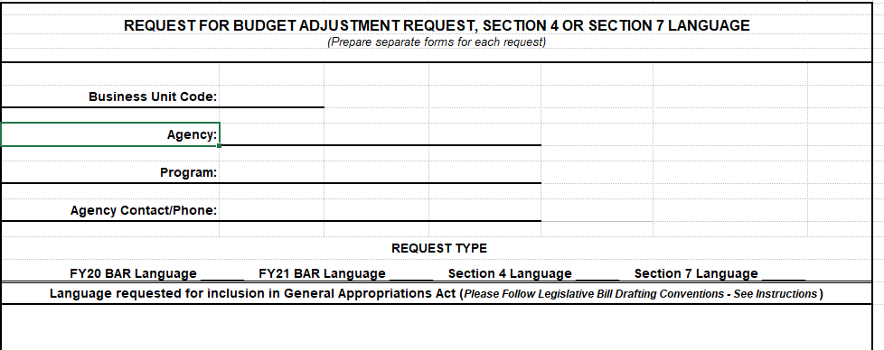
Requesting BAR Authority
DFA issues guidance to agencies in the fall for submitting BAR authority requests to be considered for inclusion in next session’s GAA
Submit language requests with short justification to both DFA and LFC (in BFM by 10/1)
DFA and LFC recommend BAR authority for inclusion, LFC drafts bill.
Note: Program transfer authority, even if specific, is difficult to get approved
Offering a maximum amount can help increase odds of language approval

Slide 10

Components of a Complete BAR
BAR Form (Excel)
Budget Journals (copies from SHARE, convert to PDF)
BAR Narrative (create in Word, convert to PDF)
Backup documentation depending on type of BAR, possibly including:
Copy of specific statutory authority (copy of general authority not needed – just citation)
Federal grant award and budget worksheet
5% worksheet
SHARE reports showing budget availability for category decrease
Budget projections
Utilize BAR Checklist on SBD’s website to ensure complete submission

Slide 11
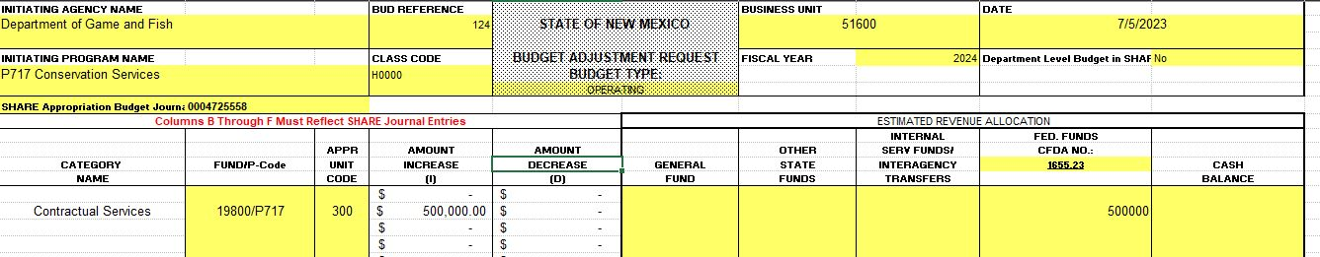
Completing the BAR Form
*note: New BAR Form to use in FY24 with drop-downs!
Complete all spaces with yellow highlighting
Initiating Org: PCode number and name
Use Budref and Class for Section 4 budget for that FY
Note proper format of Fund/Agcy/P-code entry (19800/516/P717). No 10-digit codes.
Don’t round or truncate numbers
Include positive and negative lines in transfer BARs
Only need to fill in revenue side on top right – Increase and Decrease columns will automatically populate

Slide 12
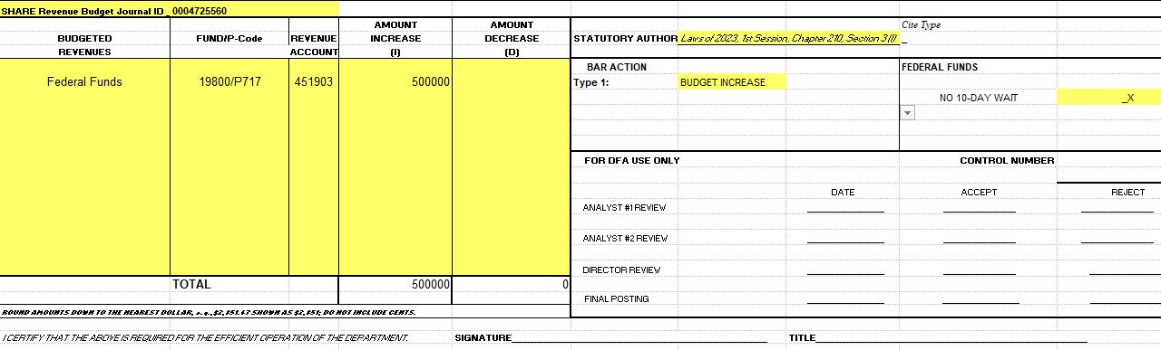
Completing the BAR Form
*note: New BAR Form to use in FY24 with drop-downs!
Be sure to include correct journal number(s)
Include appropriate statutory authority from GAA, statutes, etc
Complete revenue section which should tie to revenue above, include 6 digit code. Use correct equity code for fund balance BAR.
Mark type of BAR and check “No 10 Day Wait” box if BAR utilizes exclusively federal funds.
Ensure CFO or designee has signed form

Slide 13


Completing the BAR Narrative
Use correct narrative for type of BAR: Budget Increase, Budget Decrease, or Category Transfer (can be adapted for program transfers)
Narrative justification of why BAR is necessary – complete thoroughly and accurately. Be specific about what funds are being used for.
Especially important for category transfers such as requests to move budget out of 200 category
Keep in mind that the Budget Director reviews BARs for appropriateness and the LFC will review later and may have questions
Make sure information provided on narrative matches that on form, backup documents, etc.
Examples of completed BARs with narratives will be posted on Boot Camp Training website

Slide 14
Completing the BAR Journals
Budget Entry Type: BARs are always Adjustments, even if setting up a “new” budget for a federal grant
Entry Type is always BAR. Use budref (124) and class code (H0000) consistent with that FY’s Section 4 operating budget
Ensure that budget increases and decreases have a REVENUE and APROP_P journal
Ensure that a transfer BAR is created as a Budget Transfer journal
Ensure that journals have been approved at all agency levels to be routed to DFA
Department-level decrease journals for transfer BARs
  Cannot be done as a transfer – must be done separately (first decrease, then increase)
  Create and post department level decrease journal (Entry Type = AGY) before submitting BAR to DFA, include copy of posted journal in backup
  After DFA posts BAR, create and post department level increase journal (otherwise it will error out – child exceeds parent budget)

Slide 15

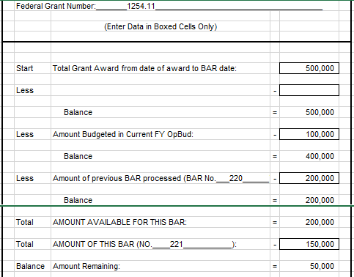
Backup for Federal Increase BARs
Copy of grant award that details available funding amount and period of award
Completed grant recon sheet showing any previous established budget and this BAR
May consolidate more than one award into one BAR but need recons for each

Slide 16
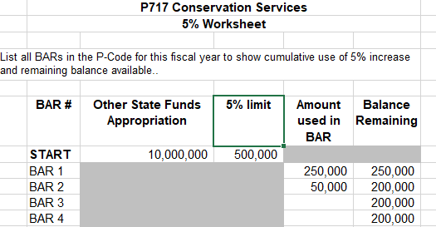
Backup for Other Increase BARs
Special revenue fund statutes detailing authority to increase (if applicable to that fund)
Copy of fund trial balance report showing available fund balance and correct equity code as well as fund balance reconciliation sheet
Copy of MOU or similar document if receiving funds from other entity
Completed 5% worksheet if using that authority to increase

Slide 17
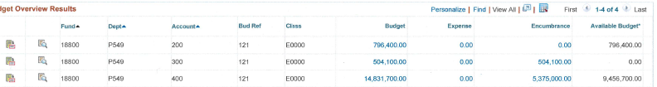
Backup for Transfer BARS
Up-to-date budget projections for P-code showing need for BAR
Copy of posted department-level decrease journal (if your agency budgets at dept level)
Copy of SHARE budget status report showing sufficient budget in requested category to decrease

Slide 18
Guidelines for BAR consolidation
  Each BAR may only contain actions of one type: Budget Increase, Budget Decrease, Category Transfer, or Program Transfer.
  Multiple actions of the same type may be included on the same BAR, including from different funds and program codes. Each specific action on the BAR must be allowed by appropriate statutory authority.
  Every BAR involving exclusively federal funds and thus exempt from the LFC’s ten-day review period must be separated from BARs of other revenue types. Multiple federal actions (of the same type) may be included on the same BAR.
  BARs with multiple actions may combine them on SHARE journals. For example, a category transfer BAR with 5 actions need only have one category transfer journal. A federal increase BAR with 5 grants may combine them on one revenue and one appropriation journal.
  Each action on a BAR must be clearly identified and justified on the BAR narrative. Appropriate backup documentation must also be provided for each.

Slide 19
BAR 10-Day Waiver Process
Complete BAR as normal – do not check “No 10 day wait” box on BAR form
01
Submit BAR to SBD, obtain 10 Day Waiver Form from Office Manager
02
SBD will review BAR as normal and when complete will submit to LFC
03
Office Manager will notify agency BAR review is complete, agency submits waiver form to LFC waiver form must be signed by Director or Deputy Director
04
Be prepared to answer questions from LFC regarding need for waiver
05
If LFC approves waiver, SBD will post BAR
06

Slide 20
Budgeting Non-Recurring Appropriations: OPBUD-4
Most commonly budgeting items from Sections 5, 6, and 7 of GAA. Occasionally other legislation such as junior budget bills. Not subject to 10-day review by LFC.
Lump-sum: Agencies have authority to establish budget in different expenditure categories as needed, according to fulfilling the purpose of the appropriation.
  Exception: May not establish budget in 500 category unless specifically directed by appropriation
Table of Budget Codes
  Produced by SBD after every legislative session, posted on SBD website
  Establishes Z-codes, class codes, and budrefs for all nonrecurring appropriations in GAA and other legislation. Consult and include copy of relevant line when submitting OPBUD-4s

Slide 21

Components of a Complete OPBUD-4
Complete, signed OPBUD-4 Form (Excel)
Budget Journals – REVENUE and APROP_P
Budget Entry Type: Original (establishing new appropriation budget)
Entry Type: OPBUD-4
Copy of appropriation line from Table of Budget Codes
Backup dependent on type of appropriation:
Complete, signed allotment form if appropriation is from general fund, computer systems enhancement fund (Section 7), or tobacco settlement fund
Copy of PCC certification letter if budgeting Section 7 IT appropriation, with certified amount matching what is being budgeted
Trial balance report if appropriation is from fund balance
Documentation that any contingencies in the appropriation have been met

Slide 22
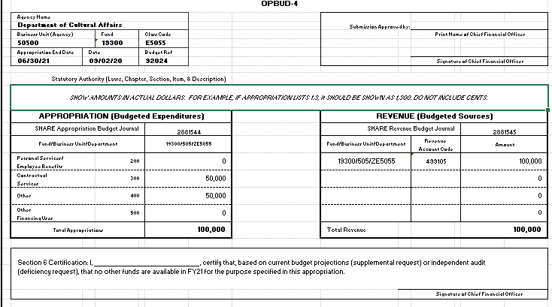
Completing the OPBUD-4 form

Slide 23
Completing the OPBUD-4 form
Use corresponding info from Table of Budget Codes, including statutory citation
CFO/designee should always sign top right section
Set up expenditure category budget as desired to fulfill purpose of appropriation
Use correct 6-digit revenue code (499105 for General Fund)
Be sure to include both journal numbers
Section 6 Certification: Only complete if appropriation is from Section 6 of the GAA, denoting an appropriation to fill a budget shortfall in the current or previous fiscal year
Ensure all info on the budget journals matches the OPBUD-4 form

Slide 24

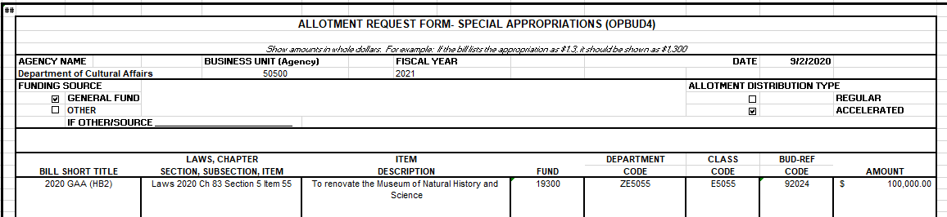
Completing the Allotment Form
Funding Source: If not GF, specify Computer Systems Enhancement Fund or Tobacco Settlement Fund
Allotment Distribution Type: Accelerated (get all money at once)
Otherwise use same info from bill and OPBUD-4 Form

Slide 25
Special Appropriation Reauthorizations
If a nonrecurring appropriation is not spent entirely by its original end date, an agency can request an extension, typically granted for one additional fiscal year.
Budgeted via normal OPBUD-4 process after original budget period is over
Use same Z-code as original appropriation but new class code and budref per the Table of Budget Codes
Budget must be for remaining balance of appropriation – include SHARE report showing balance as of last day (6/30) of original period
Do not include allotment form – money was already sent

Slide 26
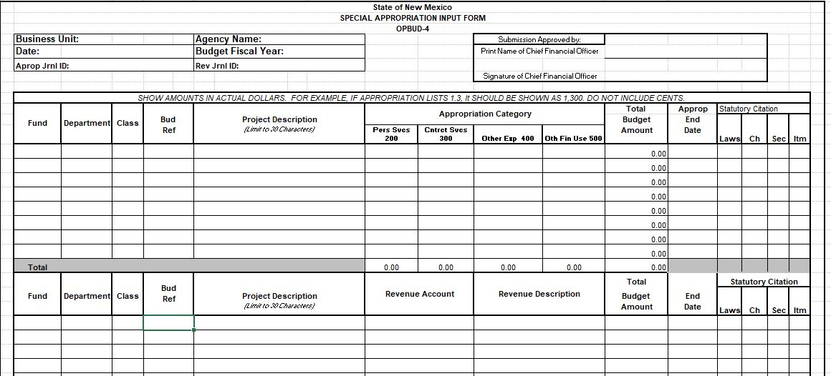
Multiple Appropriation OPBUD-4 Form
All the same info as on the single form, just ensure revenues = expenditures
Can use one revenue and one APROP journal for entire submission

Slide 27
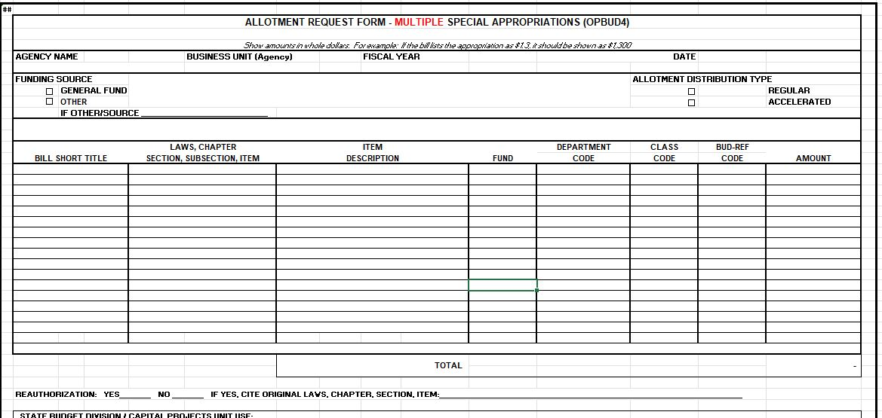
Multiple Appropriation Allotment Form

Slide 28
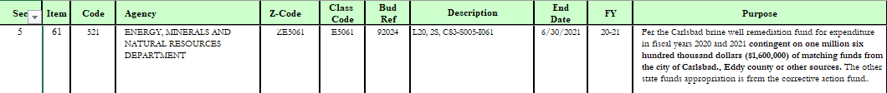
Companion BARS and OPBUD-4s
Two possible use cases
  Agency transfers funds from special revenue fund into operating budget and wants to increase OSF budget, thereby also increasing special revenue fund transfer. May even come from another agency in limited circumstances
  Agency received nonrecurring appropriation from another agency’s special revenue fund and therefore needs to receive transfer from that agency before it can spend the money. Agencies will need to coordinate.
Procedure: 2 BARs or OPBUD-4s required (companions)
  Budget with transfer revenue and expenditures in 200/300/400 as desired
  Budget with original revenue (OSF or fund balance) and 500 category expenditure

Slide 29
Budget Reallocation Forms (BRFs)
Used for two purposes:
Changes to established nonrecurring appropriations. Usually a category transfer. Increases are only allowed for federal funds.
Courts use BRFs as BARs since GAA gives them lump-sum Section 4 appropriations (can set up expenditure categories as they wish)
Not subject to 10-day LFC review
Components of a complete BRF
BRF Form (Excel)
Budget journal(s). Budget Entry Type: Adjustment. Entry Type: BRF. Create Budget Transfer journal for category transfer BRFs.
Documentation of federal funding availability if applicable
SHARE report showing available budget for category transfer
Courts submitting BRFs for Section 4 budgets should provide same documentation as required for a BAR of that type (increase, category transfer, etc.)

Slide 30
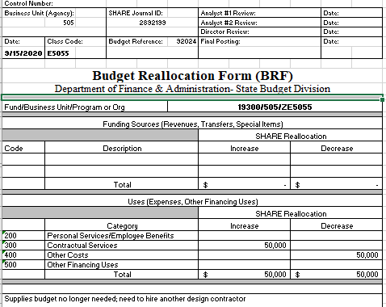
Completing the BRF form
Use relevant Z-code, class, budref for the nonrecurring appropriation
Courts – Use your P-code, class and budref for that FY’s recurring budget if adjusting Section 4 budget
Include brief justification for change to nonrecurring appropriation

Slide 31



Completing Budget Projections
Template available on SBD website, https://www.nmdfa.state.nm.us/budget-division/budget-adjustment-requests/
Updated every FY with new account codes and number of salary hours (such as 2,080)
Use for budget management and planning during FY
Submit to DFA as BAR backup (showing need/effect of BAR mainly for category transfers) and budget availability for HR actions such as raises or upward reclasses of positions
Complete one projection packet per P-code, and different tabs for each funding source within that P-code
Category tab is a summary rollup and copies from detail tabs – shouldn’t need to hard key any numbers here
Populate yellow areas, white areas are formula-driven

Slide 32
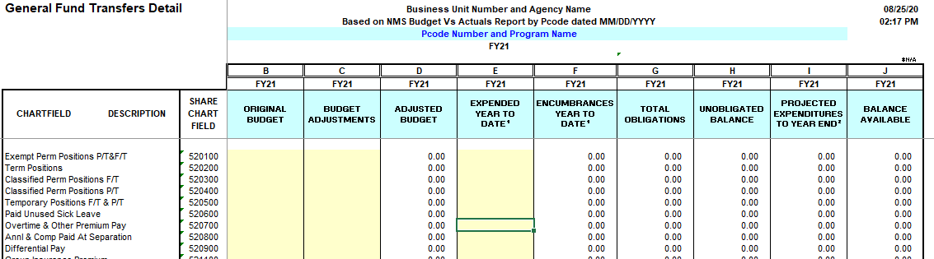
Completing Budget Projections
Detail tab
  Populate column B with line-item budgets, column C with adjustments through BARs
  Populate columns E and F with actual expenditures / encumbrances from SHARE reports at detail level
  Column I (projected expenditures) in the 200s (PSEB) will populate from data entered on Salary Projections tab. Manual entry required for 300s, 400s, 500s

Slide 33
Completing Budget Projections
Salary Projections tab
  Complete each field with current HR data
  Class = Exempt, Term, Exempt, Perm F/T, Perm P/T, Temp
  Obj Code = job classification
  Enter annual salary, hourly wage will auto-populate
  Enter remaining pay hours based on current data and payroll schedule tab
  Enter insurance costs per pay period dependent on employee’s insurance plan and salary
  Projected remaining costs for each line item will calculate in column S > used for PSEB projections on Detail tab
Vacant Positions
  Enter remaining work hours based on when you plan to fill position
  Enter zero if no plans to fill position
  Enter salary based on estimate of what you plan to pay position, use midpoint of salary range if unsure
  Use single coverage to estimate insurance costs

Slide 34
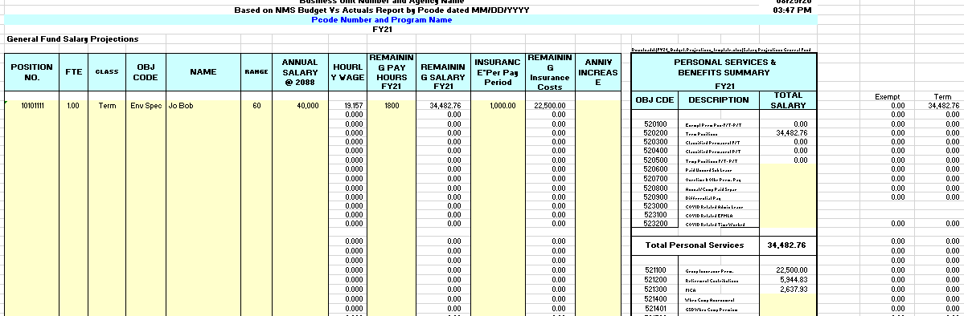
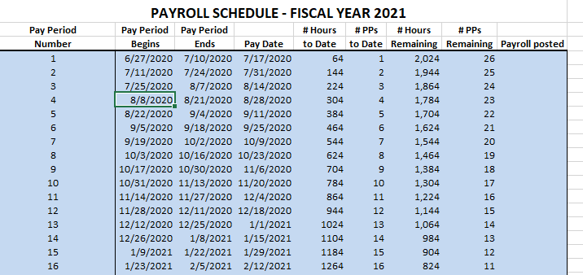
Completing Budget Projections

Slide 35

Module 2 Complete

