Slide 1

Budget Boot Camp Module 3:
The SHARE System and BFM for Budget Analysts
Dr. Andrew Miner, DPA
Acting Director, State Budget Division
andrew.miner@state.nm.us
(505) 819-1772

Slide 2
Module Overview
Creating budget journals in SHARE – Types, components and process
    Demonstration in SHARE
Other processes in SHARE: Routing and posting journals, department level budgets, chartfield requests
Useful budget/financial reports generated from SHARE
    Background and demonstration
Applications of information pulled from SHARE
    Completing budget projections
    50% rule verification
Introduction to BFM (Budget Formulation and Management System)

Slide 3
Creating Budget Journals in SHARE
Navigator > Commitment Control > Budget Journals > Enter Budget Journal > Add a New Value
  Clicking Add when NEXT is in the Journal ID box will auto-generate a number for the journal ID once you save the journal
  You may instead enter a custom ID if your agency has specific naming conventions
  Generally, all journals establishing a budget will need an appropriation journal and a revenue journal
TRANSFER: Navigator > Commitment Control > Budget Journals > Enter Budget Transfer > Add a New Value
  Generally used to transfer budget authority in the same ledger group, such as from the 300 to the 400 category in a category transfer BAR
Adjust date as needed for when journal needs to be effective (such as 6/30/20 for a corrective adjustment to prior FY)

Slide 4
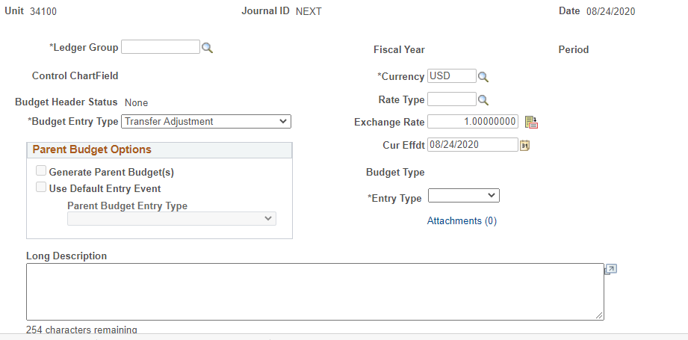
Budget Header Page

Slide 5
The Budget Header Fields
Ledger Group
  APROP_P: P-code level expenditure budget, entered at category level (200, 300, etc)
  DEPT: Sub P-code level expenditure budget (category level). Note that revenue budgets are not entered at this level.
  DETAIL: 6-digit line-item expenditure level – not budgeted
  REVENUE: P-code level revenue budget
Budget Entry Type
  Original: used when establishing a budget for the first time (new appropriations)
  Adjustment: used when adjusting an already established budget. Includes federal BARs for new grants (adjusting established federal budget)
Long Description: Describe purpose of journal, including reference numbers or statutory citations if applicable
Alternate Description: Generally not used, optional

Slide 6
The Budget Header Fields
Current Effective Date (Curr Effdt)
  Generally, match the date you established when you added the journal
Entry type
  Very important as this determines how journal is routed
  AGY: Agency level adjustments such as department-level BARs. Do not go to DFA for approval.
  BAR: Budget Adjustment Request (any type) to DFA
  BRF: Budget Reallocation Form (adjustment to nonrecurring appropriation or Court) to DFA
  CBAR, CBRF, CBUD: Capital outlay requests to DFA Capital Outlay Bureau
  OPBUD-3: Establishes recurring (Section 4) budget. Generated from external budget system and imported into SHARE. OPBUD-3 journals are almost never created directly in SHARE.
  OPBUD-4: Establishes nonrecurring budget such as for Section 5, 6, and 7 appropriations

Slide 7
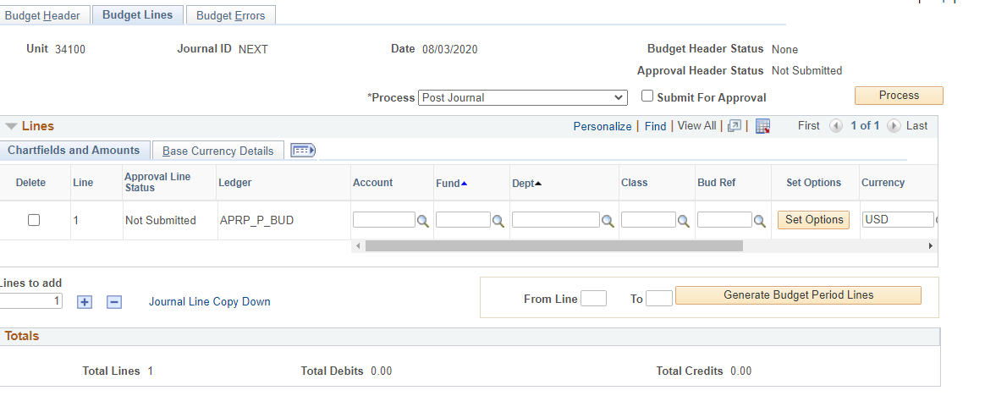
Budget Lines Page

Slide 8
The Budget Lines Fields
Account
  Enter expenditure category if in APROP_P or DEPT ledgers or revenue line if in REVENUE ledger
  CAREFUL!! SHARE does not stop you from entering the wrong account type in the ledger you are in (possible to enter revenue codes in an APROP_P journal)
Fund
  Enter fund number for journals
  Use magnifying glass icon to look up if necessary
Department
  Use P-code for adjustments to program level recurring budgets
  Use Z-code for adjustments to nonrecurring budget / special appropriations
  Use A-code for capital budget adjustments
  Use 10 digit code for adjustments to department-level budgets in a DEPT ledger group journal with AGY entry type ONLY

Slide 9
The Budget Lines Fields
Class
  All recurring Section 4 budgets have the same class in a fiscal year, such as E0000
  Each nonrecurring appropriation has a unique class code that closely matches its Zcode (ZE5101, class E5101)
  E2020: executive orders for calendar year 2020
Budref
  All recurring Section 4 budgets have the same budref in a fiscal year, starts with 1 and ends with the FY (121)
  Nonrecurring appropriations have 3-5 digit budrefs, such as 92024, with component parts:
    9: denotes nonrecurring appropriation
    20: FY in which the appropriation began
    24: Authorized length of appropriation. Note this does not mean 24 full months but rather the remainder of the current FY and all of the next FY. 36 = rest of current FY + two more FYs, etc.
  A three digit budref such as 921 is only valid in the denoted FY
  Budrefs for nonrecurring appropriations are provided on the Table of Budget Codes

Slide 10
The Budget Lines Fields
Amount
  Enter amounts in whole numbers, not rounded
  Enter reductions as negative numbers
  Positive numbers will show as credits below, negative as debits
  Be sure that debits and credits equal on transfer journals
Click the + under the lines to create a new line and copy the info down, adjust as needed
Saving and Submitting
  Click Save below to save journal and give it a number if you didn’t give it a custom one
  In drop down menu above lines, click Submit Journal and Process (Submit for Approval checkbox should auto-populate)

Slide 11
Routing and Posting Journals
Level 1: Journal Creator
Level 2: Agency Approval
AGY entry type: Authority to approve in queue and post journal (click on Post Journal and Process in lines tab)
Other entry types: Authority to approve in queue which submits to DFA
Level 3: DFA Approval
Authority to approve in queue and post journal
Agencies should never attempt to post own journals that are not AGY entry types
When the journal creator submits a journal, it should be routed to the next level of approver at the agency

Slide 12

Journal Errors
Invalid Values
Budget Error
SHARE does not check journals against available budget until posting is attempted – please ensure accuracy of journal and prevent activities from hitting budget until posted
Common Errors
Most common journal errors encountered by SBD when posting:
Generally, the only errors SHARE will identify when you are creating a journal is if you try to enter an invalid value in a certain field
If you are certain the value is correct (such as a certain class code), contact your SBD analyst – may need to be activated
Details found by clicking on Error next to Budget Header Status
Child Exceed Parent: DEPT level budget was not reduced before attempting to reduce APROP_P budget
Exceeds Budget Tolerance: Not enough available budget to reduce by journal amount
Value not at CF Level: Some sort of incorrect entry in account, department, class field that SHARE didn’t pick up on initially (for example, revenue accounts entered in APROP_P journal)

Slide 13

Establishing Department Level Budgets
Lower-level budgets using 10-digit department codes that roll up to P-code budget, used by larger agencies to subdivide their budgets. No revenue budget.
  Not controlled by SBD except to check that a department level budget is reduced before an APROP_P level category transfer BAR
Agencies may create journals in SHARE to set up these budgets and post with 7/1 effective date after SBD has posted APROP_P level budget journals for new FY
Ledger group DEPT, Entry Type AGY.
Account should be expenditure categories
Same class and budref as current FY recurring budget

Slide 14
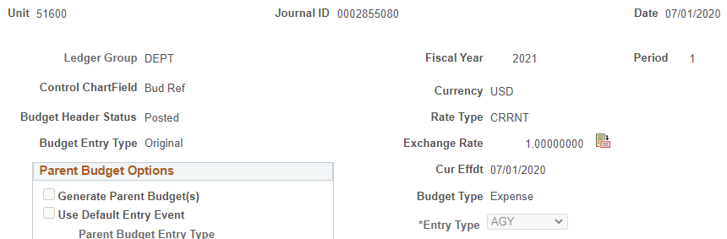
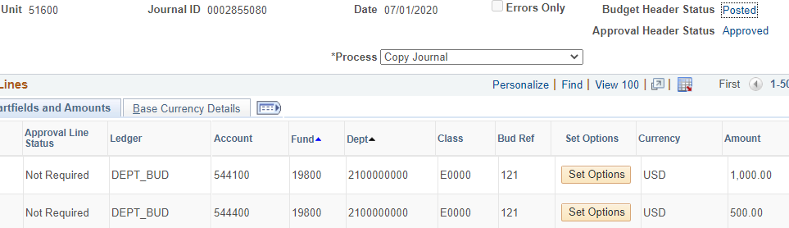
Department Level Budget Journal Example

Slide 15
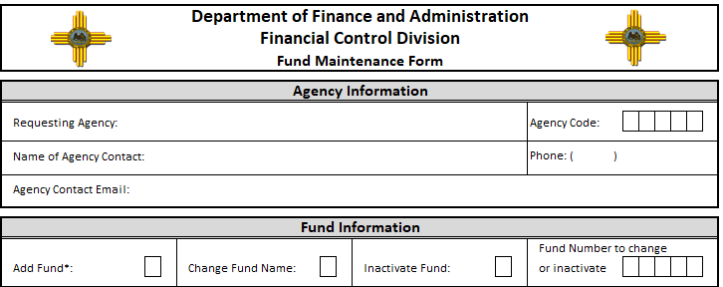
Chartfield Requests, Department and Fund Maintenance Forms
Used to establish new fund, inactivate fund, create new department code, change accounting structure, etc.
Reviewed and approved by both FCD and SBD
Find in SHARE: Setup Financial Supply Chain > Common Definitions > Design Chartfields > Define Values > Chartfield Request
Complete and attach appropriate Fund or Department Maintenance Form, ensure info on the form matches info entered in SHARE. Forms on FCD website.
For more assistance contact your SBD analyst, FCD or the SHARE Help Desk

Slide 16
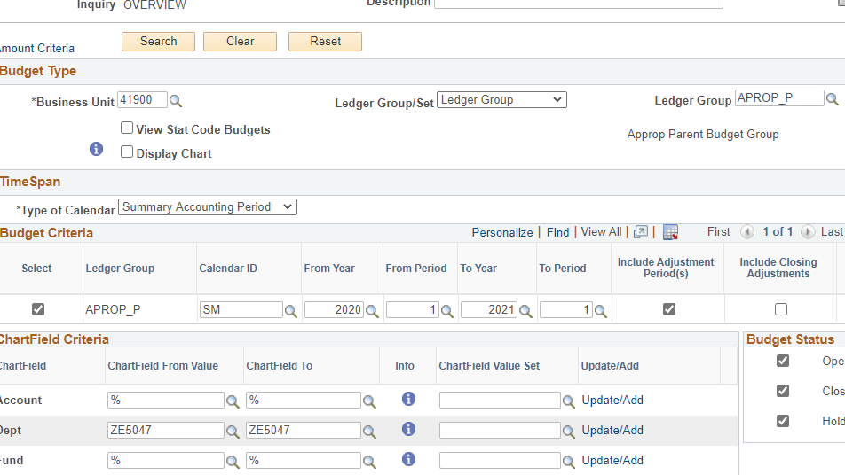
Budget Overview Report
Navigator > Commitment Control > Review Budget Activities > Budget Overview
Shows budget, expense, encumbrances for a P-code or other budget for certain number of FYs in selected ledger group

Slide 17
Budget Overview Report
Ledger Group: Can look at expenditure or revenue budget, select Detail if you want to see expenditures at 6-digit line-item level
Type of Calendar: generally, use Summary Accounting Period
Calendar ID: SM. Note if pulling up by FY, enter 1 in both period fields
Chartfield Criteria
  Leave % in any fields that you want to return all possible values (no filter)
  Enter same value in From and To fields if you only want results for that value
  Account: enter range of accounts you want depending on report’s ledger group
  Dept: could be P-code, Z-code, 10-digit code, etc.
Click on Search button near top of report to run

Slide 18
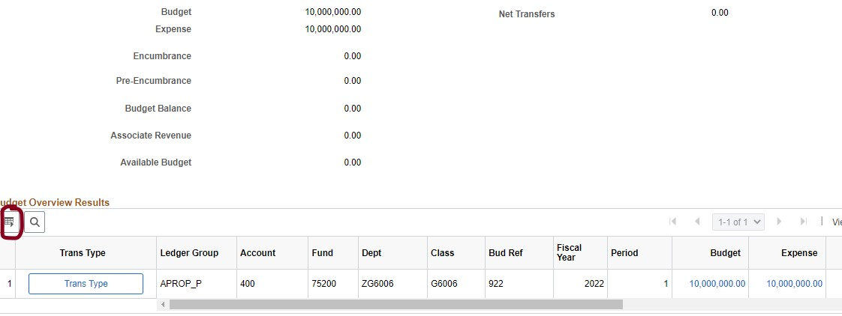
Budget Overview Report
Can download results into Excel using Grid Action Menu button at left above results lines, so you can manipulate data, create pivot tables, etc.

Slide 19
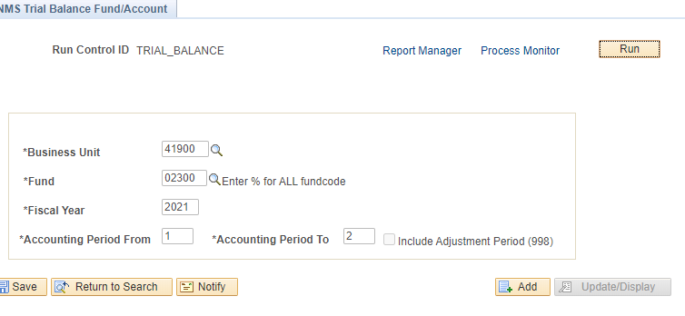
Trial Balance Report
Useful for tracking revenue and expenditure history of funds, getting fund balance of special revenue funds for BARs and budgeting purposes
Navigator > General Ledger > General Reports > NMS Trial Balance Fund/Account

Slide 20
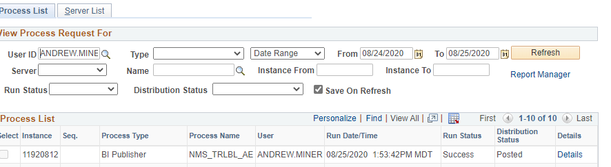
Trial Balance Report
Enter
Enter fund, fiscal year, and accounting period (may specify range of months)
Click
Click Run, then OK.
Click
Click Process Monitor, click Refresh until Run Status = Success and Distribution Status = Posted
Click
Click Report Manager

Slide 21
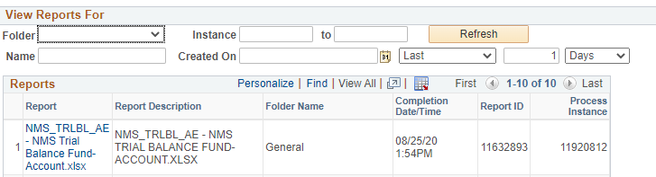
Trial Balance Report
Click
Click on report in Excel format on left.

Slide 22
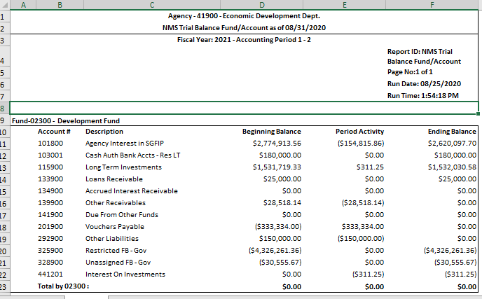
Trial Balance Report – Result in Excel

Slide 23
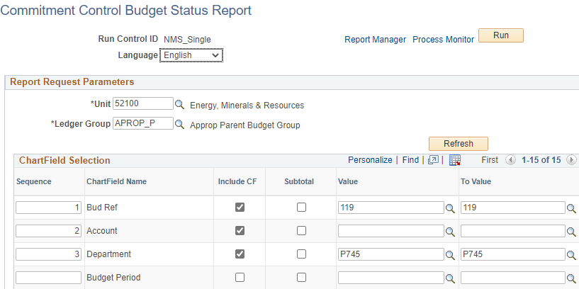
Single Year CAFR Budget Status Report
Navigator > Commitment Control > Budget Reports > Print Budget Status Report
Select chartfields to include in report, sequence to be ordered in, and range of values for each
Follow same Run > Process Monitor > Report Manager sequence as for Trial Balance Report

Slide 24
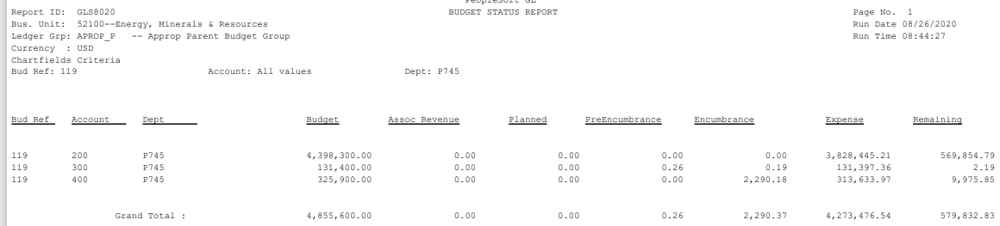
Single Year CAFR Budget Status Report
Output will be PDF
Results tie more closely to General Ledger than Budget Overview

Slide 25


50% Rule Verification
6-3-6 NMSA 1978: State agency expenditures for the first 6 months of every odd-numbered fiscal year are limited to one half of the approved budget for that year
  Ensure that at least half of an agency’s budget is available to new agency heads or elected officials taking office after an election
Does not apply to legislative committees, legislative council, State Fair
Applies to agency as a whole, not individual programs
Can request exemptions for certain portions of budget – must be approved by DFA Secretary
Around December 1 of each odd-numbered FY agencies must submit verification that they are in compliance with the 50% rule
  Instructions and forms distributed by SBD in advance
  Use SHARE reports to verify actual expenditure data and rule compliance

Slide 26
Intro to BFM
Access via web browser, Chrome preferred: https://nm.bfm.cloud/bfmnm/default.aspx
User ID is (generally) SHARE ID, password will initially be set to “password” and you will be prompted to change it on first login
Definitions
Stage: Steps in workflow. Users have different access (edit, review, submit, etc.) at different stages depending on their role.
Budget Form: How users enter budget data in BFM. Can display historical and current data and allow users to enter numbers and text.
Report: Compile data from BFM to present budget information for decision-making and analysis
PCF: Personnel Cost Forecasting, tool that creates personnel base budget based on HR data and planning values loaded into system, such as planning insurance rates
Refer to BFM tab of SBD website for comprehensive BFM training materials and videos. Individual forms are detailed during request / operating budget training.

Slide 27
BFM Staging Workflow
New budget forms are created at Stage 1, Initial Entry, and sent up the process.
Once a user submits a budget form, they will not have access any longer, but the reviewer/manager has the authority to submit the request backwards in the process for edits/revisions.
Note: If you are the ONLY BFM user at a small agency and therefore need levels 1-3 access, please email your SBD analyst.
Stage | Description
Stage 1 | Initial Entry
Stage 2 | Manager Review
Stage 3 | Agency Management Changes
Stage 4 | Submit to DFA

Slide 28
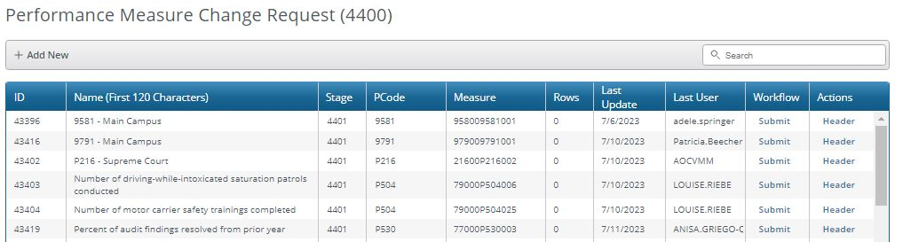
Navigation in BFM
Every page has a Title at the top, followed by a search area, and then a list of records with action options
Quick Search: Narrow record list by searching for text or numbers in any non-date columns (such as Description or Pcode)
Elements of a Budget Form
  Header Tab – General info such as organizational unit (Pcode, Dept ID) and form name
  Detail Tab – Detailed info depending on form such as fund, account, amount, justification, etc.
  Attachments Tab – Allows for attachments of PDF, Word, Excel files
  Narrative/Explanation Tab – Contains text fields for detailed narrative descriptions

Slide 29
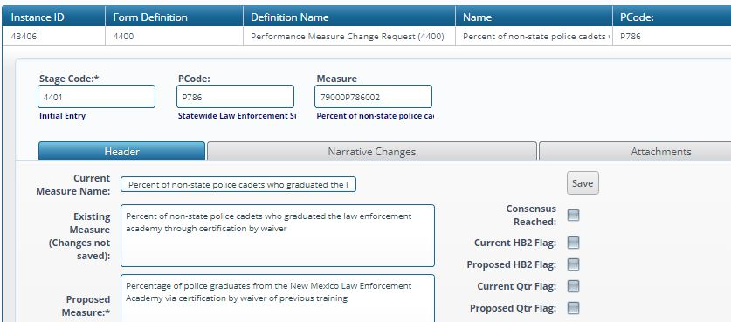
Data Entry in BFM
Columns with an asterisk (*) are data entry columns
Enter in whole numbers without formatting
Enter data, click Save All at bottom, then Refresh at top to refresh totals
Justification/other narrative fields: 8,000-character limit
Cannot delete a row on a form, must zero it out (for audit purposes)

Slide 30
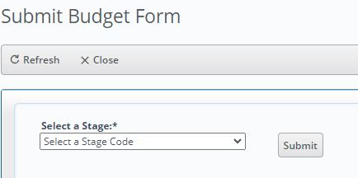
Submitting Budget Forms
Go to budget form you want to submit, and click on Submit button on main page (next to Header and Detail buttons)
Select Stage to submit to in dropdown menu on Submit Budget Form screen (will display which stages you have access to submit to). Reviewers can submit back to prior stage.
Once submitted the form will no longer appear on the user’s budget forms list page if they do not have edit access at the new stage

Slide 31
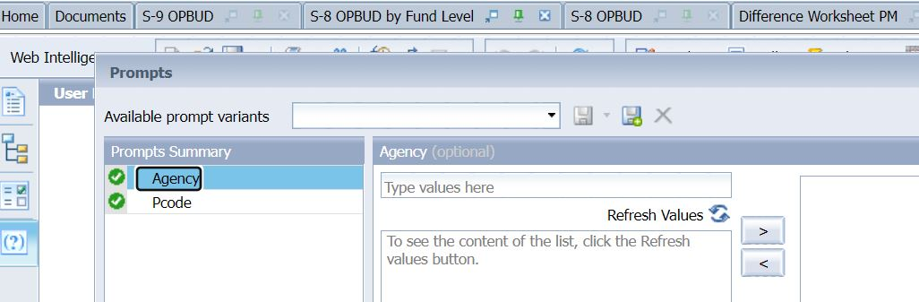
Intro to BFM Reports
Accessed under Links menu at top right of BFM
Dragging Reporting tab to create new instance of browser will enable you to have BFM and Reporting open concurrently and refresh reports
Complete each prompt as necessary before running report (Agency, P/Zcode, Include Department section
Reports will round and display numbers in the thousands
Note that revenue lines will now be listed on detailed S-9 report

Slide 32

Module 3 Complete

