Slide 1

Budget Boot Camp Module 4:
Budgeting History and Scholarship
Dr. Andrew Miner, DPA
Acting Director, State Budget Division
andrew.miner@state.nm.us
(505) 819-1772

Slide 2
Introduction
We’ve talked about “how” to do your job, now let’s talk about the “why” and the context in which budgets are crafted and executed
Budgeting is a core function of government – raise revenue and appropriate expenditures
The budget document is the most significant indicator of preferred policies by executive and legislative leadership
  Crafted by legislators, signed by governors, proposed by agencies, planned and executed by civil servants – all subject to influence
Module Overview
  History of Public Budgeting in the US and New Mexico
  Comparative Budgeting Among States
  Aaron Wildavsky, Budgeting Scholar
  Budgeting Models
  Game Theory and Budgeting
  Influences on the Budget Process

Slide 3
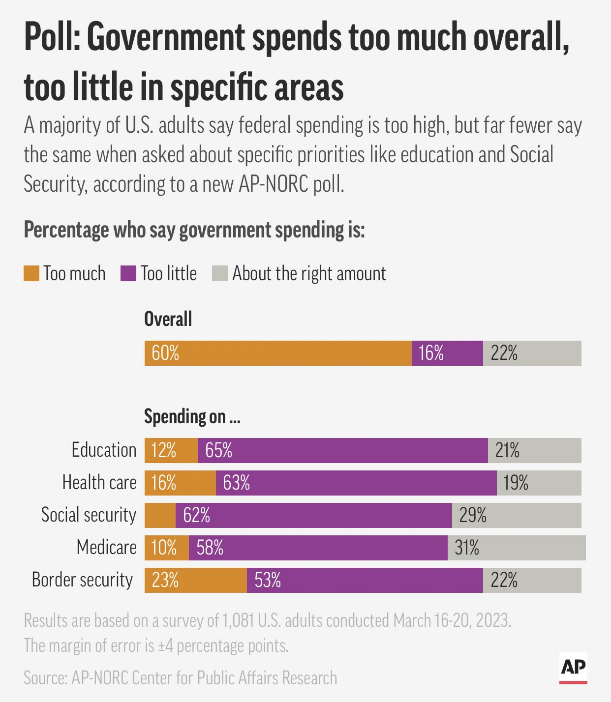

Slide 4
History of Public Budgeting in the U.S.
Marked by struggle between legislatures controlling the purse strings and executive authority seeking to maximize its power
Prior to the American Revolution
Colonial legislatures tried to control governors through fiscal restraints such as requiring taxes and salaries to be renewed annually
Stamp Act, etc. were attempts by Parliament to free appointed governors from colonial legislative control
First US budget, 1789: One page long and $689,000 (about $23.8 million today)
Congress dominated the budget process for the first century of U.S. history
Line-item advocates won out over Federalists who wanted agencies to have broad spending power
Over time agencies gradually increased their power, such as ability to transfer funds from one purpose to another

Slide 5
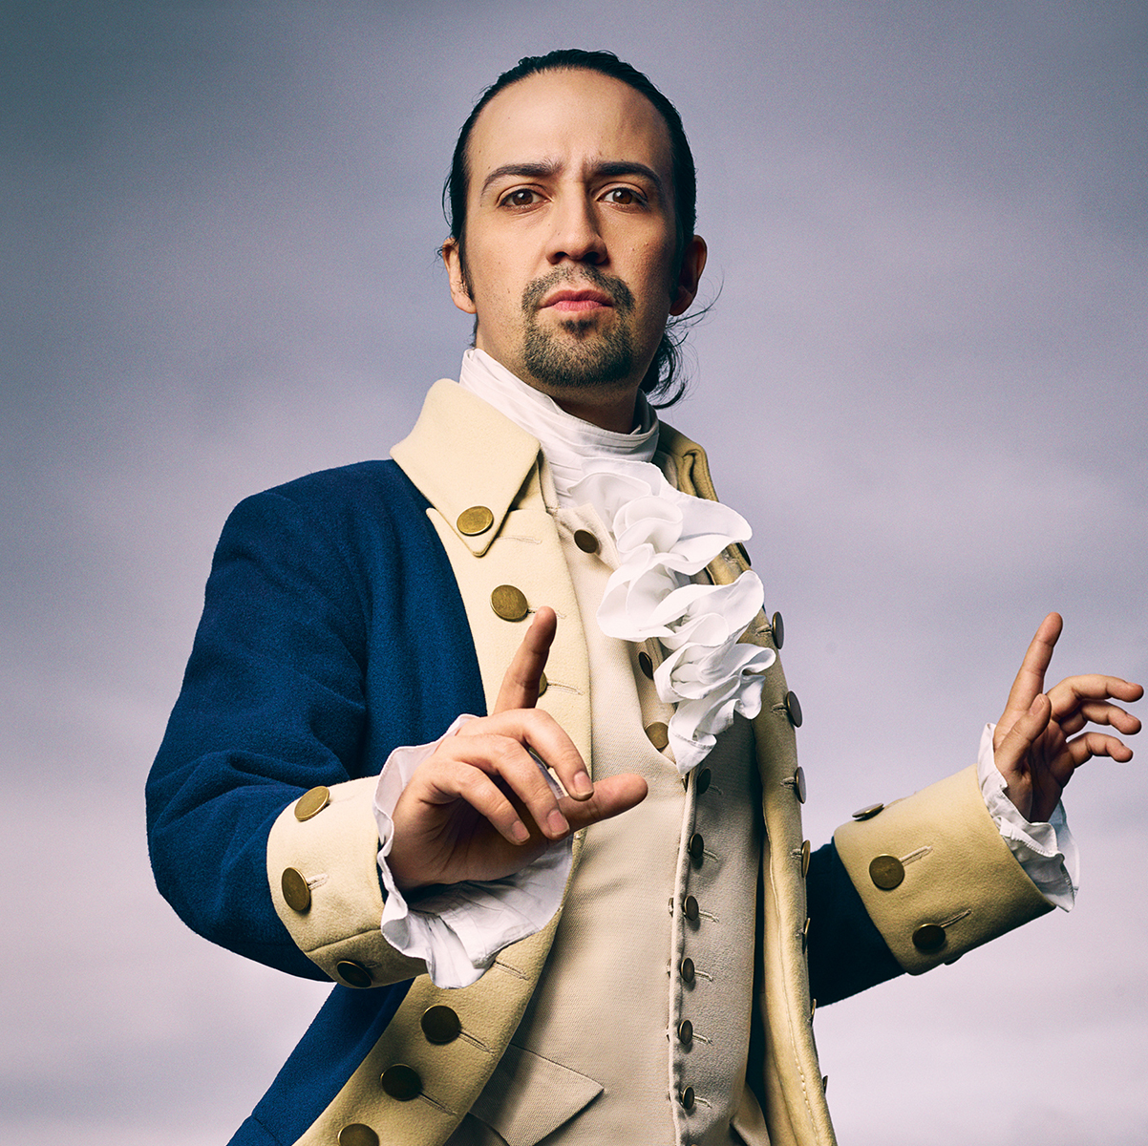
History of Public Budgeting in the U.S.
Careful balancing act between political groups
Federalists (Hamilton) wanted deficit spending for internal improvements, allied with Whig industrialists who would impose high tariffs for this purpose
Jeffersonians: deficit spending gave too much power to the central government, interest payments redistributed wealth from poor to rich
Slow growing, balanced budget was the general result
Civil War: financial controls went out the window and were difficult to reimpose afterward
Presidents gained more discretion over funding, agencies demanded it
“Iron triangles” among agencies, public stakeholders, and Congressional allies begin to form – insider access wins the day. Eventually: military-industrial complex that Eisenhower warned about in 1961 farewell address

Slide 6
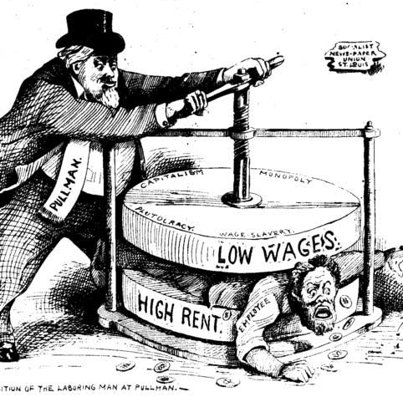
History of Public Budgeting in the U.S.
Progressive Era, 1900-1920
  Party boss system fostered widespread corruption and waste in city governments, which spurred budget reforms for transparency
  Progressive reformers applied scientific method to create unbiased, practical system of appropriating funds
  Reformers believed budgeting should be left to administrators divorced from politics
  Politics vs Administration dichotomy – how responsive should budget administrators be to public demands?
Large WWI debt prompted Congress to reform
  1921 Budget and Accounting Act established modern executive budget process, Bureau of the Budget (become OMB), gave President much larger control over agency budgets
  Most modern state budget processes follow this model

Slide 7
Further Budget Reforms
Introduction of Performance Budgeting in 1940s-1950s
Response to growth in federal government after New Deal and WWII
Design budgets that achieve program objectives as efficiently as possible
Congress attempts to reassert control
1974 Congressional Budget and Impoundment Act created more budget committees and Congressional Budget Office as counterweight to OMB (in NM: LFC to SBD)
1985 Emergency Deficit Control Act: set deficit reduction goals for each year, which were missed
1990 Budget Enforcement Act: replaced deficit reduction targets with pay-as-you-go requirements (any new spending must not adversely affect the deficit)
Today: Occasional attempts at austerity followed by massive spending increases or revenue cutbacks. Budget gridlock often results in lurching forward through continuing resolutions
Last balanced budgets passed in late ‘90s
Growth in entitlement (formula-driven) spending
Bush and Trump tax cuts
War on Terror, 2001-21 (?)
Great Recession (ARRA) and COVID (CARES Act)
“Bidenomics” (ARPA, Inflation Reduction Act)

Slide 8
Modern Challenges to Budgeting
Earmarks
Increased dramatically in 20th century as legislators fought back against increased agency budget authority and directed funds to specific projects
External actors including interest groups reap rich rewards through earmarks
“Pork barrel politics” or “bringing home the goods” to make deals and get budgets done?
Contracts
“Run government like a business” by farming out work to ever-increasing number of contractors who compete for government funds
Salaries and overhead costs are actually often much higher than government workers
Competition for contracts has declined, accountability is lacking
Size of federal contractor workforce: 80% of IT staff, 90% of all Department of Energy operations (including Los Alamos and Sandia). Federal contractors are a “shadow workforce” of up to 7.5 million people, compared to 2.1 million actual federal employees (besides the military and USPS)

Slide 9
U.S. Budgeting History Conclusion
Despite many conflicts among differing groups, traditional budget process served U.S. well for almost 200 years
  Growth of entitlement and deficit spending has greatly complicated matters
  “Entitlement” = formula-driven mandatory spending, no connotations in original meaning
Reforms have attempted to be large in scope but only small, gradual steps have been achieved.
  Limited by politics and (in 20th century) large growth in entitlement spending.
Budget itself grew very incrementally from 1971-2010, with only spikes in response to major events – Civil War, Great Depression, WWII

Slide 10

Budgeting History in New Mexico
General budgeting process has been much the same throughout NM history
Similar contests between the executive and legislative branches over control of the budget have played out in New Mexico
Debates over use of and reliance on oil and gas revenue (land grant permanent fund)
Consolidation of expenditure categories
Expenditures were formerly more specifically defined in the GAA, such as travel, supplies and materials, and maintenance and repairs
Adoption of AGA in 1999 - performance measures are added to GAA in 2002, but expenditure categories are reduced and consolidated in 2001
“Junior” budget bills – a recent development, here to stay?
Supplemental budget bills containing a variety of appropriations for many state agencies at the wish of legislators
Constitution limits GAA appropriations to those expenditures required under existing law
Legislators responding to voters and interests or an unnecessary complication of the budget process?

Slide 11
Comparative Budgeting Among States
Many of the same factors influencing the federal budget process are prevalent among states as well
  Key difference: States must pass balanced budgets
31 states enact annual budgets, 19 enact biennial budgets
  States with professional/full-time legislatures can take much longer to pass budgets
New Mexico is one of only a few states where both the executive and legislature publish budget recommendations before work on the budget begins
  In most states the Governor’s budget recommendation forms the basis for budget negotiation
Differences in Governor’s veto powers
  Some have no line-item veto power – must accept everything in budget or nothing
  Some have rather powerful line-item veto power to change appropriations, which legislatures often fight
  New Mexico: line-item veto limited to bills containing appropriations but can be used for non-appropriation purposes in those bills

Slide 12
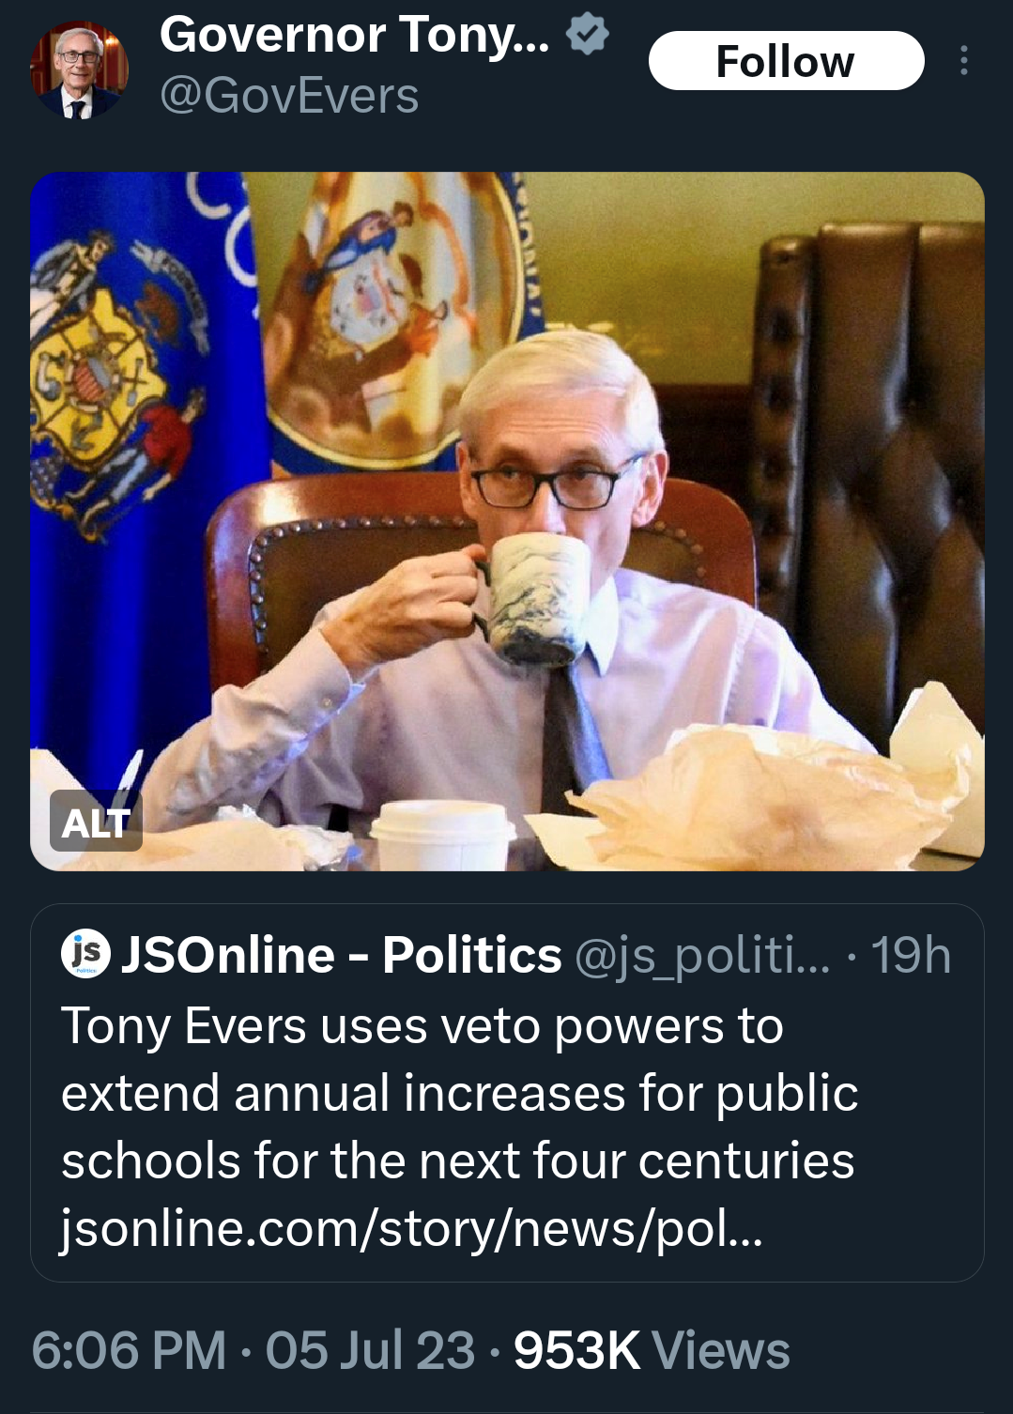
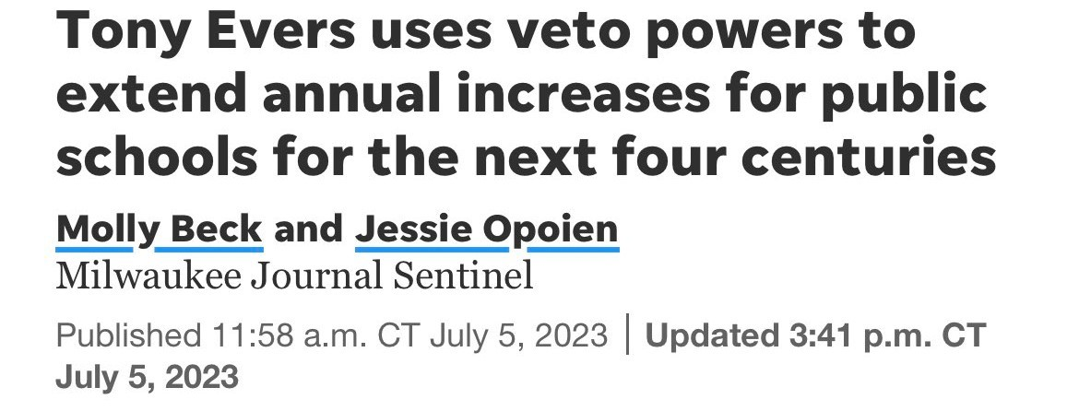
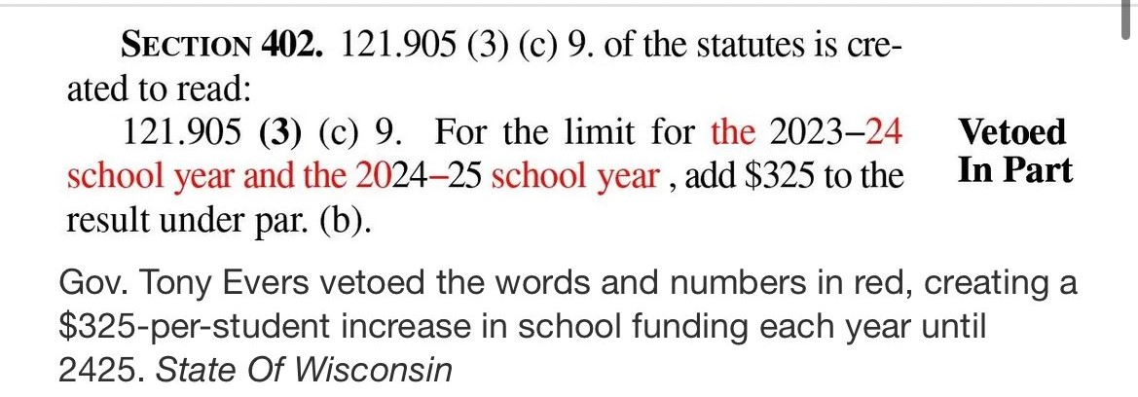
The Power of Wisconsin’s Frankenveto

Slide 13


Comparative Budgeting Among States
Differences among revenue structures
  7 states with no income tax (AK, WA, TX, FL, WY, SD, NV), 2 only tax interest and dividend income (TN, NH)
  5 states with no sales tax (AK, OR, DE, MT, NH). States with no sales tax exemption for food: AL, KS, HI, ID, MS, OK, SD
  “Energy” states like Alaska or NM generate significant revenue from severance taxes
  Different reliance on federal revenue depending on wealth of state and presence of federal facilities
Appropriations and expenditures
  Education, health and human services dominate most state budgets
  Many different options in appropriations, from high level lump-sum to very specific
For more info, check out:
  National Association of State Budget Officers: www.nasbo.org
  National Conference of State Legislatures: www.ncsl.org

Slide 14
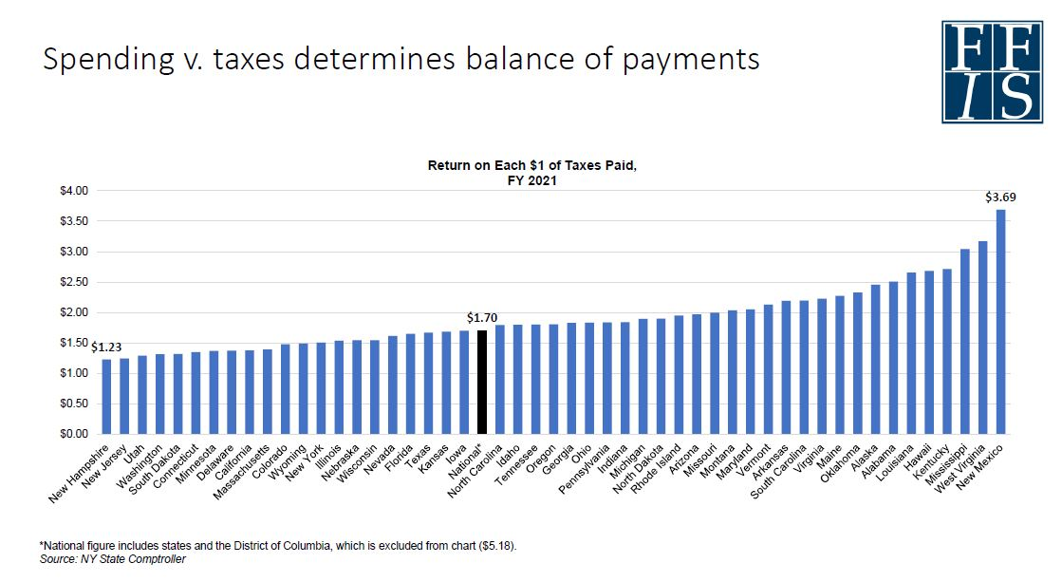

Slide 15
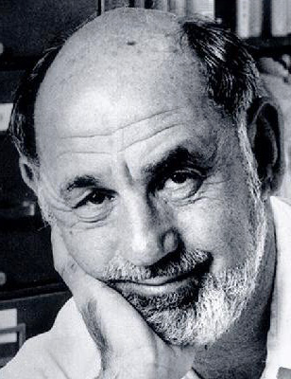
Budgeting Scholarship: Aaron Wildavsky
The Politics of the Budgetary Process (1964)
  Inseparably connected budgeting with the political system – no longer on the administrative side of the dichotomy
  Public and policymakers need to be well-informed
  Realist: compromises in democratic budgeting process spread dissatisfaction to all parties, but better than any alternative
  Incrementalist: Use prior year’s budget as baseline, focus on narrow increases – but enables budgets to evolve over time
The New Politics of the Budgetary Process (1988)
  Political and budgetary ramifications of the rise of entitlement spending
  Less emphasis on eliminating budget deficits – inevitable result of values-driven political conflicts

Slide 16

Budgeting Scholarship: Aaron Wildavsky
Necessity of compromise in budget: accepting the budget you want means accepting the budget of something else you’re indifferent or hostile toward
Agencies’ budgetary strategies
  “Goldilocks” approach: ask for just the right amount of budget increase – not too big, not too small
  Look for signals from legislators, the executive, their constituencies to determine budget request amount
  Entitlements opened up the budget to new clientele groups that agencies work with to increase budget
Clientele (interest/advocacy) groups
  Anyone affected by a government program. Build networks at all levels to influence government programs
  Often interact with executive and legislative actors on behalf of agencies
  More influential if broadly-based, spread across wide geographic area, intensely devoted to their cause (Social Security)
  Hard to lobby to create entitlements, but their existence is strong incentive to defend them

Slide 17
Budgeting Models
Traditional: not closely tied to agency performance, funds appropriated to units not aligned with agency mission
Eases control by central administrators, but poor at conveying effective use of taxpayer money
Modern performance budgeting – include performance measures alongside funding levels to connect to accomplishment of agency goals
Provides greater accountability and responsibility, enables other actors to be involved in budget process
Performance budgeting has noble goals (effectively manage money, incentivize increasing productivity, improve planning and transparency) but often falls short:
Too great of workload associated with proper evaluation
What constitutes a good measure of performance?
No solid empirical evidence that performance budgeting has had a significant impact on agency budgets or their productivity

Slide 18
New Performance Budgeting
Adopt best components of previous models, focus on societal outcomes rather than simple outputs
Include detailed strategic plan, quantifiable performance measures, flexible paths of achievement
Challenges
  Difficult to coordinate measures across agencies
  Agencies resent being held accountable for measures beyond their control
  Data overload – what to do with it all?

Slide 19

Game Theory and Public Budgeting
Game theory: study of decisions actors make under various conditions and rulesets and impact decisions have on collective results
  See the “prisoner’s dilemma”
Agencies and other actors use game-like strategies during budget process through taking advantage of asymmetric information and public emotions
  Facing cuts? Cut popular programs to generate public outcry
  Requesting increase? Round up cost estimates to create budgetary slack
  Argue that new program will generate more revenue than it will cost

Slide 20
Game Theory and Public Budgeting
Connection to evolutionary theory. Actors use deception and trickery to manipulate others
  Defend budgets by warning of dire consequences
  Camouflage money or true purpose of program at first
  Put on an impressive display of statistics
  Offer up a sacrificial lamb you don’t care about to get what you really want
Can budget analysts learn from birds?
  Examine world through set of preconceived notions. Agencies seek to learn the analyst’s filter – what they look for – and adjust accordingly
  Analysts must be adaptable, but may be limited by time or poor judgement
  If too many agencies use deception, central office may “evolve” to counter it

Slide 21

Influences on the Budget Process
Institutional actors (internal factors) appear to have the greatest influence on budget negotiations
Governor’s budget recommendation often sets maximum spending for state agencies based on anticipated revenues
Professional legislatures have greater capacity to be assertive on budgets
Political makeup of legislature and Governor have a strong influence on budgets
External factors are important but on a selective basis
Per capita income has a small negative relationship with agency budgets
Interest groups important when administrative leaders perceive they are important.

Slide 22

Influences on the Budget Process
What factors influence agency budget requests?
Generally agreed they are result of interplay among legislators, interest groups, and bureaucrats, but influenced in many different directions
Increasing monitoring ability and professionalization of legislature, as well as vigilance by interest groups, can constrain agency budgets
But more professional legislature may also be better at targeting funding and inserting earmarks
Also constraining requests: gubernatorial involvement, veto powers, inability for agencies to adapt to rapidly changing situation

Slide 23

Influences on the Budget Process
The role of bureaucrats in agency requests
Often able to secure a budget larger than is economically efficient because they provide one or more public goods, and the legislature is the sole “buyer” of them
Do not act as single hive mind. Individual reasons for action:
Demonstrate technical competence, seeking to advance personal career
Secure more funding for salaries/raises
Political ideology (Republicans request less than Democrats)
Interest group influence positively correlated with agency requests – agencies with strong public support are more confident to request budget expansions

Slide 24
Conclusion: Implications for Public Administrators
How should public administrators react to interest groups advocating for increased agency budgets?
Officially apolitical but surrounded by the politics of their environment - must be keenly aware of it and appropriately responsive
Understand both the political culture and history of their state as well the ideologies and priorities of elected or appointed leaders
Role of budget analysts – You are important, and you’re not just a cog!
Do not operate in a vacuum. Integral part of producing the budget and vital policy. “Show me your budget, and I’ll tell you what you value.” – Joe Biden
Must fully understand the political world that surrounds them and the myriad factors and forces at work to produce results.
Balance being properly responsive to will of the electorate while still performing administrative, technical roles of their jobs to the best of their ability
Americans expect well-run, efficient and generous government services but don’t want to pay much for them – this is the balancing act budget administrators constantly grapple with.

Slide 25
Final Exam Instructions
Final Exam Document
Course Certificate
Exam Contents
5 ungraded questions related to course feedback
Feedback
15 multiple choice questions, 5 questions each from Modules 1-3. Get 10 of 15 correct to pass
To receive a course completion certificate, complete and return to Andrew.miner@dfa.nm.gov by 5:00 PM on Friday, August 4. (Please do not convert to PDF)
This will be emailed to all course participants
If you don’t want a certificate, you can complete just the feedback section or email me any comments directly.
Your feedback is very important and will help shape this course in future years.

Slide 26

Module 4 Complete

