Slide 1


2026 Training on Capital Outlay Questionnaires
April 9, 2026
Presented by
Scott Wright, Deputy Director, Infrastructure Planning and Development Division

Slide 2
Historical Overview
QUESTIONNAIRE AGENDA
Overview & Deadlines
CAPS Orientation
Types of Questionnaire (New, Follow-Up, Decline, Time Extension)
Questionnaire Status
Live Demo
Q&A
Training is recorded & will be available here: https://www.nmdfa.state.nm.us/infrastructure-planning-and-development-division/icip-virtual-training/

Slide 3
Historical Overview
Overview
Questionnaires are completed in CAPS
Available to complete as of April 8, 2026
    2026 Capital Outlay Bill (SB240) & Reauthorization Bill (HB332)
    &
    Previous Capital Outlay Bills & Reauthorization Bills
Questionnaires due at 11:59pm on April 22, 2026
Training is recorded & will be available here: https://www.nmdfa.state.nm.us/infrastructure-planning-and-development-division/icip-virtual-training/

Slide 4
Historical Overview
Questionnaire Process Overview
Ready to budget
Entity completes questionnaire
Budget established
DFA review
Entity follow-up
Entity resubmission
Training is recorded & will be available here: https://www.nmdfa.state.nm.us/infrastructure-planning-and-development-division/icip-virtual-training/

Slide 5
Historical Overview
Questionnaire / Budget Process Overview
April 8: Questionnaires open
April 22: Entities deadline to submit
May 13: Entity follow-up deadline
April
July
May 7:
DFA deadline to complete reviews
“Ready”
“Follow-up”
“Entity Declined”
May 19:
DFA deadline for final review for follow-up
June 1: DFA reviews audit compliance for entities
Late June (Early July): DFA budget upload for Capital Outlay
Mid-June: DFA sends list of projects (questionnaires) to state agencies ready to budget for review
Training is recorded & will be available here: https://www.nmdfa.state.nm.us/infrastructure-planning-and-development-division/icip-virtual-training/

Slide 6
Historical Overview
Questionnaires
Date | Key Dates (Spring 2026)
4/8/26 | Questionnaires are available in CAPS
4/22/26 | Entity deadline to complete & submit questionnaires
5/7/26 | DFA deadline to complete reviews
5/13/26 | Entity deadline to follow-up / resubmit questionnaire(s)
5/29/26 | DFA deadline to complete follow-up reviews
Training is recorded & will be available here: https://www.nmdfa.state.nm.us/infrastructure-planning-and-development-division/icip-virtual-training/

Slide 7
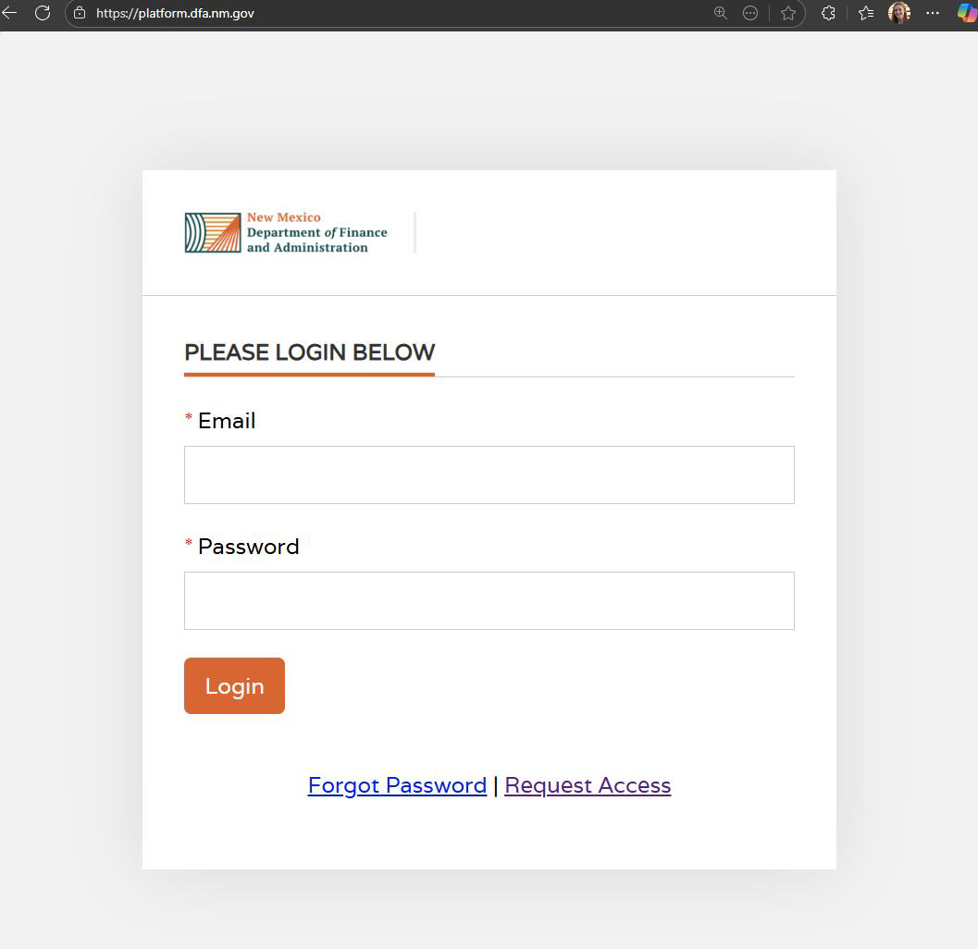
System Access
System location: https://platform.dfa.nm.gov/​
​Locked out?
Deactivated (60+ days inactive)
Multiple failed password attempts
​New to system?
Request Access on Login Page
Request access to CAPS
Training is recorded & will be available here: https://www.nmdfa.state.nm.us/infrastructure-planning-and-development-division/icip-virtual-training/

Slide 8
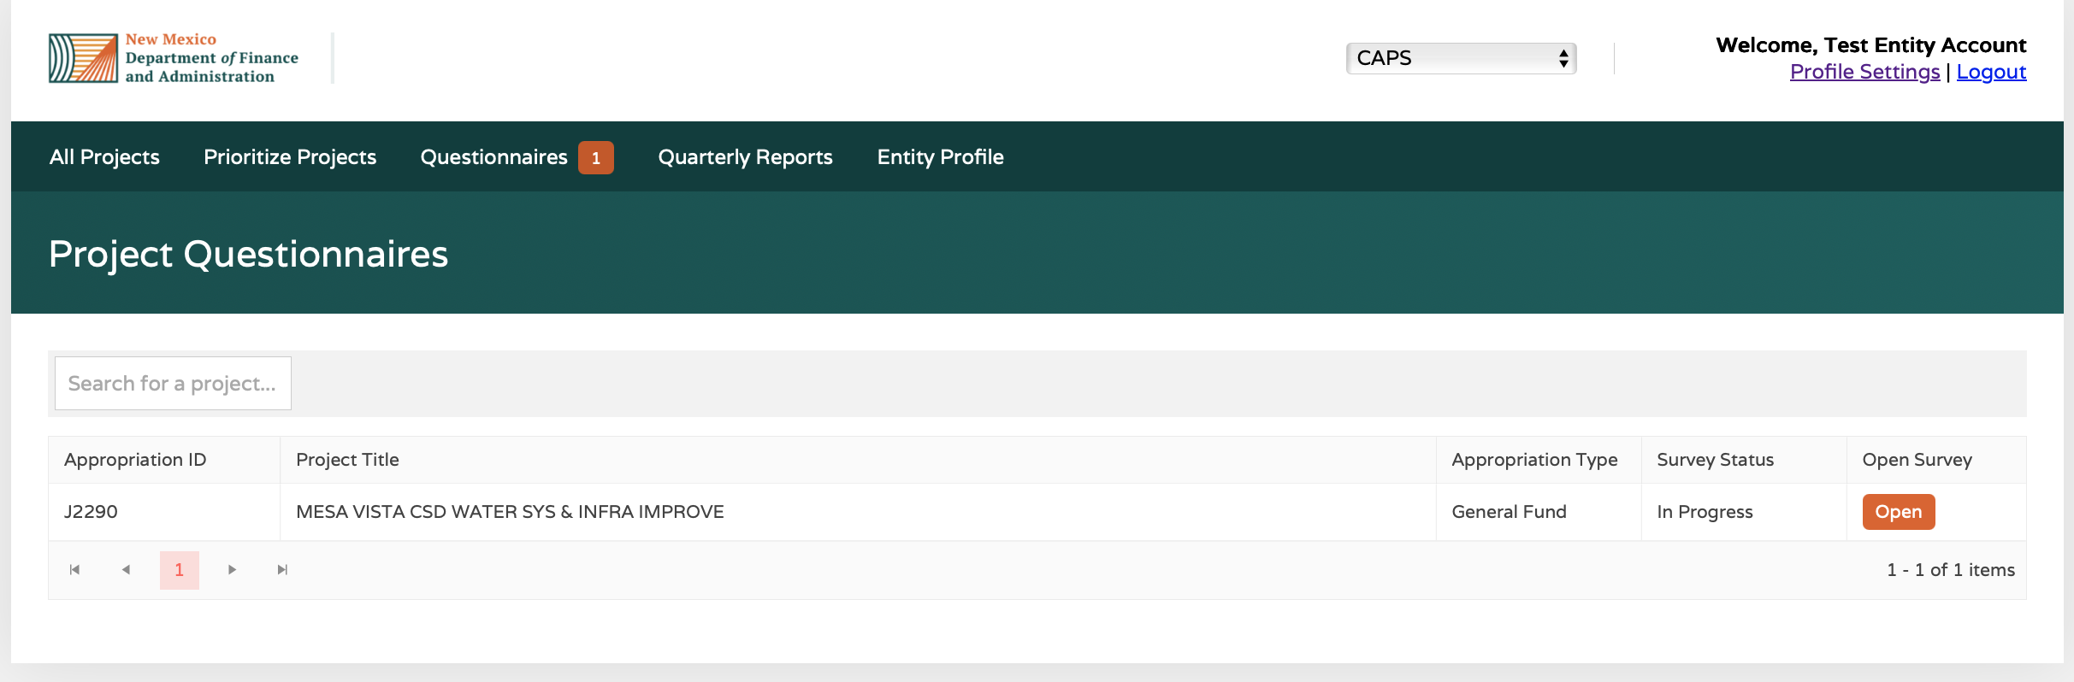
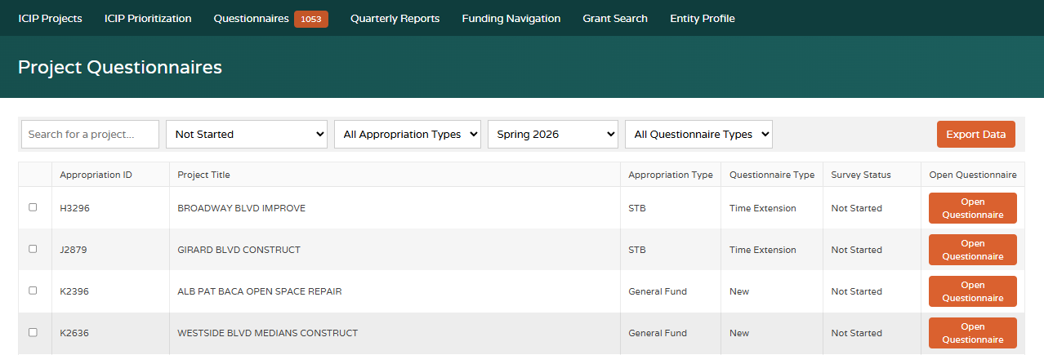
Questionnaire Access
Select the “Questionnaires” tab
Make sure you are in CAPS, if applicable
2
1
3
Start
Training is recorded & will be available here: https://www.nmdfa.state.nm.us/infrastructure-planning-and-development-division/icip-virtual-training/

Slide 9
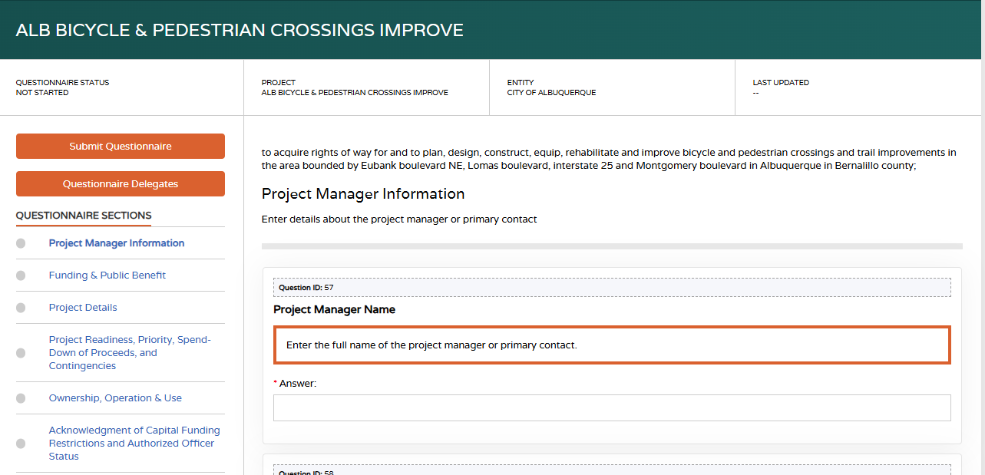
Questionnaire Orientation
Last updated
Questionnaire status
Submit button
Appropriation language
Sections of questionnaire
Training is recorded & will be available here: https://www.nmdfa.state.nm.us/infrastructure-planning-and-development-division/icip-virtual-training/

Slide 10
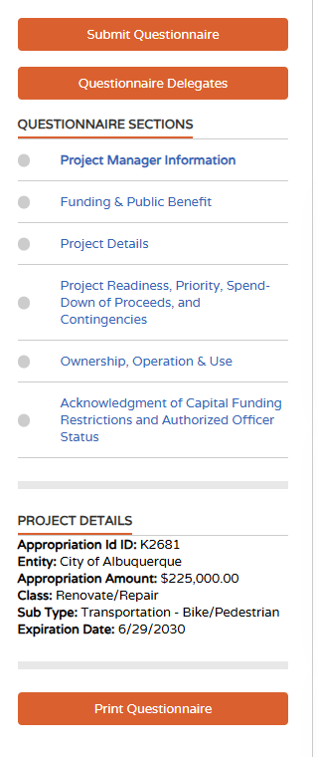
Questionnaire Orientation
Delegate
Key project details
Print
Training is recorded & will be available here: https://www.nmdfa.state.nm.us/infrastructure-planning-and-development-division/icip-virtual-training/

Slide 11
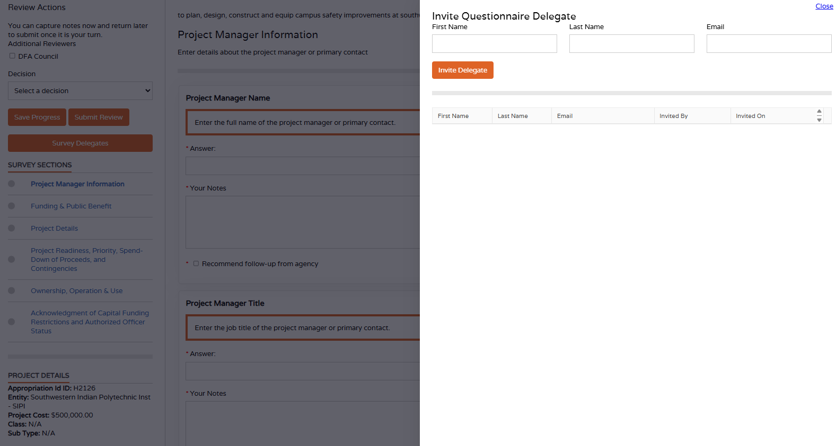
Delegations
Delegate
Delegates do not need to be users in the system.
Delegates will receive an email from CAPS
Training is recorded & will be available here: https://www.nmdfa.state.nm.us/infrastructure-planning-and-development-division/icip-virtual-training/

Slide 12
Historical Overview
Questionnaires Types
Type | Description
New | Full questionnaire for new project
Reauth | Reauthorized & full questionnaire
Time Extension | Truncated questionnaire
Training is recorded & will be available here: https://www.nmdfa.state.nm.us/infrastructure-planning-and-development-division/icip-virtual-training/

Slide 13
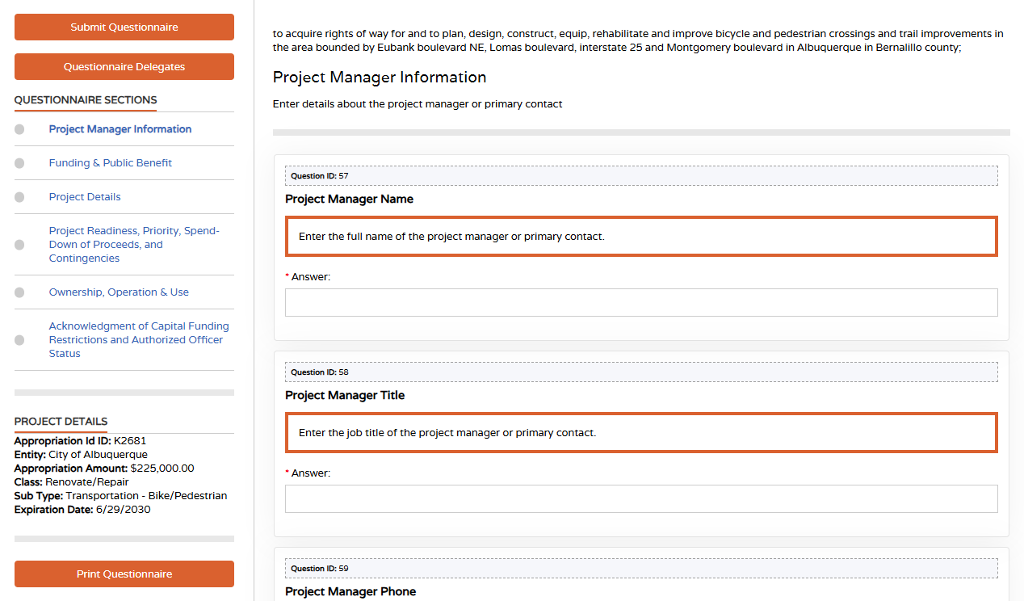
Historical Overview
Project Manager Information
Name
Title
Phone
Email
Complete or save (bottom of each section)
Training is recorded & will be available here: https://www.nmdfa.state.nm.us/infrastructure-planning-and-development-division/icip-virtual-training/

Slide 14
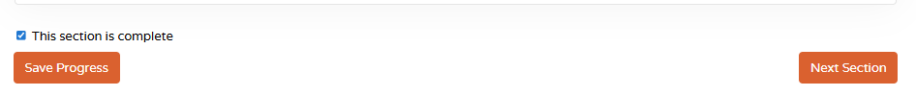
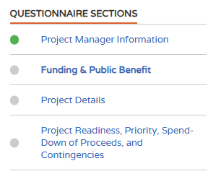
Historical Overview
Section Status
Complete & Next Section
In the next section, you will see a green status in the questionnaire section
Training is recorded & will be available here: https://www.nmdfa.state.nm.us/infrastructure-planning-and-development-division/icip-virtual-training/

Slide 15
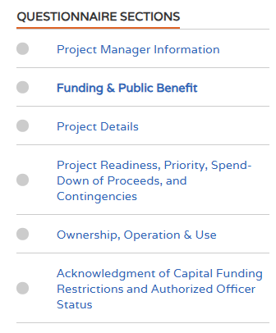
Historical Overview
Funding and Public Benefit
Note: some questions is this section are dependent/conditional
Are you requesting the total amount of the appropriation to be funded at this time?
Is the appropriation enough to fund EITHER the entire project OR a well-defined phase of the project if part of a larger project?
Training is recorded & will be available here: https://www.nmdfa.state.nm.us/infrastructure-planning-and-development-division/icip-virtual-training/

Slide 16
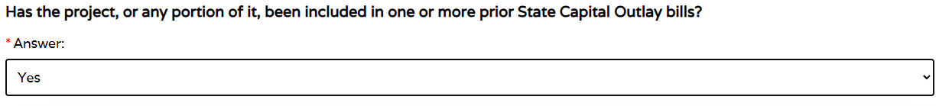
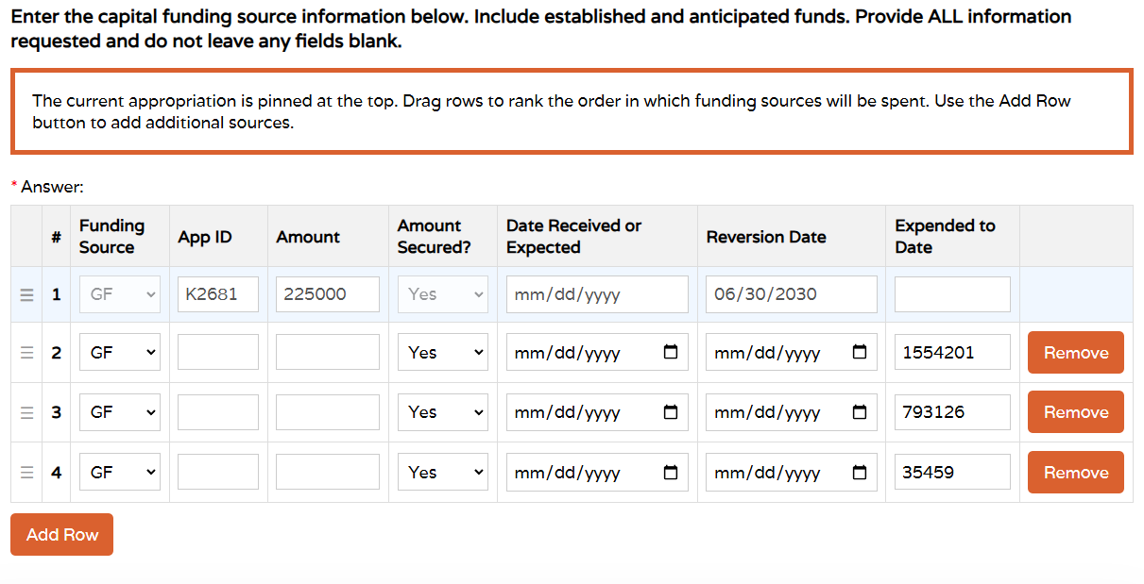
Historical Overview
Funding and Public Benefit
Prior Capital Outlay bills
Questionnaire
ICIP

Slide 17
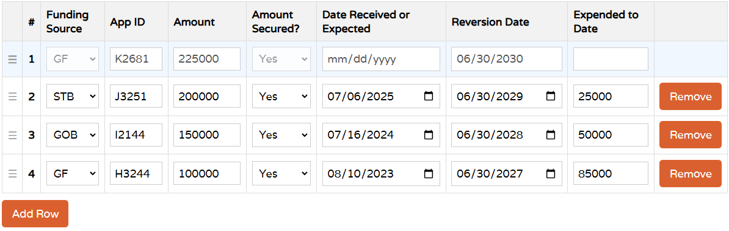
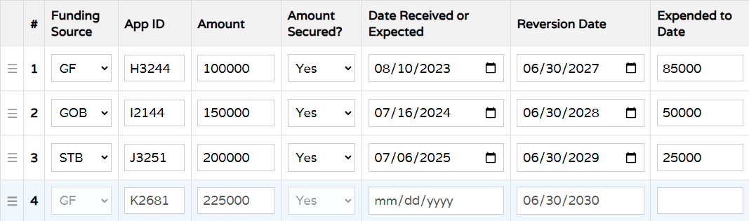
Historical Overview
Funding and Public Benefit
Step 1: complete info
Add or delete
Step 2: drag to prioritize
Training is recorded & will be available here: https://www.nmdfa.state.nm.us/infrastructure-planning-and-development-division/icip-virtual-training/

Slide 18
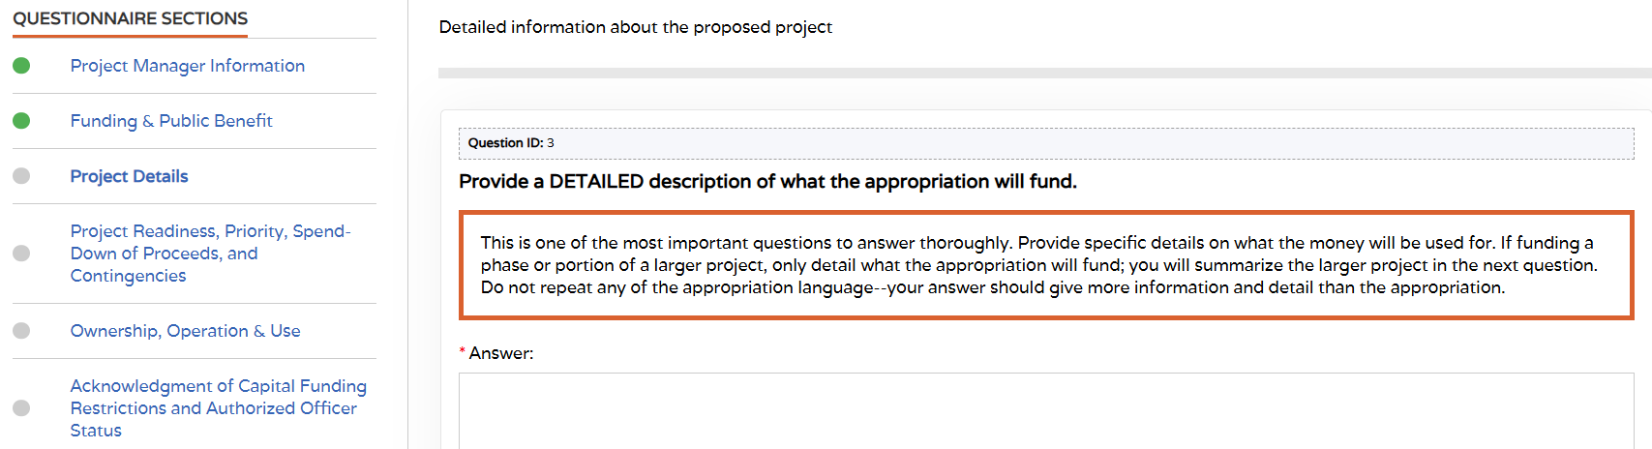
Historical Overview
Project Details
#1 reason for follow-up
Is it ready to go?
Is there a plan in place?
Training is recorded & will be available here: https://www.nmdfa.state.nm.us/infrastructure-planning-and-development-division/icip-virtual-training/

Slide 19
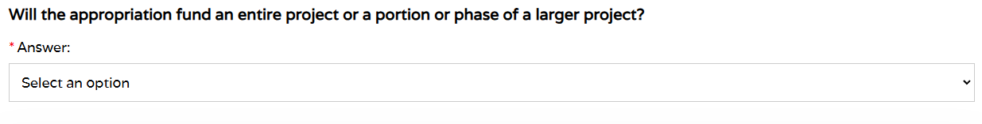
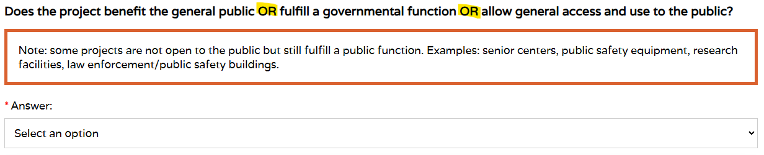
Historical Overview
Project Details
Training is recorded & will be available here: https://www.nmdfa.state.nm.us/infrastructure-planning-and-development-division/icip-virtual-training/

Slide 20
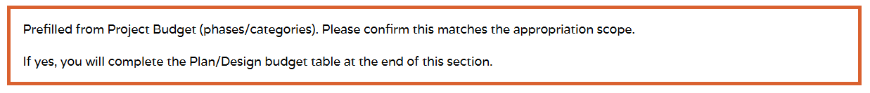
Historical Overview
Project Details
Training is recorded & will be available here: https://www.nmdfa.state.nm.us/infrastructure-planning-and-development-division/icip-virtual-training/

Slide 21
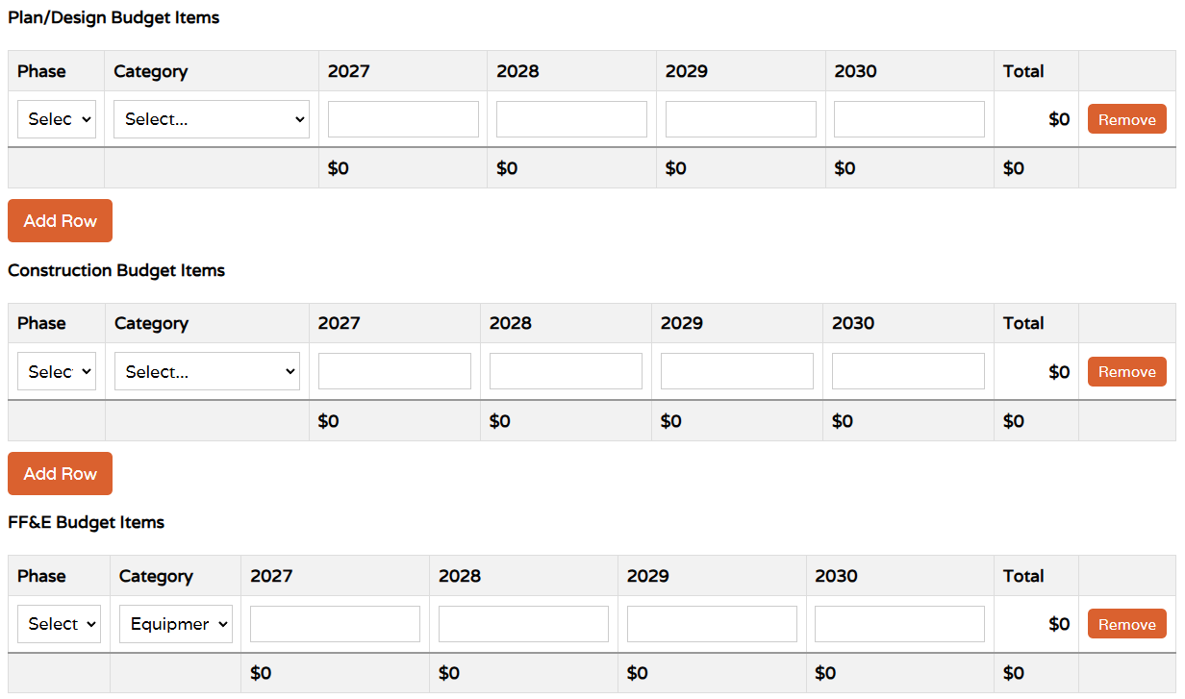
Historical Overview
Funding and Public Benefit
Budget table
Appear as phases based on previous responses
Select phase, category & enter annual amounts
Training is recorded & will be available here: https://www.nmdfa.state.nm.us/infrastructure-planning-and-development-division/icip-virtual-training/

Slide 22
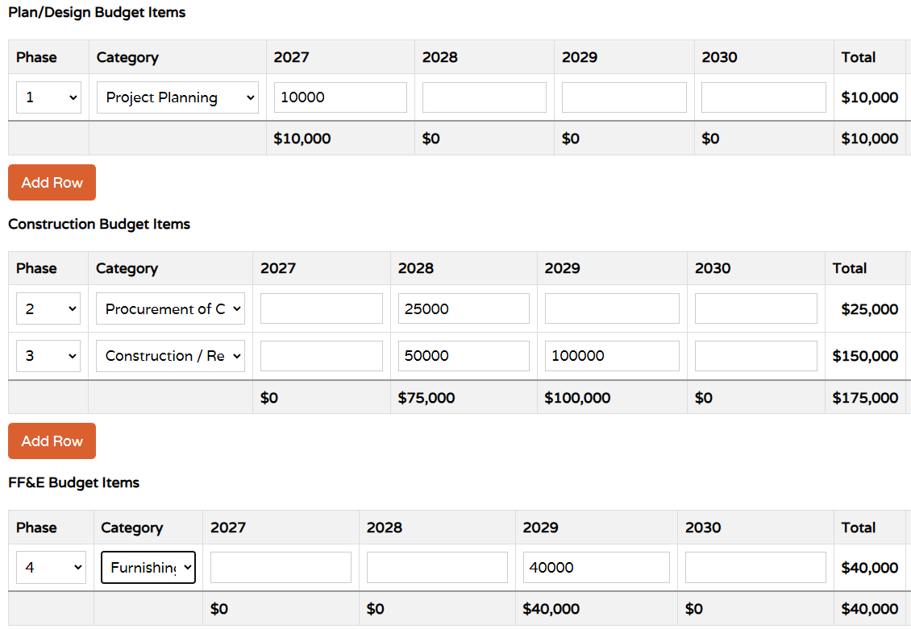
Historical Overview
Funding and Public Benefit
Budget table
Total budget amount must equal appropriation amount or error message will appear
Training is recorded & will be available here: https://www.nmdfa.state.nm.us/infrastructure-planning-and-development-division/icip-virtual-training/

Slide 23
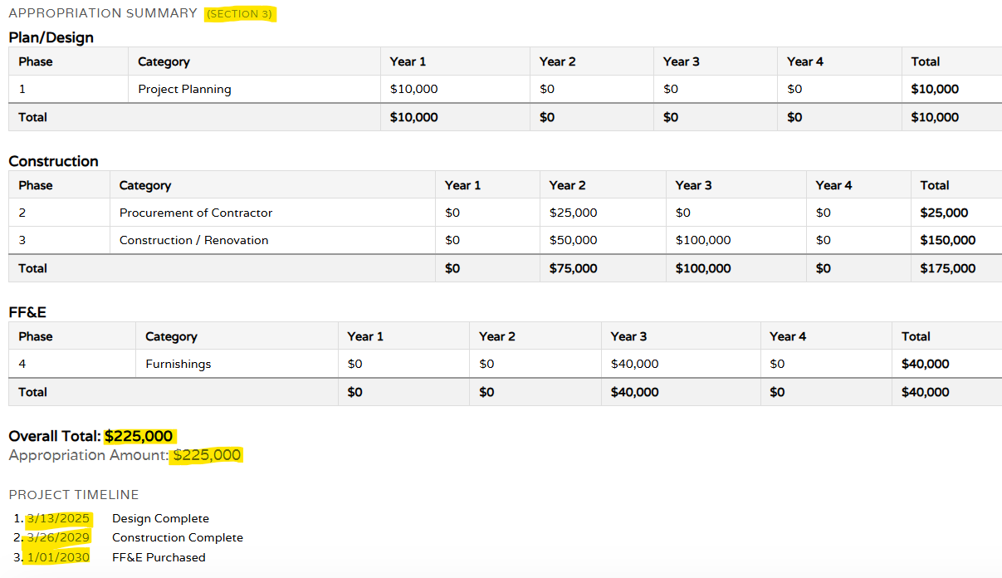
Historical Overview
Funding and Public Benefit
Summary & Timeline

Slide 24
Historical Overview
Project Readiness, Priorities, Spending, Contingencies
Can you obligate/encumber at least 5% of the appropriated funds by 12/25/2026?
Can you expend 85% of funds by:
  3 years from the bond sale?
  6 months before the grant expires?
Training is recorded & will be available here: https://www.nmdfa.state.nm.us/infrastructure-planning-and-development-division/icip-virtual-training/

Slide 25
Historical Overview
Ownership, Operation & Use
Who owns the property/equipment?
Are there private, non-profit, or federal government partnerships?
  If yes:
    What is their role?
    Do you already have an agreement in place?
Training is recorded & will be available here: https://www.nmdfa.state.nm.us/infrastructure-planning-and-development-division/icip-virtual-training/

Slide 26
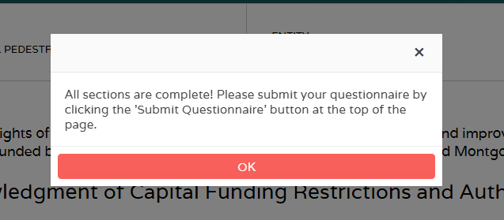
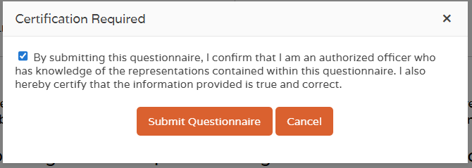
Historical Overview
Restriction Acknowledgement & Authorizing Officer
Once final section is complete, you receive notification, click “OK”
Click “Submit Questionnaire” Check the box
Click “Submit Questionnaire”
Training is recorded & will be available here: https://www.nmdfa.state.nm.us/infrastructure-planning-and-development-division/icip-virtual-training/

Slide 27
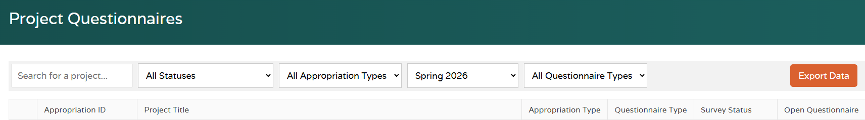
Historical Overview
Post Submission
Screen will refresh upon successful submission
Filter by status, fund type, questionnaire type
Search for project
Sort columns
Training is recorded & will be available here: https://www.nmdfa.state.nm.us/infrastructure-planning-and-development-division/icip-virtual-training/

Slide 28
Historical Overview
Follow-up Requested
Email notification will be sent and status will be “Follow-up Requested”
Click to revise/update & resubmit
Training is recorded & will be available here: https://www.nmdfa.state.nm.us/infrastructure-planning-and-development-division/icip-virtual-training/

Slide 29
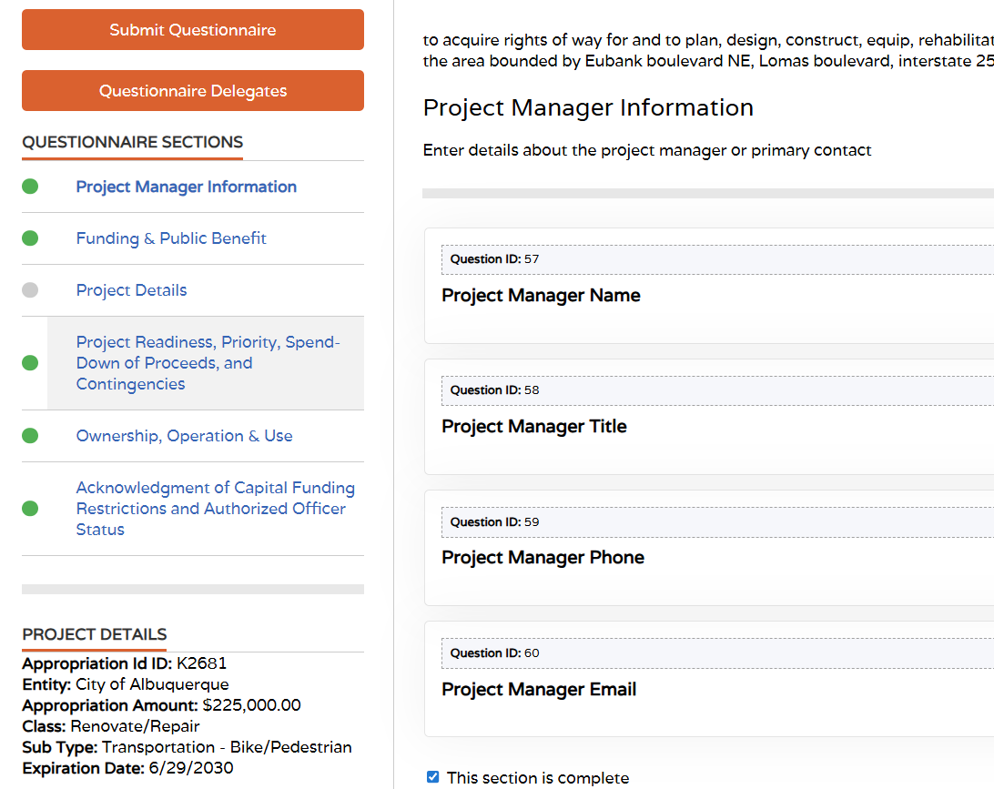
Historical Overview
Follow-up Requested
Focus on section(s) with gray circle
All other questions collapsed
Click to revise/update
Training is recorded & will be available here: https://www.nmdfa.state.nm.us/infrastructure-planning-and-development-division/icip-virtual-training/

Slide 30
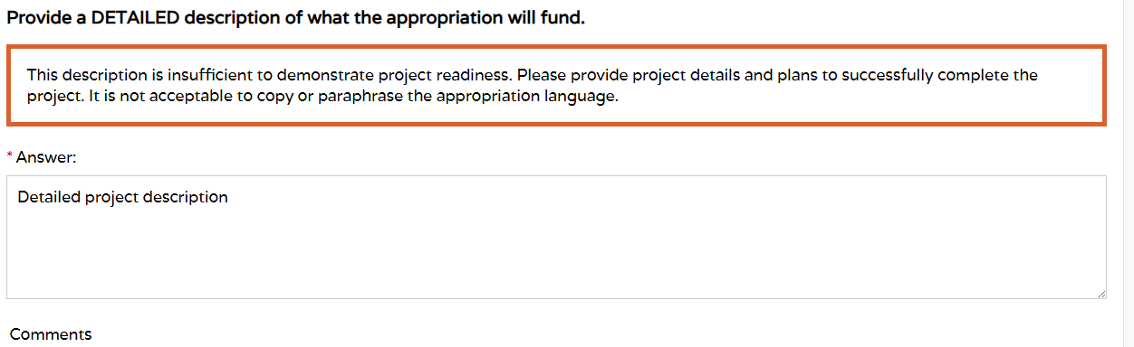
Historical Overview
Follow-up Requested
Focus on section(s) with gray circle
Revise response, then mark section as complete and resubmit until status is “ready”
Training is recorded & will be available here: https://www.nmdfa.state.nm.us/infrastructure-planning-and-development-division/icip-virtual-training/

Slide 31
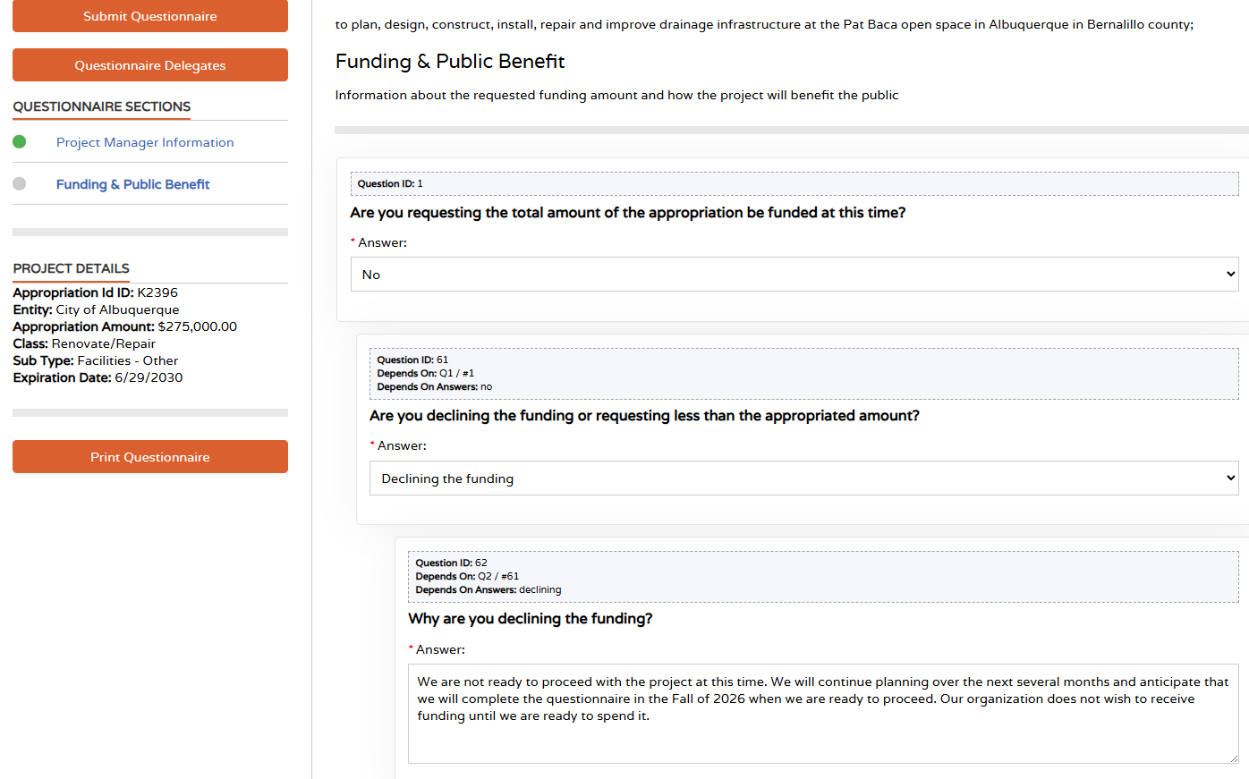
Historical Overview
Declining Funding
2 sections
Training is recorded & will be available here: https://www.nmdfa.state.nm.us/infrastructure-planning-and-development-division/icip-virtual-training/

Slide 32
Historical Overview
Declining Funding
Once second section is complete, you receive notification, click “OK”
Click “Submit Questionnaire” Check the box
Click “Submit Questionnaire”
Training is recorded & will be available here: https://www.nmdfa.state.nm.us/infrastructure-planning-and-development-division/icip-virtual-training/

Slide 33
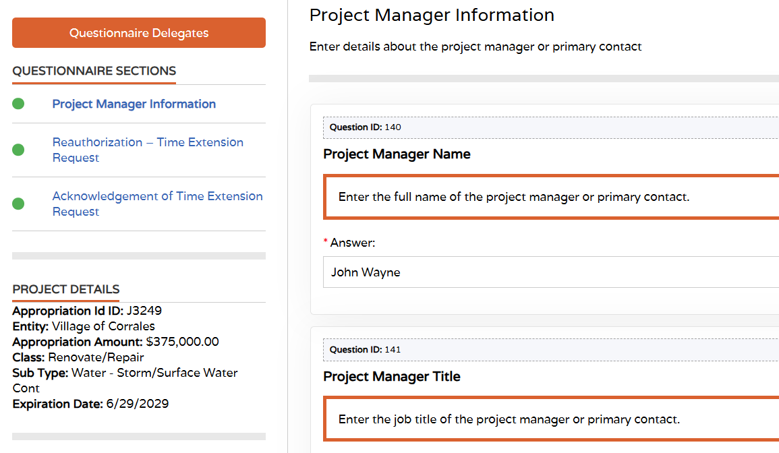
Historical Overview
Time Extension:
Project Manager Information
Name
Title
Phone
Email
3 sections
Training is recorded & will be available here: https://www.nmdfa.state.nm.us/infrastructure-planning-and-development-division/icip-virtual-training/

Slide 34
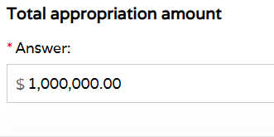
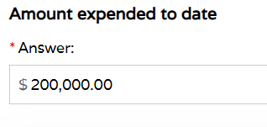
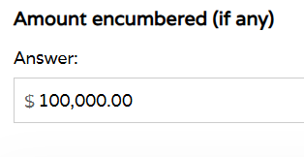
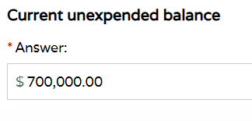
Historical Overview
Reauthorization – Time Extension Request
Training is recorded & will be available here: https://www.nmdfa.state.nm.us/infrastructure-planning-and-development-division/icip-virtual-training/

Slide 35
Historical Overview
Reauthorization - Time Extension Request
Percentage (%) of work complete
Remaining work description (#1 reason for follow-up)
Why is additional time necessary?
Causes of delay
Mitigation actions (#2 reason for follow-up)
Training is recorded & will be available here: https://www.nmdfa.state.nm.us/infrastructure-planning-and-development-division/icip-virtual-training/

Slide 36
Historical Overview
Acknowledgement of Time Extension
Once final section is complete, you receive notification, click “OK”
Click “Submit Questionnaire” Check the box
Click “Submit Questionnaire”
Training is recorded & will be available here: https://www.nmdfa.state.nm.us/infrastructure-planning-and-development-division/icip-virtual-training/

Slide 37
Questionnaire Status
Status | Definition
Entity Declined | Grantee not ready (yet)
Final Review | Final stage of DFA review
Follow-up Requested | Grantee needs to respond to questions and resubmit questionnaire
In Progress | Questionnaire started, not submitted
In Review | DFA started review
Not Ready | DFA decision not to budget
Ready | Project determined to be ready to budget
Training is recorded & will be available here: https://www.nmdfa.state.nm.us/infrastructure-planning-and-development-division/icip-virtual-training/

Slide 38
Historical Overview
Upcoming Trainings on Capital Outlay Reform
HB247
Wednesday, April 15 @ 1pm: municipalities & counties https://teams.microsoft.com/meet/23810586479069?p=QwzS34CxJCPq4Ut0ZP
Meeting ID: 238 105 864 790 69
Passcode: eT65Ua79
Thursday, April 16 @ 1pm: state agencies https://teams.microsoft.com/meet/220957482949?p=uTKbZW3jehapqXMasr
Meeting ID: 220 957 482 949
Passcode: ST6DQ2qX
Wednesday, April 22 @ 1pm: special districts https://teams.microsoft.com/meet/21969708183086?p=XiB8YBKd3Xnpn2gXq0
Meeting ID: 219 697 081 830 86
Passcode: Fa3i5Wa2
Training is recorded & will be available here: https://www.nmdfa.state.nm.us/infrastructure-planning-and-development-division/icip-virtual-training/

Slide 39
Historical Overview
Upcoming Trainings on Capital Outlay Reform
HB247
Thursday, April 23 @ 1pm: public schools https://teams.microsoft.com/meet/23629992001131?p=l7QC9zsSXlFhPTc78z
Meeting ID: 236 299 920 011 31
Passcode: bG6md7dN
Thursday, April 30 @ 1pm: Pueblos, Nations, Tribes https://teams.microsoft.com/meet/23755510815190?p=mFsd5rzNHXcju1Qk6A
Meeting ID: 237 555 108 151 90
Passcode: fx3bP3QR
Training is recorded & will be available here: https://www.nmdfa.state.nm.us/infrastructure-planning-and-development-division/icip-virtual-training/

Slide 40

DFA Contacts
Infrastructure Team
Board of Finance Team
Wesley Billingsley, Director wesley.billingsley@dfa.nm.gov
Scott Wright, Deputy Director scott.wright@dfa.nm.gov
Jesse Guillen, Bureau Chief jesse.guillen@dfa.nm.gov
Mary Ann Maestas, Local Entity Coordinator maryann.maestas@dfa.nm.gov
Ryan Serrano, State Agency Analyst ryans.serrano@dfa.nm.gov
Ashley Leach, Director ashley.leach@dfa.nm.gov
Jeannette Gallegos, Deputy Director
jeannette.gallegos@dfa.nm.gov
Nick Gonzales, Financial Analysis Specialist nicholas.gonzales2@dfa.nm.gov

