Slide 1
Excel Essentials Part 2
Lauren Conley
DFA Federal Reporting and Compliance Bureau

Slide 2
  Before we get started….
  Practice and Patience makes proficient!
    Identify where you struggled and re-watch the recording again and again!
  Please follow along - Explanation > Demonstration > Together!
  Two monitors, or two windows on one screen, is ideal
  There are many ways to perform a task, my way might be different from your way
  There will be breaks to ask questions and repeat content
  You already have the slides!
  __________________________________________________________________________________
  Agenda
  Run a SHARE Query
  View Tab
  Pivot Tables
  Slicers
  Keyboard Shortcut practice using Personal Budget tab

Slide 3
  SHARE Queries
Chart Field Descriptions
CHART_OF_ACCTS_CURRENT
DEPTS_BY_AGENCY
FUND_LISTING_DESC1
Accounts Payable/Procurement
NMS_REQUISITION_LISTING
NMS_PO_LISTING_DESCR
NMS_VCHR_REVIEW_DESCR1
NMS_AP_VCHRS_DENIED
NMS_VCHR_BUDGET_ERROR
NMS_VCHR_MATCH_EXCEPTIONS
NMS_AP_JRNL_DETAIL_FUND
  Don’t forget to reconcile this to the GL to account for any journal entry changes!
General Ledger
NMS_GL_JOURNAL_LINE
Cash
NMS_OUTSTANDING_WARRANTS
NMS_BANK_TRANS_SEARCH_BY_AMT
NMS_DFA_CASH_REPORT_V3_PUB
NMS_AR_DJ_ENTRIES_CASH_REMED

Slide 4
Questions to ask when deciding which query:
  What is your end goal or the purpose of running the query?
  Who will be the users of this data? And how will they use it?
  How will you use this data?
  What does the query data consist of?
  How is the data organized in the query?
  Do the column headers indicate the data that you need?
  Is there data missing that you’d like to include?
    Will you need to combine multiple data sources or choose a different query?

Slide 5
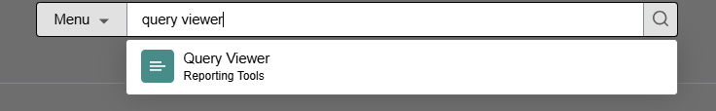
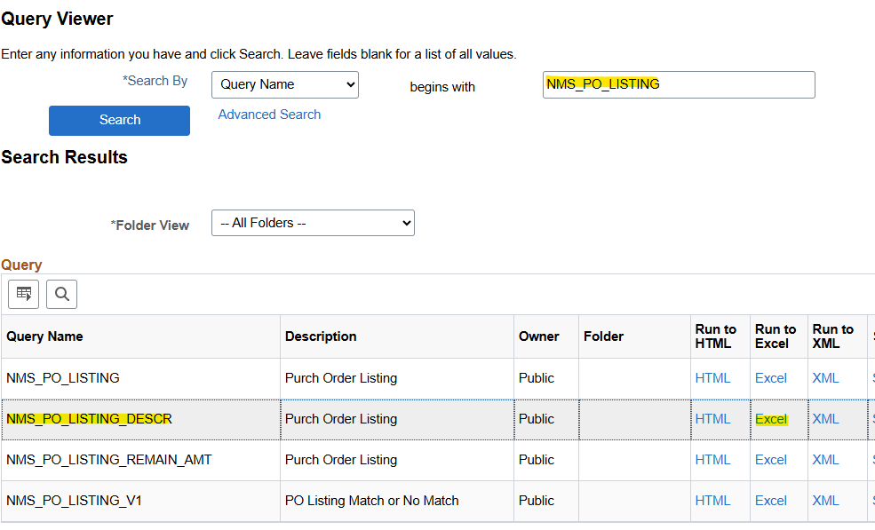
Log in
Log into SHARE - FSCM
Search for Tile
Search for QUERY VIEWER from the home page
Search for Report
Search for NMS_PO_LISTING_DESCR
Export
Export, Run to Excel

Slide 6
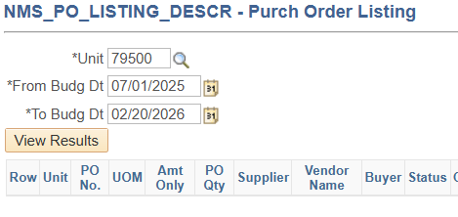
  Note: you get a preview of the column headers in this screen.
  Unit: use your business unit / agency number
  From Budg Dt: day one of fiscal year 2026 (personal preference)
  To Budg Dt: Today
  View Results
  If you have a yellow bar at the top of your excel data – Enable Editing
Download the Excel File

Slide 7
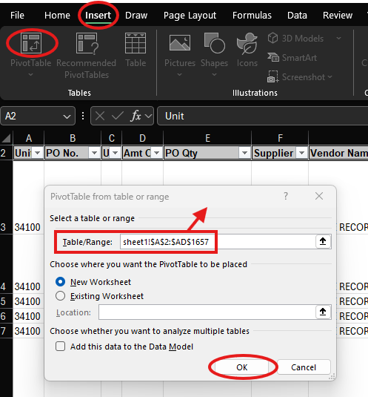
Insert pivot table
= Ctrl + A
Ensure the data range captures data from the top left to the bottom right, including headers!

Slide 8
Steps to Insert a PivotTable:
Select your data: Click any single cell inside the data set you want to analyze.
Go to the Insert tab: Click on the "Insert" tab in the ribbon at the top of Excel.
Click on PivotTable: In the Tables group, click "PivotTable".
Choose the data range: Ensure the Table/Range input has correctly identified your data source. Making changes on this screen is not common.
Click OK: A new worksheet will be created with the PivotTable Field List, allowing you to arrange your data as needed.

Slide 9
  Take a moment to get familiar with the pivot table!
How does your agency use chart fields?
    Is your department code based on Division/Bureau, Grant, or other?
Add the Status to see what has been denied
Is it more beneficial for you to organize it first by Supplier ID or Fund? PO number or PO Date?

Slide 10
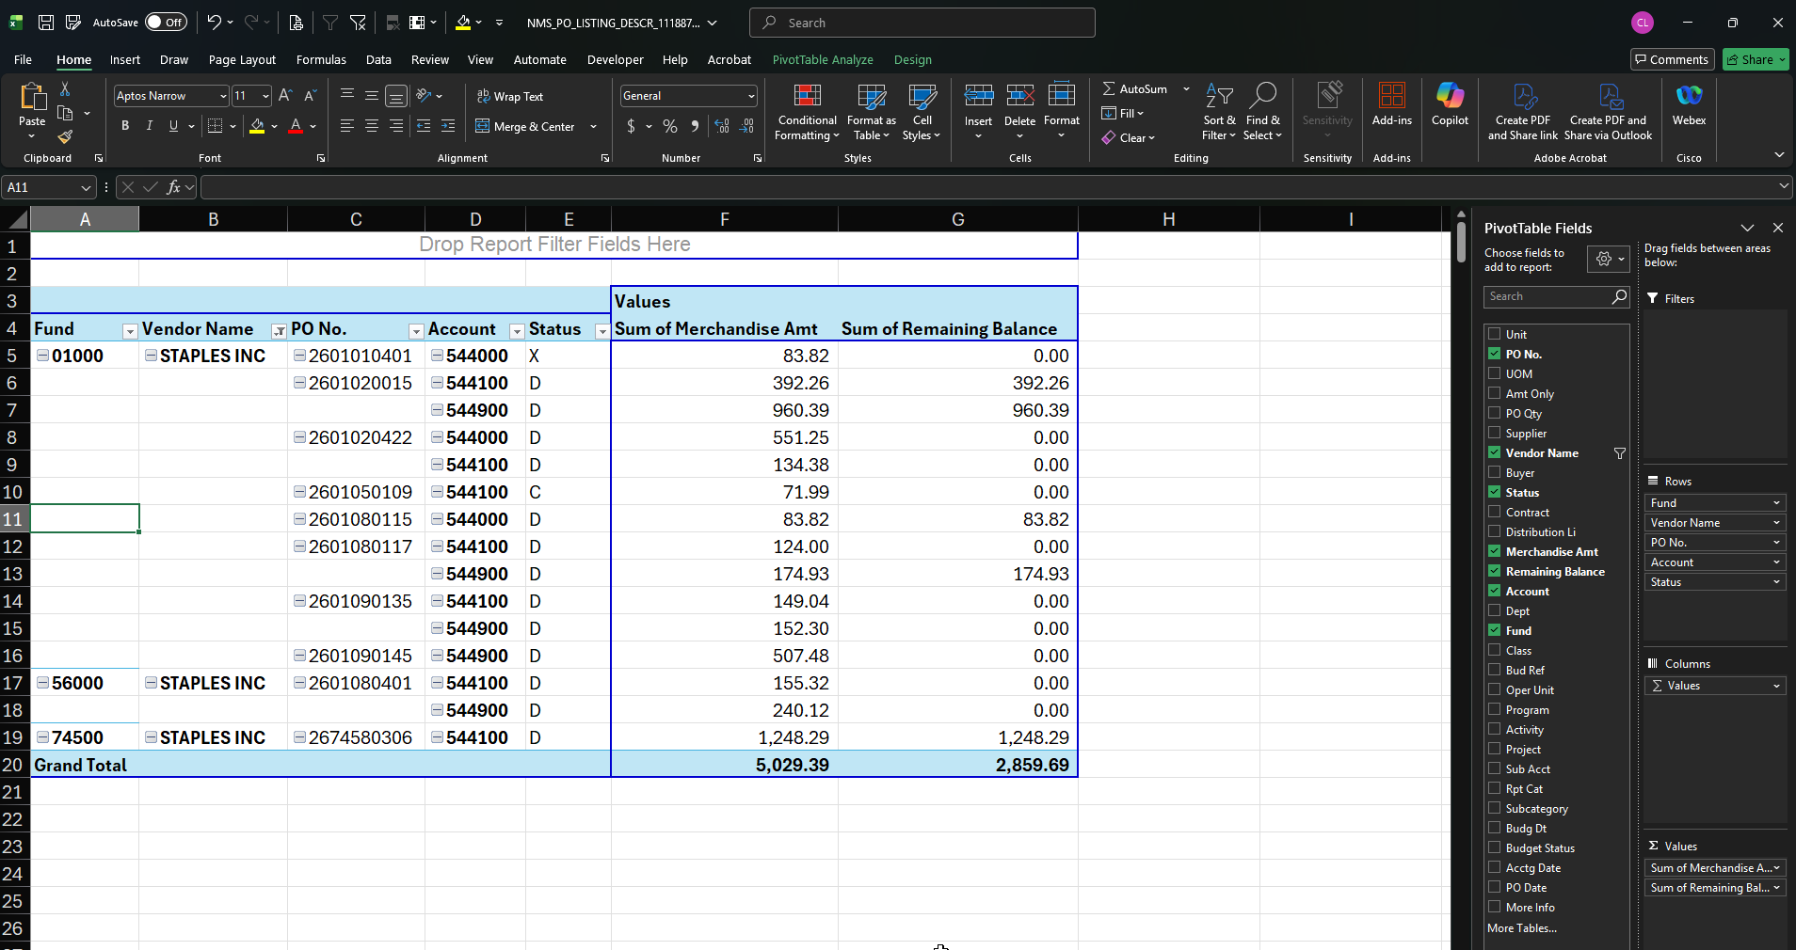
Example PO listing PivotTable –
Notice the filter on Vendor name, the order in which I have organized the rows, and the information I found useful for the users of this data.

Slide 11
Let’s take a break.
What questions do you have?

Slide 12
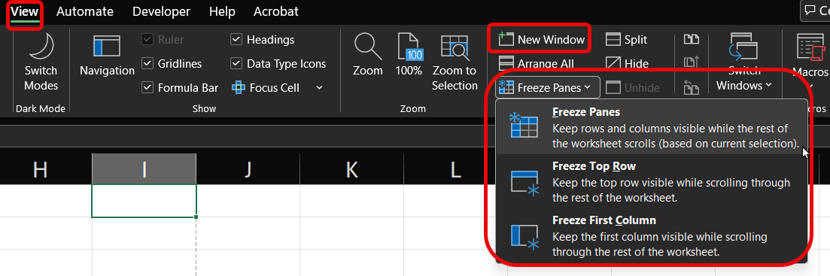
View Tab
Workbook Views:
  Click a View button in the status bar.
  Or click the View tab and select a view.
Show:
  Click each checkbox to see what happens!
Zoom
  Hold down Control and scroll with your mouse
  Hold down Control + Shift and scroll with your mouse
New Window:
  Open an additional window to work in different places at the same time
Freeze Panes:
  Freeze a portion of the sheet to keep it visible while you scroll
  Before you freeze panes… Where you put your active cell matters!
    I like to put mine in the “armpit” of the rows and columns to freeze. If I just want the headers to freeze, I will highlight the entire row below headers.

Slide 13
The Layout Group
Subtotals: Show or hide subtotals and specify their location in the PivotTable.
Grand Totals: Add or remove grand total rows for columns and/or rows.
Report Layout: Adjust the report layout to show in compact, outline, or tabular form.
Blank Rows: Emphasize groups of data by manually adding blank rows between grouped items.

Slide 14
Slicers
Quick Filtering: Instantly filter data without navigating dropdown menus.
Clear Filter Visibility: Always shows which filters are active, reducing confusion.
Dashboard Enhancement: Makes reports interactive and visually appealing, ideal for dashboards.
Multiple Table Control: One slicer can control multiple PivotTables, ensuring consistent filtering across reports.

Slide 15
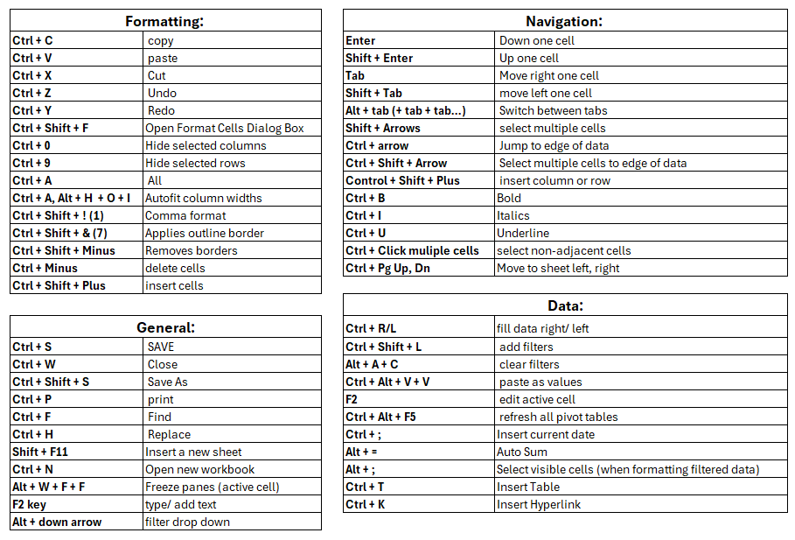

Slide 16
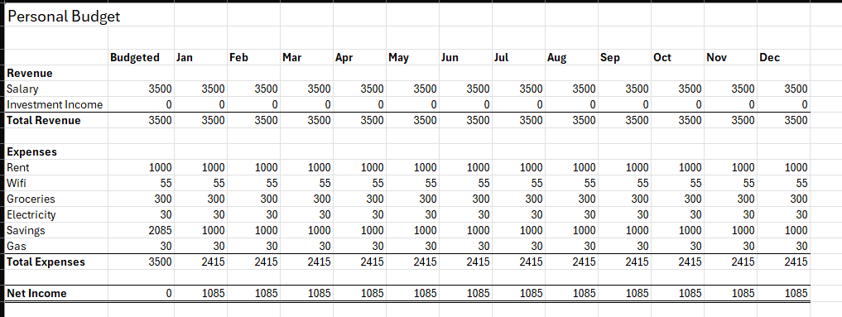
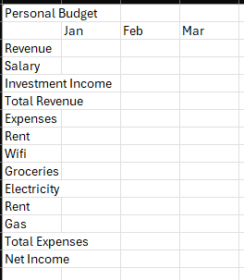
Use Keyboard Shortcuts to complete this budget:

Slide 17
Fun tips & Questions for the group
Add ‘ to the front of any text to maintain the format AND leading zeros
Hold down control + shift, scroll with mouse left and right
Hold down control and drag a sheet left or right to copy
  You can also drag sheet into another file, but this will not create a copy
In the survey:
  Share your favorite shortcuts or functions in the survey. Maybe even your favorite formulas!
  What do you want to learn more about (Excel or otherwise)?

Slide 18
Upcoming Trainings!
When: May 14, 2026 10:00 AM Mountain Time (US and Canada) (1 Hour)
Topic: Schedule of Expenditures of Federal Awards (SEFA), Fiscal Year End Discussion
Register in advance for this webinar:
https://us02web.zoom.us/webinar/register/WN_QaftBrd6QE27dYRj6PoV7Q
When: May 19, 2026 10:00 AM Mountain Time (US and Canada) (1.5 Hours)
Topic: SHARE Navigation for Procurement
Register in advance for this webinar:
https://us02web.zoom.us/webinar/register/WN__JasQdf6Tdu5eC9ZFaI_Pg

