Slide 1
Excel Essentials
Lauren Conley
Federal Reporting and Compliance Bureau Chief
Department of Finance and Administration

Slide 2
Before we get started….
  Practice makes proficient!
    Identify where you struggled and re-watch the recording again and again! See the last slide for additional resources.
  This session will be a practical demonstration using SHARE queries
  Please follow along - participate and replicate the tasks to the best of your abilities
    Two monitors or having two windows on one screen is ideal
  There will be breaks to ask questions and repeat content
  There are many ways to perform a task, so my way might be different from your way
  __________________________________________________________________________________
  Important terms and tools
  Queries
  Get set up
    Quick Access Tool Bar
    Classic Pivot Table
  Pivot tables
  Filters
  Formulas & Functions

Slide 3
Terms & Tools
Column/Row Headers = A, B, C…; 1, 2, 3…
Green box = active cell
Cell reference = cell address
Range = group of cells
Cursor
  White plus sign = default
  Thin black plus sign = fill handle, appears at the bottom-right corner of a cell
  I-beam = editing text inside cell or formula bar
  Double arrow = click & drag to adjust width of Column/row headers
Ribbon pane = dynamic tool bar
Tab = group of related commands
Worksheet = individual pages
Raw data = data that has not been manipulated
Data headers = label to organize columns/rows of data
“Crawling ants” = dashed border, indicates that cell contents and formatting are in your clipboard and ready to paste
Ctrl + A = All
Ctrl + S = SAVE
Ctrl + C = copy
Ctrl + V = paste
Ctrl + X = Cut
Ctrl + P = print
Ctrl + R/L = drag data right/ left
Alt + tab = switch between tabs
Ctrl + arrow = jump to edge of data
Ctrl + Shift = select cells
Ctrl + Shift + Arrow = select to edge of data
Bonus:
Ctrl + Shift + L = add filters
Alt + A + C = clear filters
Ctrl + Alt + V + V = paste as values
F2 = edit active cell
Ctrl + Alt + F5 = refresh all pivot tables

Slide 4
  SHARE Queries
Chart Field Descriptions
CHART_OF_ACCTS_CURRENT
DEPTS_BY_AGENCY
FUND_LISTING_DESC1
Accounts Payable/Procurement
NMS_REQUISITION_LISTING
NMS_PO_LISTING_DESCR
NMS_VCHR_REVIEW_DESCR1
NMS_AP_VCHRS_DENIED
NMS_VCHR_BUDGET_ERROR
NMS_VCHR_MATCH_EXCEPTIONS
NMS_AP_JRNL_DETAIL_FUND
  Don’t forget to reconcile this to the GL to account for any journal entry changes!
General Ledger
NMS_GL_JOURNAL_LINE
Cash
NMS_OUTSTANDING_WARRANTS
NMS_BANK_TRANS_SEARCH_BY_AMT
NMS_DFA_CASH_REPORT_V3_PUB
NMS_AR_DJ_ENTRIES_CASH_REMED

Slide 5
Questions to ask when deciding which query:
  What is your end goal or the purpose of running the query?
  Who will be the users of this data? And how will they use it?
  How will you use this data?
  Do the column headers indicate the data that you need?
  Is there data missing that you’d like to include?
    Will you need to combine multiple data sources or choose a different query?

Slide 6
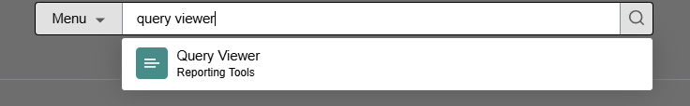
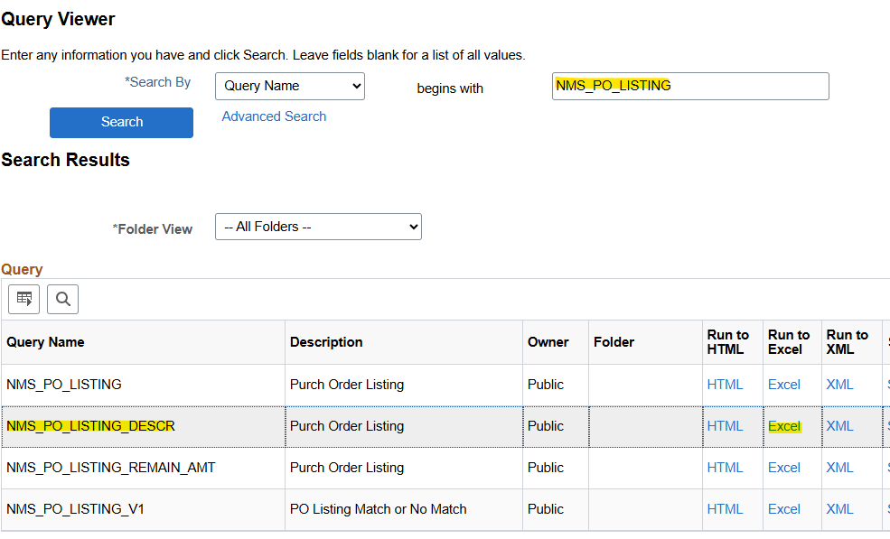
Log in
Log into SHARE - FSCM
Search for Tile
Search for QUERY VIEWER from the home page
Search for Report
Search for NMS_PO_LISTING_DESCR
Export
Export, Run to Excel

Slide 7
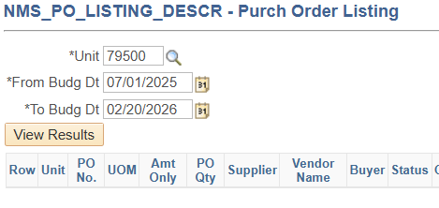
  Note: you get a preview of the column headers in this screen.
  Unit: use your business unit / agency number
  From Budg Dt: day one of fiscal year 2026 (personal preference)
  To Budg Dt: Today
  View Results
  If you have a yellow bar at the top of your excel data – Enable Editing
Download the Excel File

Slide 8
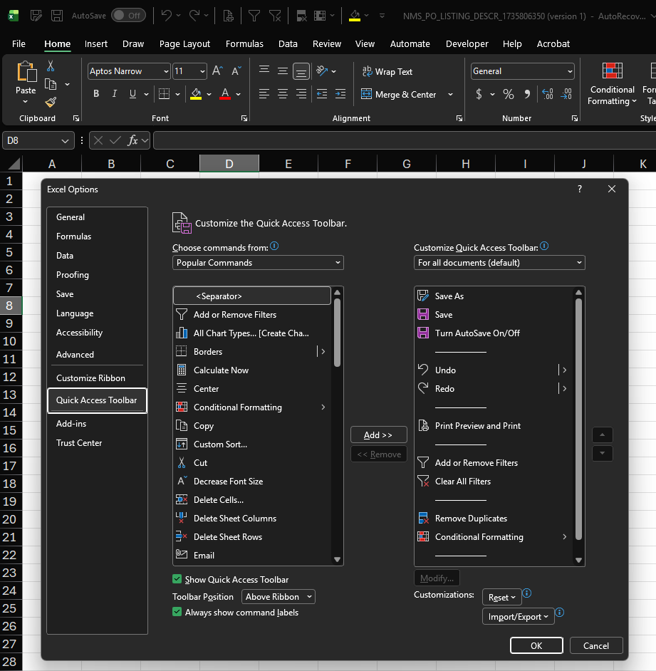
Quick Access Toolbar

Slide 9
Set Default Pivot Table Format
Set Default Pivot Table Format
A default format for PivotTables in Excel ensures consistency across your reports. Follow these steps to set your preferred default layout:
1. Open Excel Options
Go to File > Options.
2. Navigate to Data Options
In the Excel Options dialog box, select Data from the left-hand menu.
3. Edit Default Layout
Click on the Edit Default Layout button under the "Data" section.
4. Customize Layout Settings
  Subtotals: Choose to show subtotals at the top or bottom of each group, or hide them entirely.
  Grand Totals: Turn grand totals on or off for rows and columns.
  Report Layout: Select from Compact, Outline, or Tabular layout.
PivotTable Options: Access additional settings through the standard PivotTable options dialog.
  Navigate to the Display tab
  Check the box for “Classic PivotTable Layout”
  Click OK
5. Click OK and OK again to save your changes

Slide 10
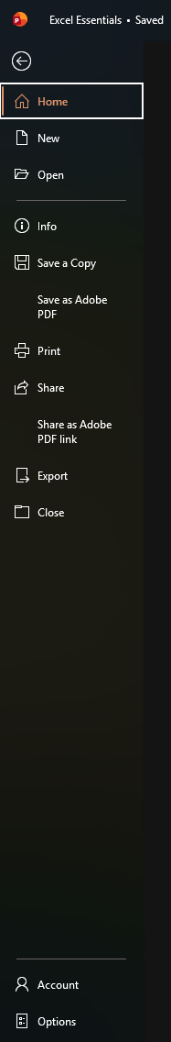
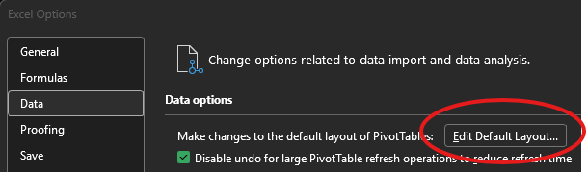
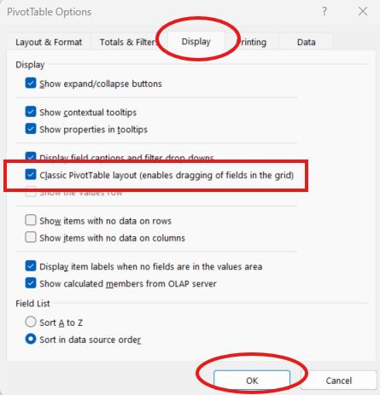
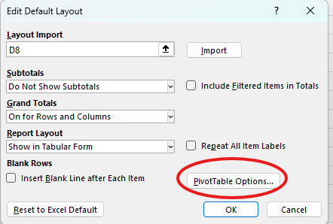
START:
File tab

Slide 11
  PIVOT TABLES!
A pivot table is a condensed version of your raw data that allows you summarize and analyze large sets of data quickly
The way you organize your pivot table depends on your audience and what you’re aiming to analyze. Ask the same questions as before:
  What is your end goal or the purpose of your pivot table?
  How will you use this data?
  Who will be the users of this data? And how will they use it?
  Do the column headers / PivotTable Fields indicate the data that you need?
    Will you need to combine multiple data sources?
    Should you run a different query instead?

Slide 12
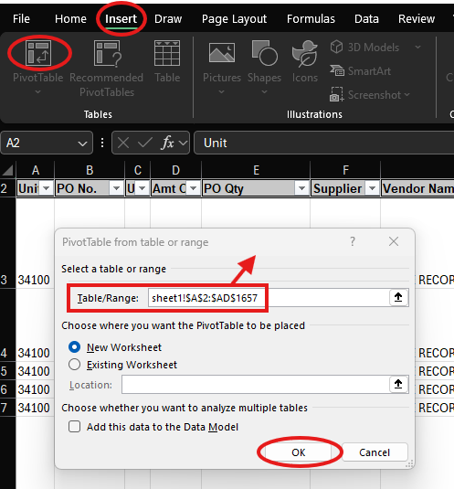
Insert pivot table
= Ctrl + A
Ensure the data range captures data from the top left to the bottom right, including headers!

Slide 13
Steps to Insert a PivotTable:
Select your data: Click any single cell inside the data set you want to analyze.
Go to the Insert tab: Click on the "Insert" tab in the ribbon at the top of Excel.
Click on PivotTable: In the Tables group, click "PivotTable".
Choose the data range: Ensure the Table/Range input has correctly identified your data source.
Click OK: A new worksheet will be created with the PivotTable Field List, allowing you to arrange your data as needed.

Slide 14
  Take a moment to get familiar with the pivot table!
How does your agency use chart fields?
    Is your department code based on Division/Bureau, Grant, or other?
Add the Status to see what has been denied
Is it more beneficial for you to organize it first by Supplier ID or Fund? PO number or PO Date?

Slide 15
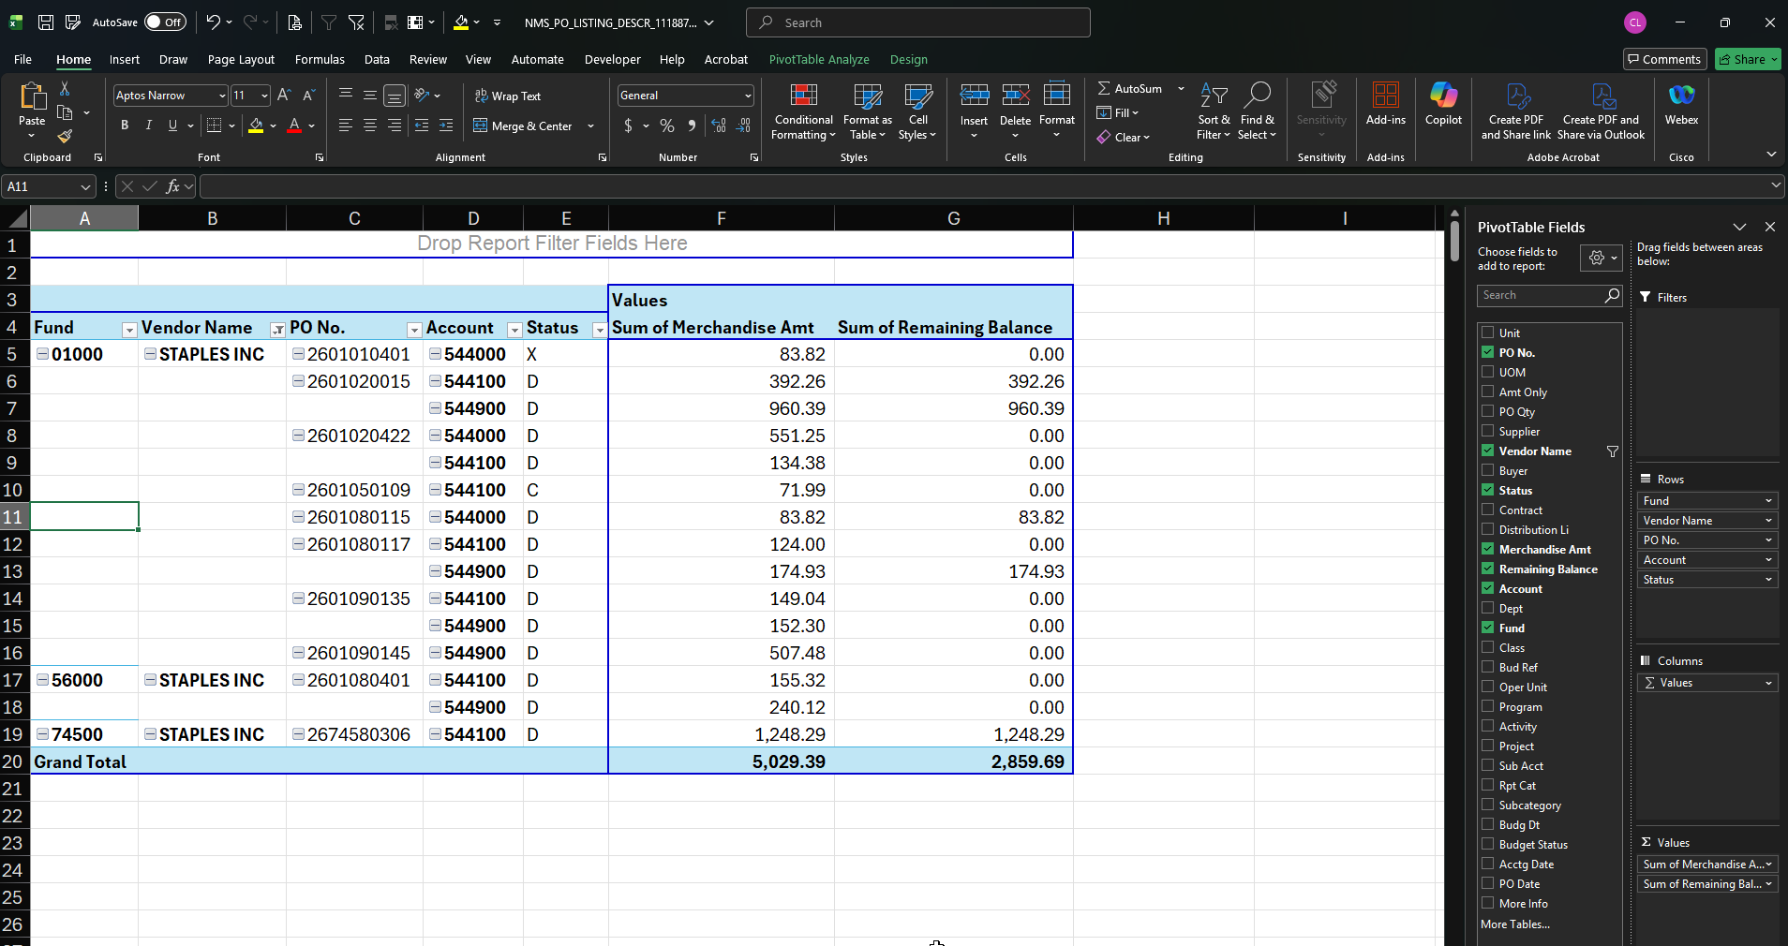
Example PO listing PivotTable –
Notice the filter on Vendor name, the order in which I have organized the rows, and the information I found useful for the users of this data.

Slide 16
  FILTERS!
Excel filters allow you to display only the data that meets specific criteria while temporarily hiding the rest, making it easier to analyze and manage large datasets
  They do not delete data; instead, they temporarily hide rows that do not match the filter criteria, allowing you to focus on relevant information.
  You can combine multiple filters across columns for complex data analysis. The order in which they are applied matters!

Slide 17
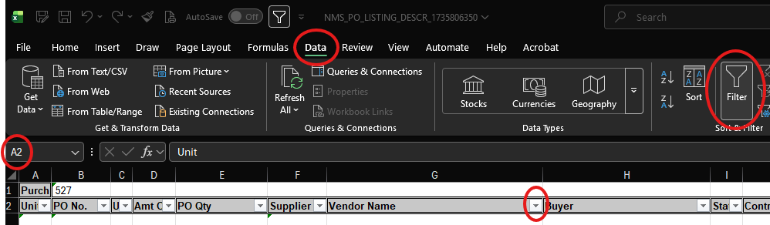
Add Filters
Select any cell in your data range or table (I prefer to put my cursor in A2).
Go to Data > Filter to add filter arrows to column headers.
Click the arrow in the column you want to filter.
Choose your filter criteria (check boxes, text, number, or date filters).
Click OK to apply the filter.
To remove a filter, click Clear on the Data tab or remove the filter arrows entirely.

Slide 18
  Take a moment to get familiar with the filters!
Filter Vendor Name for one that you’re familiar with – Staples, DoIT, etc.
Filter Status to determine if your division has any denied POs (DA)
Filter Dept to see all POs for that code
Clear all filters

Slide 19
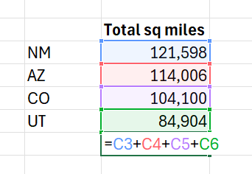
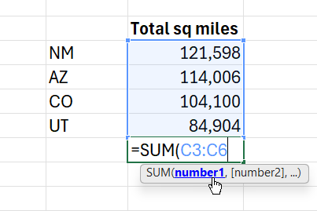
Formula vs.
Function
Formula = DIY calculation
=2+2
Function = built-in calculation
=SUM(2,2)

Slide 20
Functions
Every function starts with =
“Arguments” are the data points used in the function
In between each argument, there must be a comma
When in doubt, use “Insert a Function” command in the Formulas tab
  This option will provide a description of the function and guide you through the arguments
Not all functions are mathematical!
  Text, dates, hyperlinks
Common Functions:
=XLOOKUP(…
=SUM(…
=SUBTOTAL(9,
=SUMIF(… =SUMIFS(…
=COUNT(…
=LEFT(… =RIGHT(…
=TODAY(…
=DAYS(…

Slide 21
$ Cell Reference $
Relative – adjusts automatically when you copy a formula into another cell (A1)>(B1)
Absolute – references remain constant or fixed, regardless of where the formula is moved ($A$2)>($A$2)
Mixed – a combination of absolute and relative where a portion of the reference is fixed and the other is not ($A1)>(A$2)
Note: Find YouTube videos that explain in depth particular functions and the impact cell references will have on your output.

Slide 22
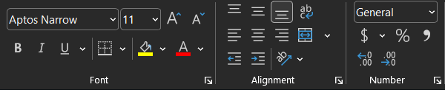
Ctrl +
Note: Explore the formatting in the Home ribbon. When dealing with financial data, it will be useful to understand the difference between Number Format options, moving decimal places, and adding separators (commas) to your dataset.

Slide 23
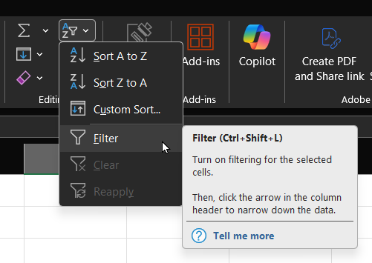
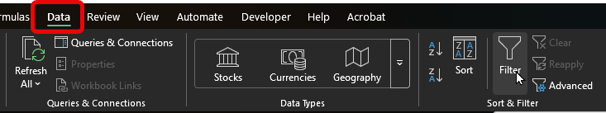
Note: There are many ways to achieve your Excel goals. As an example, you can find the Filter command in many different locations.

Slide 24
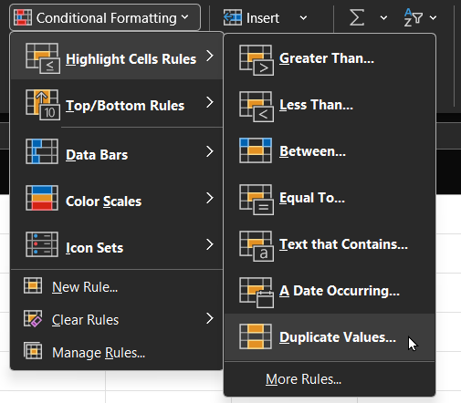
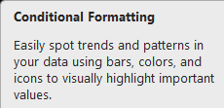
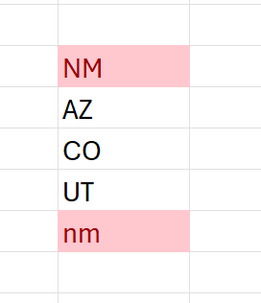
Note: There are countless YouTube videos on this command alone. Start there if you want to apply specific rules to your data to be emphasized.

Slide 25
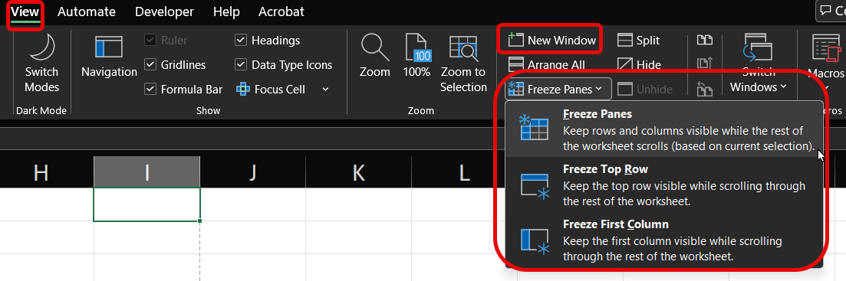

Note: your cursor/active cell placement matters!
I like to put mine in the “armpit” of the rows and columns to freeze. If I just want the headers to freeze, I will highlight the entire row below headers.

Slide 26
Additional Resources: click on the hyperlink
3/17/2026 Session
Excel Tutorial for Beginners | How to Use Excel
How to Use PivotTables in Excel: Beginner to Advanced
Cell References in Excel | Detailed Guide for Beginners
XLOOKUP in Excel Tutorial
Excel Conditional Formatting: Beginners to Advanced

