Slide 1

Operating Budget Instructions fiscal year 2027
Cecilia Mavrommatis, Mobile Budget & Policy Advisor
State Budget Division

Slide 2
Operating Budget Due Dates and Submission Requirements
Budget submission is due Friday, May 1 by statute
Important Announcement: If you are from one of the following agencies - DWS, GSD, DHOH, PED, Miners Hosp, Cumbres, AOC – you will need to submit an opbud3 journal outside the BFM system to correctly set up your budget. Please reach out to your DFA analyst for further instructions if needed.
Please follow this procedure to submit your operating budget:
Put together one complete submission of your operating budget per the checklist of required items.
Scan it in as a PDF and label as BU XXX FY27 Operating Budget Submission
Email to the following:
Your SBD analyst
DFA Submissions email DFASBD.Submissions@dfa.nm.gov
Your LFC analyst
LFC Submissions lfc@nmlegis.gov
Submit budget request in BFM as normal
Deadlines in addition to budget submission
May 6, 2026 - submit Account Maintenance Form to FCD-Support Unit
May 6, 2026 - complete all position control transactions in SHARE
Operating Budget Instructions and Forms
https://www.nmdfa.state.nm.us/budget-division/operating-budget-instructions/

Slide 3
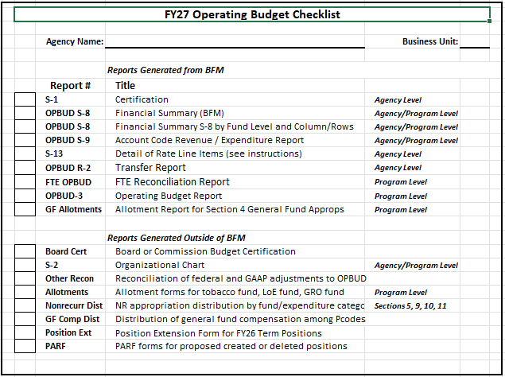
New Operating Budget Checklist via BFM
3

Slide 4
Operating budget process overview
Report 3
OPBUD-3, OPBUD-4 and General Fund Allotment Requests
Budget Journal Entries
FY27 Transactions
Entered in BFM by the agency and approved by DFA
Produced by the agency for DFA approval as the official operating budget based on the GAA
Prepared by SBD for agencies to use as the foundation for developing the OPBUD-3s and budget submission
Caution: Failure to have the operating budget submitted and approved in a timely manner will lead to problems processing FY27 fiscal transactions
BFM is now available for agency use
4

Slide 5
Review of BFM Staging Workflow
Users are assigned different roles to facilitate workflow.
“Requestor” will have EDIT access to ONLY stage 21 and can SUBMIT to stage 22
“Manager” will have access to EDIT stages 21 and 22 but can submit to stage 23.
New budget forms are created at Stage 21, Initial Entry, and sent up the process.
Once a user submits a budget form they will not have access to that form any longer, but the reviewer/manager has the authority to submit the request backwards in the process for edits/revisions.
Remember that data can still be viewed via BFM Reporting, if a user no longer has form access
Every budget form must be submitted to Stage 23 to be included in your agency’s budget submission (Stage 24)
Stage | Description
Stage 21 | Initial Entry
Stage 22 | Manager Review
Stage 23 | Agency Management Changes
Stage 24 | Submit to DFA

Slide 6
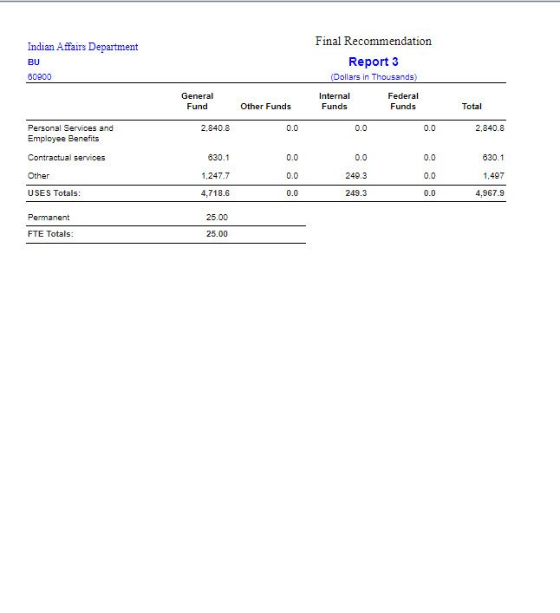
Category Detail of Appropriations (Report 3)
Produced by SBD from BFM and includes:
Recurring appropriations in HB2, Section 4: Agency appropriations
Approved FTE
Accompanied by a comment sheet detailing agency specific issues and language, nonrecurring appropriations, compensation amounts, and budget adjustment authority
6

Slide 7
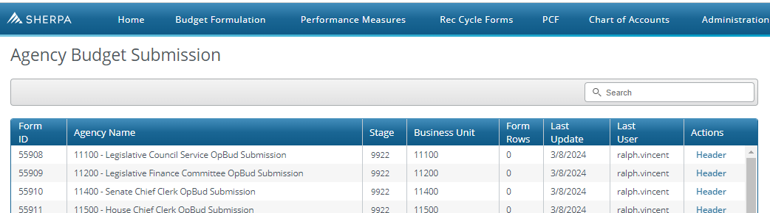
Submitting your Agency’s Operating Budget in BFM (Form 9900)
The Level 3 user will submit the agency operating budget submission when complete
Users will only see your agency name and BU, click on Header button at right
Enter in all information, there are fields to include board certification of submission, if applicable
Click on Submit tab, then Submit Entire Budget
Select Submit to DFA / Tech Review from Select a Stage dropdown and click Submit
Data entered here will populate S-1 Certification report in BFM Reporting
DFA will conduct review of budget submissions after May 1st and work with agencies to fix any issues before final OPBUD-3s are uploaded into SHARE

Slide 8
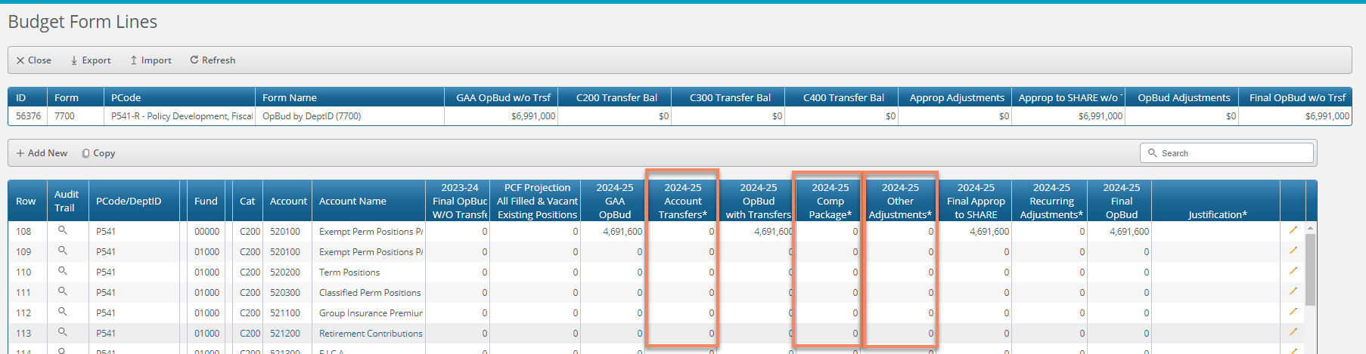
Expenditure Reconciliation: 7600 (Pcode) and 7700 (Dept) Forms
PCF Projection column: projected FY27 PSEB costs using March HR data uploaded from SHARE HCM. Primarily should be used for informational and planning purposes since PSEB appropriations cannot be changed.
2026-27 GAA Opbud: line-item budget as approved at final legislative stage
Data Entry Fields
2026-27 Account Transfers: Adjust line-item budgets as needed. Category totals must remain the same as in GAA (balances at top should be zero). Do not leave any amounts in category base line items 520000, 530000, 540000.
2026-27 Comp Package: Enter line-item amounts to budget for FY27 compensation increases in the 200 category
2026-27 Other Adjustments: Enter line-item expenditures for federal or GAAP adjustments

Slide 9
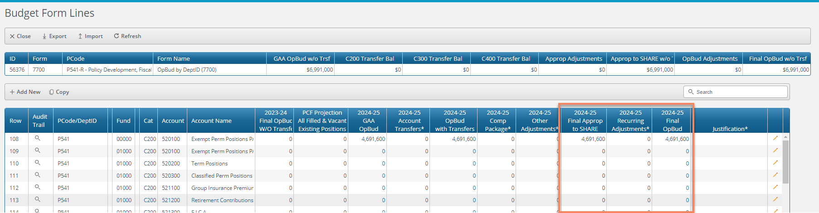
Expenditure Reconciliation: 7600 (Pcode) and 7700 (Dept) Forms (continued)
2026-27 Final Approp to SHARE: Category totals here will populate OPBUD-3 report and journals
2026-27 Recurring Adjustments column
There should be no adjustments for FY27 in this column on the expenditure side.
2026-27 Final OpBud: Final numbers that will carry through in BFM for FY28 request
Justification: Please document in text all “other” adjustments
Reminder that all dollar amounts will be rounded to the nearest hundred ($123,700 not $123,741).

Slide 10

Budgeting personnel expenditures
Remember that vacant positions are projected at midpoint and have single insurance plans.
PCF: Personnel Cost Forecasting module in BFM. Note that HR data from SHARE HCM is loaded into this module for budgeting purposes, but will not go back into SHARE HCM
HCM data in BFM will not include the 1% compensation increase for FY27.
BFM Reporting: PCF Detail Agency/Individual under Personnel Reports to generate “E-1” report
10

Slide 11
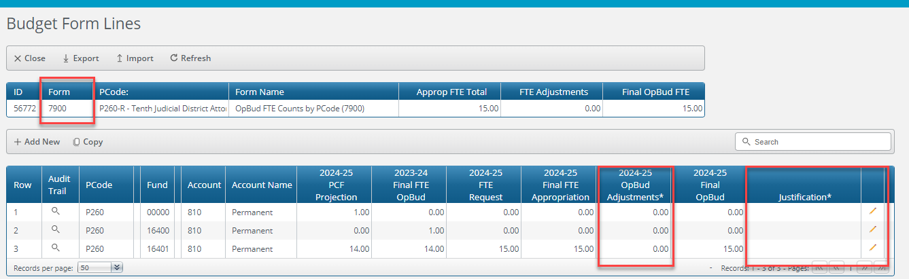
FTE Maintenance (Forms 7900 and 8000)
FTE Counts by Pcode (7900) and Dept (8000): Reconcile FTE counts among PCF, current year OPBUD and next year’s operating budget. Provide justification for differences such as transfers, reductions, or requested increases
PCF field is pulled from PCF module and not editable.
Input any needed adjustments in the “2026-27 OpBud Adjustments” column and provide written justification
Report: FTE by Pcode OPBUD and FTE by DeptID OPBUD

Slide 12
Policy Regarding FTE and Position Control
FTE deviations from your appropriation request must be documented, justified and supported:
Provide a reconciliation of any differences
Provide evidence of available funding for new positions
Delete additional positions where funding is not anticipated
FTE should reconcile to Organizational Listing report.
Term extensions: Complete (outside of BFM) Excel spreadsheet to reauthorize all term positions through FY27. Form on SBD website.
12

Slide 13
Detail of GSD/DoIT Expenditures
Use the GSD and DoIT published rate schedules for Workers Compensation, Auto and Property Insurance, Liability Insurance, Unemployment Insurance, Telecommunications and Information Technology. For HCM assessment, use a rate of $365/FTE.
Agencies must budget the rates from GSD and DoIT rate sheets that were included in your appropriation request, or as changed via legislative action that affected these lines.
Agencies must encumber the budgeted amounts for all rates on July 1, 2026.
Be sure to use the appropriate account code for GSD/DoIT services to distinguish them from outside vendor costs.
Include the Rate Report as part of the operating budget submission. This is a report in BFM Reporting at agency level that includes line items 521410, 521500, 521600, 535400, 542700, 542800, 543400, 545700, 545710, 545810, 546610.

Slide 14
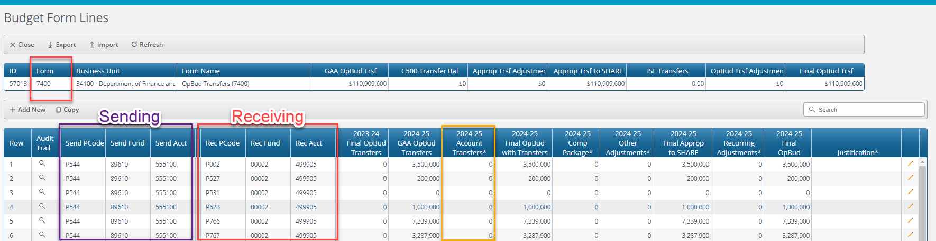
Transfer Reconciliation: Form 7400
Information regarding transfers sent out by your agency (internal or external) that were enacted in the GAA have been brought forward in the 7400 Form
Update as needed in a similar fashion to the 7600/7700 Forms, likely few changes will be needed
Report: R-2 Transfer Report OPBUD receiving

Slide 15
Other Financing Uses (500 Category)
There are three account codes that can be used in the 500 category (Other Financing Uses) to record non-reciprocal transfers:
Account code 555100 is used to budget non-reciprocal interagency transfers from one state agency to another agency when both agencies are budgeted in SHARE.
Account code 555106 is used to budget non-reciprocal transfers between funds within a state agency.
Account code 555200 is used to budget non-reciprocal transfers to a component unit of the state.
Note: Agency must provide additional detail regarding the destination of transferred funds

Slide 16
Budgeting Land of Enchantment Program Fund Appropriations
During the operating budget process, these agencies should reduce their P-code budget on the revenue and expenditure side by the amount of the LoE distribution.
Agencies will be provided an Scode and class code to establish budget for these distributions. Expenditure budget must correspond to the categories identified by GAA language. The budref should be 92748 which is indicative of the 4-year timeframe for these distributions authorized by 2026 SB 184.
Agencies should submit an OPBUD-3 form (created outside of BFM) with this Scode information in their May 1 operating budget submission.
FY26 remaining funds: At the beginning of FY27, agencies may submit a BAR to budget any remaining balance from their FY26 distribution. Note that this option will be eliminated in future years due to the process changes outlined above.
Allotment form
Submit an allotment request form (created outside of BFM and available on the SBD website) for the Land of Enchantment Program fund which is distributed by DFA to the receiving agencies.

Slide 17
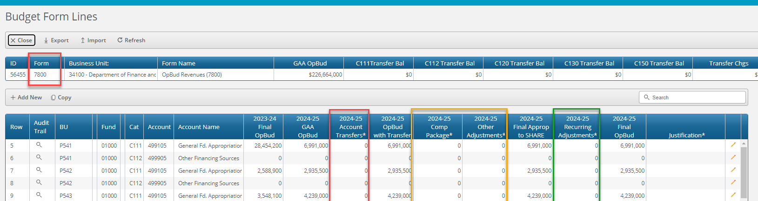
Revenue Reconciliation: 7800 Form
Only one form per agency, similar in format to 7600/7700 forms
Account Transfers: move line-item budgets within same revenue category and P-code
Comp Package: budget revenue for FY27 comp increases. General fund should be under revenue code 499905
Other Adjustments: Mainly federal revenue, possibly GAAP adjustments
Recurring Adjustments
Move GF compensation increases from 499905 to 499105

Slide 18

Types of Revenue: Transfers from the General Fund
Include General Fund appropriations in the GAA as reported on your Report 3.
General fund received from FY27 compensation appropriations should be budgeted as 499905 in the Compensation Package column but then moved to 499105 in the Recurring Adjustments column.
May need to add a new line for 499905 for the comp adjustment.
18

Slide 19

Types of Revenue: Federal Revenue
For revenue generated and collected directly from the federal government use revenue code 451903.
For revenue that has a federal source but is received indirectly through a city, county, federal contract or another state, use revenue code 452003. Indirect from component unit: 452006. Federal contracts and reimbursements such as Medicare: 453001.
Provide detail regarding grant names and purposes in justification field.
Include all available funding, not only the amounts included on the Report 3 and in the GAA. Include recon form.
Sub-awards of federal funds should be included as federal transfers (451909).
19

Slide 20

Types of Revenue: Non-General Fund Transfers
Non-reciprocal (non-exchange) Type Transfers:
If transfer is from another state agency use revenue code 499905.
If transfer is between funds within an agency, use revenue code 499906.
If transfer is from a component unit of the state, use revenue code 499999.
Note: Please be sure that amounts budgeted as nonreciprocal transfer revenue equal the amounts budgeted as a “transfer out ” (Category 500) from the specific agency or fund that is transferring the funds.
20

Slide 21
Types of Revenue: Non-General Fund Transfers
Reciprocal (exchange) Type Transfers:
For federal sub-awards received from another state agency use revenue code 451909.
For other revenue received from another state agency for services rendered use revenue code 425909.
21

Slide 22
Types of Revenue: Other Revenue
Include all revenue that does not meet the criteria for General Fund, Non-General Fund Transfers or Federal Revenue.
Refer to Chart of Accounts for list of revenue codes.
Include revenue generated by the program or agency.
Revenue reported as Other Revenue and Fund Balance is reported as one combined amount under Other State Funds on the Report 3. Agency must divide this amount appropriately between Other Revenue and Fund Balance.
22

Slide 23
Types of Revenue: Non-Reverting Fund Balances
Include fund balances budgeted in the GAA or other legislation.
Must reconcile with budgeted expenditures.
Non-reverting fund balance must cite the source of the fund balance and statutory authority.
Budget under appropriate equity code in BFM.
If you anticipate fund balance or other revenues not materializing fully, please contact your SBD analyst for further instructions.
23

Slide 24
Equity Codes
The four most common equity codes are:
Restricted: 325900
Committed: 326900
Assigned: 327900
Unassigned: 328900
Note: Identify the correct equity code by referring to your independent financial audit or the SHARE trial balance report
24

Slide 25
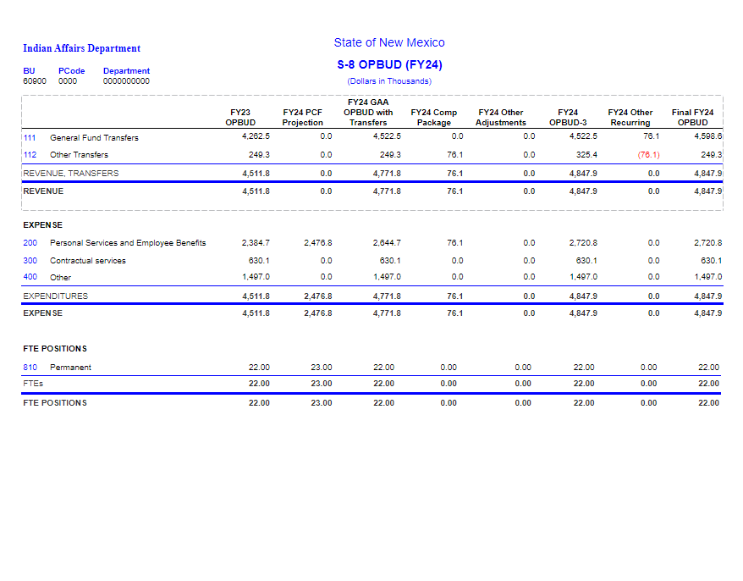
Financial Summary (S-8) and Account Code Expenditure Summary (S-9)
Generated from expenditure and FTE data entered into BFM forms previously covered.
Total revenues must equal total expenditures.
Should match amount provided on Report 3, adjusted for compensation, additional federal funds and/or GAAP adjustments.
Include an S-8 and S-9 for each appropriated program and one for the agency summary.
Include also S-8 by Fund Level and S-8 OPBUD by Fund Column/Rows Reports to ensure your revenues and expenditures by fund are balanced.
25

Slide 26
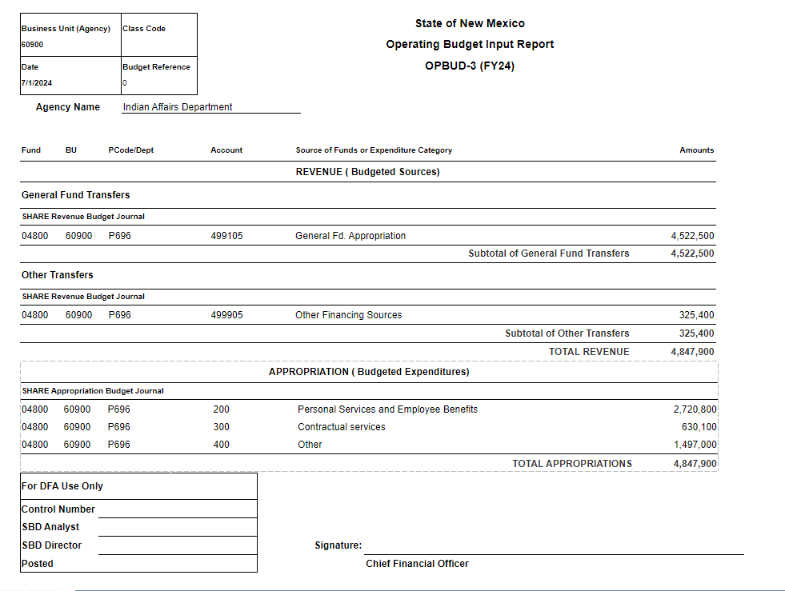
Operating Budget Report (OPBUD-3)
Using information entered on your revenue and expenditure reconciliation forms, as well as prepopulated fields such as budref and class code, BFM will automatically generate OPBUD-3 Reports in BFM Reporting
Print OPBUD-3 reports for each P-code, verify accuracy, sign and include with budget submission
After review by SBD, OPBUD-3 info will be used to generate budget journals in SHARE
26

Slide 27
Operating Budget Report (OPBUD-3)
Amounts on the OPBUD-3s will always be in whole dollars rounded to the nearest hundred (to match SHARE).
All FY27 Section 4 appropriations will use a journal date of 7/1/2027, a class code of “K0000” and a budget reference code of “127”.
Submit a corresponding Allotment Request form for each General Fund or Tobacco or Opioid Fund appropriations on the OPBUD-3.
27

Slide 28
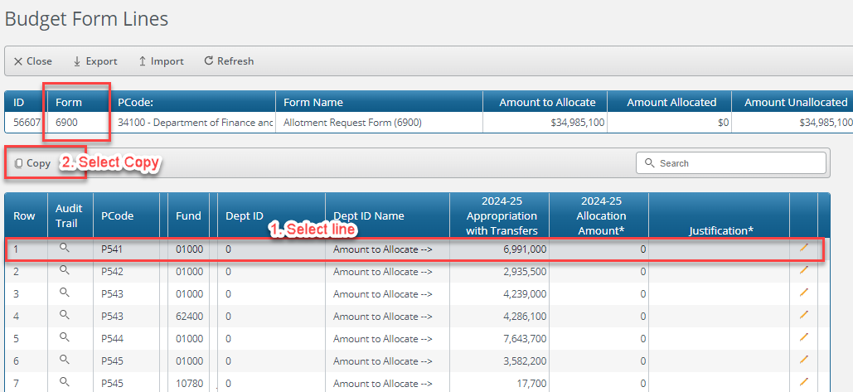
NEW: Allotment Request Form (6900) and Report
Used to create Section 4 (recurring) general fund allotment forms (other funds must still be created manually outside of BFM)
Only one form per agency like revenue form 7800
You will select one line with total amount to distribute. Select Copy for a PCODE.

Slide 29
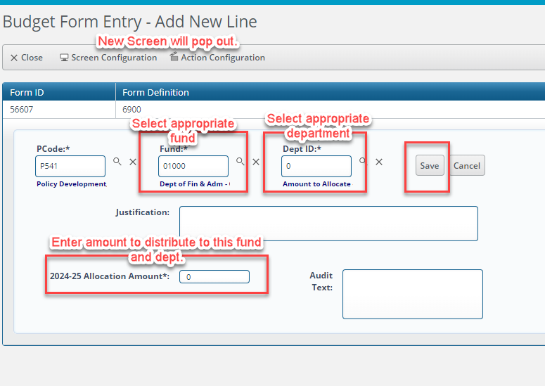
NEW: Allotment Request Form (6900) and Report
The Budget Form Entry should show.
You will need to select the following:
Fund number
Select Department ID
Enter amount to designate to dept code and fund.
Select save.

Slide 30
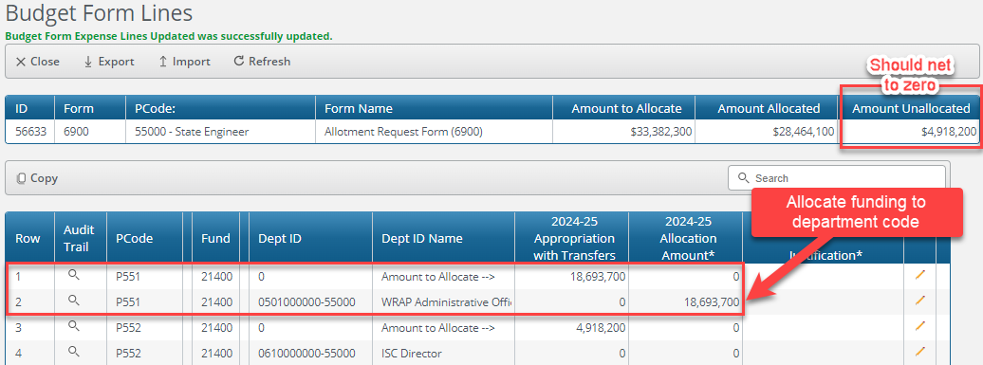
NEW: Allotment Request Form (6900) and Report
When you complete this task from the prior slide. “Amount Allocated” in top box should = Amount to Allocate.
Print Allotment Request Form report for each P-code from BFM reporting, sign and include with submission. Do not need to include agency rollup.

Slide 31
Allotment forms
You should submit only one department code for each allotment to a fund within a program code. For budgetary purposes SBD will no longer process multiple department codes for funds within a given P-code.
Agencies are free to allocate to multiple departments once budget has been established in SHARE.
Only allocate to high-level funds, not sub-funds.
New: Utilize multiple appropriation allotment form for Section 5 appropriations, corresponding to OPBUD-4 form
31

Slide 32
Compensation Appropriations
1. 2026 SB 151 provides for a 1% salary increase for state employees in FY27. It provides General Fund amounts to fund these salary increases. Exec agencies: Longevity pay has been incorporated into your base budget.
2. Agencies who fund compensation through non-General Fund sources will be provided a maximum amount they can increase their FY27 budgets to fund salary increases.
3. General Fund compensation allocations should be budgeted under revenue code 499905 on the OPBUD-3. They should then be transferred to revenue code 499105 in the “Recurring Adjustments” column on the 7800 Form.
4. The General Fund Compensation Distribution Form must be submitted to provide information required for DFA to distribute compensation appropriations included in Section 8 of the GAA.

Slide 33
SHARE: Department Level Budgets
Agency option to set up budgets at the following lower levels (only when using a P-Code):
Department (division or bureau)
Appropriation Unit, Account or Sub account
Using Agency specific chart fields
Can only be established for budgets using a P-Code. Department level budgets cannot be used for budgets established under a Z-Code.
Only appropriation level budget entries are approved by DFA. SBD will review entries to ensure they are consistent with approved agency structures.
Once the determination is made to either use or not use department level budgets, it cannot be changed during the fiscal year.
Department level budgets must be established using AGY ledger type and 10-digit department codes.
BFM cannot produce dept-level OPBUD-3s at this time; however, it may be useful to extract the 7700 Form into Excel to help construct dept-level OPBUD-3 journals.

Slide 34
Due Dates and processes for Submitting Nonrecurring appropriations
Appropriations in Section 6 of 2026 GAA/SB273
Appropriations in Section 5, 9, 10, and 11 of 2026 GAA
Nonrecurring appropriation reauthorizations
Appropriations in Section 7 of 2026 GAA
OPBUD-4 must be submitted by May 15, 2026
Submitted on May 1 per instructions on following slide
OPBUD-4 should be submitted in State Budget Submission System preferably before June 30, 2026
Not subject to a deadline due to PCC process. To release project funds, the PCC committee will need to certify funding. Please reach out to DoIT for more information.
Submitted in State Budget Submission System
Budget will be active in SHARE on 7/1/26

Slide 35
Special and Other Legislative Appropriation Input Form (OPBUD-4)
Note that this year, OPBUD-4s are only to be used for Sections 6, 7, and reauthorizations and submitted in the State Budget Submission System.
Amounts on the OPBUD-4 should be shown in actual dollars.
Z-Codes for special appropriations in sections 5-11 of the GAA have been assigned and created by SBD. See budget code table on SBD website for Z-codes, class codes, budrefs, amounts, funding sources, and line-item vetoes.
Agencies must submit OPBUD-4s on forms available on the DFA website. Attach SHARE Journal entries to the OPBUD-4 Form and submit to DFA.
Submit a corresponding Allotment Request form for each General Fund or Computer Enhancement Fund Appropriation included on the OPBUD-4. A multiple appropriation allotment form is available to use for nonrecurring appropriations.

Slide 36

Budgeting Section 5, 9, 10, and 11 Appropriations
Your analyst will provide you a list of appropriations (in Excel) for your agency, including Z-codes and other info. You must break out each appropriation by fund and expenditure category, consistent with appropriation language. Revenue codes may also be needed for certain non-GF appropriations.
Include copy of the list in your budget submission and email the Excel file back to your analyst. SBD will use this info to build journals for appropriations valid on July 1 – no further action in SHARE is required
Include allotments for all general fund and GRO appropriations in your submission
Notes on GRO (Section 9)
Section 9A appropriations are valid in FY27. Section 9B appropriations are valid in FY28 and 9C in FY29 – not to be budgeted yet.
Section 9D appropriations are valid in FY27 and FY28.
Agencies who received Section 9 GRO appropriations in the General Appropriations Acts of 2024 and 2025 will also receive a form to budget 2024 Section 9C and 2025 Section 9B that are valid in FY27.
Revenue – budgeted under 499905 (transfer from the GRO program fund).
36

Slide 37
Budgeting nonrecurring appropriation reauthorizations
Should be submitted as OPBUD-4 in State Budget Submission System
New requirement for appropriation reauthorization extensions:
Submit budget decrease journals (revenue and expenditure) to zero out remaining balance in old class code and budref
Submit budget journals to budget under new class code and budref as usual
Optional: You may budget reauthorizations before June 30. Ensure all transactions utilizing old class code and budref are complete before doing so.
All reauthorizations for FY27 will have the budref 92624 to account for the possibility of budgeting the extension in the closing months of FY26.

Slide 38
Other Required Forms
Certification (S-1 Report)
Organization Chart (S-2 Form)
Position Extension Certification for term positions. Use Excel spreadsheet posted on SBD website. Do not submit a PARF for each term position being extended.
Produced from BFM using info populated on 9900 Form. Will automatically indicate whether you use department-level budgeting depending on what you have set in BFM.
Generated outside of BFM. One at agency level and one for each P-code.
Position Extension Certification
38

Slide 39
Coming attractions
Budget Adjustment Requests (BARs)
Future Training Opportunities
Budget Boot Camp – between May and July
Budget Projections – June
FY27 BAR Training – Early July
Operating Budget Workshops
April 23 – 8:30 AM to 4:30 PM in Santa Fe
April 24 - 8:30 AM to 4:30 PM in ABQ
Reach out to your analyst for additional information. Deadline to reserve your space is Friday, April 17, 2026
End of Fiscal Year BAR submission deadline: June 5
AGA and Performance Measures - June
39

Slide 40

Thank you!
40

