Slide 1


HCM Quarterly Meeting
Presented by Central Payroll Bureau & the SHARE HCM Team

Slide 2


SHARE HCM Team

Slide 3


Queries in HCM
How Are Queries Named?
Oversight | Global
HRH_ | NMS_HR_
HRP_ | NMS_PY_
Oversight queries (start with H%) will not be modified unless requested by the oversight entity
Global query (start with NMS_) modification requests are reviewed on a case-by-case basis

Slide 4
Queries in HCM
NMS_QUERY_CATALOG
This query is a catalog of commonly used/or useful queries. You can access the query catalog by running the above query.
The SHARE Team adds to the catalog as time permits.
  Describes the purpose of different queries in HCM
  Describes the query prompts and whether query should be scheduled
  Provides additional Notes and Details
  If you notice a query is not on the catalog, but you find it particularly useful, please send in a help desk ticket and we will be sure to add it.

Slide 5
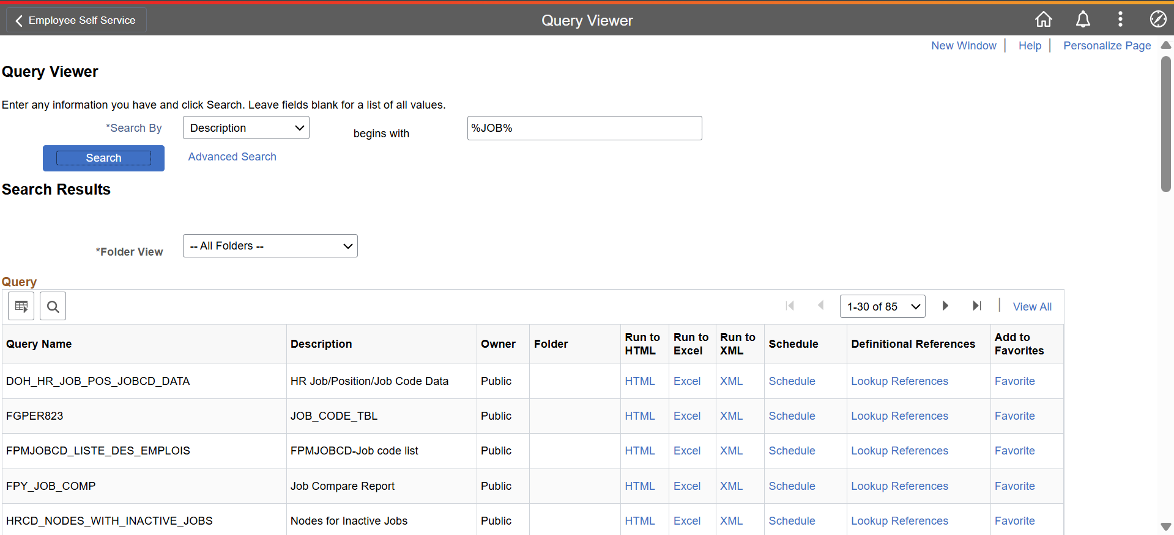
Queries in HCM
Effectively Searching For A Query
You can use a wildcard search to search query NAME or query DESCRIPTION
Wildcard function is %, so best way to use is %keyword%

Slide 6
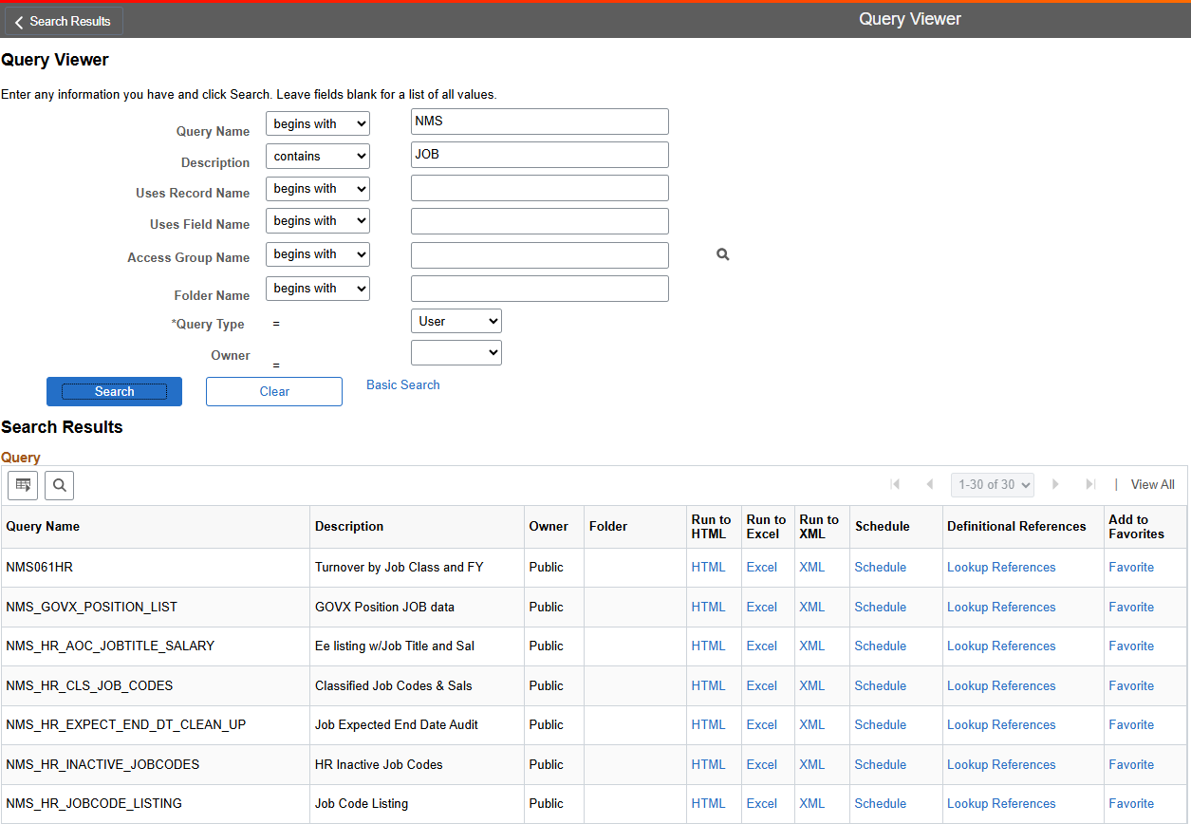
Queries in HCM
Effectively Searching For A Query
Use Advanced Search

Slide 7
Email Addresses
Employees can have two email addresses on their personal data “Contact Information” page
  1. Home Email – Can be any domain
  2. Business Email – Business email should be setup with a State of New Mexico valid domain.
  Examples include @xxx.nm.gov, @nmcourts.gov, @da.nm.gov, etc.
  If you setup a business email with a non-valid domain, it can delay the employee in getting their SHARE login and security setup.

Slide 8
FY27 Benefits
1. Open Enrollment period has ended
2. An employee’s SEPA qualification is not determined by an employee’s hourly rate. It is determined based on tax data on record with TRD or through an application with HCA. Please do not ask a member of the SHARE team to change an employee’s SEPA code.
3. Reminder: If an employee has a 7/1/26 row changing their SEPA status and you need to insert a current row, please submit a ticket to SHARE.help@dfa.nm.gov for assistance.

Slide 9
FY27 Salary Increases
Legislative increase process
The SHARE team has been working on a process that will award the FY27 Legislative 1% increase to all eligible employees. We are planning to add the increases after hours around July 9-10, 2026. In order for eligible employees to receive the increase please remember the following:
Do not add a row on Job Data with an effective date after 7/4/2026.
Employees with an expected end date before 07/04/2026 will not receive the increase. If the employee is eligible, please update their expected end date by July 3rd. You can use NMS_HR_JOB_END_DATE to identify employees with expected end dates prior to 07/04/2026.
EDAs need to be dated between 7/1/2025 – 7/3/2026. The deadline to enter EDAs into SHARE is July 3rd. You can use NMS_HR_EDA_NOT_DONE_FY27_INCR to identify employees needing an EDA.

Slide 10
FY27 Salary Increases - Biweekly
1% Increase – Biweekly Process
After the initial 1% increase run that will take place for all eligible employees on July 4, 2026, the SHARE team will run a biweekly process for AOC, AODA, CLSS, LOPD for employees completing their probation.
Employees coming off probation will be eligible the beginning of the pay period AFTER they have completed their probation; the insert will occur on the first Saturday of the pay period.
To receive the increase, the employee must have a satisfactory EDA in SHARE dated between June 1, 2026 and June 30, 2027.
Action: Pay Change, Reason: FY27 Legislative Increase

Slide 11
FY26 Longevity Pay
Longevity Final Payments for FY26
The SHARE team has been working on a process that will award final payments on the last pay date in FY26.
The final payments for Longevity Bonuses will be made in pay period ending June 19, 2026 with a pay date of June 26, 2026.
These final payments may be slightly different than the payments received over the past fiscal year.
The SHARE team will calculate a true-up of the payments to ensure that the proper annual amounts are correctly paid for the current fiscal year.
Some individuals may have a .01-.10 adjustment loaded directly to paylines – to bypass distribution issues.

Slide 12


FY27 Longevity Pay
Is the employee in the Classified, Governor’s Exempt or State Police salary administration plan? (CLSS, GOVX, STPL)
On 7/1/26 will the employee be temporary or salaried?
On 6/30/2027 (end of FY27) will the employee have 5 or more years of continuous state service (any branch)?
Yes
No
Yes
Yes
The employee is eligible for FY27 Longevity Pay.
The employee is not eligible for FY27 Longevity Pay.
Longevity Pay Fiscal Year 2027
Years of Continuous Service | Payment Per Pay Period | Annual Amount
5 – less than 10 | $26.93 | $700.00
10 – less than 15 | $57.70 | $1,500.00
15 – less than 20 | $73.08 | $1,900.00
>20 | $80.77 | $2,100.00

Slide 13
Thank You

Slide 14
Central Payroll Bureau
Important Updates & Information

Slide 15

End of Fiscal Year
PPE July 4th is the split-year payroll.
The system will automatically split the expenses between the two fiscal years.
Any additional pays or longevity payments will post in the fiscal year the input date falls on. If you have payments that need to be credited to FY26, please create a note in the FSS system when the form is submitted.

Slide 16
Combo Code/Task Profile Updates
The automated combo code update process will be run on May 31, 2026.
This process looks at all active task profile IDs and updates them if they meet the following criteria:
If the task profile ID contains a combination code with budget reference 126 and class J0000 (values for FY26), the process inserts a 7/1/2026 row and updates the budget reference to 127 and class to K0000 (values for FY27).
If the task profile ID contains a combination code with budget reference 926 and class J0000, the process inserts a 7/1/2026 row and updates the budget reference to 927 and class to K0000.
The automated process does not update the task profile ID if it does not contain either of the budget reference/class combinations listed above. If you have any task profile IDs that were not updated and need to be updated for the new fiscal year, you are responsible for updating them manually.
The HCM query NMS_CA_TASKPROFILE_ALL_BY_BU identifies all task profile IDs, both active and inactive, for your agency. To identify the combo code assigned to the Department Budget Tables for each fiscal year use NMS_CA_DEPT_BUDGET_TBL_COMBOCD
Notes:
CR

Slide 17
Insurance Corrections
Three plan years will be open for adjustments in July 2026
Plan Year FY25 which covers periods from January 2025-December 2025. Any contributions that need to be added for this plan year are post tax.
Plan Year FY26 which covers periods from January 2026-June 2026. Any contributions that need to be added for this plan year can be pretax until December 31, 2026. From January 1, 2027, and forward these adjustments would be post tax.
Plan Year FY27 which covers periods from July 2026-June 2027. Any contributions that need to be added for this plan year are pretax until December 31, 2027.

Slide 18
Transition of Benefits for New Hires
Instructions for Human Resources on Hiring New Employees During the Transition Period
(May 16,2026 - June 30,2026)
Objective: To ensure a smooth transition for new hires during the open enrollment closeout period while accommodating their benefits, preferences and changes in plan designs.
Overview: Between May 16, 2026 and June 30, 2026 Human Resources will process new
hires and facilitate their enrollment in benefits. New hires will have the ability to submit necessary paperwork and enrollments for their benefits, considering the upcoming plan design changes effective July 1, 2026.
Instructions:
1. New Hire Paperwork Submission:
• Ensure that new hires complete all necessary documentation, including W-4 forms,
job-related documents, and benefits enrollment forms associated with their initial hiring process.
2. Enrollment Process Overview:
• New hires must be informed about their benefits choices, particularly regarding the changes effective July 1.
• Communicate the options available for benefits enrollment and the implications of choosing different plans.
3. Eligibility for Special Enrollment:
• Explain to new hires that they are eligible to participate in a special enrollment period due to changes in plan designs, known as the “New Hire 7/1 Election QE.”
• This QE event will be available within the enrollment tool starting May 16, 2026.
Closing July 31, 2026, at 11:59 PM.
Steps for New Hires to Enroll:
Step 1: Review the available benefits plans and any changes in the plan designs, effective
July 1.
• Review the premium rate sheets
• Review the Comparison Grid
• Review SEPA program and eligibility information
• Step 2: Access the enrollment tool via the provided Open Enrollment link.
Enrollment Information | SoNM Group Benefits Plan
Step 3: Locate the "New Hire 7/1 Election QE" option in the enrollment tool menu. Please
be advised that enrollment will time out after 15 min of inactivity.
Step 4: Complete the enrollment for the benefits plan of choice. Ensure the selection is
distinct from the default cross-walked plans.
Step 5: Submit any required documents and review the confirmation of your enrollment
submission.
5. Deadline:
• New hires must complete their initial new hire enrollment within 31 days of their hire
date. They must complete the qualifying event enrollment process by July 31, 2026
at 11:59 PM to ensure benefits coverage changes for the new plan year commence
as planned.
6. Support:
• Provide assistance for any questions or clarifications regarding the enrollment
process. HR personnel should remain available to guide new hires through the benefits selection and submission process.
• Additional support will be provided by EASI Gov. 505-244-6000 option 2
Next Steps:
• Monitor the completion of new hire paperwork and benefit enrollments.
• Confirm successful submissions for all new hires by the deadline. Employees must
submit a copy of the enrollment form to HR for personnel files.
• Prepare to address any inquiries from the new hires regarding their enrollment
choices or plan designs.
By following these steps, HR can effectively manage the hiring and enrollment process
for new employees while ensuring compliance with the changing benefits landscape.

Slide 19
Leave Buyback
Sick Leave Buy Back
In accordance with Subsection I of 1.7.7.10 NMAC, employees who have excess of 600 hours of unused sick leave are entitled to be paid for unused sick leave at 50% of their hourly rate of pay up to 120 hours. Employees are entitled to participate in this program only once per fiscal year per employee.
Sick leave buy back will be in PPE 07/18/2026.
The query NMS_PY_SICK_LEAVE_OVER_600 will list all employees with sick leave balances over 600. This should not be run until after PPE 07/04/2026 is completed.
Use the Time Reporting Code (TRC) of SCKBB on the eligible employee’s timesheet and enter the total number of hours greater than 600 hours

Slide 20
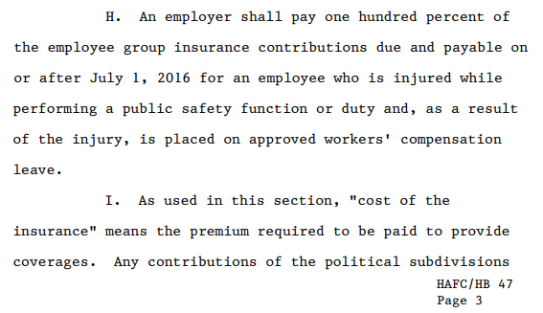
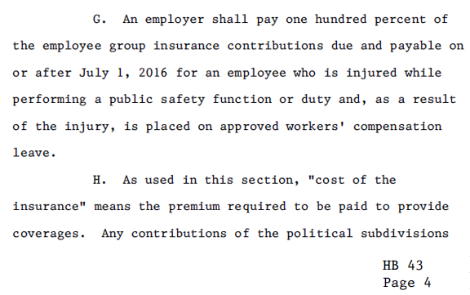
Legislative House Bill 47 & House Bill 43 both have clauses for agencies to cover the cost of benefits if an employee is out on Worker’s Compensation.
No Difference between House Bill 47 & 43 as it pertains to insurance

Slide 21
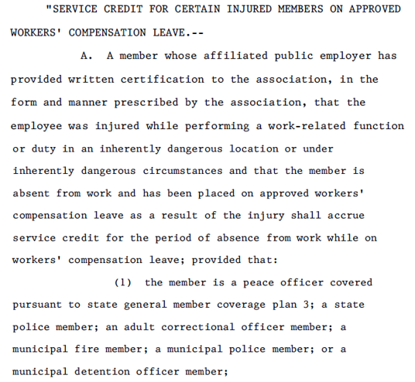
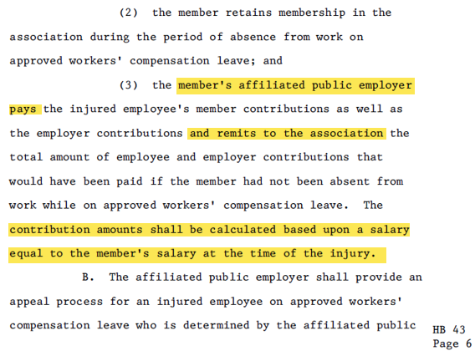
HB 43 Impact on PERA

Slide 22
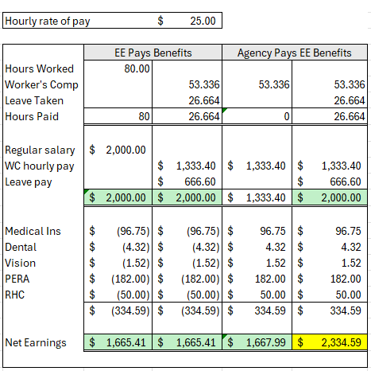
The purpose of the House Bills are to ensure employees who are injured in the line of duty are made whole.
If an employee choses to use leave while on worker’s compensation, that is considered made whole.
NMAC specifically states an employee cannot exceed his regular salary payments while on worker’s compensation.
If an employee does not use leave and is on full time worker’s compensation, agencies need to pay both insurance and PERA contributions.

Slide 23
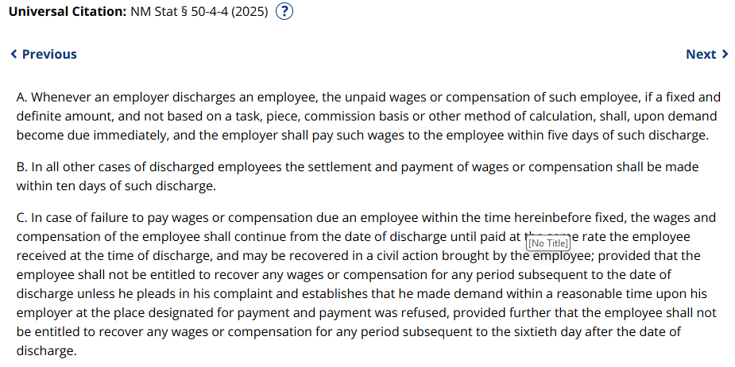
Discharged employees—5-day payout.
If an agency is discharging an employee, they should reach out to payroll immediately. A discharged employee can demand final pay making wages due immediately.
If not demanded, the agency only has 5 days to pay all wages due including TLV payouts.
The State does not have an exemption to this statute.
See MAPS PR 1.7

Slide 24
Preventing Overpaid Holidays
Inactivate Workgroups Promptly
Why it matters
Employees who terminate before the end of a pay period containing a paid holiday may accidentally receive holiday pay.
This results in overpayments that require corrections, manual adjustments, and agency follow‑up.
Agency Should
Inactivate the employee’s workgroup upon notification of termination
Do not wait until the next pay period.
Ensure employees who are no longer eligible do not receive accrued holiday hours or holiday pay.
This practice is not limited to holidays. Workgroups should always be updated promptly to avoid overpayments caused by accidental timesheet entries and approvals.
Notes:
CR Slide

Slide 25
TRC Changes
Additional Pay TRC
CPB can now correctly code additional pays to reflect appropriately on pay stubs.
If an additional pay is subject to PERA please use the TRC ADL on the request. This will reflect on the paystub as Additional Pay subject to PERA.
If an additional pay is not subject to PERA please use the TRC NAD on the request. This will reflect on the paystub as Additional Pay No PERA.

Slide 26
Clean up information
Please verify new hires’ SSN by comparing their Social Security Card to the information shown on forms. This should be done even if a passport is provided for I-9 verification. CPB is still getting notifications of incorrect SSN input into the system.
Remind all employees that they should be verifying payroll information, including names, addresses, and SSNs, to ensure all information is correct.
When inputting information into HCM, you should not be using Spanish punctuation, brackets, colons, or any other special characters. These cause PERA files to fail, tax uploads to fail, and reporting errors, as other systems do not recognize these characters.

Slide 27
Manual Warrant Changes Coming Soon
Direct deposit will be rolled out for manual warrants. This will begin next fiscal year. Training will be available as we get closer to the start date.
Changes to the process will include:
Manual Warrants will not be generated for fewer than 8 hours.
Manual Warrants will be processed once per week, on Wednesdays.
Exceptions can be made for employees who did not receive a paycheck.

Slide 28
FSS Action Items
FSS Changes
Forms Submission System (FSS Administrator Access)
Agency Delegate Access FORM(ADAF)
Writ of Garnishment Job Aid (FSS)
Notes:
CR

Slide 29
Forms Submission System (FSS) Administrator Access
Each agency is required to designate a Forms Submission System (FSS) Administrator by completing the Forms Submission System Administrator Access Agreement.
Responsibilities of FSS Admin:
• Grant and manage user access within the Forms Submission System (FSS).
• Maintain and audit the list of users.
• Ensure all submissions have been processed, closed, or returned for corrections as appropriate.

Slide 30
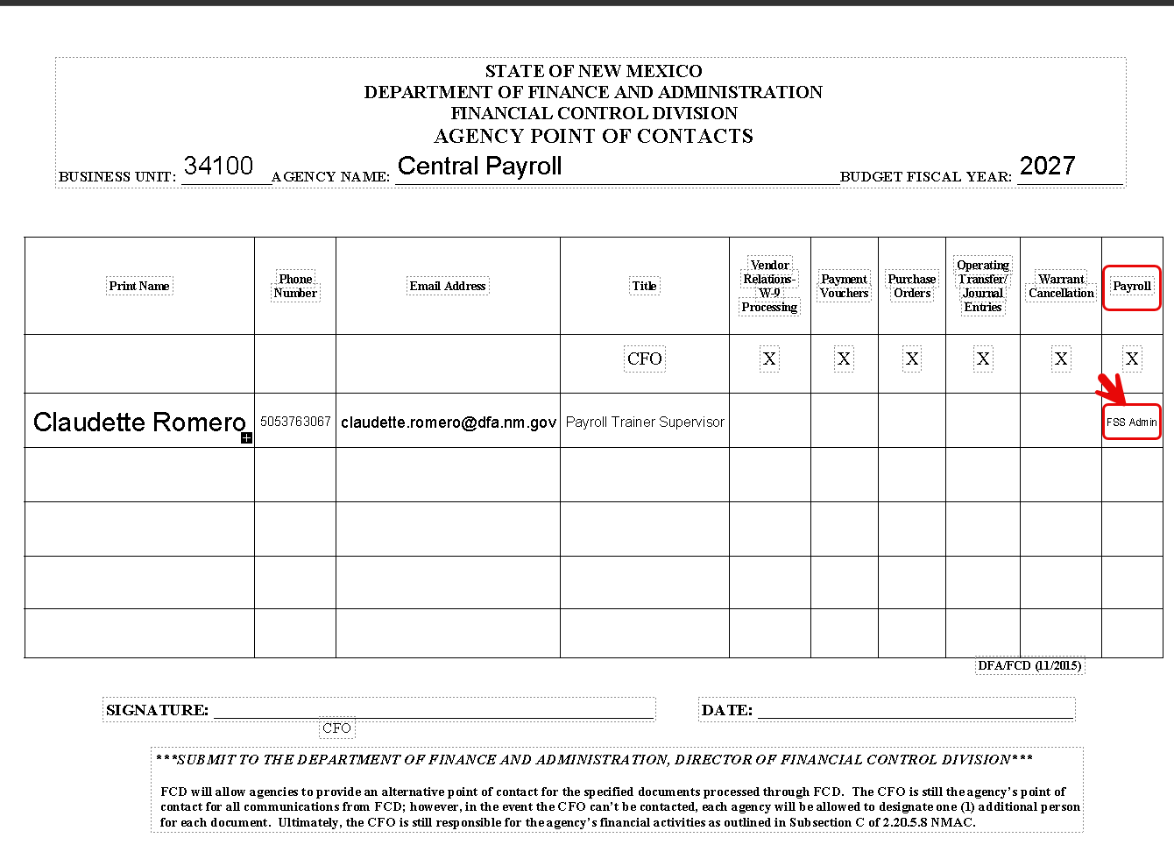
Forms Submission System (FSS) Administrator Access
Central Payroll will now use the same POC forms that DFA uses for FSS Administrator updates.
The form must be updated annually by June 30th for each fiscal year. The form must also be updated any time there is an employee change:
• FSS Admin Leaves the agency
• FSS Admin Changes positions
• FSS Admin will no longer serve as the FSS Administrator
Type FSS Admin in the Payroll Section
Link to POC Form:
https://www.nmdfa.state.nm.us/wp-content/uploads/2021/04/Attachment-V-Agency-Point-of-Contacts-Form.pdf
Notes:
CR

Slide 31
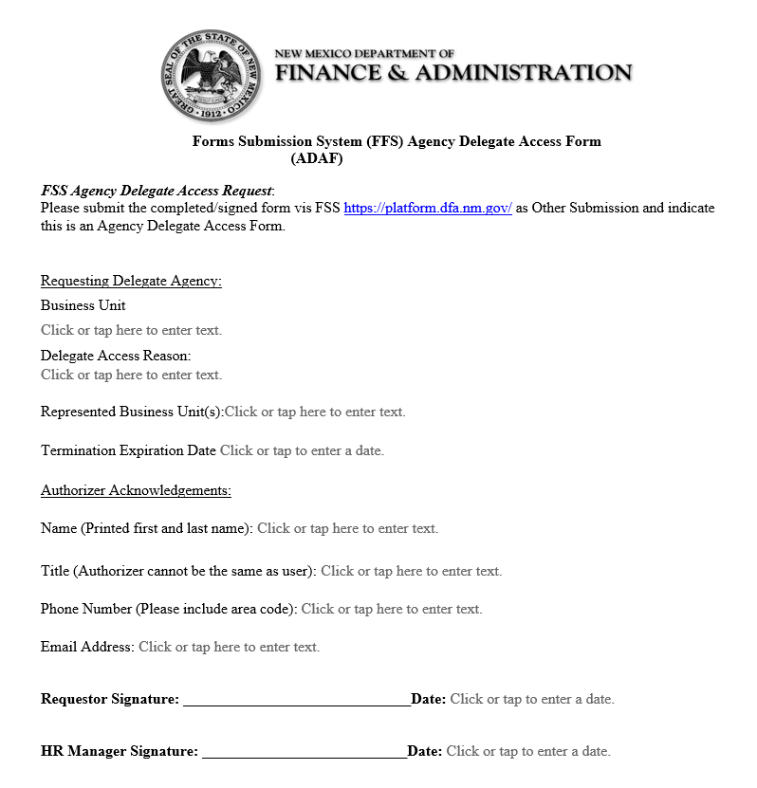
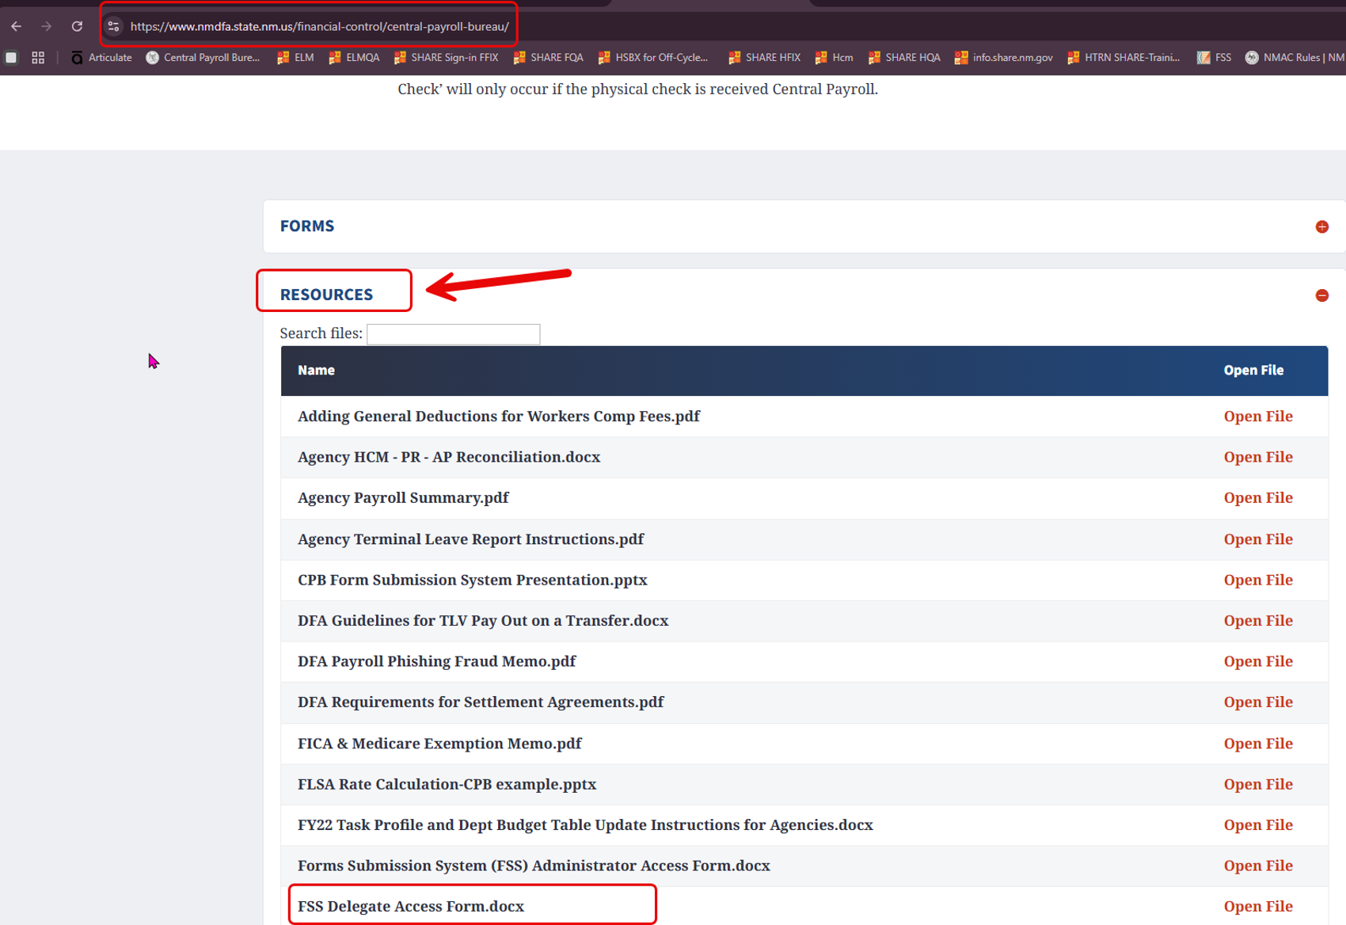
Agency Delegate Access FORM(ADAF)
Effective May 1, 2026, Agency Delegation Access, allowing agencies to submit on behalf of other agencies, has been terminated. This change is part of our ongoing efforts to strengthen security, improve accountability, and ensure accurate submission tracking within the Forms Submission System (FSS).
To restore or update access, agencies must complete the Forms Submission System (FSS) Delegate Access Form
Submit through the FSS Portal: https://platform.dfa.nm.gov/
Type of Form: Other Submission (one-offs).
If you have any questions or need assistance
contact:
Claudette Romero
CPB Trainer Supervisor
Phone: 505-376-3067
Email: cpbtrainers@state.nm.us

Slide 32
Writ of Garnishment Job Aid (FSS)
1. CPB – Data Control
Create a Writ of Garnishment ticket in the FSS system.
2. CPB Payroll Administrator
Review the ticket submitted by CPB Data Control.
Process the memo using the wage information provided to the agency.
Enter all documentation directly into FSS and HCM.
A TXL Notification is automatically sent to the FSS Agency Administrator.
Effective immediately, CPB will no longer send information by email
3. Agency Responsibilities
Notify the employee of the garnishment.
  It is critical that the agency completes this step. Timely employee notification ensures compliance.
Provide the employee with a copy of the memo.
Provide the employee with a copy of the Writ of Garnishment.
Confirm employee notification by marking the Employee Notification checkmark in FSS.
4. CPB Final Processing
Confirm agency notified employee via checkmark in FSS.
Additional Support
Contact your CPB Trainer CPBtrainers@dfa.nm.gov or Claudette Romero (505) 376-3067 for one-on-one training if additional assistance is needed.
Notes:
CR

Slide 33
Payroll 101
📢 Payroll 101 is now available!
We are excited to announce that the Payroll 101 class is now live in ELM and available for enrollment. To enroll, please log in to ELM and search for "Payroll 101" in the course catalog.
This course is mandatory for all new users in a Payroll position and is recommended for users who may be experiencing challenges within payroll.
https://elm.share.nm.gov
Code: SoNM-2097-1

Slide 34
CPB Trainers
Central Payroll Trainers Open Hours
The Central Payroll Training team will hold an open Teams meeting bi-weekly on Wednesdays from 3 pm to 4 pm.
Anyone can join at any time within the hour to ask questions regarding Central Payroll Forms, existing requests in the FSS, or the FSS in general.
This is also a great way to share best practices with your peers regarding the FSS and the forms.
Teams Meeting Link: https://tinyurl.com/CPBTrainers
Just a note, this will be an open forum where people from any State agency can join, so please refrain from sharing sensitive information during this time.
Notes:
Will need to verify with Elizabeth Jaramillo if we are allowed to use TinyURL.

Slide 35
Payroll Resources
Central Payroll Trainers
Claudette Romero, Payroll Trainer Supervisor P:(505)376-3067 E: Claudette.Romero@dfa.nm.gov
  Preferred E-mail: CPBTrainers@dfa.nm.gov
  Book with Me https://tinyurl.com/Book-with-CPB-Trainers
    15 & 30 minute sessions
Central Payroll Web page
https://www.nmdfa.state.nm.us/financial-control/central-payroll-bureau
Department of Finance & Administration YouTube Channel
https://www.youtube.com/@nmdfa8097

Slide 36
Thank You

